Slide 1
Trendz: Online Shopping Site

Slide 2

Trendz: Online Shopping Site
Subject: Major Project
Code: CS-706
Submitted To: Submitted By:
Ms. Sameeksha Khandelwal Tushar Thakur 0829CS181157 Rupali Nargole 0829CS181127 Soham Patidar 0829CS181146 Parag Nargole 0829CS181102

Slide 3
ABSTRACT

Slide 4
ABSTRACT
This project is a web based shopping system. Online shopping is the process whereby consumers directly buy goods or services from a seller in real-time, without an intermediary service, over the Internet. It is a form of electronic commerce. This project is an attempt to provide the advantages of online shopping to customers of a real shop. It helps buying the products in the shop anywhere through the internet by using an android device. Thus the customer will get the service of online shopping from his favorite shop.
This system can be implemented to any shop in the locality or to multinational branded shops having retail outlet chains. The system recommends a facility to accept the orders 24*7 which can make customers happy
We have developed an Online Shopping Site based on HTML, CSS, javascript and Java..

Slide 5
FEATURES

Slide 6
Features of Project
Customers can choose the product from the different categories available
New User can signup in the website using signup page.
Existing User can login in the website using Login page.
Home page of website contains information about website, information about the owners the website.
Customers can add the item in the Cart.
Trending offers will be shown on the Home screen.

Slide 7
USECASE DIAGRAM

Slide 8
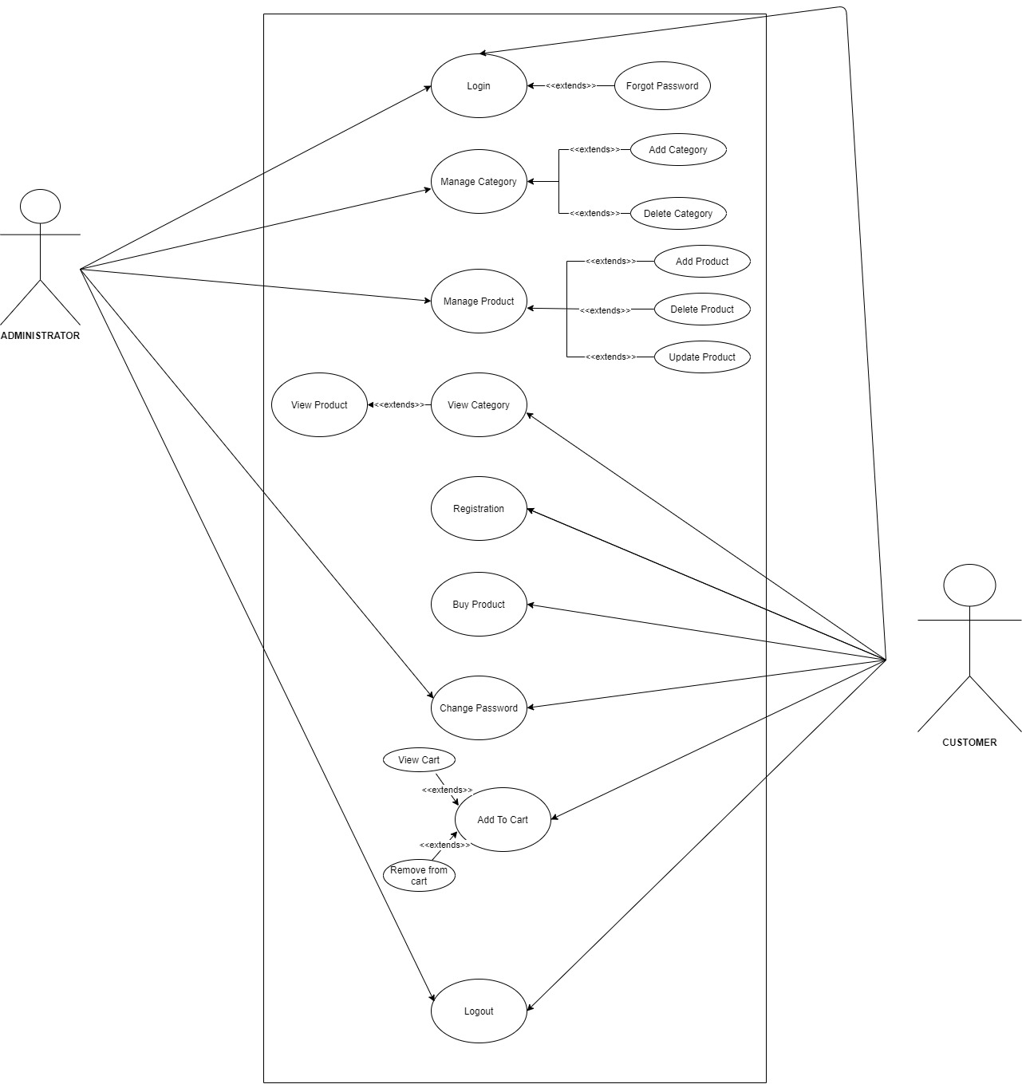

Slide 9
CLASS DIAGRAM

Slide 10
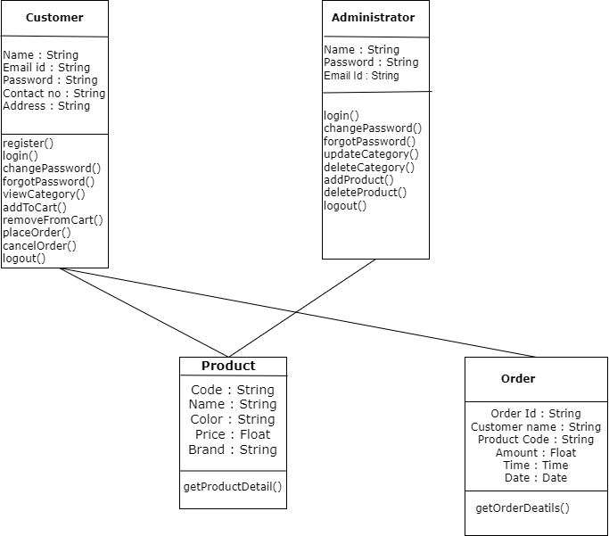

Slide 11
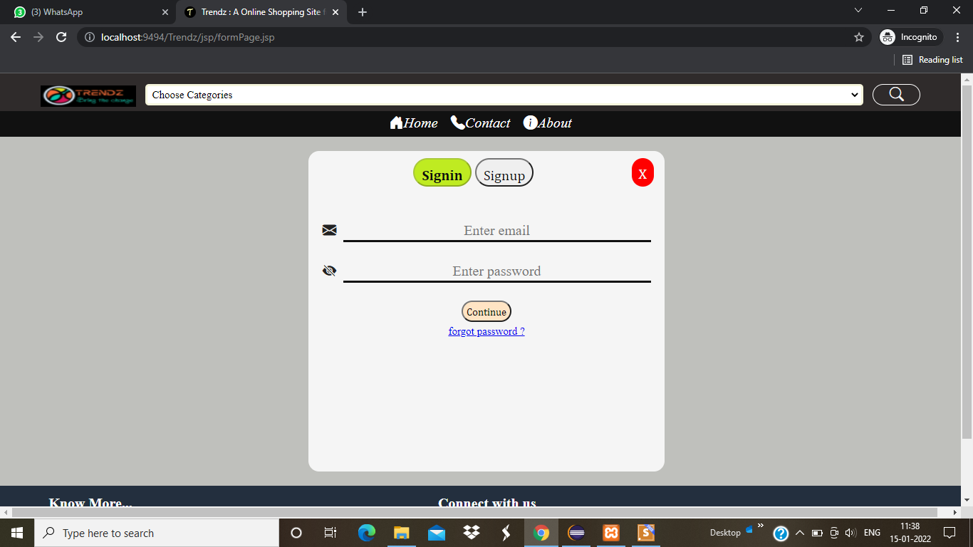
Login Page

Slide 12
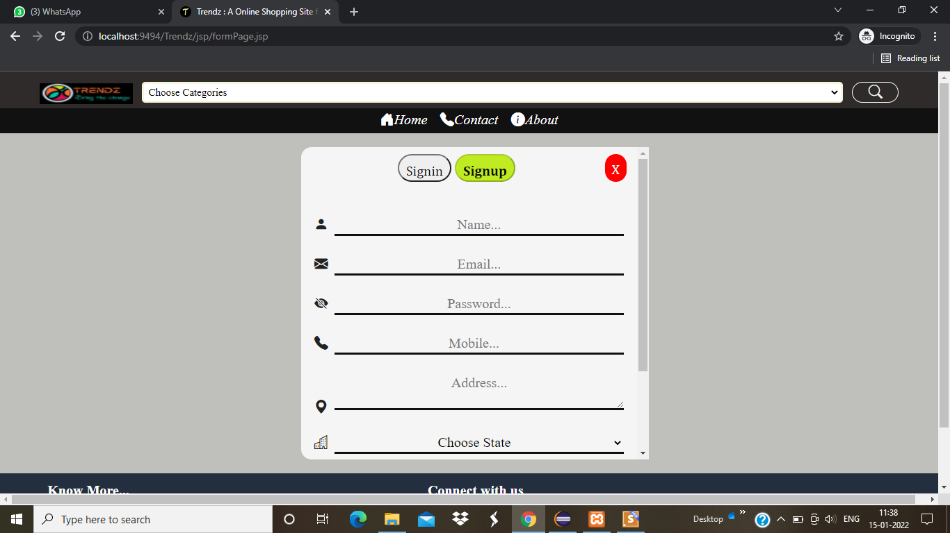
Signup Page

Slide 13
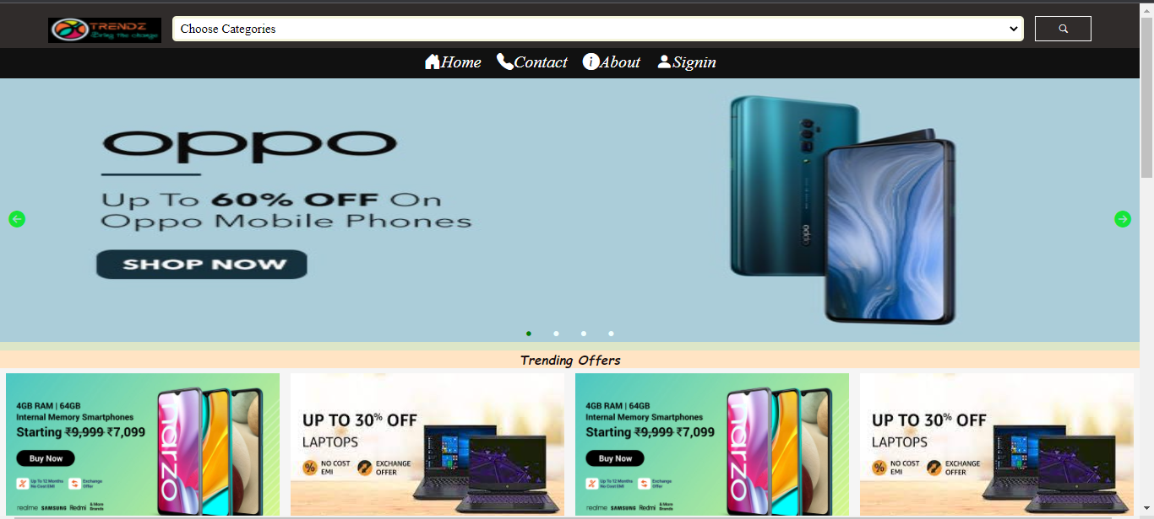
Home Page

Slide 14
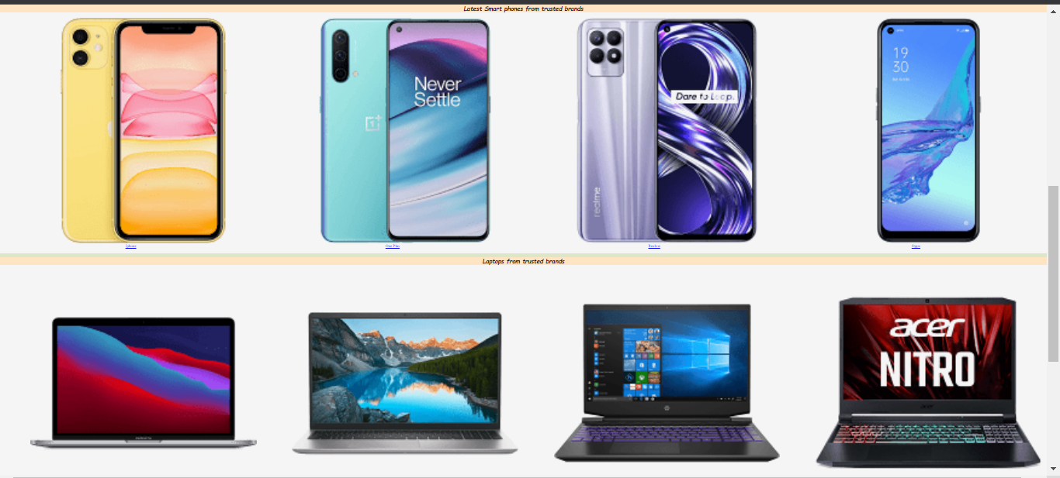
Different Categories

Slide 15
Advantages
It saves time and efforts.
Provides convenience of shopping at home.
Wide variety of products are available.
We can compare various brands and models.
24*7 Customer support

Slide 16
Disadvantages
Delay in Delivery.
Lack of significant discount in online shopping.
Missing the Shopping Experience.
frauds in online shopping.

Slide 17
Thank you

