Slide 1




G H RAISONI SKILLTECH UNIVERSITY
CODE FORGE
NAGPUR, MAHARASHTRA
CODE
FORGE
OFFICIAL TEMPLATE
Department of Science & Technology
HACKATHON PRESENTATION
PROBLEM STATEMENT TITLE
Urban Infrastructure Cascade Simulator
TEAM NAME
PROBLEM CODE
TEAM MEMBERS
INSTITUTION
Smasherz
CF-2026-S-03
Tushar Tiple, Smit Patil, Atharva Trinagriwar, Yugal Kalaskar
St.Vincent Palloti College of Engineering and Technology, Nagpur

Slide 2








CODE FORGE
G H RAISONI SKILLTECH UNIVERSITY
The Problem
In Our Own Words
Real-World Context
Urban networks (power, water, healthcare) are highly interdependent, yet current models fail to track cascading failures across different domains efficiently.
Modern smart cities rely on interconnected services where a single substation failure can trigger water shortages and hospital outages.
Who Is Affected?
Existing Limitations
City planners, emergency responders, and utility managers who need to predict cascading impacts of natural disasters or targeted attacks.
Existing simulations are tightly coupled, monolithic, and lack discrete-time tracking, making it hard to identify the exact cascade path and recovery times.
ONE CLEAR PROBLEM STATEMENT
"How to accurately model and simulate cascading failures across interdependent urban infrastructure networks to predict and mitigate systemic collapses."

Slide 3






CODE FORGE
G H RAISONI SKILLTECH UNIVERSITY
Problem Decomposition
Core Technical Problem
Key Assumptions
Developing a purely functional, discrete-time propagation engine (Lane 2) that deterministically evaluates failure cascades based on weighted dependency edges.
Infrastructure nodes have capacity and failure thresholds. Edges represent dependency weights. State is evaluated strictly at discrete ticks.
Known Constraints
Edge Cases & Complexity
The simulation must run in a separated 4-lane architecture (DB, Engine, Visuals, Metrics) with strict cross-lane data contracts (immutable snapshots).
Handling simultaneous disruptions, cyclical dependencies, and interleaving recovery actions before failure propagation within a single tick.

Slide 4





CODE FORGE
G H RAISONI SKILLTECH UNIVERSITY
Research & Prior Art
Approach / System | Core Methodology | Key Strengths | Where It Fails | Our Identified Gap
Rule-Based Thresholds | Static Min/Max Limits | Zero compute overhead, instant setup | Incapable of capturing inter-sensor dynamics; high false alarms
Classic LSTM-AE | Reconstruction Error | Detects temporal sequential drift | High computational latency; fails to capture spatial graph topology
Cloud Transformer AI | Full Attention Layers | High precision on complex data | Requires constant cloud connectivity, high bandwidth & cost
 | Adaptive Graph Neural Nets + Dynamic Scoring | Captures joint spatial-temporal interplay at low compute footprint | Requires short initialization window (~2 mins)

Slide 5



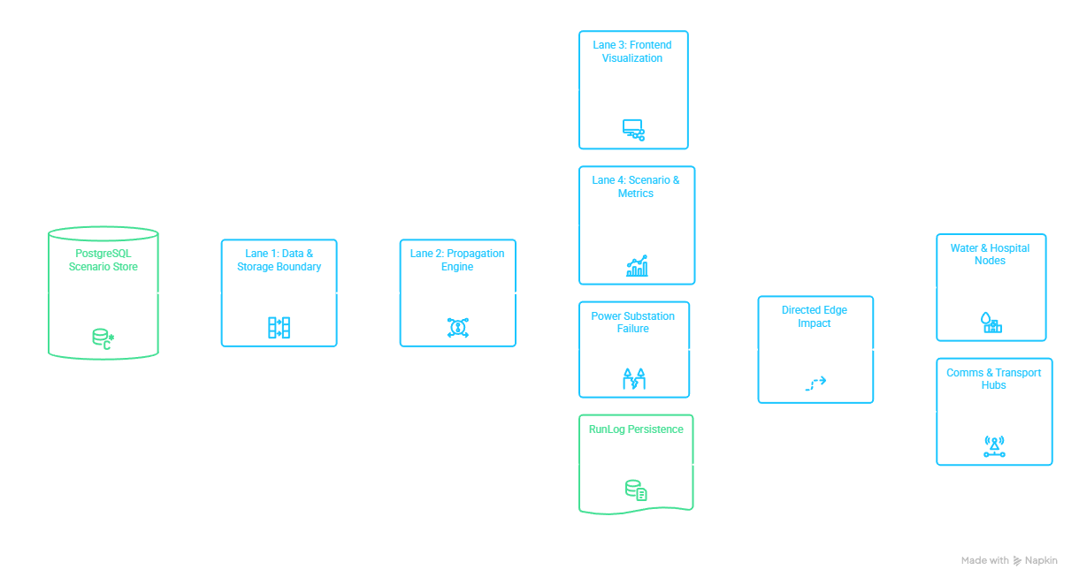
CODE FORGE
G H RAISONI SKILLTECH
Proposed Approach
Major Components & Workflow
Data Model (Lane 1): PostgreSQL-backed, mutable Scenario and Recovery models loaded into memory at start.
Propagation Engine (Lane 2): Pure Python, stateless discrete-tick loop capturing immutable snapshots.
Solution Concept
A 4-Lane Discrete-Tick Cascade Simulator deployed with PostgreSQL, Python Engine, and React Frontend.
Metrics & Frontend (Lanes 3/4): Computes cascade depth, hop depth, and animates system state chronologically.

Slide 6


CODE FORGE
G H RAISONI SKILLTECH UNIVERSITY
System Architecture
Technical Components
Security & Data Flow
Storage Layer: PostgreSQL with psycopg2, maintaining scenarios, nodes, edges, and recovery actions.
Settlement Detection: The engine halts exactly when a tick produces no state changes and no pending recoveries remain.
Simulation Engine: Evaluates impact = Σ(edge.weight × (1 - upstream.capacity)). Fails if impact > threshold.
Robust Testing: 27/27 automated unit tests covering hand-traced multi-hop cascades and cross-lane validation.
Cross-Lane Contract: Lane 2 passes immutable SimulationResult (TickSnapshots + StateChangeEvents) to Lane 4.
Analytics: Lane 4 calculates recovery_time, affected_services, and peak_impact for the Lovable React frontend.

Slide 7



CODE FORGE
G H RAISONI SKILLTECH UNIVERSITY
Innovation & Impact
27/27
100%
4
AUTOMATED TESTS PASSING
DETERMINISTIC ACCURACY
ISOLATED ARCHITECTURE LANES
Core Innovation
Technical Insight
What is genuinely different? Our architecture strictly isolates the database (Lane 1) from the simulation logic (Lane 2), communicating solely through frozen data contracts.
By utilizing a discrete-tick engine with pre-tick capacity freezing, the simulation guarantees order-independent propagation and reproducible cascade timelines.

Slide 8





CODE FORGE
G H RAISONI SKILLTECH UNIVERSITY
Deployment & Roadmap
Target Beneficiaries
Deployment Strategy
Urban resilience planners, disaster response coordinators, and civil infrastructure engineers.
Deployable as a standard Python/PostgreSQL backend with a modern React visualization dashboard.
Measurable Benefits
Moving Beyond Prototype
Enables rapid wargaming of infrastructure vulnerabilities, reducing response times and improving urban resilience against cascading blackouts.
Integrating real-time GIS data, expanding to stochastic (probabilistic) failure models, and deploying to cloud infrastructure.

Slide 9

CODE FORGE
G H RAISONI SKILLTECH UNIVERSITY
Technical References
Category | Reference Source / Technology | Utilization in Project
Research Papers | "Multivariate Time-Series Anomaly Detection via Graph Neural Networks" (AAAI 2021) | Inspiration for spatio-temporal graph attention mechanics
Open-Source Frameworks | PyTorch Geometric (PyG), ONNX Runtime, C++ gRPC Core | Graph neural network training & high-speed edge inference engine
Industry Standards | OPC-UA Telemetry Spec & IEEE 1451 Smart Sensor Architecture | Data ingestion normalization and industrial protocol mapping
Benchmark Datasets | SWaT (Secure Water Treatment) & WADI Industrial Testbeds | Model training, validation, and multi-sensor drift simulation

Slide 10




CODE FORGE 2026
G H RAISONI SKILLTECH UNIVERSITY
Thank You!
Team Smasherz | Problem Code: CF-26 S-03
GitHub Repository
GHRCEM Nagpur

