Slide 1
Crypegangraphy A secure communication technique using steganography and cryptography
Tushar Totla

Slide 2
Abstract
With increase in the data transmission and data exchange in daily life, along with the increasing data thefts and other adversary snooping, the security and privacy of data has become an important thing to be concerned about. Throughout the years many different approaches, ideas, algorithms and protocols have been developed to protect the data from snoopers and adversaries and ensure secure communication. Each approach has its own pros and cons. This project is an attempt to combine two different approaches of data protection- (Steganography and Cryptography) to develop a powerful and secured method for data exchange.

Slide 3
cryptography
Cryptography is basically a method in which you will be hiding or encrypting a message that a user wants to send it to someone. This method allows us to form an encrypted text (cipher text) that hides the message.
The working of cryptography is done via following steps:
Firstly, the textual confidential data which the user wants to send is converted to numerical form.
Secondly, this numeric form that has the message, is applied into the algorithm along with the encryption key, which we can say, is like a string of bits.
Together, when applied into the encryption algorithm, it forms cipher-text. The cipher-text that is generated is then sent to the receiver through the network.
Reaching the other side, the receiver then decrypts the cipher-text in a similar way. Here, he uses the cipher-text and decryption key as the inputs for the decryption algorithm and decrypts it back to the numeric form.
Finally in the end the numeric form is converted to the intended message

Slide 4
Steganography
Steganography is a method in which you hide the message intended to send to someone in an image. The image might look the same after using steganography but a point to remember is that it has the message. Steganography hides the identity of the message in the cover.
The confidential data is taken as input from the user along with the cover image in which the data is to be hidden.
These act as an input for the Steganographic Encoder which encodes the given message into the cover file, resulting the output as the STEGO-IMAGE.
Now the receiver is provided with stego-image which he/she decodes it with the Steganographic Decoder and finally gets the intended message.

Slide 5
Algorithms
RSA
lsb
AES
Asymmetric cryptographic algorithm
A Steganographic algorithm
symmetric cryptographic algorithm

Slide 6
ALGORITHMS
AES
LSB
RSA
A symmetric algorithm where the key is the same for both the sender and the receiver. It works on block cipher technique which means that size of the plain text and cipher text must be the same. Here an input key is given into the algorithm which is of the same size as the plain text.
LSB steganography technique, the information hider embeds the secret information in the least significant bits of a media file.
A block-cipher type algorithm that converts plain text to cipher text. It is an asymmetric cryptography algorithm; this means that it uses a public key and a private key. As their names suggest, a public key is shared publicly, while a private key is secret and must not be shared with anyone.

Slide 7
ARCHITECTURE AND MODULE DESCRIPTION
ENCRYPTION MODULE
DECRYPTION MODULE
This module encrypts plain text to cipher text. In this model we have used the AES and RSA encryption algorithm
This module performs AES/RSA decryption by using the private key and extracts the plain text from the cipher text.
ENCODING MODULE
DECODING MODULE
This module is responsible for hiding the cipher text to the cover image by the use of steganography techniques
This module extracts the hidden cipher text from the stego image which is sent by the sender.

Slide 8
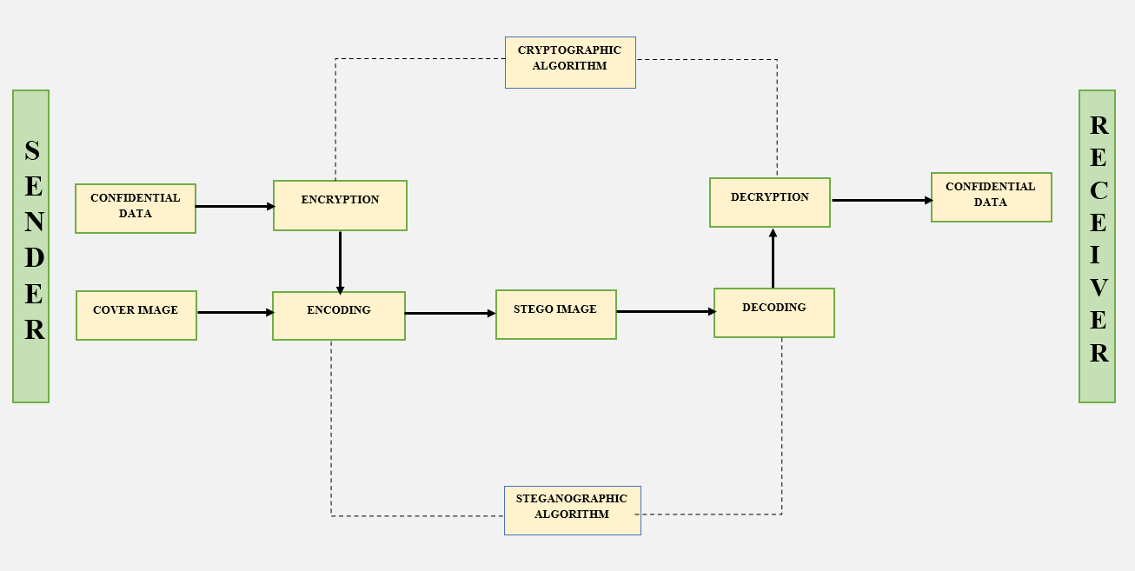
ARCHITECTURE DIAGRAM

Slide 9
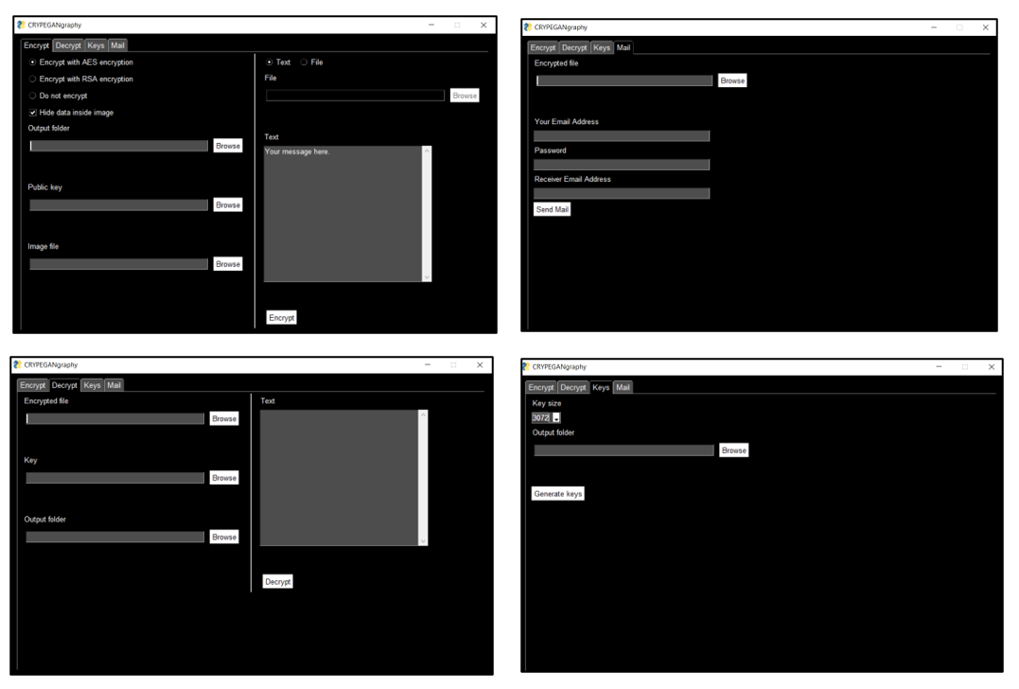
implementation
ENCRYPT:
SYMMETRIC ENCRYPTION
ASYMMETRIC ENCRYPTION
SYMMETRIC ENCRYPTION WITH STEGANOGRPAHY
ASYMMETRIC ENCRYPTION
WITH STEGANOGRAPHY
DECRYPT
KEYS
WITH KEY SIZE=2048
WITH KEY SIZE=3072
WITH KEY SIZE=4096
WITH KEY SIZE=8192
MAILS

Slide 10
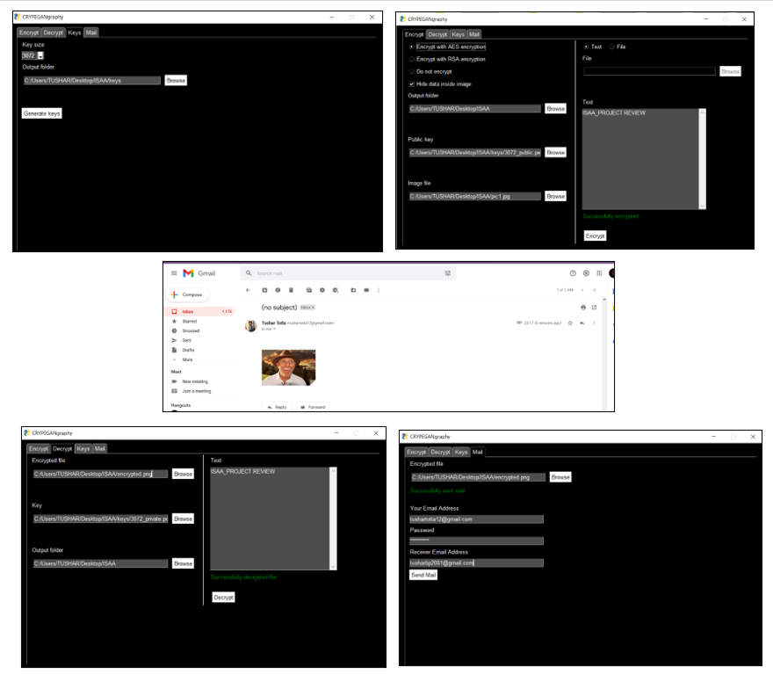
results

Slide 11
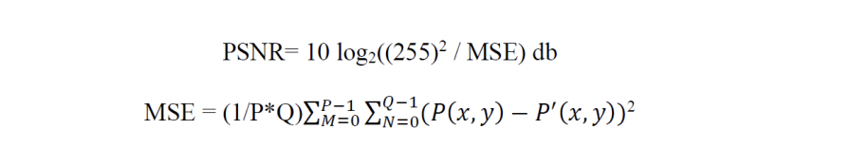
PERFORMANCE ANALYSIS
PEAK SIGNAL TO NOISE RATIO [PSNR]
For evaluation of the proposed steganography technique a performance metric known as PSNR was used to evaluate the distortion between the image before and after the image were encoded with the secret text. Peak signal to noise ratio is used to compute how well the algorithm performed.
IMAGE | PSNR VALUE
PIC1 | 83.68325325
PIC2 | 92.5770748712
PIC3 | 90.22543984536
PIC4 | 85.95438621

Slide 12

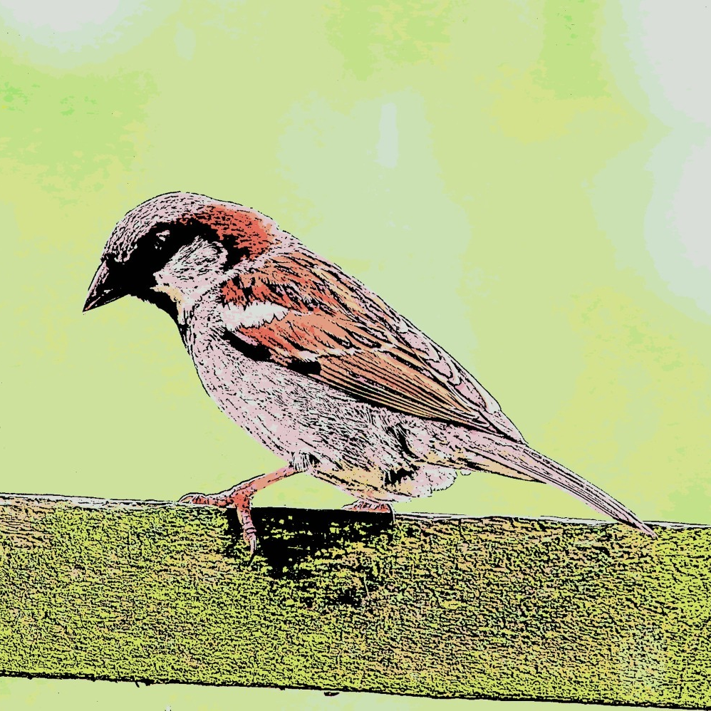
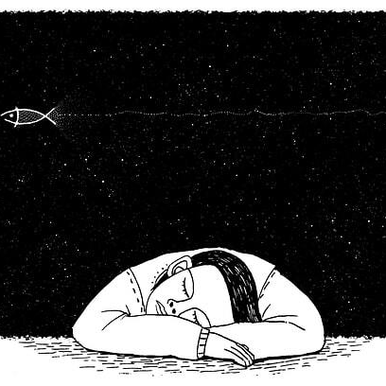
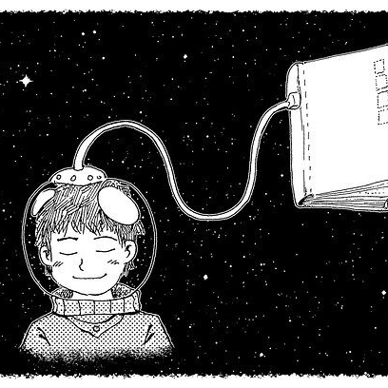
TESTING PICS
PIC1
ORIGINAL IMAGE
PIC2
ORIGINAL IMAGE
PIC3
ORIGINAL IMAGE
PIC4
ORIGINAL IMAGE
ENCRYPTED
ENCRYPTED IMAGE
ENCRYPTED
ENCRYPTED IMAGE
ENCRYPTED
ENCRYPTED IMAGE
ENCRYPTED
ENCRYPTED IMAGE

Slide 13
CONCLUSION AND FUTURE WORK
From the whole study, we conclude that using both steganography and cryptography together refers to secure information and communication technique. The GUI implementation for the whole system giving choice to the user to choose his preferable technique for secure communication is added as a part of innovative idea to it. Considering the future work, the application can be further improved by adding some more utilities and designing abetter UI. Some features like providing more crypto algorithms like DES, Blowfish, SA etc. for encryption of the message can provide more utilities to the application. Overall, the present application is very handy, secured and interactive providing sufficient utilities to the users.

Slide 14
THANK YOU ☺

