Slide 1

FIRE AND SMOKE DETECTION USING DEEP LEARNING
TUSHAR TOTLA

Slide 2
ABSTRACT
The technologies underlying fire and smoke detection systems play a crucial role in ensuring and delivering optimal performance in modern surveillance environments. For this majority of cities have already installed camera-monitoring systems, this encouraged us to take advantage of the availability of these systems to develop cost-effective vision detection methods.
However, this is a complex vision detection task from the perspective of deformations, unusual camera angles and viewpoints, and seasonal changes. To overcome these limitations, we want to propose a new method based on a deep learning approach, which uses a convolutional neural network that employs dilated convolutions.
An evaluation on the method would be done by training and testing it on custom-built dataset, which consists of images of fire and smoke that would be collected from the internet and labeled manually.
The experimental results are expected to indicate the classification performance and complexity of the method are superior. In addition, the method would be designed to be well generalized for unseen data, which offers effective generalization and reduces the number of false alarms.

Slide 3
ARCHITECTURE
According to the principle of object detection algorithms, the flow of image fire detection algorithms based on convolutional neural networks is designed as shown in figure. The detection CNN has functions of region proposals, feature extraction and classification. Firstly, The CNN takes an image as input and outputs region proposals by convolution, pooling. Secondly, the region-based object detection CNN decides the presence or absence of fire in proposal regions through convolutional layers, pooling layers, fully-connected layers, etc.

Slide 4
PROPOSED ALGORITHM
Convolutional neural network (CNN), a class of artificial neural networks that has become dominant in various computer vision tasks, A convolutional neural network (CNN) is type of artificial neural network used in image recognition and processing that is specifically designed to process pixel data. A neural network is a system of hardware and software patterned after the operation of neurons in the human brain.
CNN is designed to automatically and adaptively learn spatial hierarchies of features through backpropagation by using multiple building blocks, such as convolution layers, pooling layers, and fully connected layers. Understanding the CNN working by a sequence of steps gives a good clarity. The steps are as follows:
Convolution Operation
ReLU Layer
Polling
Flattening
Full Connection
SoftMax and Cross-Entropy

Slide 5
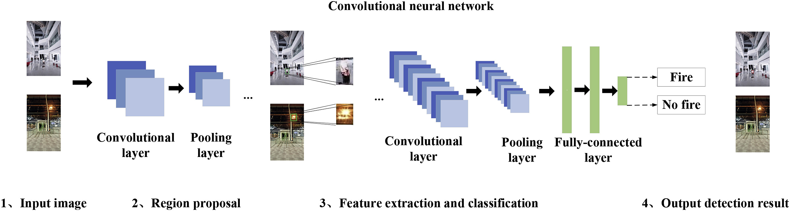
CONVOLUTION NEURAL NETWORK

Slide 6
PROPOSED ALGORITHM-METHODS
CUSTOMIZED ALEXNET CNN MODEL
AlexNet is the first convolution network consists of 5 convolutional layers, 3 max-pooling layers, 2 normalization layers, 2 fully connected layers, and 1 SoftMax layer. Each convolutional layer consists of convolutional filters and a nonlinear activation function ReLU. The pooling layers are used to perform max pooling. Input size is fixed due to the presence of fully connected layers. The input size is mentioned at most of the places as 224x224x3 but due to some padding which happens it works out to be 227x227x3. AlexNet overall has 60 million parameter.
CUSTOMIZED INCEPTION V3 MODEL
Inception-v3 is a convolutional neural network that is 48 layers deep. It can load a pretrained version of the network trained on more than a million images from a dataset. The pretrained network can classify images into 1000 object categories, such as fire, no fire in our case. As a result, the network has learned rich feature representations for a wide range of images. The network has an image input size of 299-by-299. In an Inception v3 model, several techniques for optimizing the network are suggested to loosen the constraints for easier model adaptation. The techniques include factorized convolutions, regularization, dimension reduction, and parallelized computations.

Slide 7
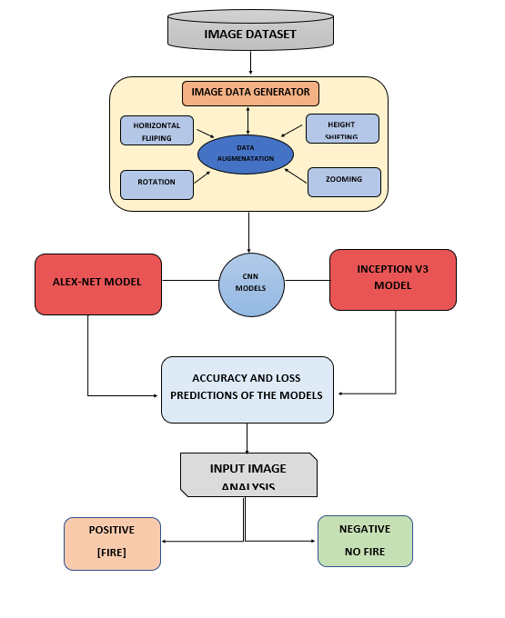

Slide 8
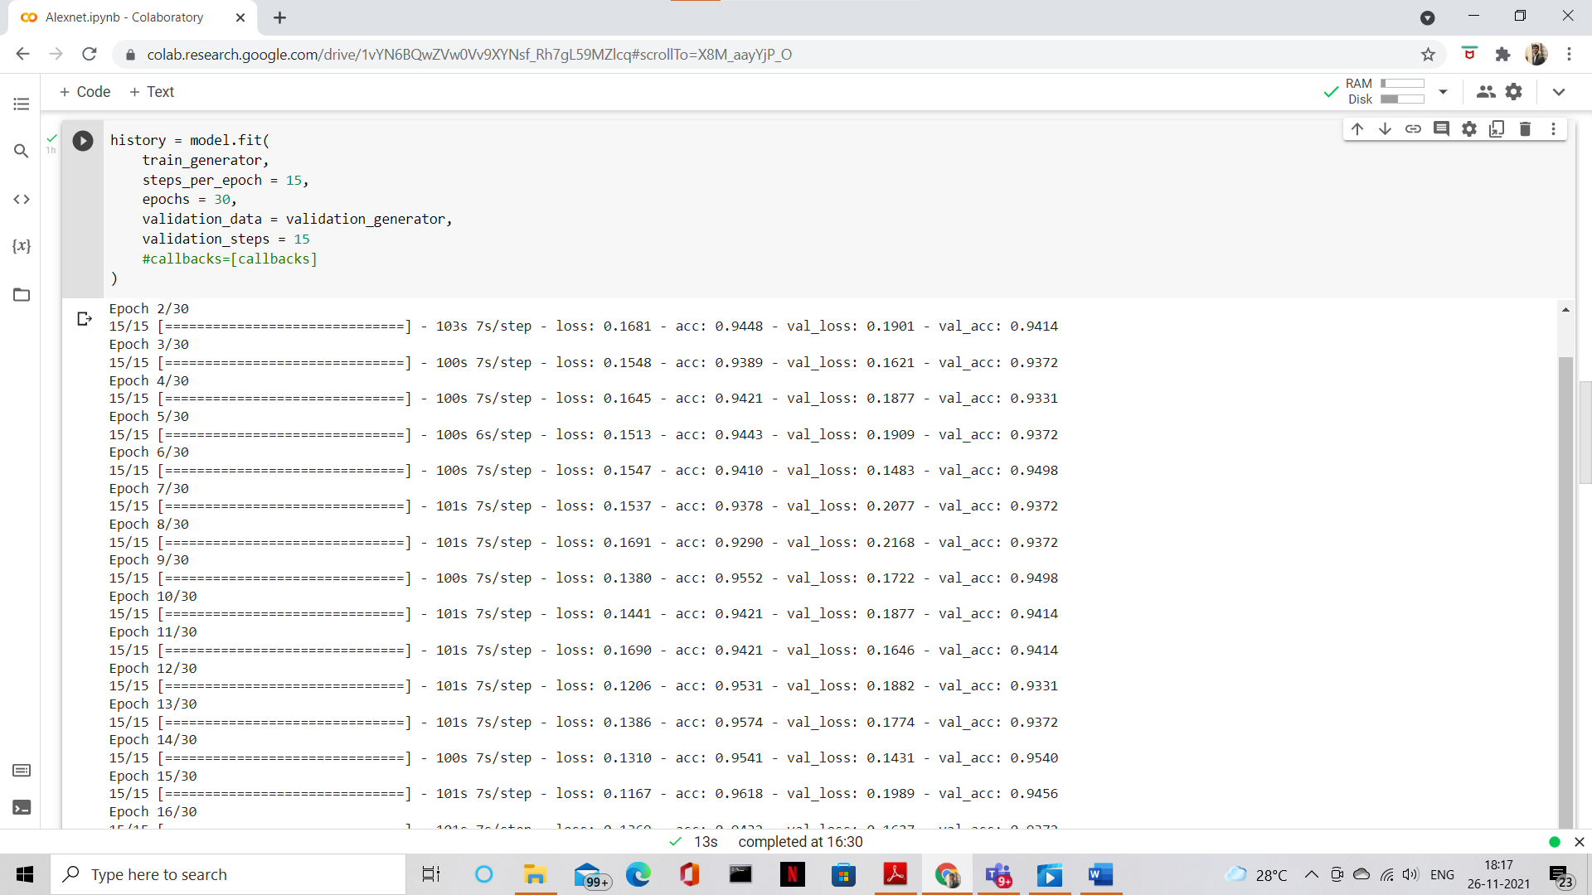
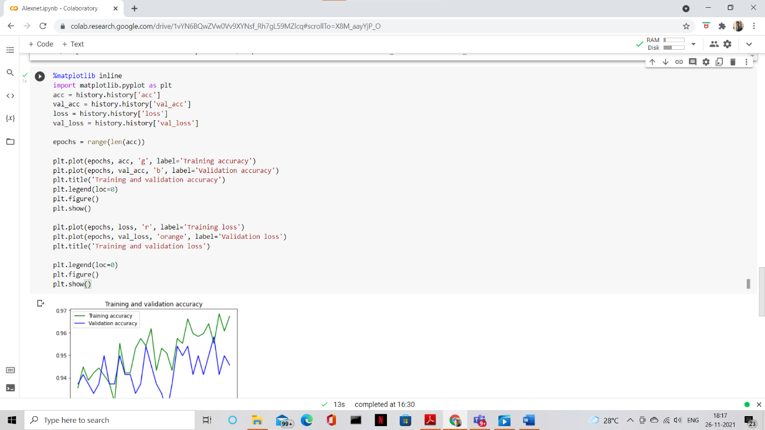
SAMPLE CODE-OUTPUT

Slide 9
RESULT COMPARSISON
Since we have been going via various architecture methods like the Inception V3 model and AlexNet model, we majorly compare the training accuracy, validation accuracy, training losses and validation losses. We train the model using the training data and check its performance on both the training and validation sets. The training loss indicates how well the model is fitting the training data, while the validation loss indicates how well the model fits new data.
Type | Value
Training accuracy | 98.04
Validation accuracy | 96.43
Training loss | 0.063
Validation loss | 0.118
Type | Value
Training accuracy | 96.83
Validation accuracy | 94.98
Training loss | 0.09
Validation loss | 0.13
INCEPTION V3 MODEL
ALEXNTET MODEL

Slide 10
REQUIREMENTS
Python 3
Pytorch
Numpy
Matplotlib
TorchFussion

