Slide 1

IILM UNIVERSITY
School of Computer Science & Engineering
INTERNSHIP PRESENTATION
Web Development Internship at
Myra's Global Tech
STUDENT NAME
PROGRAM & SEMESTER
Tushar Kumar Verma
B.Tech CSE — 3rd Semester
ENROLLMENT NUMBER
ORGANIZATION
25SCS1003004920
Myra's Global Tech

Slide 2
About the Organization
Myra's Global Tech — Innovating the Future
1
A technology company focused on web development, digital solutions, and building practical, industry-ready skills in aspiring developers.
M
Myra's
Global Tech
2
Provides hands-on internship programs covering front-end and back-end development, website design, and real client project delivery.
Patna, Bihar, India
www.myraglobaltech.com
hr@myraglobaltech.com
3
Works with clients across sectors — including educational institutions — to design and deploy functional, responsive websites.
Founder: Dr. Manish Jha Co-Founder: Ms. Sudha Devraj
Internship Presentation • Tushar Kumar Verma
2

Slide 3
Internship Overview
Snapshot of the internship engagement
ROLE
DURATION
CERTIFICATE ID
MODE
Web Developer
One Month
(02 Jul – 02 Aug 2026)
MGT-WD-2026-03
Live Client Projects
What the Internship Involved
Completed a one-month Web Developer internship at Myra's Global Tech, gaining practical, project-based exposure to website design and development, front-end and back-end technologies, responsive web design, debugging, and end-to-end application development — successfully delivering all assigned tasks and client projects.
Internship Presentation • Tushar Kumar Verma
3

Slide 4
Objectives of the Internship
What the internship aimed to achieve
1
Practical Web Development
2
Front-End & Back-End Exposure
Apply classroom concepts of web technologies to real, live client projects.
Gain hands-on experience across both client-facing and server-side development.
3
Responsive Design Skills
4
Debugging & Problem-Solving
Learn to build websites that work seamlessly across devices and screen sizes.
Develop the ability to identify, troubleshoot, and fix real-world code issues.
5
Client Project Delivery
6
Professional Work Exposure
Understand the full cycle of taking a client brief to a completed, working website.
Build workplace skills — communication, deadlines, and quality delivery.
Internship Presentation • Tushar Kumar Verma
4

Slide 5
Work Done During the Internship
Building complete school websites for real clients
Core Project Work
PROJECT SCALE
Designed and developed multiple school websites from scratch as live client projects, handling both front-end and back-end.
Multiple
Built responsive layouts ensuring the websites worked smoothly across desktop, tablet, and mobile devices.
School Websites Delivered
Implemented core school-website features such as informational pages, galleries, contact/enquiry sections, and navigation structures.
PROJECT VALUE RANGE
₹25,000 – ₹80,000
Performed testing and debugging to identify and fix functional and layout issues before final delivery.
per project, varying by scope and features
Coordinated project requirements and revisions directly based on client (school) needs, taking ownership from planning to deployment.
Real client engagement — from requirement gathering to final, working delivery.
Internship Presentation • Tushar Kumar Verma
5

Slide 6
Technologies & Skills Used
Tools and concepts applied on real projects
Front-End
Back-End
Practices
HTML5
Server-Side Logic
Debugging & Testing
CSS3
Application Development
Cross-Device QA
JavaScript
Data Handling
Client Requirement Analysis
Responsive Design
Internship Presentation • Tushar Kumar Verma
6

Slide 7
Challenges & How They Were Solved
Turning real project obstacles into learning
Making layouts fully responsive
Tested and adjusted designs across screen sizes using responsive CSS techniques until the layout held up on every device.
Identifying and fixing functional bugs
Followed a structured debugging approach — isolating issues, testing fixes, and verifying behaviour before final delivery.
Meeting varied client requirements
Communicated closely with client needs, translating requests from different schools into consistent, working features.
Balancing multiple live projects
Prioritized tasks and managed time across concurrent website projects to meet delivery expectations.
Internship Presentation • Tushar Kumar Verma
7

Slide 8
Skills Gained & Key Learnings
What the internship added to my capabilities
Stronger practical command of front-end and back-end web development.
Ability to design and build fully responsive, multi-device-ready websites.
✓
✓
Improved debugging discipline and structured problem-solving under real constraints.
First-hand experience delivering complete projects to paying clients, end to end.
✓
✓
Better time management while handling multiple live projects simultaneously.
Increased confidence in translating client requirements into functional software.
✓
✓
Internship Presentation • Tushar Kumar Verma
8

Slide 9
Conclusion
The one-month Web Developer internship at Myra's Global Tech was a valuable, hands-on extension of my academic learning. Working on multiple live school-website projects — end to end, from client requirements to a working, responsive product — strengthened my front-end and back-end skills, sharpened my debugging ability, and gave me genuine confidence in delivering real, client-ready software.
Practical Growth
Professional Readiness
Clear Direction
Moved from theory to real, deployed client work.
Gained workplace habits: ownership, deadlines, communication.
Reinforced interest in pursuing web development further.
Internship Presentation • Tushar Kumar Verma
9

Slide 10
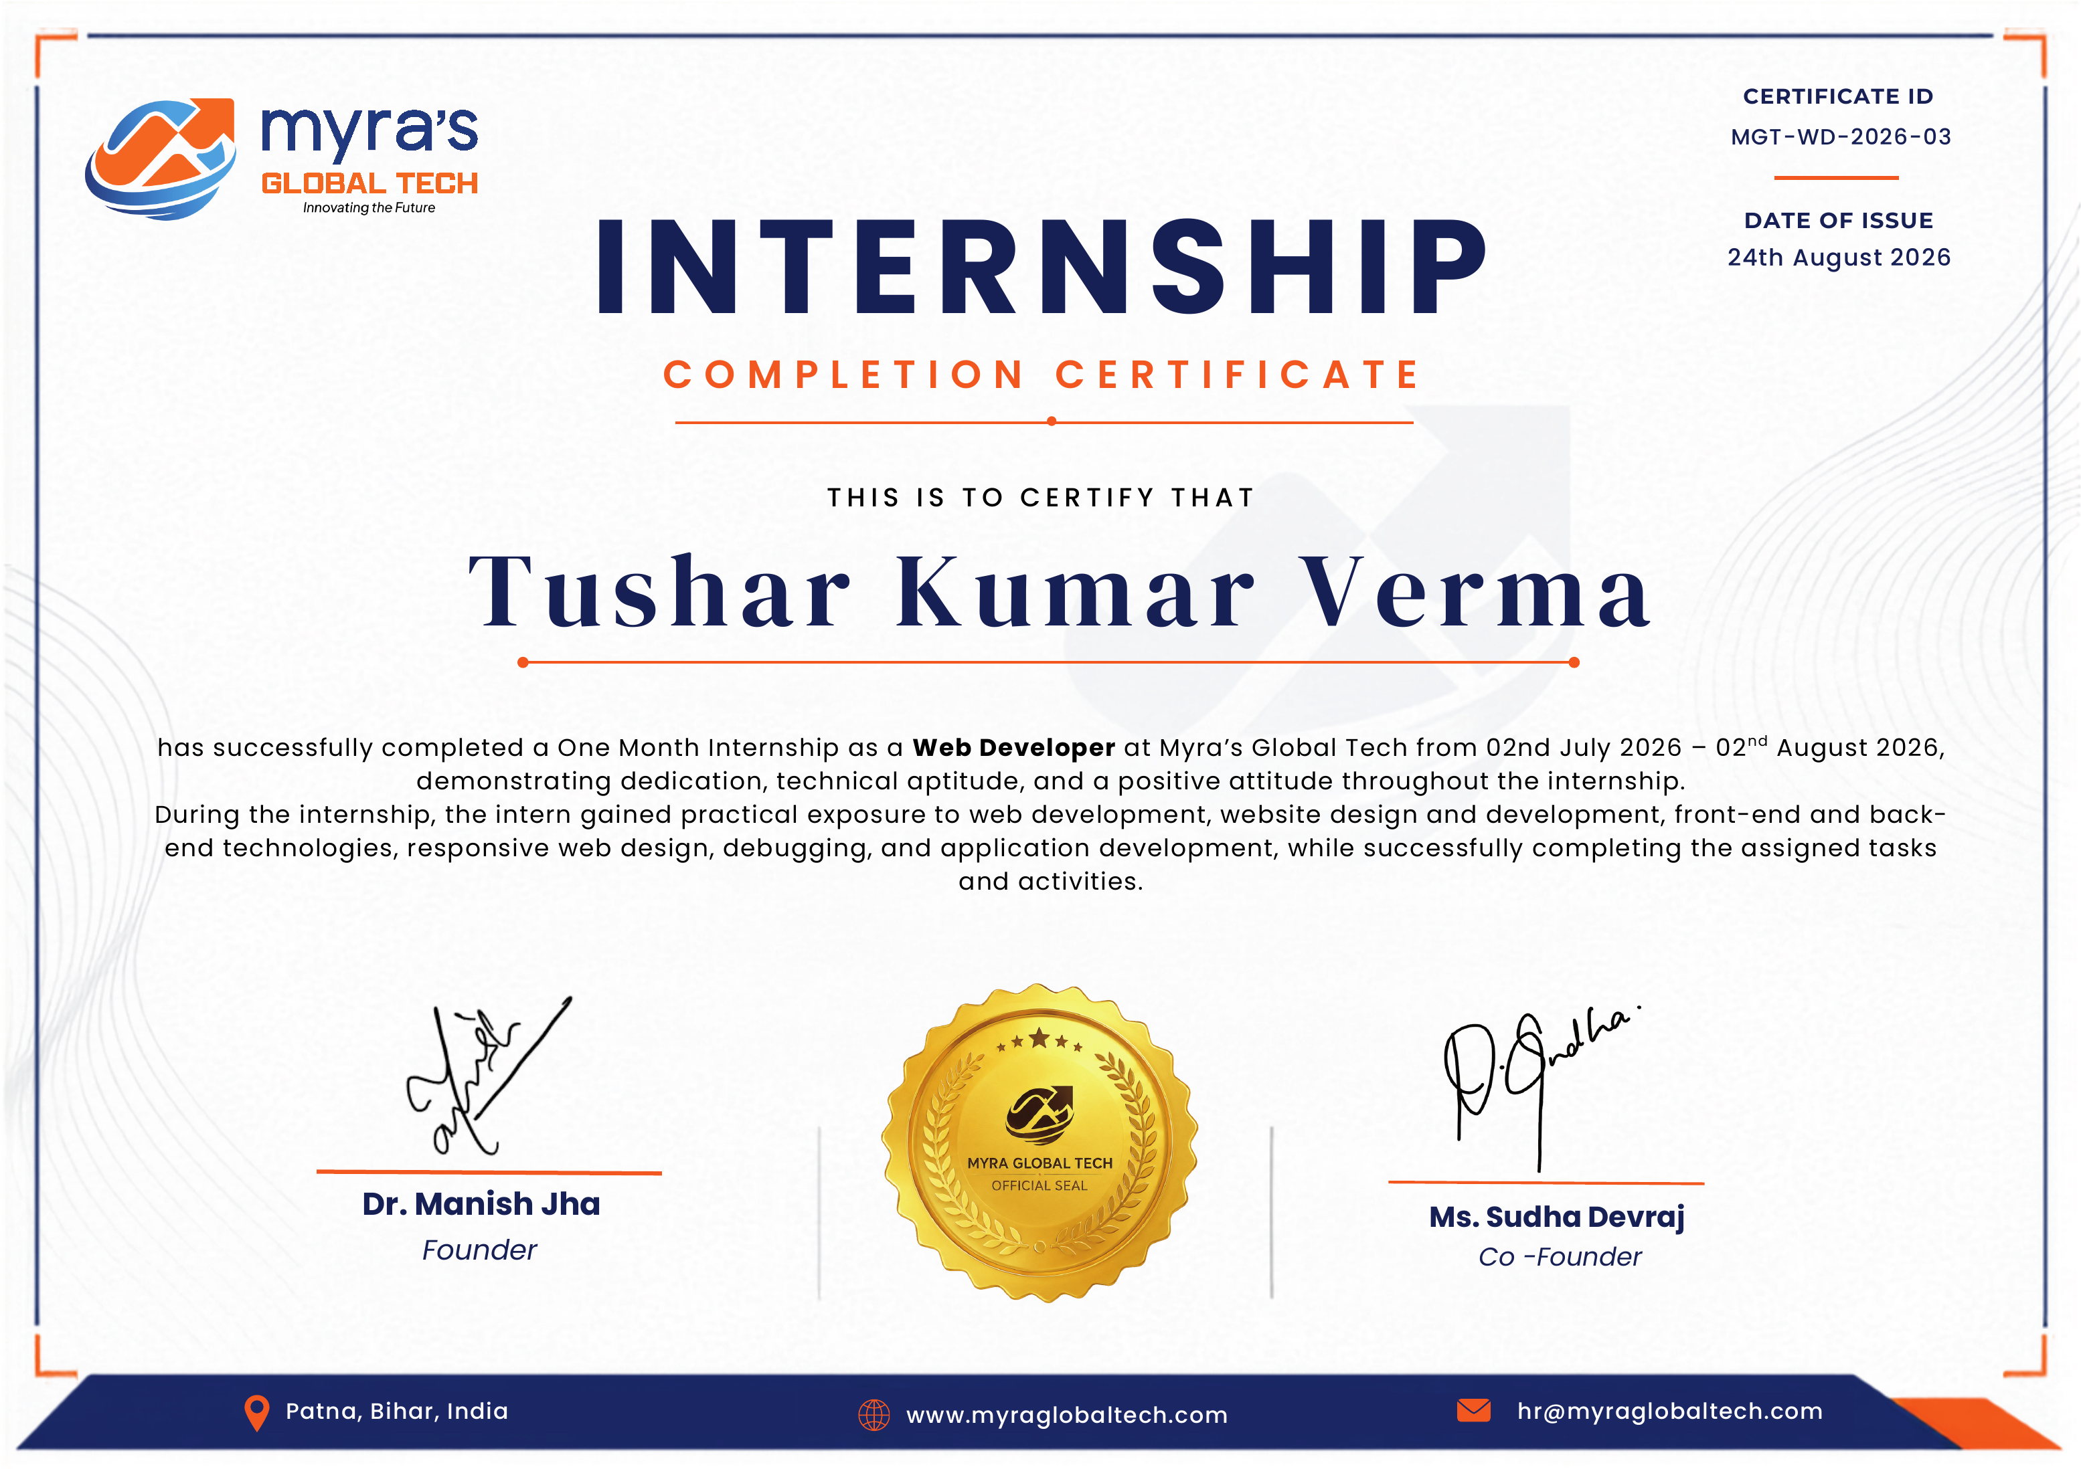
Thank You
Internship Completion Certificate — Myra's Global Tech
Tushar Kumar Verma | 25SCS1003004920 | B.Tech CSE, 3rd Semester | IILM University

