Slide 1
E-Commerce Sales Data Analysis
and Interactive Power BI Dashboard
Week 6 Internship Assignment — Data Analytics Capstone Project
Student: [Your Name] | October 2026
Tools: Python | Pandas | Matplotlib | Seaborn | Power BI | Git/GitHub
⚠ Dataset: Synthetically generated for educational purposes

Slide 2
Problem Statement & Objectives
Problem Statement
Project Objectives
Businesses need data-driven decisions but lack clear visibility into:
• Which products and categories are truly profitable?
• How do discounts impact the bottom line?
• Which regions and customer segments drive growth?
• What seasonal patterns should drive inventory planning?
This project builds a complete analytics solution to answer these questions.
1. Analyze sales and profit performance
2. Identify high/low performing products
3. Examine monthly and yearly trends
4. Study regional & segment performance
5. Investigate discount-profit relationship
6. Create 8+ Python visualizations
7. Build interactive Power BI dashboard
8. Generate 5+ business insights
9. Provide actionable recommendations
10. Publish project on GitHub
E-Commerce Sales Analysis | Week 6 Internship Assignment | Synthetic Data
Slide 2

Slide 3
Dataset Overview
Synthetic Sample Superstore-Style Data
9,994
21
26
2020-2023
Records
Original Columns
After Feature Engineering
Date Range
Dataset Fields
Data Quality
Order ID, Order Date, Ship Date, Ship Mode
Customer ID, Segment, Country, Region
State, City, Category, Sub-Category
Product ID, Product Name
Sales, Quantity, Discount, Profit
+ Derived: Year, Month, Quarter, Margin %
Raw rows: 9,997
After cleaning: 9,994 (-3 duplicates)
Missing Ship Dates: 12 (retained)
Invalid records: 0 removed
Duplicates removed: 3
Source: Synthetically generated
Seed: 42 (fully reproducible)
E-Commerce Sales Analysis | Week 6 Internship Assignment | Synthetic Data
Slide 3

Slide 4
Data Cleaning & Preparation
src/data_cleaning.py
1
2
3
4
Load Dataset
Inspect Structure
Missing Values
Duplicate Removal
UTF-8 with fallback encoding
Shape, dtypes, column names
12 Ship Dates retained as valid
3 exact duplicates removed
5
6
7
8
Date Parsing
Validation
Feature Engineering
Export
DD/MM/YYYY → datetime64
Sales>0, Discount in [0,1]
Year, Month, Quarter, Margin%
data/cleaned_sales.csv
Outlier Decision: 1,733 potential outliers RETAINED — represent legitimate bulk/high-value orders
E-Commerce Sales Analysis | Week 6 Internship Assignment | Synthetic Data
Slide 4

Slide 5
Exploratory Data Analysis — Key Findings
$33.17M
$3.64M
9,070
11.0%
Total Sales
Total Profit
Total Orders
Profit Margin
By Category
By Region
By Segment
Technology: $25.02M
Furniture: $6.86M
Office Supplies: $1.30M
West: $10.05M
East: $9.28M
South: $7.21M
Central: $6.63M
Consumer: $17.59M (53%)
Corporate: $10.18M (31%)
Home Office: $5.40M (16%)
E-Commerce Sales Analysis | Week 6 Internship Assignment | Synthetic Data
Slide 5

Slide 6
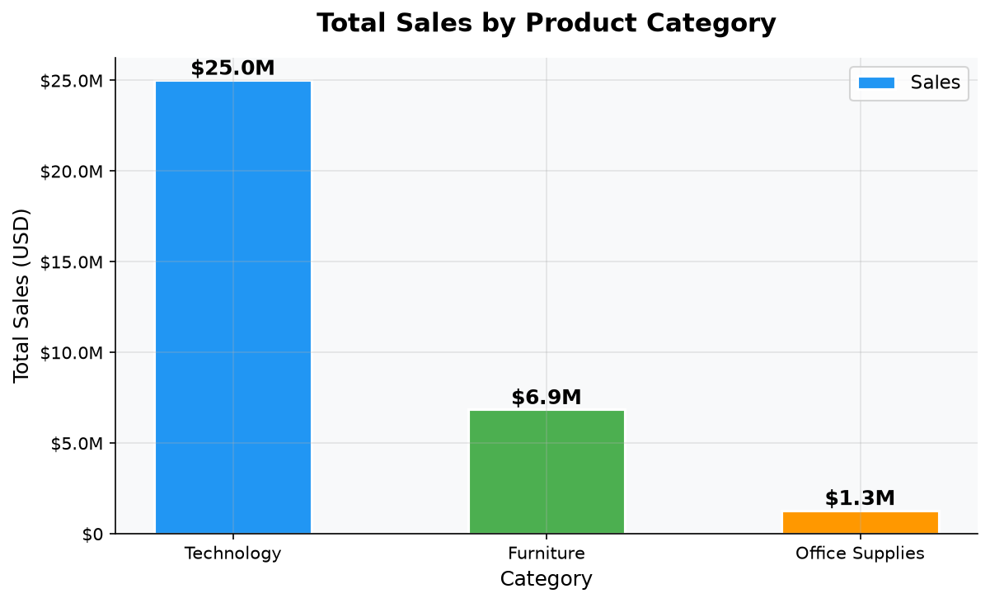
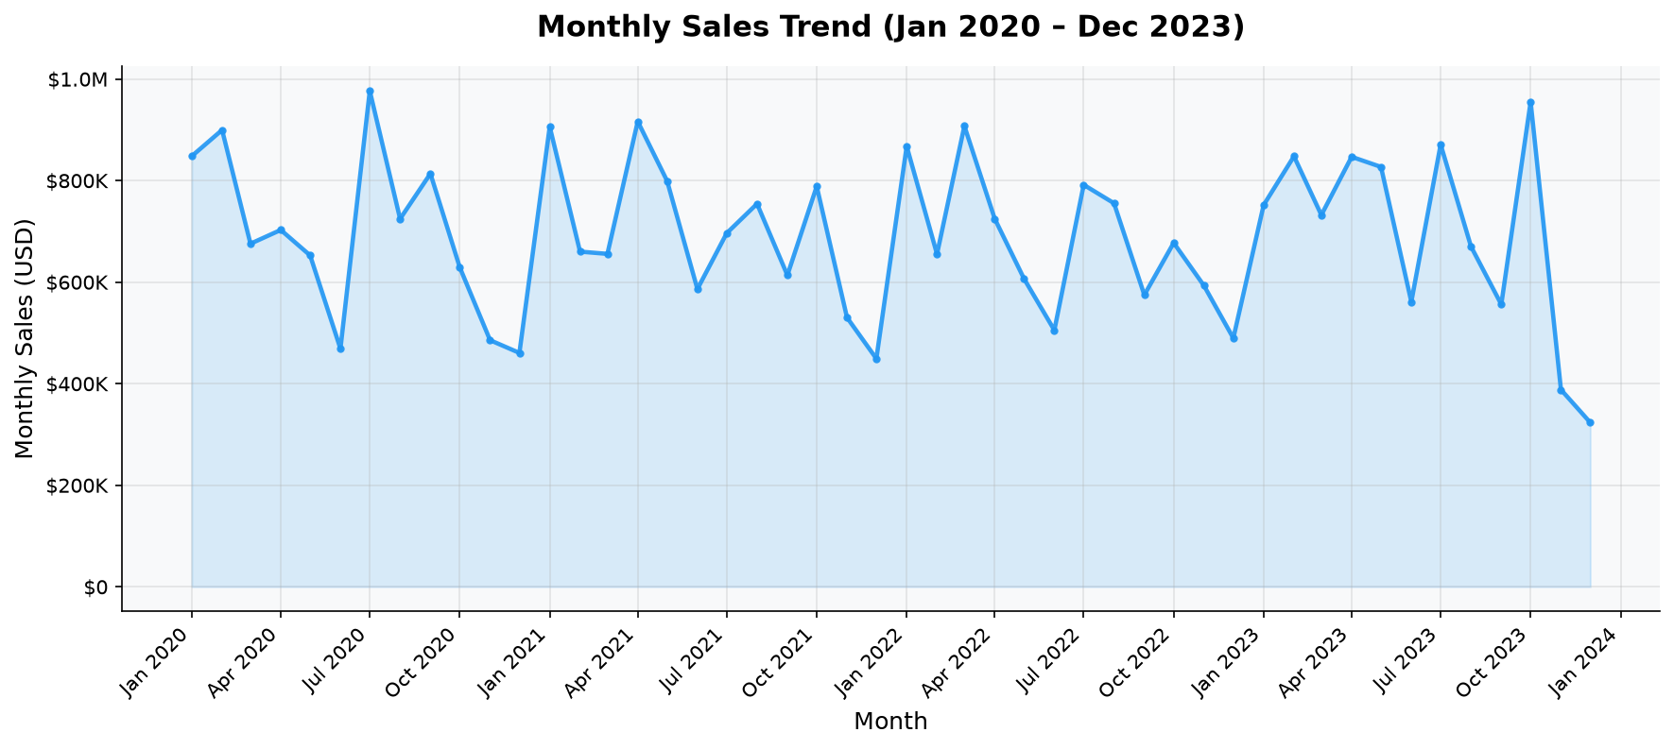
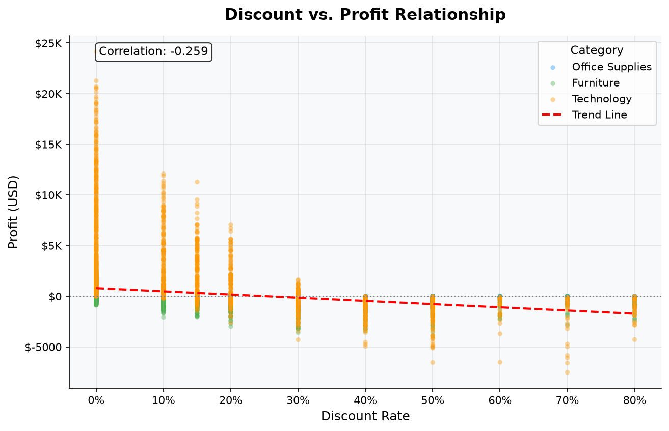
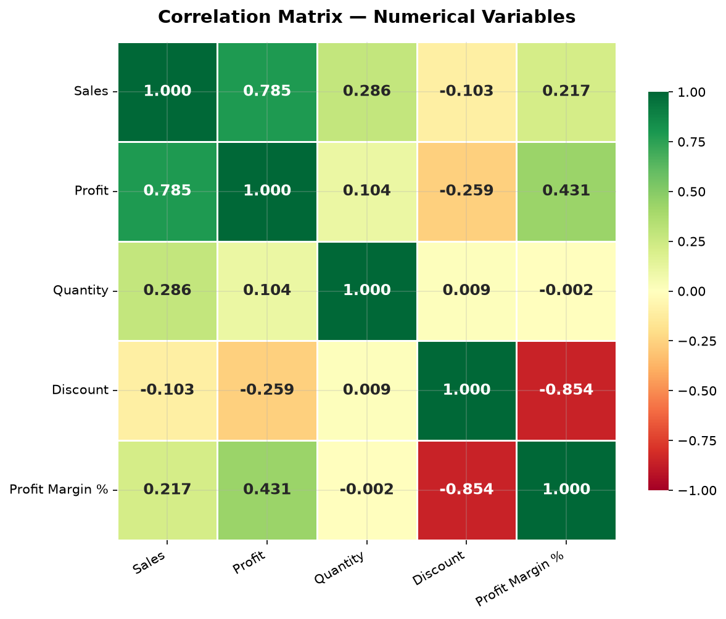
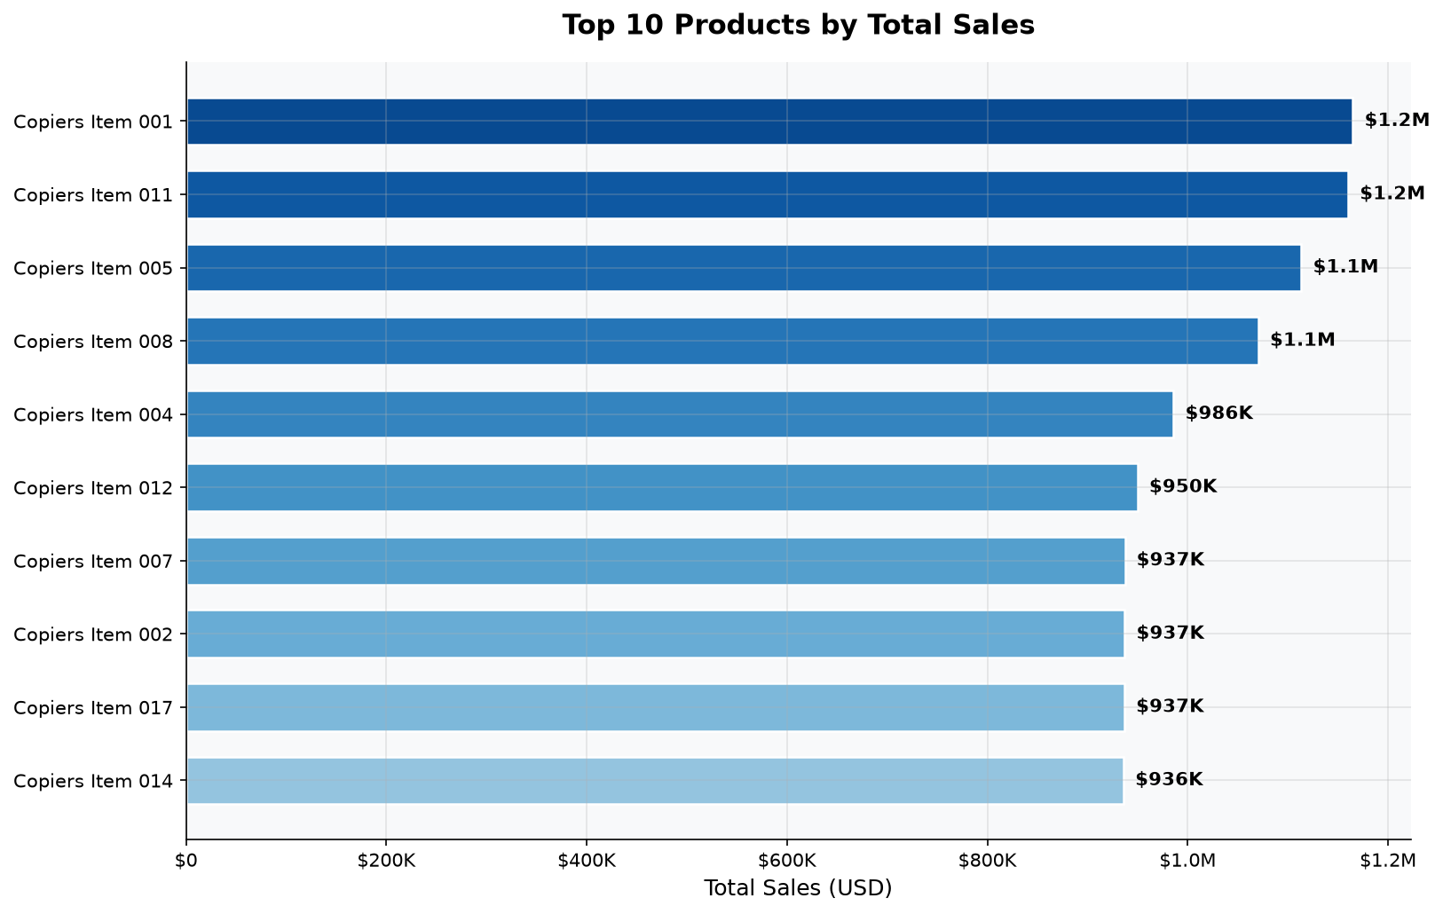
Data Visualizations
10 charts generated from cleaned dataset
E-Commerce Sales Analysis | Week 6 Internship Assignment | Synthetic Data
Slide 6

Slide 7
Power BI Dashboard
E-Commerce Sales & Profitability Analytics
E-Commerce Sales & Profitability Analytics Dashboard
$33.17M
$3.64M
9,070
10.98%
Total Sales
Total Profit
Total Orders
Profit Margin
Monthly Sales Trend (Line Chart) | Sales by Category (Bar) | Profit by Region (Bar) | Segment (Donut) | Top 10 Products
Slicers: [Order Date] [Region ▼] [Category ▼] [Customer Segment ▼]
Note: Power BI Desktop is required to build the .pbix file.
Setup guide: docs/powerbi_setup_guide.md | DAX measures: docs/powerbi_dax_measures.md
E-Commerce Sales Analysis | Week 6 Internship Assignment | Synthetic Data
Slide 7

Slide 8
Key Business Insights
Evidence-based findings from data analysis
1. Discount-Profit Crisis
2. Technology Leads Revenue
3. Tables Sub-Category Loses Money
Discount ↔ Profit Margin correlation = -0.854
Discounts >20% consistently generate losses
Highest transaction count (3,389)
Copiers sub-category: ~38% margin
Structural negative margin
Losses worsen with any discount applied
4. Q4 Seasonal Peak
5. Corporate Segment Underserved
6. West & East Dominate
Nov & Dec are highest revenue months
Jan & Feb are consistently weakest
30% of transactions, but higher order values
Growth potential vs Consumer segment
2,977 and 2,777 transactions respectively
Central & South have room to grow
E-Commerce Sales Analysis | Week 6 Internship Assignment | Synthetic Data
Slide 8

Slide 9
Business Recommendations
Data-driven actions for management
Recommendation 1: Discount Governance Policy
Recommendation 2: Corporate Segment Growth Strategy
Recommendation 3: Fix Tables Sub-Category Pricing
• Cap all discounts at 20% without CFO approval
• Identify top 100 Corporate customers by lifetime value
• Conduct COGS analysis for Tables SKUs
• Eliminate 30-50% discount tiers from standard campaigns
• Assign dedicated account managers to key accounts
• Reprice Tables to achieve minimum 5% gross margin
• Replace heavy discounts with value bundles (buy 3 get 1)
• Offer volume pricing tiers (within margin guardrails)
• Apply no-discount policy to all Tables immediately
• Monitor discount-profit in real time via Power BI dashboard
• Launch 'Corporate Preferred' program with faster shipping
• Consider discontinuing lowest-selling Tables SKUs
Low complexity | High impact
Medium complexity | High impact
Low complexity | Quick win
E-Commerce Sales Analysis | Week 6 Internship Assignment | Synthetic Data
Slide 9

Slide 10
Conclusion
✓ 9,994 records cleaned and analyzed
✓ 10 professional visualizations generated
✓ 10.98% overall profit margin identified
✓ Key insight: Discounts above 20% are loss-making
✓ 3 actionable recommendations provided
✓ Power BI dashboard preparation complete
✓ GitHub documentation ready for submission
Questions & Discussion
Thank you!

