Slide 1

SUBMITTED BY :
LOAN ORIGINATION SYSTEM
TUSHIT JAIN (09496502712)
AKSHAY MITTAL (09996502712)
GUNISH GROVER (09796502712)
AKASH KUMAR (09096502712)

Slide 2
CONTENTS
ABSTRACT
BENEFITS AND ADVANTAGES
INTEGRATION WITH BANKS
SCOPE OF THE PROJECT
MODULES

Slide 3
ABSTRACT
Loan origination is the process by which a borrower applies for a new loan, and a lender processes that application.
Origination generally includes all the steps from taking a loan application up to disbursal of funds (or declining the application).
Loan servicing covers everything after disbursing the funds until the loan is fully paid off.
LOS is a Loan Workflow software designed to assist a bank or financial institution in automating the lending process from origination to pre-disbursement verification and includes sanctioning.

Slide 4
BENEFITS AND ADVANTAGES
The software automatically calculates the EMI to be paid according to the plan chosen by the Borrower.
NOTE: ( The plan provides the minimum amount that can be borrowed as a loan and the duration for which the EMI has to be Paid and it may vary from bank to bank).
The software generates a unique user id based on the details of the borrower.
It uses a Defaulter List provided by various banks to check for any Fraudulence.

Slide 5
BENEFITS AND ADVANTAGES
The defaulter list consist of list of Defaulters with their respective IDS, documents and details to check whether the borrower has already a pending loan in the same or different bank.
It calculates the Fraud percentage based on the defaulters list.
It calculates a score and checks whether a person is eligible for the loan or not.
The information can be viewed in PIE Charts and BAR charts also.

Slide 6
BENEFITS AND ADVANTAGES
It gives the final information about the EMI to be paid and the duration. (EMI is strictly according to the interest percentage a particular Lender charges)

Slide 7
MODULES AND MAIN SCREENS
Splash Screen
The splash screen is the initial screen and makes the other processes ready for the execution and also displays a Progress Bar.

Slide 8
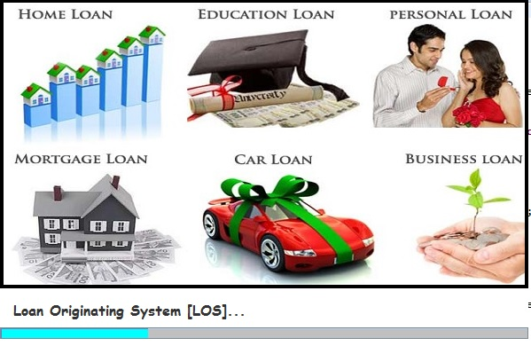
MODULES AND MAIN SCREENS
Splash Screen
The splash screen is the initial screen (frame) and makes the other processes ready for the execution and also displays a Progress Bar.

Slide 9
MODULES AND MAIN SCREENS
Register/login screen
Register screen enables the user to get registered for the same and with the help of password can login into the same so that he/she has access of the ongoing processes.

Slide 10
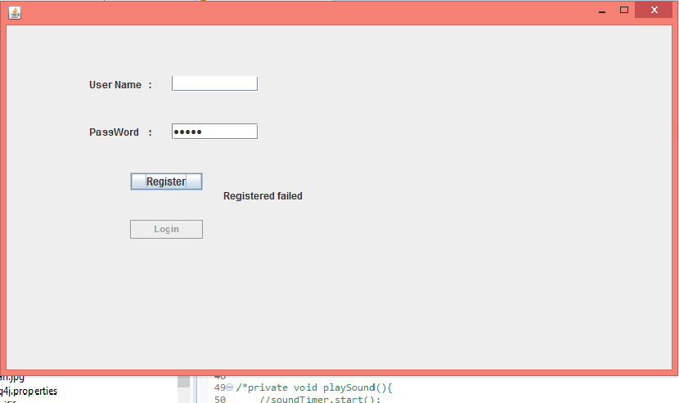
MODULES AND MAIN SCREENS
Register/login screen
Register screen enables the user to get registered for the same and with the help of password can login into the same so that he/she has access of the ongoing processes.

Slide 11
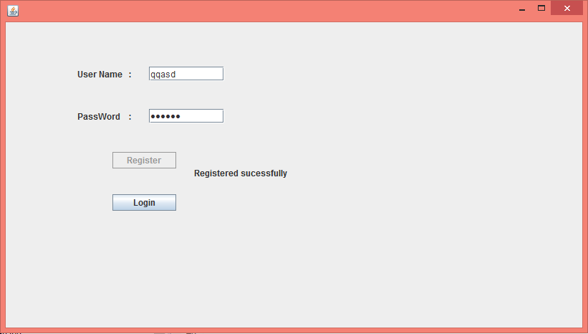
MODULES AND MAIN SCREENS
Register/login screen
Register screen enables the user to get registered for the same and with the help of password can login into the same so that he/she has access of the ongoing processes.

Slide 12
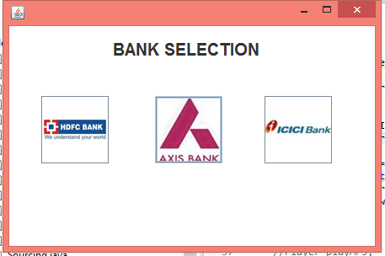
MODULES AND MAIN SCREENS
Bank Selection

Slide 13
MODULES AND MAIN SCREENS
Sourcing Screen
Sourcing screen helps to take the initial levels details and try to figure out the credentials of the applicant is eligible for the same or not.
It also generates a unique id based on the information provided.

Slide 14
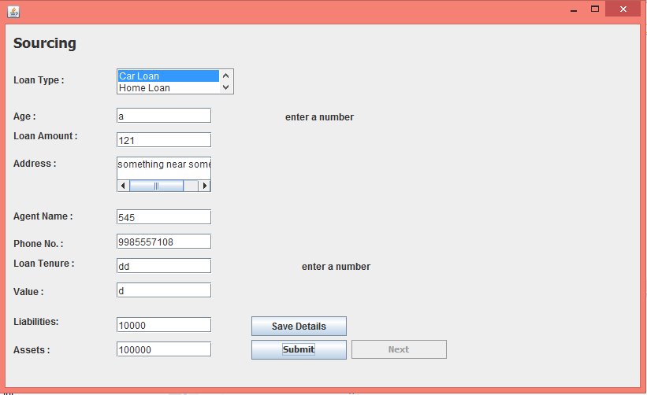
MODULES AND MAIN SCREENS
Sourcing Screen
Sourcing screen helps to take the initial levels details and try to figure out the credentials of the applicant is eligible for the same or not.
It also generates a unique id based on the information provided.

Slide 15
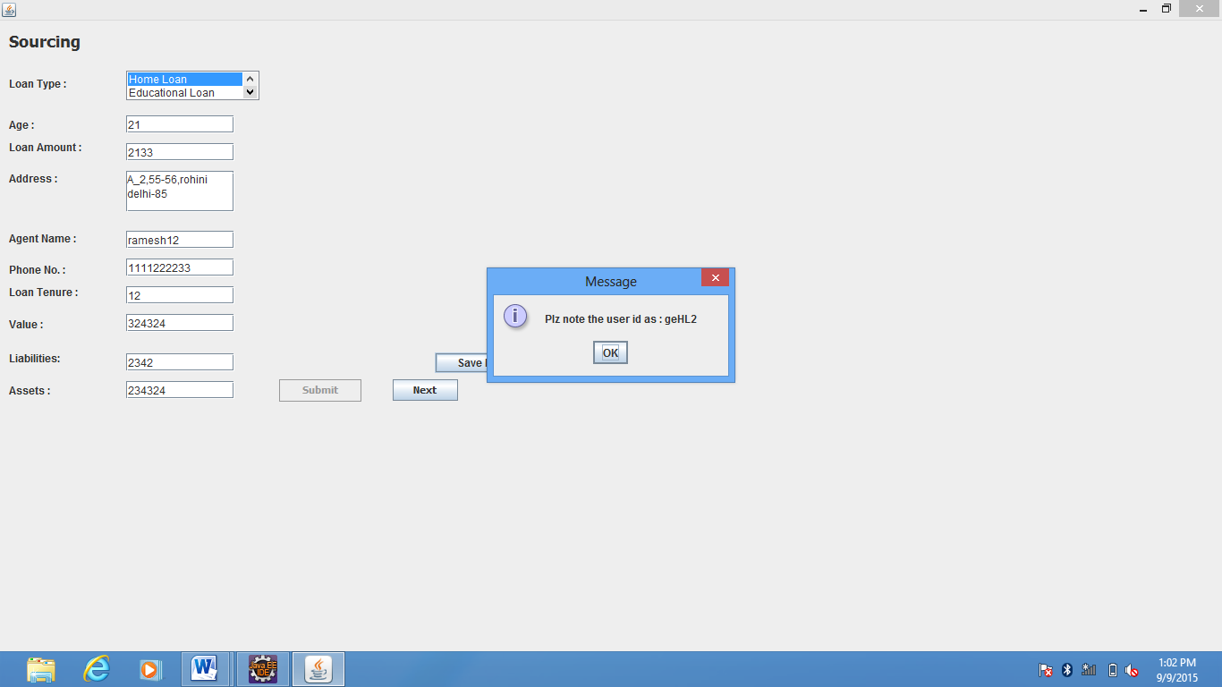
MODULES AND MAIN SCREENS
Sourcing Screen
Sourcing screen helps to take the initial levels details and try to figure out the credentials of the applicant is eligible for the same or not.
It also generates a unique id based on the information provided.

Slide 16
MODULES AND MAIN SCREENS
Qde Screen
Qde screen is for the more personal details including general, personal and casual information so that the actual EMI plan generation is generated and the proper division is carried out accordingly.

Slide 17
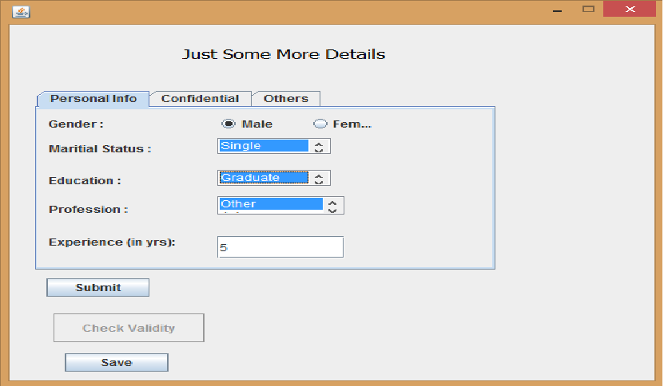
MODULES AND MAIN SCREENS
Qde Screen
Qde screen is for the more personal details including general, personal and casual information so that the actual EMI plan generation is generated and the proper division is carried out accordingly.

Slide 18
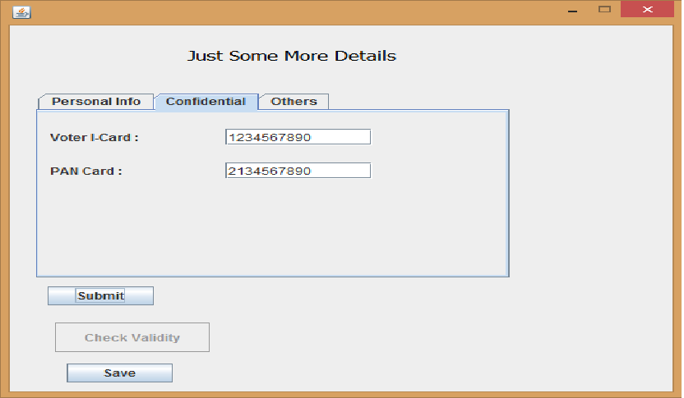
MODULES AND MAIN SCREENS
Qde Screen
Qde screen is for the more personal details including general, personal and casual information so that the actual EMI plan generation is generated and the proper division is carried out accordingly.

Slide 19
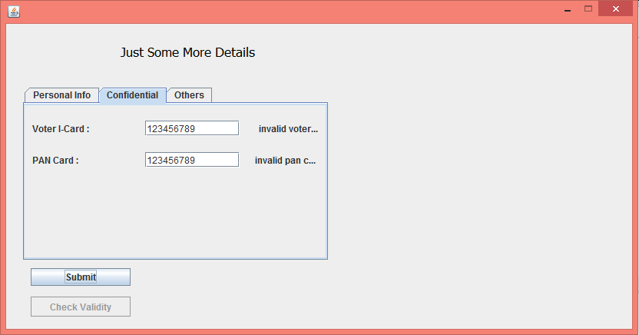
MODULES AND MAIN SCREENS
Qde Screen
Qde screen is for the more personal details including general, personal and casual information so that the actual EMI plan generation is generated and the proper division is carried out accordingly.

Slide 20
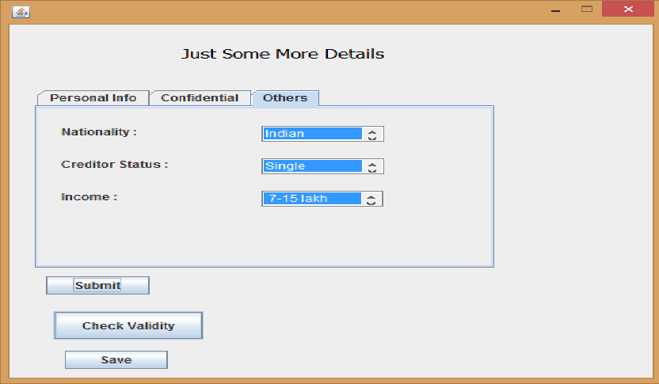
MODULES AND MAIN SCREENS
Qde Screen
Qde screen is for the more personal details including general, personal and casual information so that the actual EMI plan generation is generated and the proper division is carried out accordingly.

Slide 21
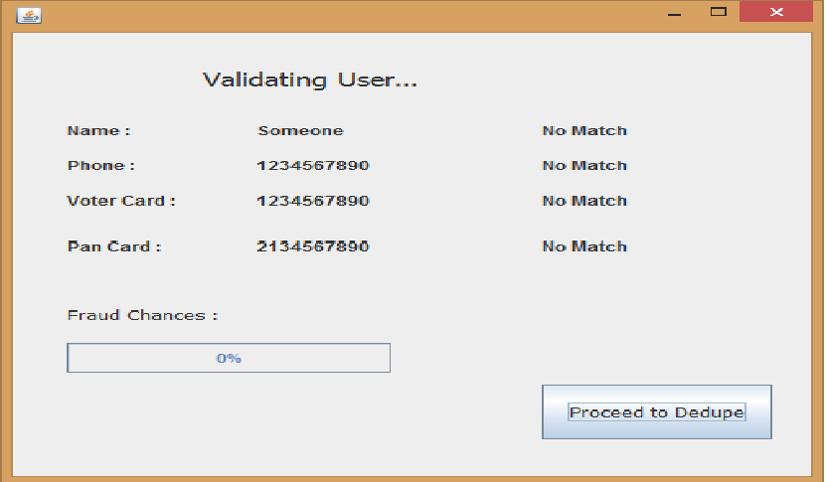
MODULES AND MAIN SCREENS
Defaulter Screen
After processing through the QDE procedure, the applicant is checked upon his/her credentials that he/she is defaulter or not.
The defaulter percentage is displayed accordingly in the progress bar and the further processing is carried upon only when the applicant can be considered to be fair or not.

Slide 22
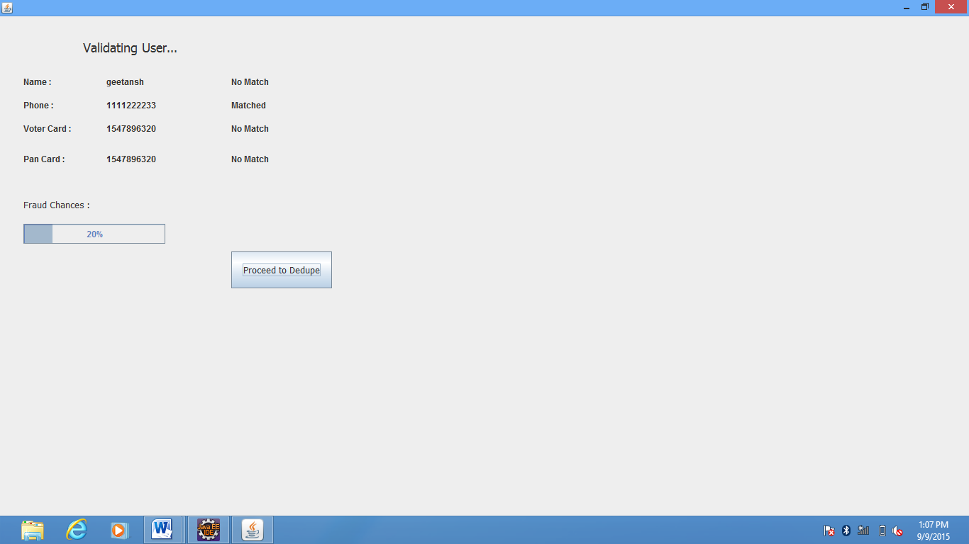
MODULES AND MAIN SCREENS
Defaulter Screen
After processing through the QDE procedure, the applicant is checked upon his/her credentials that he/she is defaulter or not.
The defaulter percentage is displayed accordingly in the progress bar and the further processing is carried upon only when the applicant can be considered to be fair or not.

Slide 23
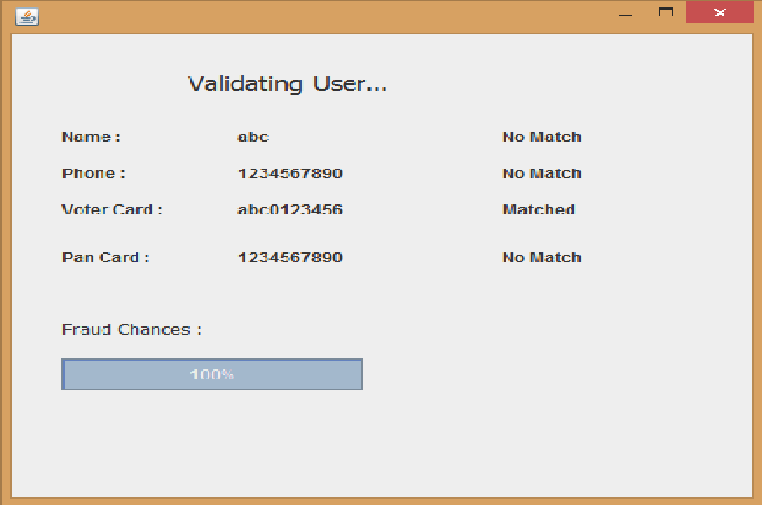
MODULES AND MAIN SCREENS
Defaulter Screen
After processing through the QDE procedure, the applicant is checked upon his/her credentials that he/she is defaulter or not.
The defaulter percentage is displayed accordingly in the progress bar and the further processing is carried upon only when the applicant can be considered to be fair or not.

Slide 24
MODULES AND MAIN SCREENS
Dedupe Screen
Based on the credentials the applicant gets the score which is known as the dedupe score and forms the basis of its application status.

Slide 25
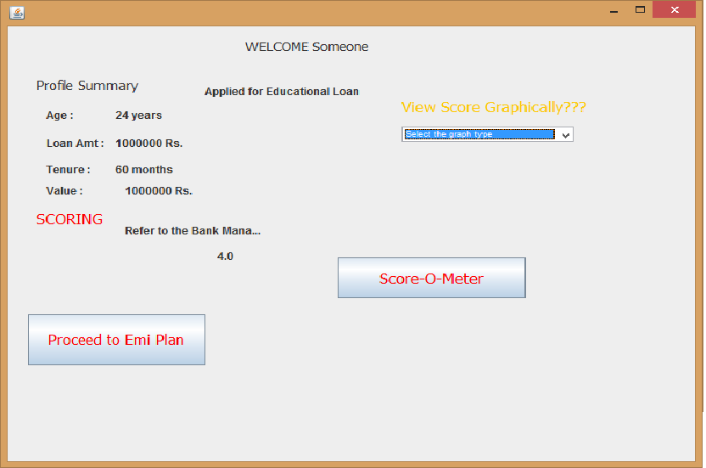
MODULES AND MAIN SCREENS
Dedupe Screen
Based on the credentials the applicant gets the score which is known as the dedupe score and forms the basis of its application status.

Slide 26
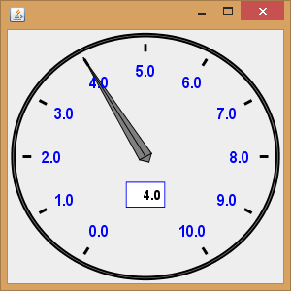
MODULES AND MAIN SCREENS
Dedupe Screen
Based on the credentials the applicant gets the score which is known as the dedupe score and forms the basis of its application status.

Slide 27
MODULES AND MAIN SCREENS
Dedupe Screen
Based on the credentials the applicant gets the score which is known as the dedupe score and forms the basis of its application status.
The applicant can also view the bifurcation of the score (dedupe score) which he/she receives on calculation on the PIE-Chart and thus be able to differently able to see his/her areas of score and where not.

Slide 28
MODULES AND MAIN SCREENS
Dedupe Screen
Based on the credentials the applicant gets the score which is known as the dedupe score and forms the basis of its application status.
The applicant can also view the bifurcation of the score (dedupe score) which he/she receives on calculation on the PIE-Chart and thus be able to differently able to see his/her areas of score and where not.

Slide 29
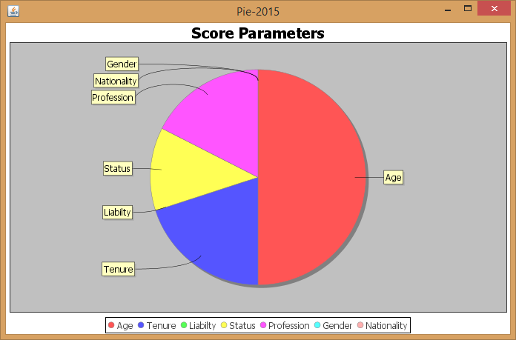
MODULES AND MAIN SCREENS
Dedupe Screen
Based on the credentials the applicant gets the score which is known as the dedupe score and forms the basis of its application status.
The applicant can also view the bifurcation of the score (dedupe score) which he/she receives on calculation on the PIE-Chart and thus be able to differently able to see his/her areas of score and where not.

Slide 30
MODULES AND MAIN SCREENS
EMI Screen
The EMI screen displays the applicant’s credentials and his/her monthly installment plan and to the duration he/she has to pay the amount along with the interest based on his/her credentials.

Slide 31
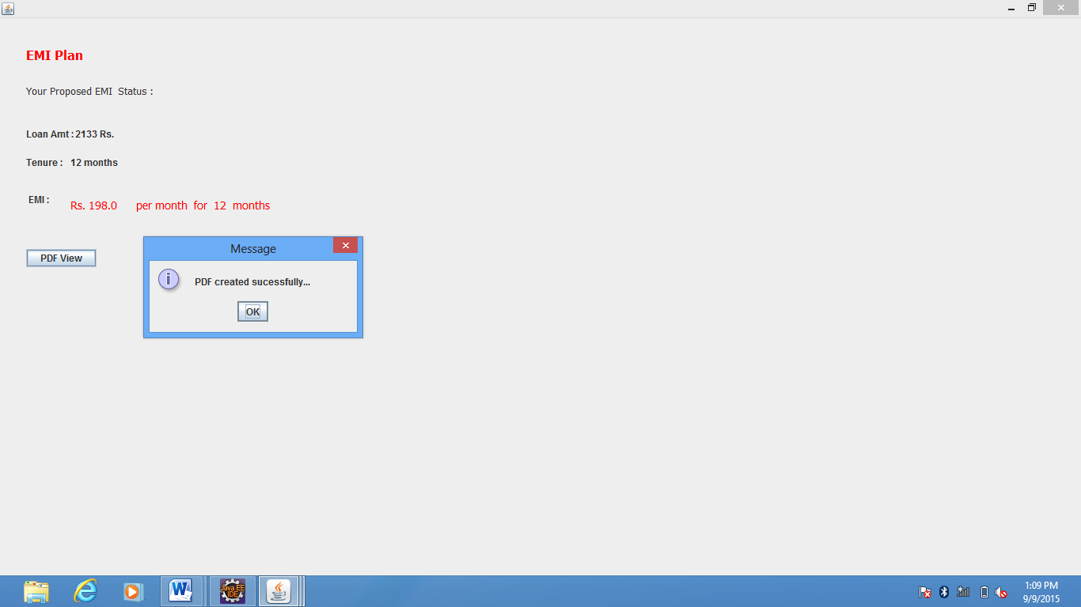
MODULES AND MAIN SCREENS
EMI Screen
The EMI screen displays the applicant’s credentials and his/her monthly installment plan and to the duration he/she has to pay the amount along with the interest based on his/her credentials.

Slide 32
MODULES AND MAIN SCREENS
PDF Generation
A pdf will be generated after the completion of the emi procedure containing the details of the amount and emi to be paid.
The pdf can be used by the customer to check his balance and due amount to be paid by the due date.
Further advancements can be made in this pdf generation to alarm the user of his due dates by reading the pdf and setting alarms accordingly.

Slide 33
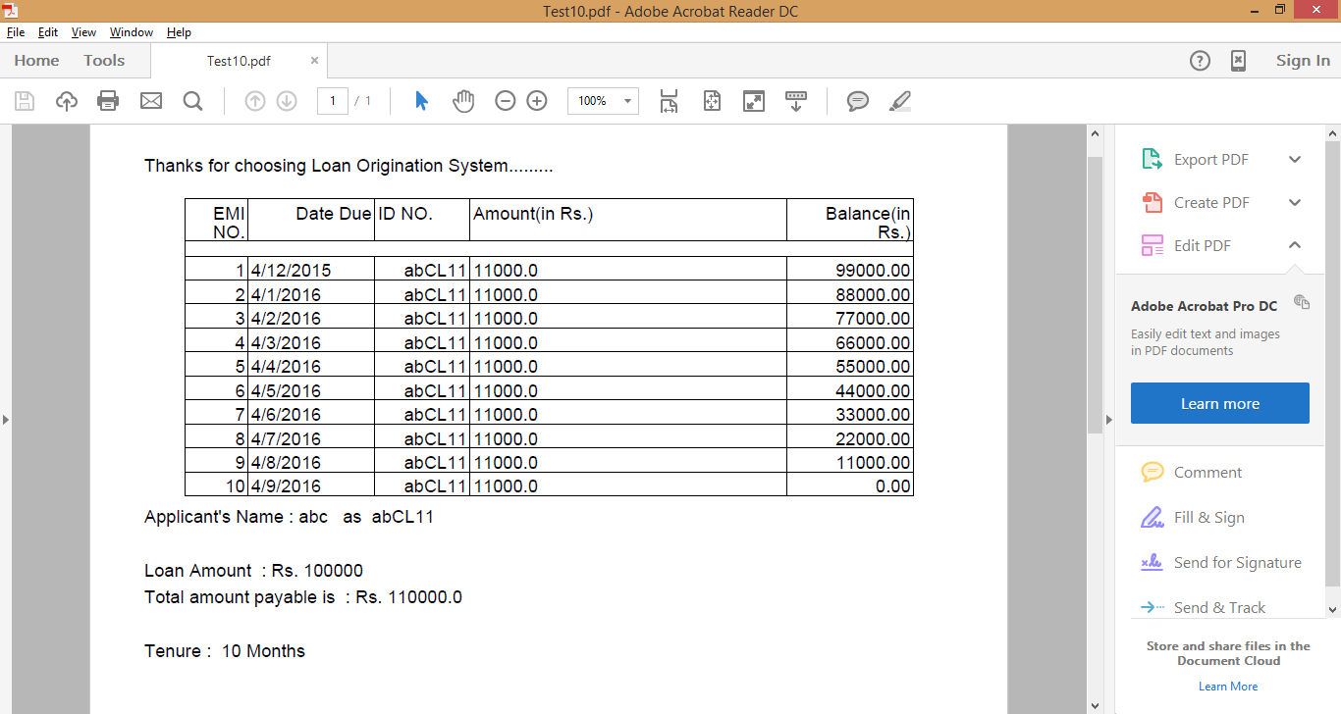
MODULES AND MAIN SCREENS
PDF Generation
A pdf will be generated after the completion of the emi procedure containing the details of the amount and emi to be paid.
The pdf can be used by the customer to check his balance and due amount to be paid by the due date.
Further advancements can be made in this pdf generation to alarm the user of his due dates by reading the pdf and setting alarms accordingly.

Slide 34
SCOPE OF THE POJECT
During further development of the application, some more banks can be included and their way of giving loan can be implemented.
With further integrations we can send the scores and graphs directly to the banks accounting for loan borrower’s candidature.
Project can be molded into an application which can be remotely used by the user and the banker to check the candidature of the borrower.

Slide 35
SCOPE OF THE POJECT
We can save the progress of the customer on the files and using the user id we can resume from the place last left over.
File handling use and online databases can be integrated and an online system can be generated

Slide 36
THANK YOU!!!

