Slide 1
Collections

Slide 2
Collections
Classification of different collections by following characteristics:
Element access
Performance profile
Add, Remove, Search
Grow and shrink dynamically

Slide 3
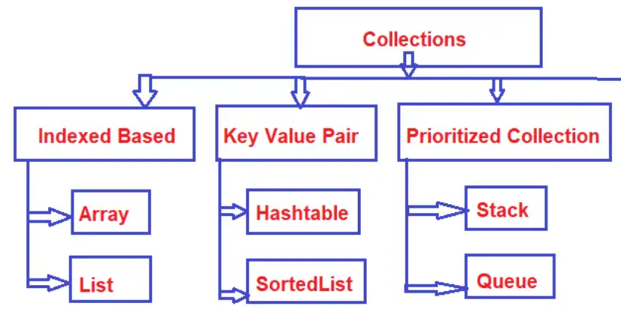
Collections

Slide 4
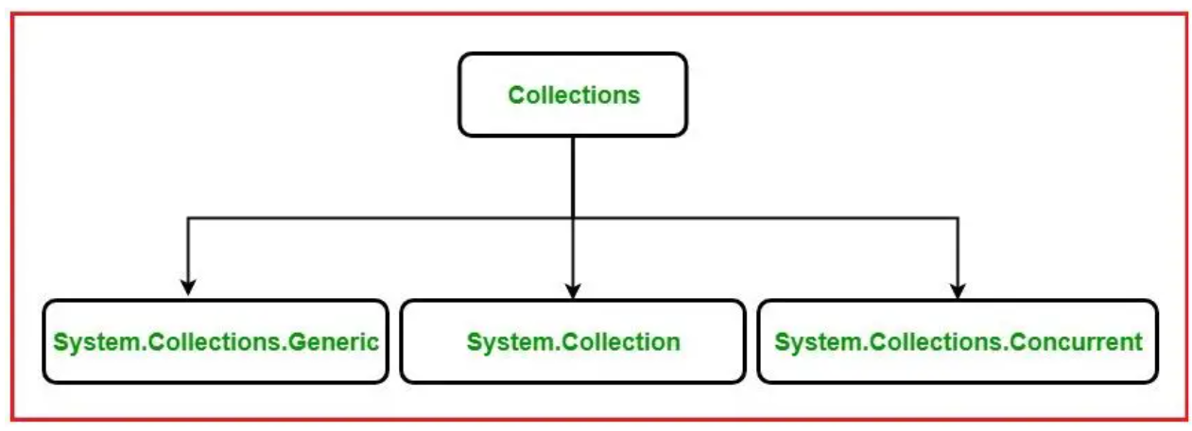
Collections

Slide 5
Collections
Non-Generic collections
ArrayList
Hashtable
SortedList
Stack
Queue

Slide 6

Collections
Queue Vs. Stack

Slide 7
Collections
Generic collections
List<T>
Dictionary<TKey, TValue>
SortedList <TKey, TValue>
Stack<T>
Queue<T>

Slide 8
Collection
Provides thread-safe implementations of collections
ConcurrentStack<T>
ConcurrentQueue<T>
ConcurrentDictionary<TKey, TValue>

Slide 9
Generics

Slide 10
Generics
Generics allow you to define a class with placeholders for the type of its fields, methods, parameters, etc.
Generics replace these placeholders with some specific type at compile time.
A generic class can be defined using angular brackets <>.

Slide 11
Generics
Advantages of Generics
Increases the reusability of the code.
Generics are type safe. You get compile time errors if you try to use a different type of data than the one specified in the definition.
Generics has a performance advantage because it removes the possibilities of boxing and unboxing.

Slide 12
Generics
Generics can be implemented with,
Generic classes
Generic methods
Generic Interfaces
Constraints on Generics
Where T : Class
Where T : Struct

Slide 13
Extension Method

Slide 14
Extension method
It allows you to add new methods in the existing class or in the structure without modifying the source code of the original type
No need to re-compile the original type.

Slide 15
Extension method
Advantages of Extension method
The main advantage of the extension method is to add new methods in the existing class without using inheritance.
You can add new methods in the existing class without modifying the source code of the existing class.
It can also work with sealed class.

Slide 16
Reflection

Slide 17
Reflection
Reflection is the ability of inspecting an assembly's metadata at runtime.
It is used to find all types in an assembly and/or dynamically involve methods in an assembly
Late binding can be achieved using reflection.
Reflection can be used to create an instance of a type. About which we don’t have any information at compile time.
System.Reflection enables you to obtain data about the loaded assemblies, the elements within them like classes, methods and value types.

Slide 18
Reflection
Class | Description
Assembly | Describes an assembly which is a reusable, versionable, and self-describing building block of a common language runtime application
AssemblyName | Identifies an assembly with a unique name
ConstructorInfo | Describes a class constructor and gives access to the metadata
MethodInfo | Describes the class method and gives access to its metadata
ParameterInfo | Describes the parameters of a method and gives access to its metadata
PropertyInfo | Discovers the attributes of a property and provides access to property metadata

Slide 19
Delegates

Slide 20
Delegates
It’s a type safe function pointer
A delegate holds the reference of a method and then calls the method for execution
Method calling in C#,
Non static method: by using instance of a class
Static method: by using name of a class
By using a delegate

Slide 21
Delegates
How to write a delegate,
Method name and delegate name will not be same
Return type of a delegate must be same as method’s return type
Parameters of a delegate must be same as parameters of a method
Define a delegate
Should be under namespace, but can be declared inside a class as well
[<modifiers>] delegate ReturnType | Void <Name>([<parameter list>])
Instantiate a delegate
Delegate holds the reference of a method
Call a delegate
Calling a delegate by passing the required parameter values. So, internally the method which bound to the delegates gets executed

Slide 22
Delegates
Multicast delegates
Delegate will hold the reference of the more than one methods
Best case use of multicast delegates,
With void return type

Slide 23
Delegates
Generic delegates
If we have five methods, we can create five delegates. But when we work on large projects, we may have to create fifty or five hundred delegates. If we want to encapsulate them by using delegates, then we must create fifty or five hundred delegates. That will really increase the size of our code and make our application slow.
This ca be addressed with generic delegates

Slide 24
Anonymous Methods
The anonymous methods are defined using the delegate keyword
An anonymous method must be assigned to a delegate type.
This method can access outer variables or functions except for the outer function ref and out parameter.
An anonymous method can be passed as a parameter.

Slide 25
Lambda Expressions
The Lambda Expression in C# is the shorthand for writing the Anonymous Function.
So, we can say that the Lambda Expression is nothing but to simplify the anonymous function in C# and,
we also discussed that Anonymous Functions are related to delegate and they are created by using the delegate keyword

Slide 26
Delegates
Generic Delegates
Func
Action
Predicate

