Slide 1
Android UI design patterns
A UI design pattern describes a general solution to a recurring question.
Mature UI patterns have flexible layouts towards different devices. They are self-adaptive to multi-screen.
Here we introduce some useful patterns.
  Action Bar
  Workspace
  Dashboard
  Slide navigation

Slide 2
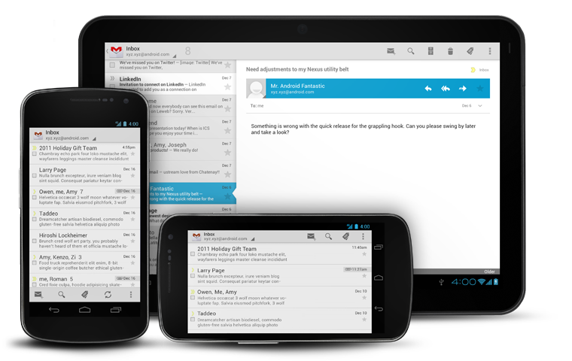
Action Bar
Replace the old TitleBar.
Many functions:
  Menu
  Search
  Navigation
    Tab
    Spinner
    Up
  Action Mode
  Split Action Bar

Slide 3
Action Bar
Replace the old TitleBar.
Many functions:
  Menu
  Search
  Navigation
    Tab
    Spinner
    Up
  Action Mode
  Split Action Bar

Slide 4
Action Bar
Replace the old TitleBar.
Many functions:
  Menu
  Search
  Navigation
    Tab
    Spinner
    Up
  Action Mode
  Split Action Bar

Slide 5
Action Bar
Replace the old TitleBar.
Many functions:
  Menu
  Search
  Navigation
    Tab
    Spinner
    Up
  Action Mode
  Split Action Bar

Slide 6

Workspace
A scrollable TabView.
Could combine with ActionBar.

Slide 7
Workspace
A scrollable TabView.
Could combine with ActionBar.

Slide 8
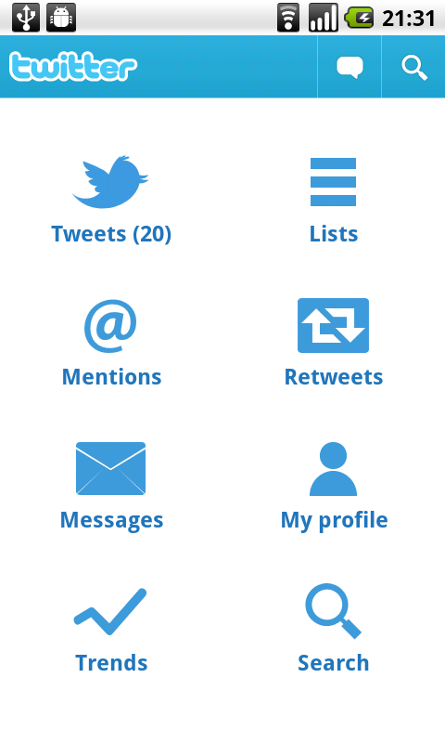
Dashboard
Acted as the landing page and holds all main functions.

Slide 9
Dashboard
Acted as the landing page and holds all main functions.

Slide 10
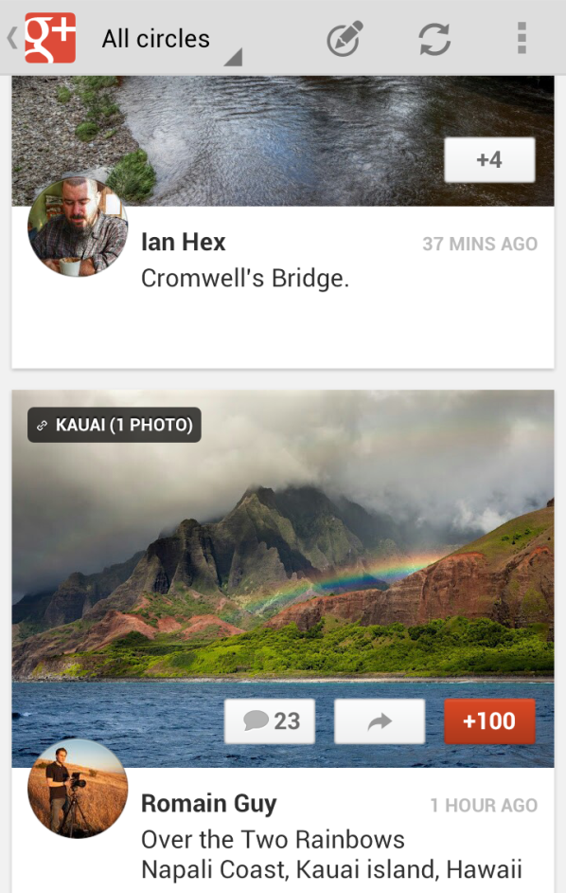
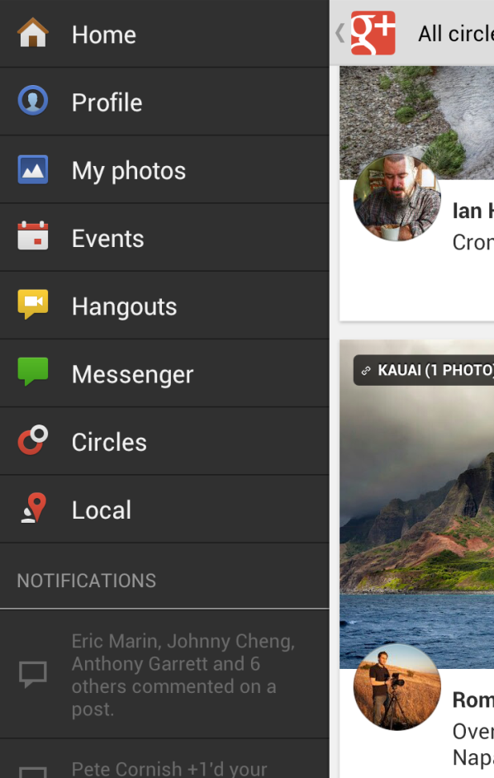
Slide navigation
Could replace the Dashboard.
Make the navigation easier.
Appearance is better in tablets.

Slide 11
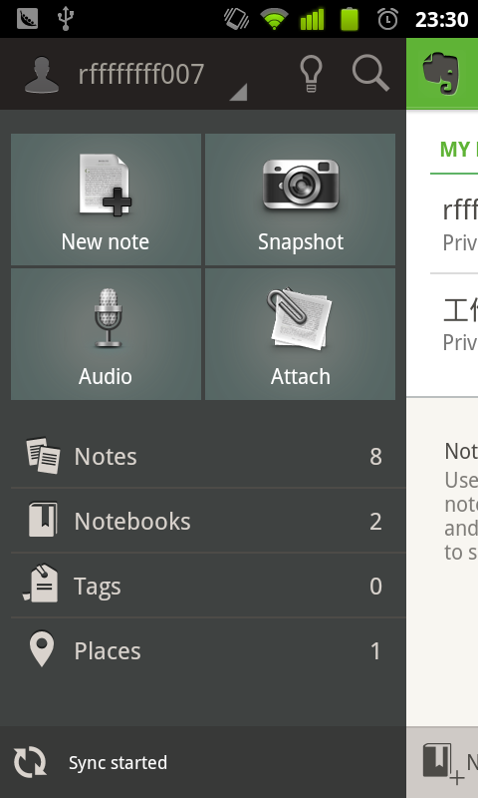
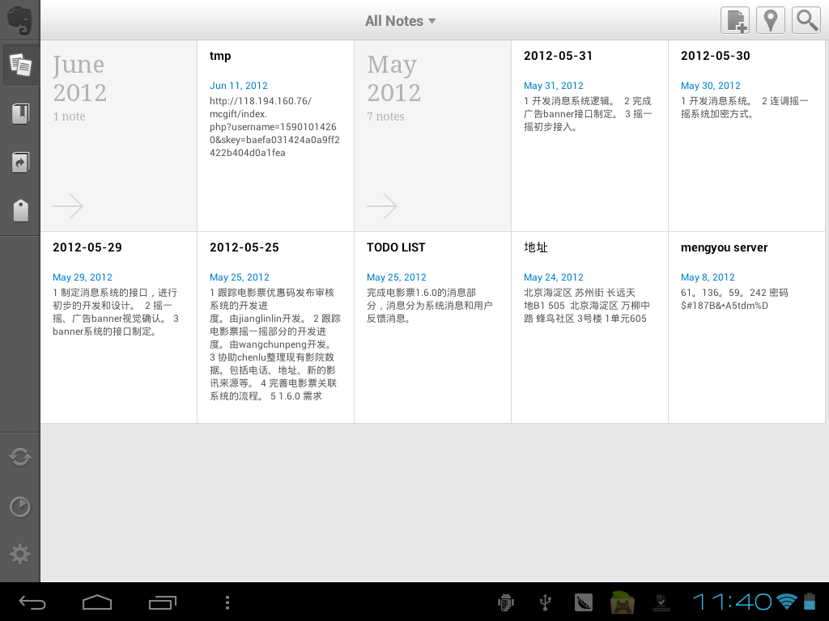
Slide navigation

Slide 12
Conclusion
Density independence in android could handles most of work to adapt apps to each devices.
What you should do is supporting flexible, dynamic layouts.(think like a web designer)
Remember developing one app for all devices.
Follow platform guideline and use more UI design patterns.

