Slide 1
App demos
IOSched2011
IOSched2012
Google Play

Slide 2
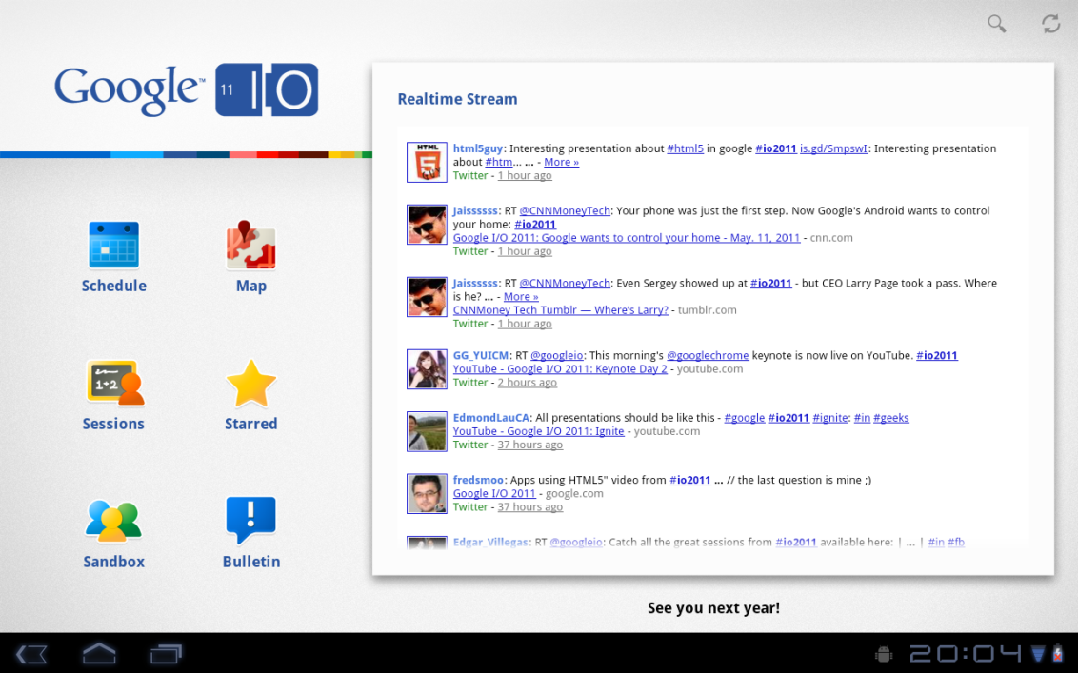
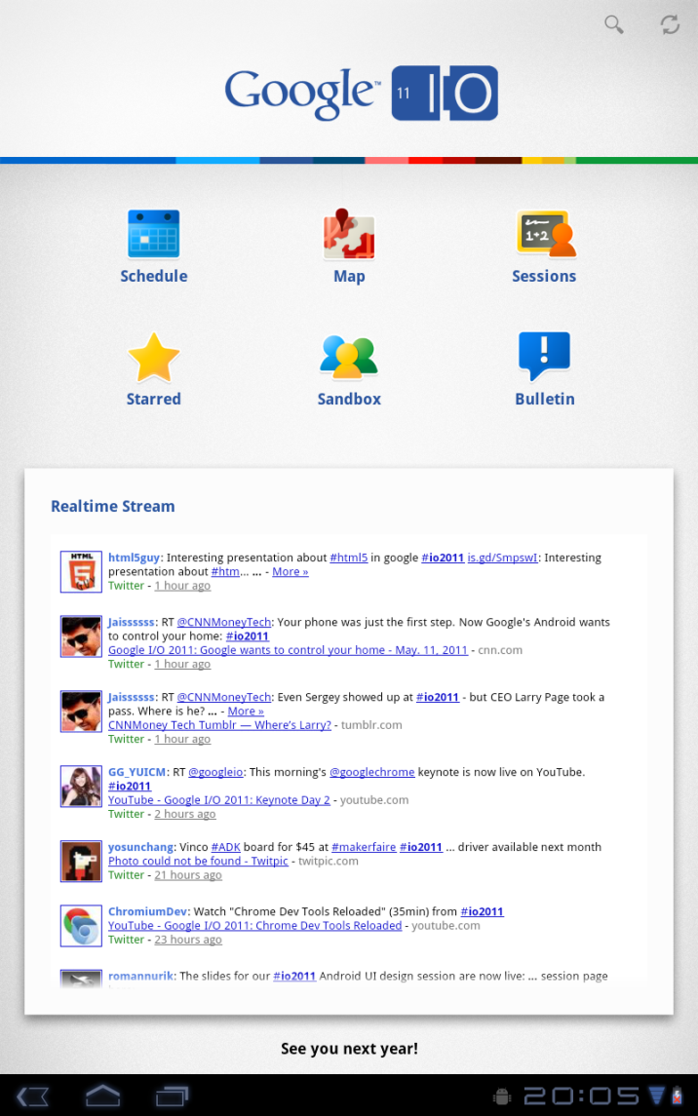
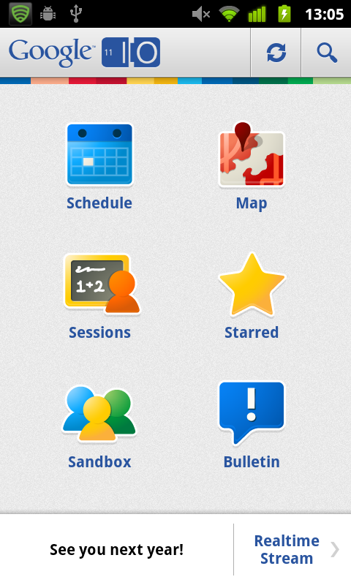
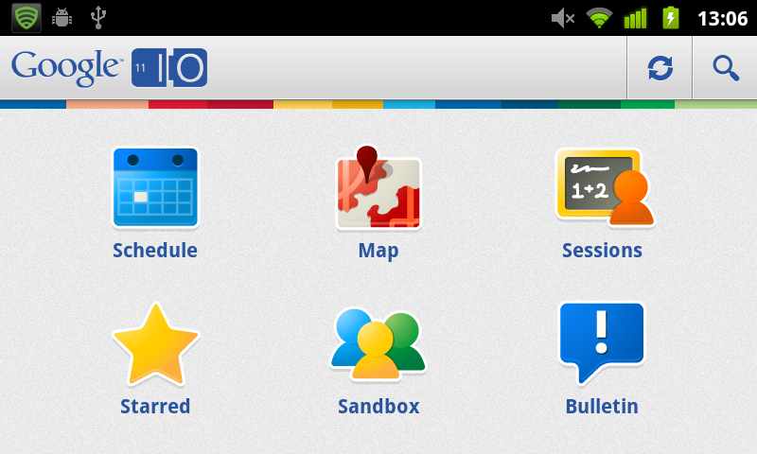
IOSched2011
3 fragments
4 layouts

Slide 3
IOSched2011
3 fragments
4 layouts

Slide 4
IOSched2011
3 fragments
4 layouts

Slide 5
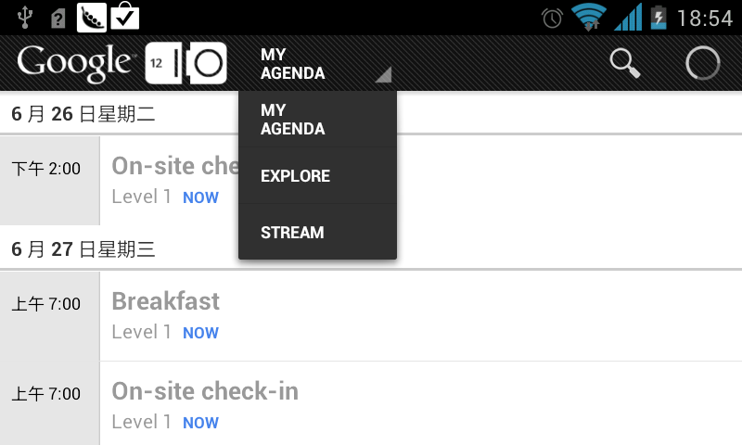
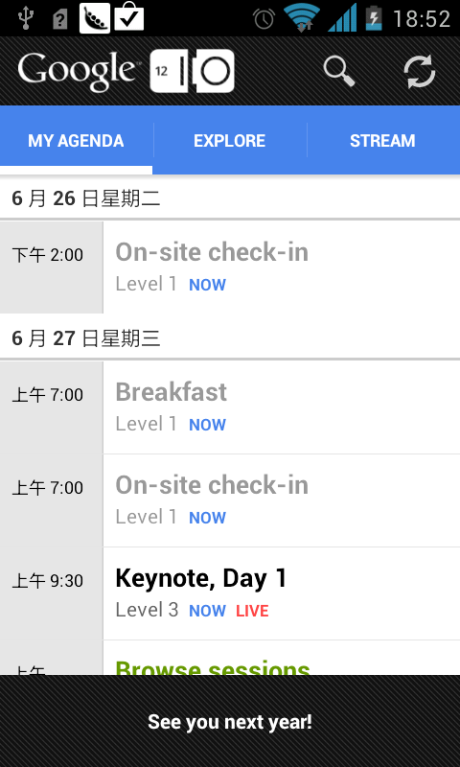
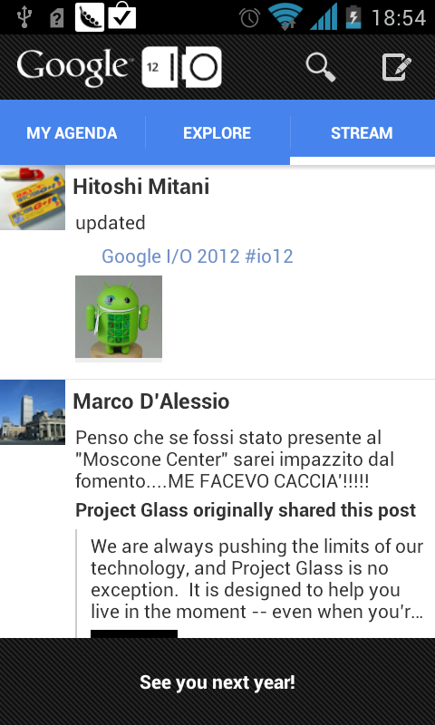
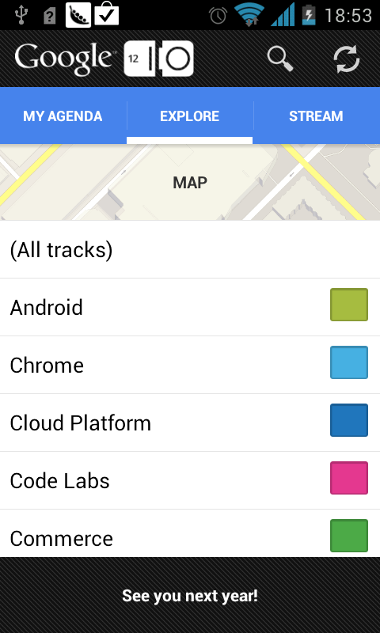
IOSched2012
4 fragments
4 layouts

Slide 6
IOSched2012
4 fragments
4 layouts

Slide 7
IOSched2012
4 fragments
4 layouts

Slide 8
IOSched2012
4 fragments
4 layouts

Slide 9
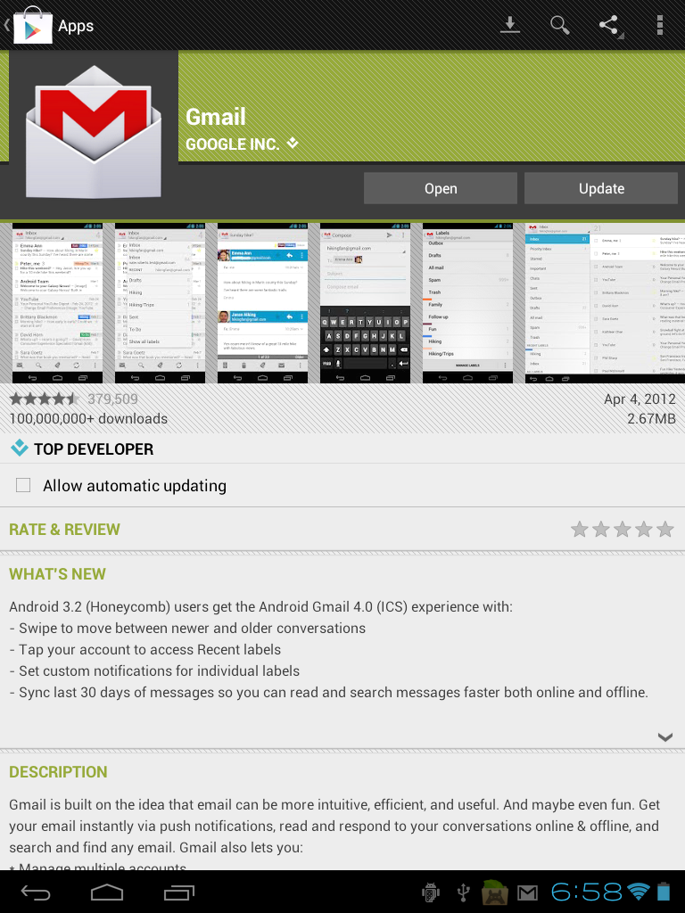
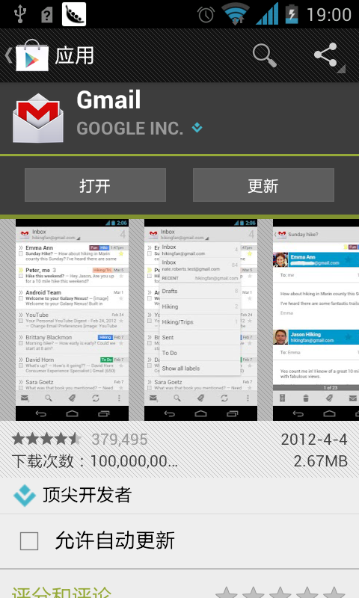
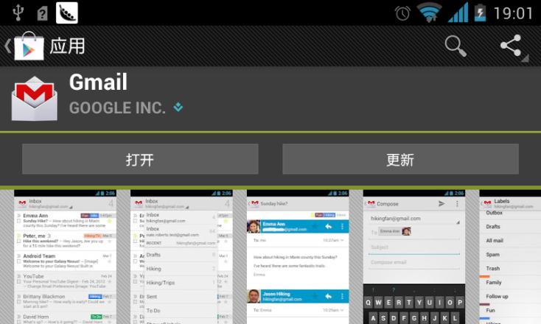
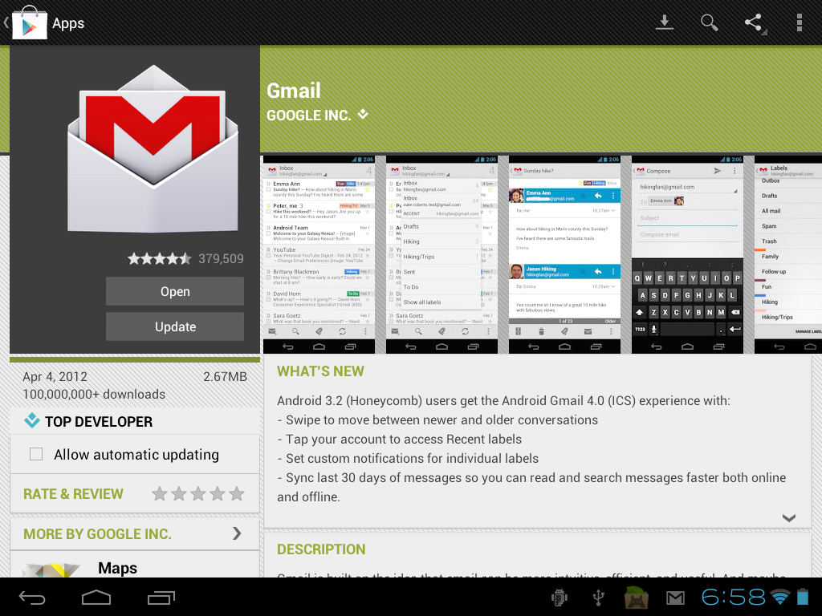
Google Play
Version: 3.4.4
4 layouts
generic_details.xml

Slide 10
Google Play
Version: 3.4.4
4 layouts
generic_details.xml

Slide 11
Google Play
Version: 3.4.4
4 layouts
generic_details.xml

