Slide 1
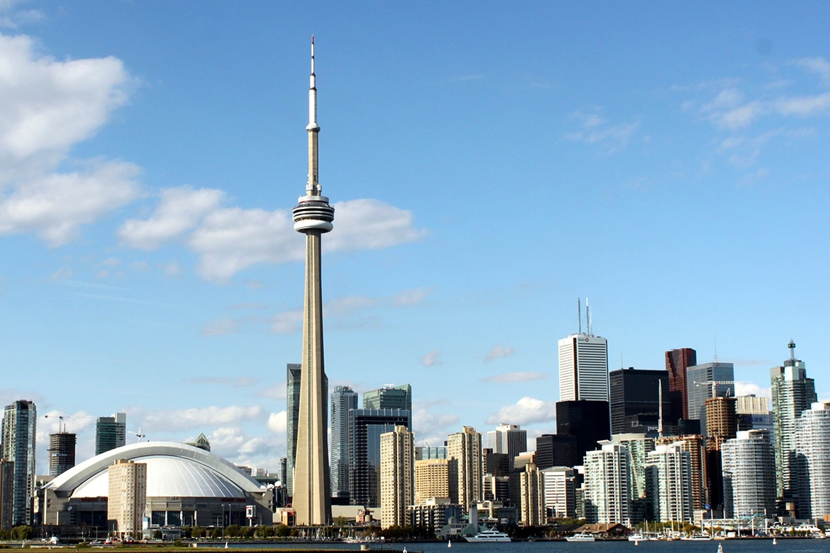
Project Report
TORONTO
ENTREPRENEURIAL FOR INDIAN BUSINESSMEN

Slide 2
.
CONTENT
INTRODUCTION - WE INTRODUCE THE PROBLEM
DATA - WHERE WE GET THE DATA
DATA ANALYSIS - IDENTIFY SIGNIFICANT STATS INDICATORS
METHODOLOGY - ROAD MAP TO SOLVING THE PROBLEM
MACHINE LEARNING - WHAT ML ALGORITHMS WE USE
DATA RESULTS - SHARE DATA FINDINGS
DISCUSSION - SHARE INVESTIGATING FINDINGS
CONCLUSION - FINAL THOUGHTS

Slide 3
INTRODUCTION
The city of Toronto has approached our company to help them develop a service that helps the Indian entrepreneurs who want to establish new businesses in the city of Toronto select an ideal business location based on the Indian ethnic communities they want to be a part of.
This service will help find an ideal location for a new business based on such factors as business venue, population density in the area, the demographics inthe area, average income, proximity to other business venues.

Slide 4
PROBLEM STATEMENT
The success and failure of any Business depends on a vast spectrum of
economics and demographics factors. Entrepreneurs may want to find an
optimal venue and geographic location for their new business venture so
that they get maximum profit from it.
As we know that there is vast population of Indian community residing in City
of Toronto.So if an Indian businessman wants to start a business considering
the indian population than he must take into consideration the trends and
patterns of it.
The multicultural city of Toronto wants to offer such an online
service where the Indian entrepreneurs can receive all the necessary
information that will help them in picking the location for their new ventures
based on their desire to support the Indian ethnic community of Toronto.

Slide 5
AUDIENCE
The target audience for this service :
Indian Business Entrepreneurs seeking to establish new businesses in the
city of Toronto Having a tool that can help the entrepreneurs to choose the
right location for their business will assure long and prosperous existence
for such businesses, serving the communities and helping them grow.

Slide 6
PROPOSED SOLUTION
The solution will leverage the Foursquare location data as well as the
demographics open dataset available from Wikipedia. In order to advise the
entrepreneurs on a good location, we will consider the density (frequency) of
similar business venues in various parts of Toronto that cater to preferredethnic area/neighbourhoods, average income, population,
population density, population growth rate, spoken languages in the same
area.

Slide 7
DATA SOURCES
To solve the problem our service will rely on open datasets generated from the
following sources:
•Wikipedia -- Toronto
Boroughs/Neighbourhoods https://en.wikipedia.org/wiki/List_of_postal_codes_of_Canada:_M – Canada
• Census - Toronto
Demographics https://en.wikipedia.org/wiki/Demographics_of_Toronto_nei
Ghbourhoods
•GeoCoder/Google Geolocation APIs
•Foursquare APIs

Slide 8
.
Toronto Boroughs/Neighbourhoods: a list of postal codes in Canada where
the first letter is M. Postal codes beginning with M are located within the city of
Toronto in the province of Ontario
Canada Census - Toronto Demographics: a list of demographic data on
each Toronto neighbourhood as taken from the Canadian Census.
GeoCoder/Google Geolocation APIs: converts addresses into geographic
coordinates
Foursquare APIs: offers rich location-based experiences and enables access
to millions of up to date business venues, tips, photos and many other helpful
tips

Slide 9
METHODOLOGY
In order to perform statistical inference, and apply the machine learning
algorithms, the data must be acquired and pre-processed based on the rules
derived from the preliminary data analysis
DATA ANALYSIS - Identify the significant informational indicators to use in
inferential statistics and machine learning algorithm [Unsupervised: K-Means]DATA ANALYSIS - Statistical Validation: The datasets underwent statistical
analysis and cross referencing in order to determine the data validity and
proper distribution, mean and standard deviations, outlier identification.
MACHINE LEARNING - UNSUPERVISED MACHINE LEARNING K-MEANS: In order
to cluster various regions of the city based on the business analysis
requirements the solution utilizes the unsupervised machine learning
algorithm K-MEANS
DATA RESULTS - Present the finding to the stakeholders
DISCUSSION - discuss data investigative findings based on the results
CONCLUSION - report conclusions

Slide 10
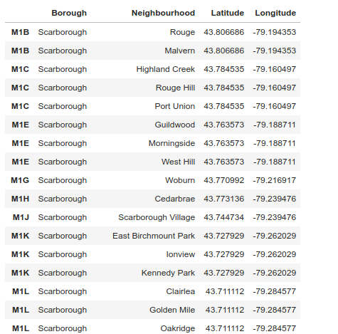
DATA
TORONTO BOROUGHS

Slide 11
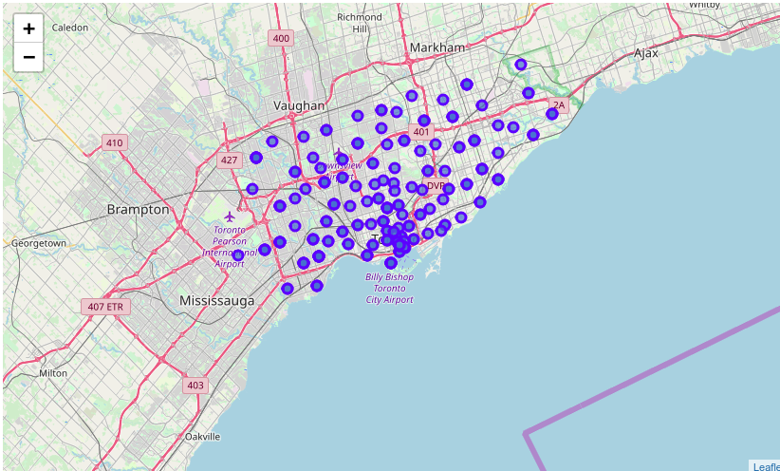
DATA RECORDS
TORONTO BOROUGH MAPS

Slide 12
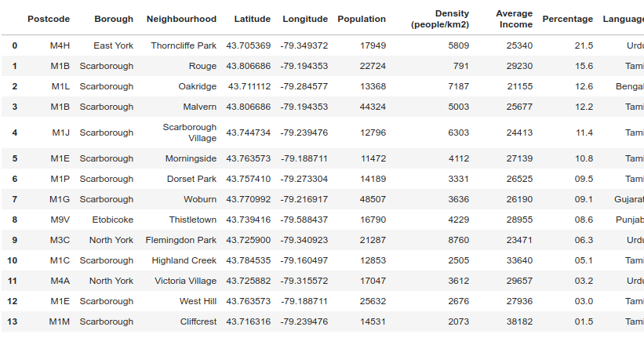
DATA RECORDS
TORONTO DEMOGRAPHICS

Slide 13
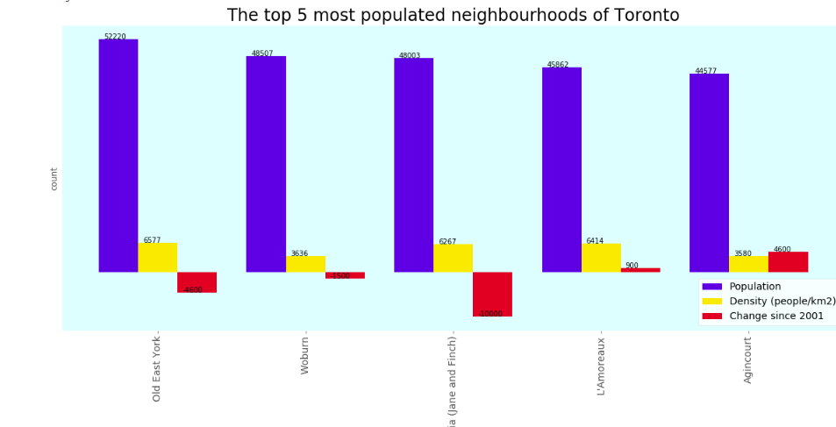
DATA RECORDS
MOST POPULATED NEIGHBOURHOODS

Slide 14
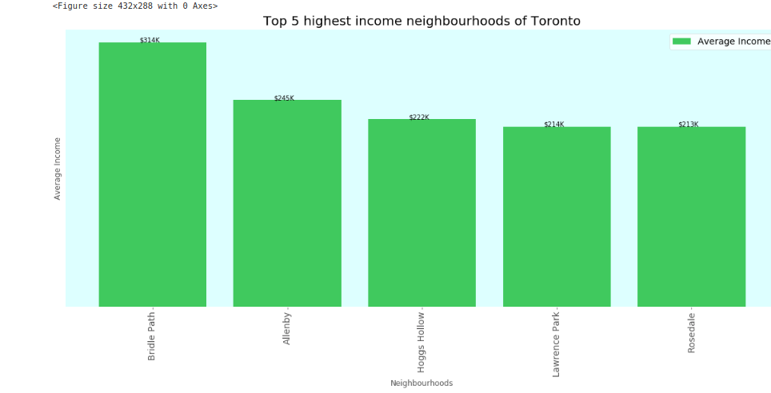
DATA RECORDS
HIGHEST INCOME NEIGHBOURHOODS

Slide 15
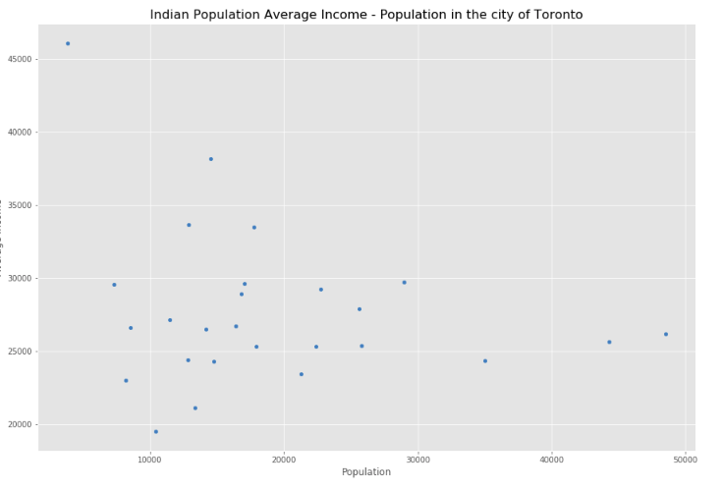
DATA RECORDS
AVERAGE INCOME - POPULATION

Slide 16
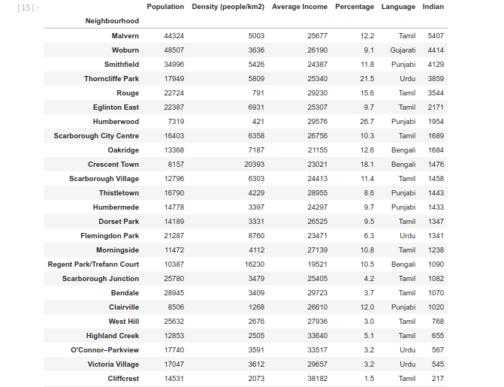
DATA RECORDS
INDIAN ETHNIC COMMUNITY AS BUSINESS TARGET

Slide 17
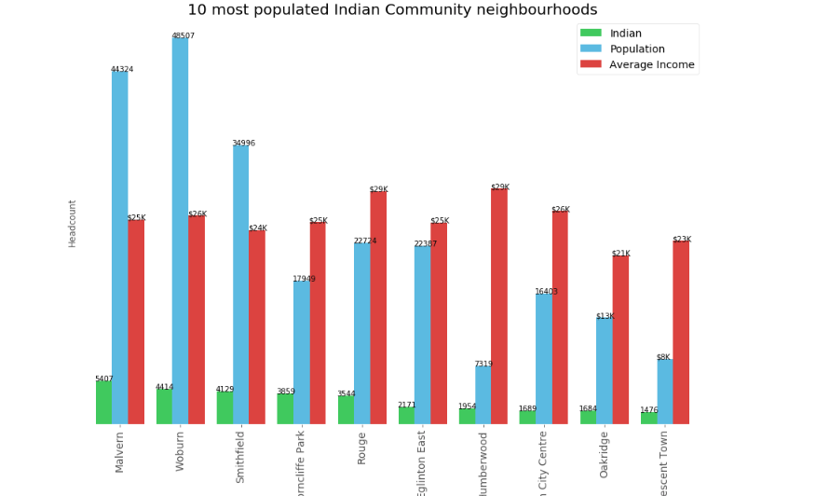
DATA RECORDS
IDENTIFYING TOP 10 TARGET GROUP BOROUGHS

Slide 18
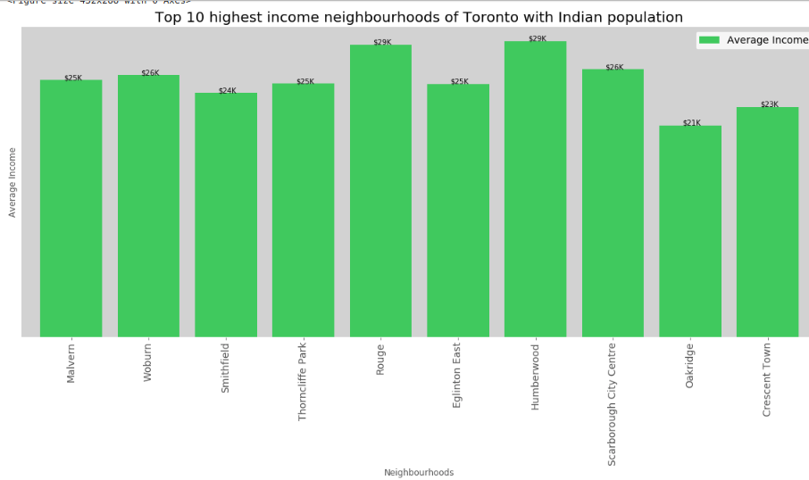
DATA RECORDS
IDENTIFYING TOP 10 TARGET GROUP BOROUGHS

Slide 19
MACHINE LEARNING
Our data analysis shows lack of proper data labeling in the datasets used
By the solution
Based on the data analysis and the solution requirements we suggest
Using an unsupervised machine learning approach
We suggest using k-means unsupervised machine learning algorithm to
Identify geo clusters in the city of toronto that are most suitable for
Opening new small businesses in the city of toronto
In order to perform accurate geo clustering our algorithm relies on
Google geo locations and foursquare apis

Slide 20
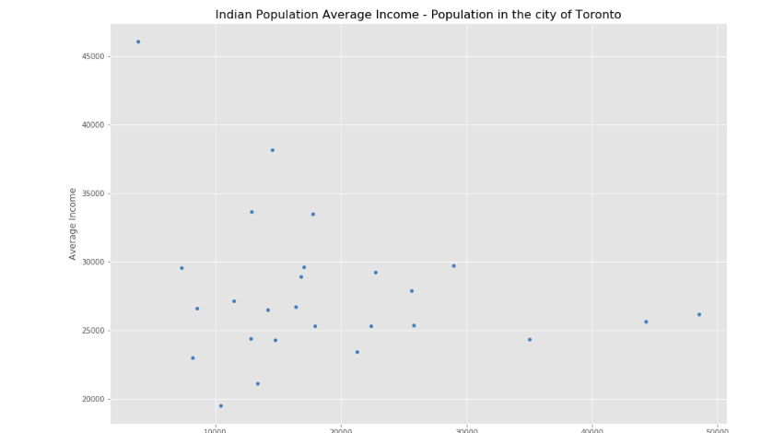
DATA RECORDS
TARGET GROUP POPULATION/INCOME

Slide 21
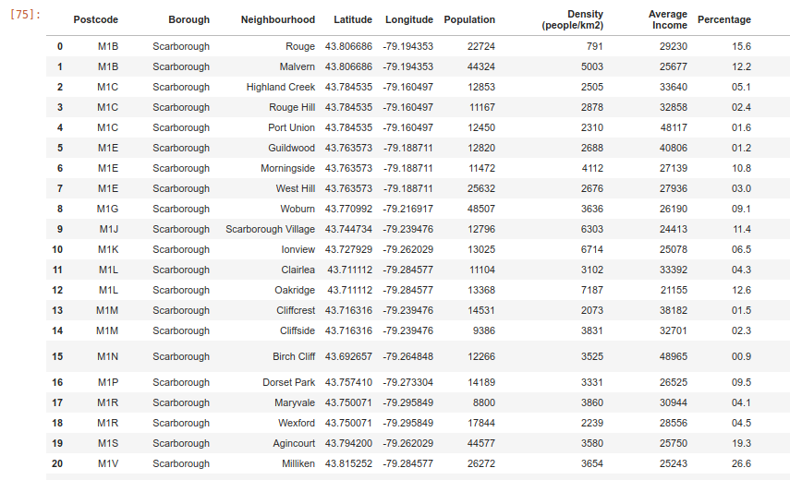
DATA RECORDS
TARGET GROUP GEO-MAPPING

Slide 22
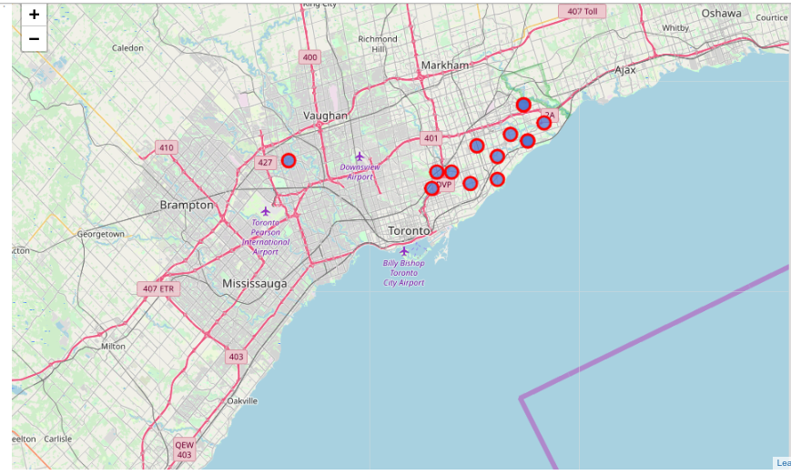
DATA RECORDS
TARGET GROUP GEO-MAPPING

Slide 23
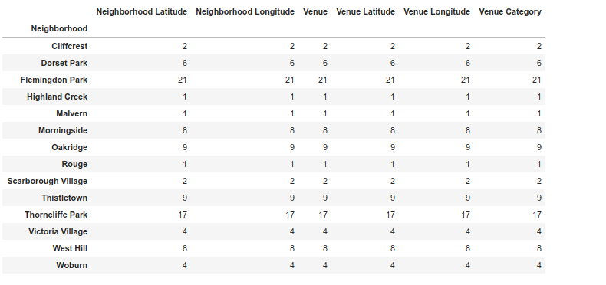
DATA RECORDS
TARGET GROUP BOROUGHS BUSINESS VENUES

Slide 24
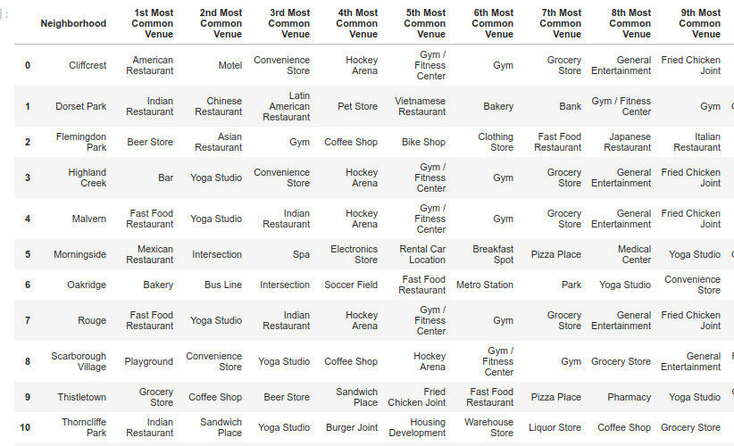
DATA RECORDS
TARGET GROUP MOST COMMON VENUES

Slide 25
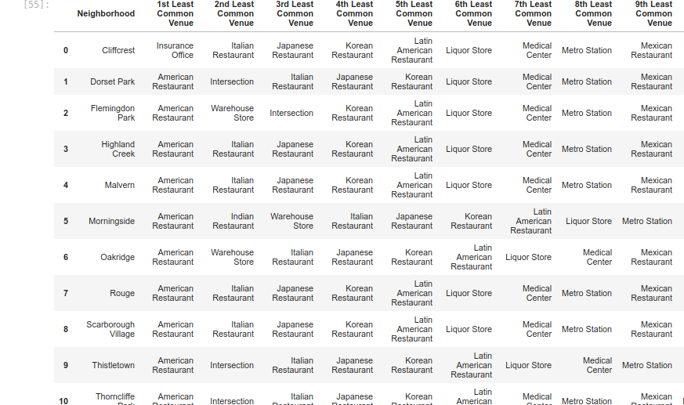
DATA RECORDS
TARGET GROUP LEAST COMMON VENUES

Slide 26
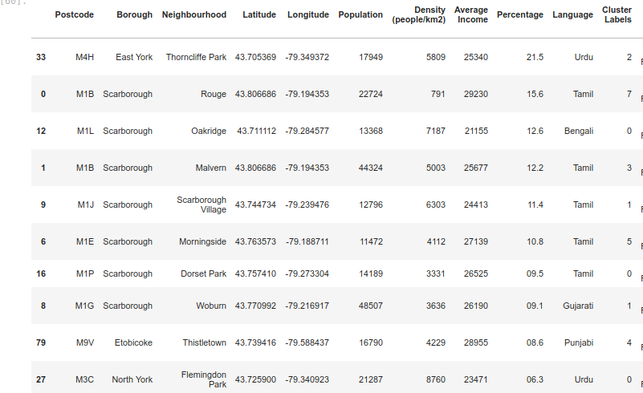
DATA RESULTS
K-MEANS CLUSTERING -TARGET GROUP CLUSTERING

Slide 27
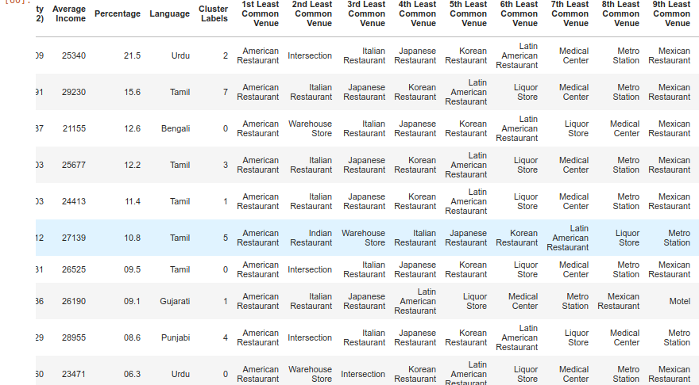
DATA RESULTS
K-MEANS CLUSTERING-TARGET GROUP CLUSTERING

Slide 28
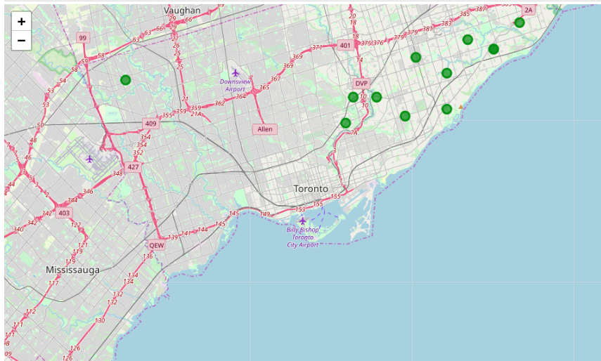
DATA RESULTS
TARGET GROUP CLUSTERS MAP

Slide 29
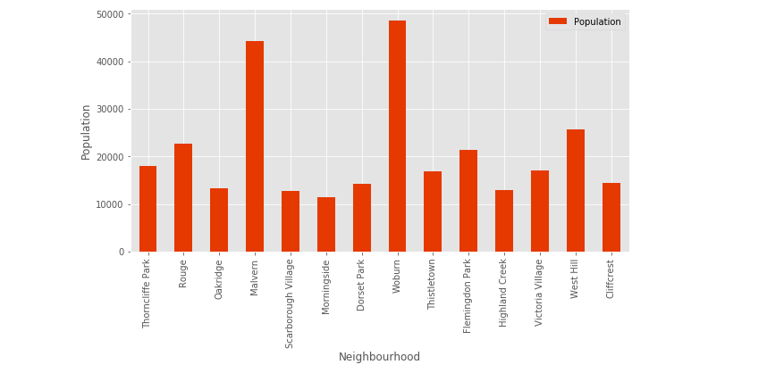
DATA RESULTS
TARGET GROUP POPULATION/NEIGHB

Slide 30
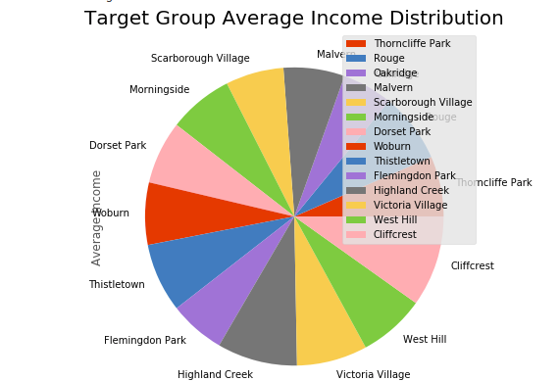
DATA RESULTS
TARGET GROUP INCOME DISTRIBUTION

Slide 31
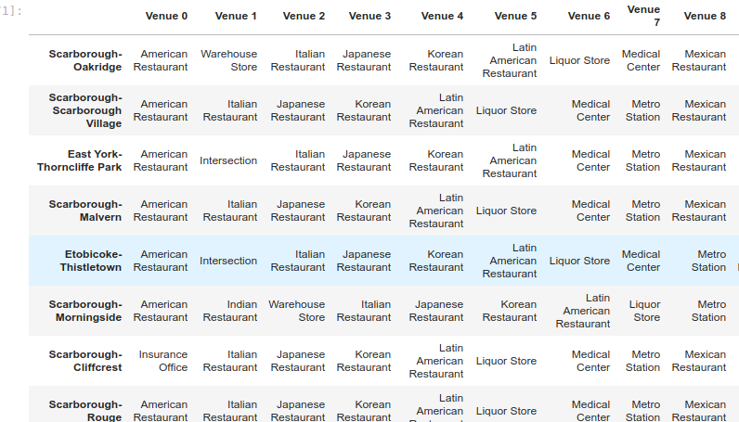
DATA ANALYSIS
BUSINESS VENUE RECOMMENDATIONS

Slide 32
DISCUSSION
There are very interesting trends showing up n the data analysis that
Suggest that it is possible to recommend new locations to businesses that
Want to expand or new businesses looking for the first location.
There are multiple statistical methodologies that can be employed to
Formulate a sound business hypothesis. Such formulated hypothesis do
Require validation via gathering and processing the supporting evidence.
Such supporting evidence can be produced by employing one or more
Machine learning algorithms.
There is additional potential in employing a recommender system
Algorithm to further improve the recommendations report based on a
Number of business requirements

Slide 33
CONCLUSION
Given enough relevant data it is possible to generate sufficient amount of
Supporting evidence in order to recommend with a high level of precision
Geo locations for new or growing businesses.
The current project demonstrates that a new location can be selected
Based on a list of indicators derived via inferential statistics and the
Results processed with k-means clustering machine learning algorithm.
Being a business with close ties to various ethnic communities in toronto
We definitely concur that the findings presented in this report have
Strong merits.

