Slide 1
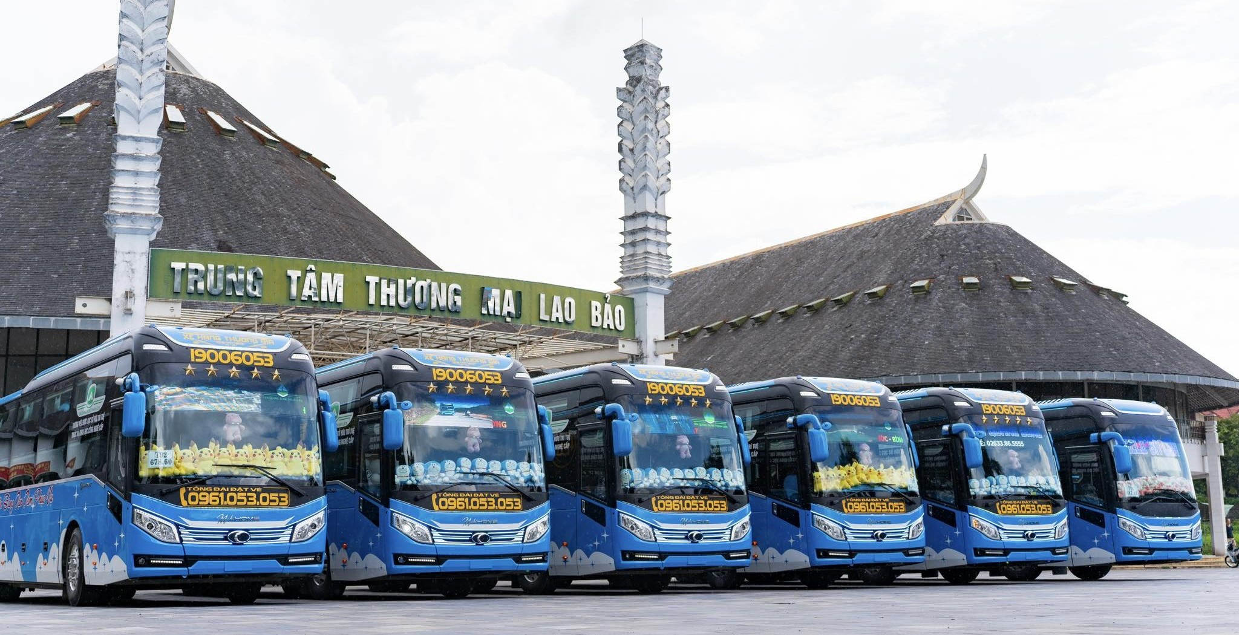
BUSBOOKING
Online Intercity Bus Ticket Booking System
Graduation project presentation - two Android apps, one Spring Boot web admin, centralized MySQL data, and VNPAY payment.
Students
Đặng Tú Nguyên - 24IT181
Trần Anh Tân - 24IT237
Supervisor: Dr. Phạm Nguyễn Minh Nhựt
Da Nang, 2026

Slide 2
BUSBOOKING
02
ROADMAP
Presentation Roadmap
01
Project context and objectives
02
Technology stack and architecture
03
System requirements and actors
04
Design: database, use cases, and workflows
05
Implemented interfaces and results
06
Evaluation, future work, and conclusion
BusBooking - Online Intercity Bus Ticket Booking System
2/20

Slide 3
BUSBOOKING
03
PROBLEM
Manual booking leaves data fragmented across the journey.
Fragmented booking
Payment mismatch
Operational blind spots
Manual booking makes it difficult to check routes, departure times, available seats, and passenger information in real time.
Ticket status and payment status can become inconsistent when confirmation is handled outside a centralized backend.
Bus staff need a fast way to verify tickets and track who has actually boarded each trip.
The project digitalizes the full journey from published trips to passenger check-in.
BusBooking - Online Intercity Bus Ticket Booking System
3/20

Slide 4
BUSBOOKING
04
SCOPE
BusBooking centralizes booking, payment, and passenger control.
2
1
4
VNPAY
Android modules
Web admin + REST API
Core actors
Payment provider
User app: search trips, choose seats, book one-way or round-trip tickets, pay online, and view ticket QR.
Staff app: view assigned trips, scan QR or enter ticket code, check in passengers, and inspect seat status.
Web admin: manage users, staff, routes, buses, seats, trips, tickets, payments, and revenue reports.
BusBooking - Online Intercity Bus Ticket Booking System
4/20

Slide 5
BUSBOOKING
05
ACTORS
The system now has four clear actors, including Staff.
U
S
A
V
USER
Staff
Admin
VNPAY
Search, book, pay, and present ticket QR.
Verify tickets, check passengers in, and monitor assigned trips.
Manage master data, staff accounts, payments, and reports.
External payment gateway that returns transaction results.
Staff is a dedicated actor. The CARRIER role is removed from the final system model.
BusBooking - Online Intercity Bus Ticket Booking System
5/20

Slide 6
BUSBOOKING
06
TECHNOLOGY
A two-app, one-web architecture keeps operations separated.
User App
Staff App
Web Admin
Database
Android Studio, Kotlin, XML layouts, ViewBinding, MVVM-style ViewModels, REST API client.
Separate Android module for staff login, assigned trips, QR scanning, passenger check-in, and seat map.
Java 21, Spring Boot 3.3.5, Thymeleaf, Spring Security, embedded Tomcat, VNPAY endpoints.
MySQL through XAMPP. Tables cover users, staff, buses, trips, seats, tickets, payments, and check-ins.
BusBooking - Online Intercity Bus Ticket Booking System
6/20

Slide 7
BUSBOOKING
07
ARCHITECTURE
Spring Boot and MySQL act as the single source of truth.
User App
MySQL
Search, booking, payment, ticket QR
Centralized operational data
Spring Boot Backend
REST API, validation, security, VNPAY callback
Staff App
VNPAY
Trip assignment, QR scan, check-in
Payment page and result callback
Web Admin
Thymeleaf UI
Runs on embedded Tomcat
BusBooking - Online Intercity Bus Ticket Booking System
7/20

Slide 8
BUSBOOKING
08
DATABASE
The database supports booking, payment, seat, and check-in states.
Identity
Operations
Booking
Payment & control
users
routes
tickets
payments
staff_profiles
buses
trip_seats
payment_items
bus_companies
seats
bookings
ticket_checkins
trips
booking_tickets
trip_staff_assignments
Ticket QR is generated from ticket status; VNPAY QR belongs to payment records.
BusBooking - Online Intercity Bus Ticket Booking System
8/20

Slide 9
BUSBOOKING
09
USE CASES
Use cases are grouped by real operational responsibility.
USER
Staff
Admin
Register / log in
Log in with admin-issued email
Manage USER accounts
Search trips
View assigned trips
Create staff accounts
Choose seats
View passengers
Manage routes, buses, seats, trips
Book one-way / round-trip
Scan QR or enter ticket code
Monitor tickets and payments
Pay with VNPAY
Confirm passenger boarding
View revenue statistics
View tickets and history
BusBooking - Online Intercity Bus Ticket Booking System
9/20

Slide 10
BUSBOOKING
10
USER FLOW
The USER flow moves from search to ticket QR.
Search
Select seat
Book
Pay
Use ticket
Origin, destination, date
Seat map and price
Create pending ticket
VNPAY URL or QR
Show ticket QR
My Ticket
The User App never connects directly to MySQL. It receives trip, seat, payment, and ticket data through Spring Boot REST APIs.
Confirmed ticket
QR for staff scan
BusBooking - Online Intercity Bus Ticket Booking System
10/20

Slide 11
BUSBOOKING
11
STAFF FLOW
The staff flow turns QR scanning into passenger check-in.
Login
Assigned trips
Verify ticket
Check in
Gmail account issued by admin
Only trips mapped to staff
Scan QR or enter code
Update ticket and seat state
After check-in, the seat map changes the passenger seat from booked to checked-in. The staff can tap the dark seat to review passenger and ticket details.
BusBooking - Online Intercity Bus Ticket Booking System
11/20

Slide 12
BUSBOOKING
12
ADMIN FLOW
The admin flow manages the whole transport operation.
1
Create master data
2
Create trip
3
Assign staff
4
Monitor sales
Routes, buses, seats
Route, bus, time, price
Available staff combo box
Tickets, payments, revenue
Trip edit screen
Left: trip data form | Right: seat layout preview | Staff selector included
BusBooking - Online Intercity Bus Ticket Booking System
12/20

Slide 13
BUSBOOKING
13
PAYMENT AND QR
Payment confirmation creates valid tickets and QR evidence.
Pending ticket
VNPAY payment
Callback
Confirmed ticket
Ticket is created before payment
Backend signs URL and QR
Checksum and amount verified
Ticket QR becomes visible
Important distinction: VNPAY QR is used for payment; ticket QR is generated after successful payment for staff verification.
BusBooking - Online Intercity Bus Ticket Booking System
13/20

Slide 14
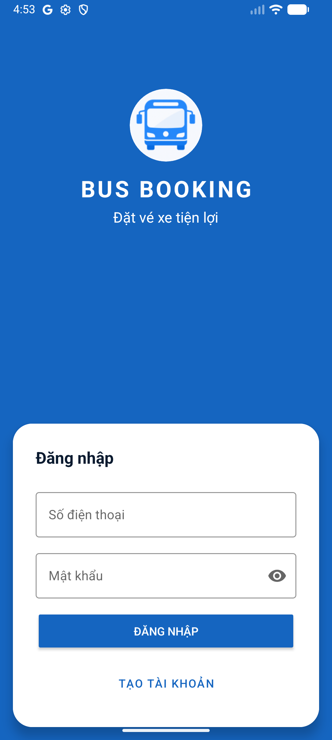
BUSBOOKING
14
USER UI
User app interfaces cover the full booking journey.
Home
Trip List
Seat Selection
Ticket Detail
Route cards
Departure time
Available / booked
Payment status
Trip search
Bus plate
Total fare
Seat number
Upcoming trips
Available seats
Confirm booking
Ticket QR
Login screen captured from the current mobile app.
BusBooking - Online Intercity Bus Ticket Booking System
14/20

Slide 15
BUSBOOKING
15
STAFF UI
Staff app interfaces focus on fast station and onboard work.
Staff Home
Trip Detail
QR Scanner
Check-in Result
Staff name
Route and bus
Open camera
Passenger info
Assigned trips today
Passenger list
Manual ticket code
Payment state
Checked-in count
Seat map
Verify API
Confirm boarding
Seat colors: available, booked, checked-in passenger.
BusBooking - Online Intercity Bus Ticket Booking System
15/20

Slide 16
BUSBOOKING
16
WEB ADMIN UI
Web admin interfaces control trips, seats, staff, and reports.
Dashboard
Trip Management
Operations
Users
Date/time labels
USER accounts
Trips
Bus selector
Staff accounts
Tickets
Staff assignment
Payments
Revenue
Seat preview
Reports
The admin web is both the management interface and the backend service provider for the Android apps.
BusBooking - Online Intercity Bus Ticket Booking System
16/20

Slide 17
BUSBOOKING
17
RESULTS
Implementation results show the system working end-to-end.
16
504
3
3
Seed vehicles
Four-city seeded trips
Core apps
Staff check-in states
User App can search trips, choose seats, create tickets, pay with VNPAY, and display ticket QR.
Staff app can log in, read assigned trips, scan QR, verify tickets, check in passengers, and inspect seats.
Web admin can manage trips, buses, seats, users, staff assignment, tickets, payments, and statistics.
BusBooking - Online Intercity Bus Ticket Booking System
17/20

Slide 18
BUSBOOKING
18
QUALITY
Security and reliability are handled at the API and data layer.
Security
Consistency
Reliability
Role-based access separates USER, STAFF, and ADMIN. Android clients call REST APIs instead of directly accessing MySQL.
Seat, ticket, payment, and check-in states are stored centrally so web admin and apps share the same source of truth.
Payment is confirmed through signed VNPAY response verification before ticket confirmation and QR availability.
BusBooking - Online Intercity Bus Ticket Booking System
18/20

Slide 19
BUSBOOKING
19
FUTURE WORK
The next development step is operational scale.
Near term
Polish Android UI, complete staff operational screens, and expand admin reporting.
Mid term
Add notification, cancellation/refund workflow, route recommendations, and better seat layout tooling.
Long term
Deploy backend to a public server, harden security, support multiple transport companies at scale.
BusBooking - Online Intercity Bus Ticket Booking System
19/20

Slide 20
BUSBOOKING
20
BusBooking delivers a complete foundation for digital bus booking.
Centralized Spring Boot + MySQL backend.
Thank you
User App for booking and payment.
Questions & discussion
Staff app for QR verification and passenger boarding.
Web admin for operations, assignments, and reporting.
Đặng Tú Nguyên - 24IT181 | Trần Anh Tân - 24IT237

