Slide 1
Combination of Continues and Discrete DLM

Slide 2
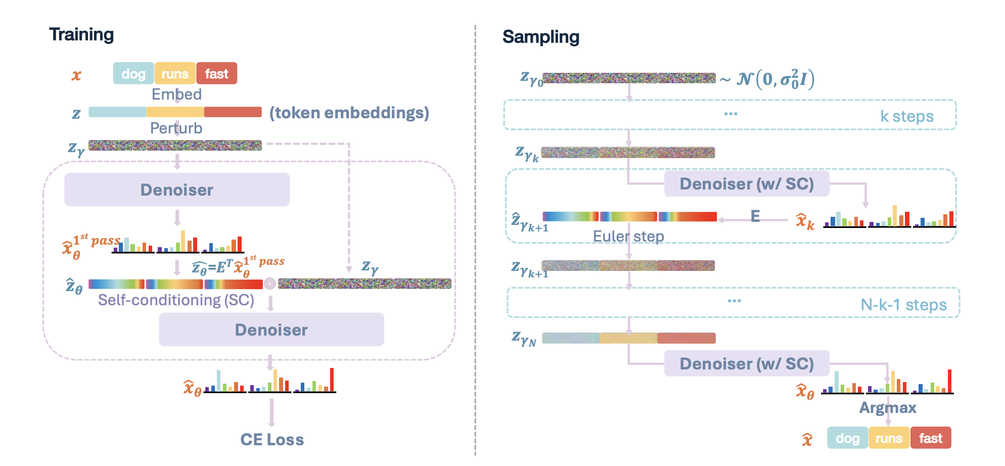
Stage 1 Continues DLM

Slide 3
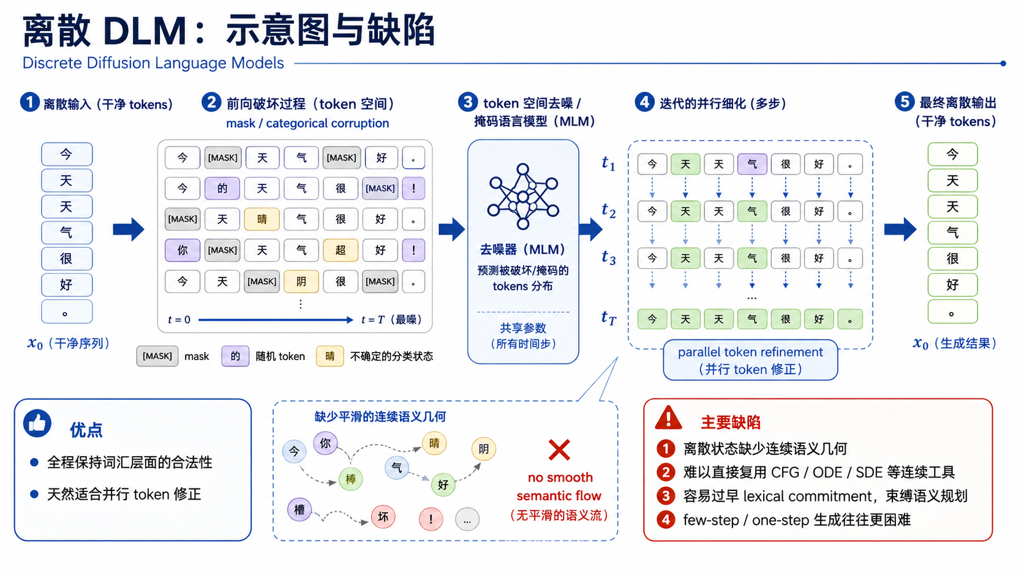
Stage 2 Discrete DLM

Slide 4
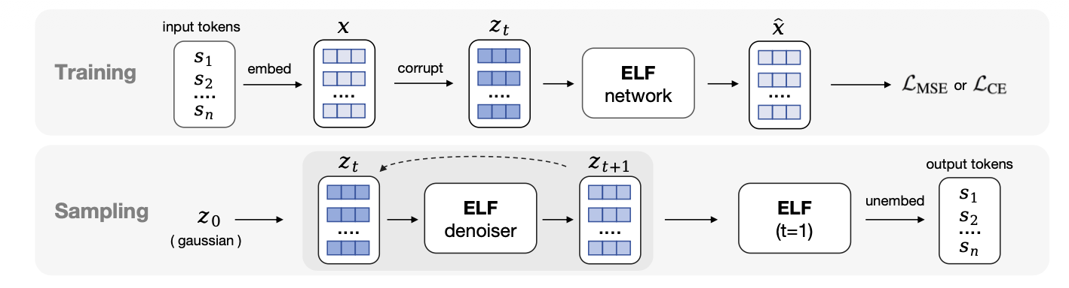
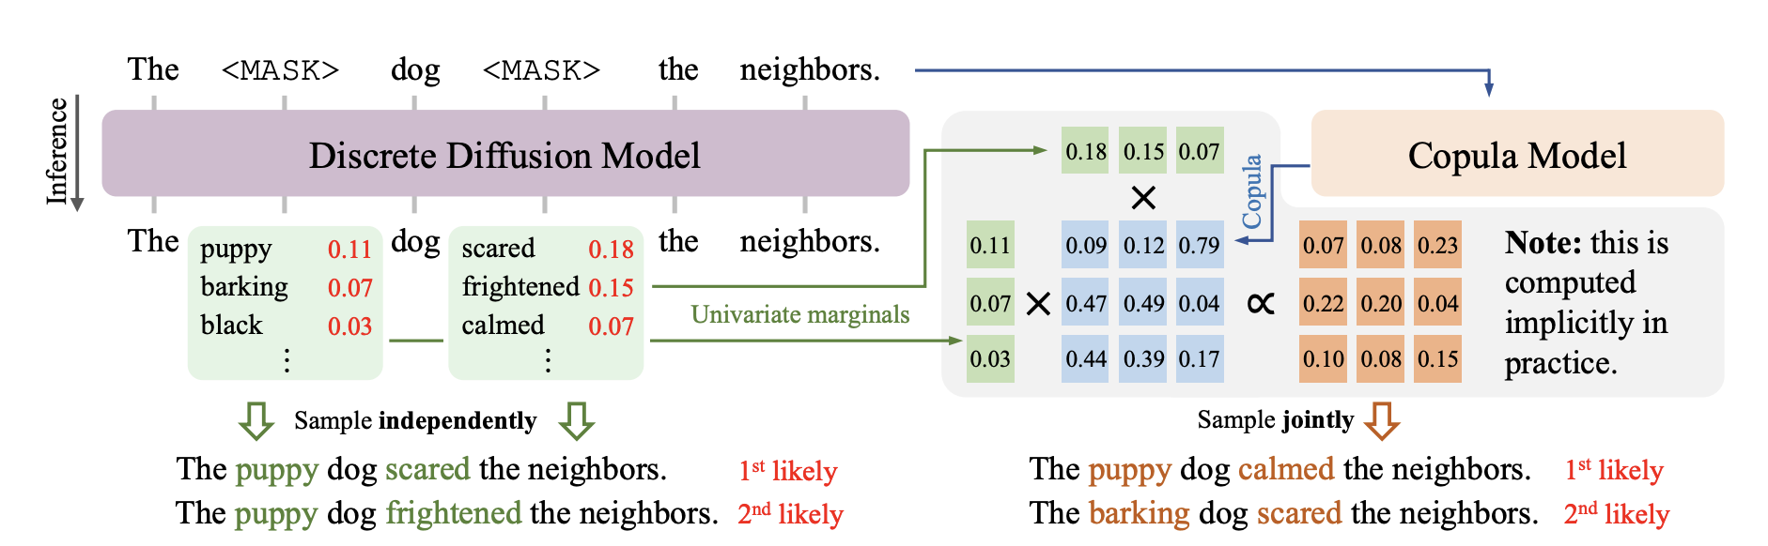
What ELF does
Weakness：

Slide 5
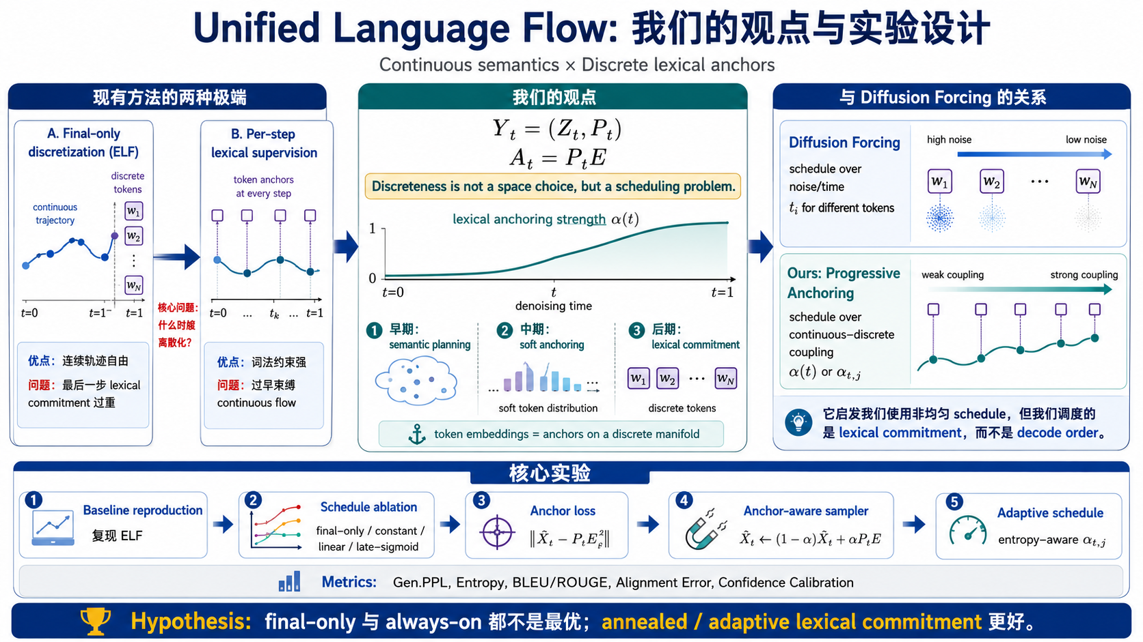
Stage 3 Combination

