Slide 1

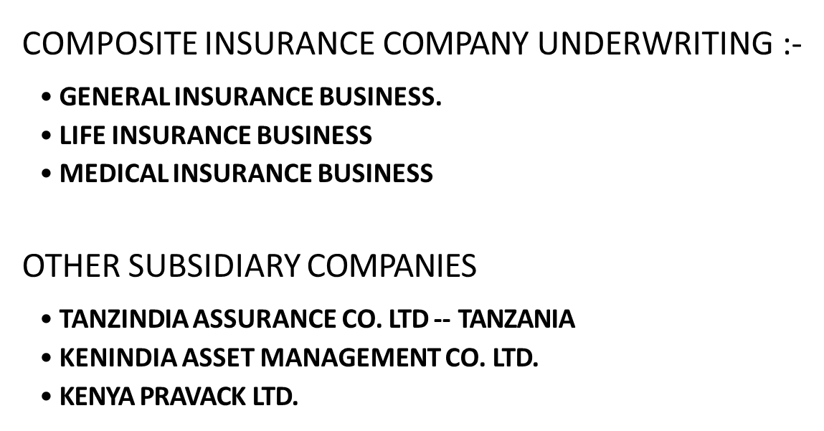
KENINDIA ASSURANCE COMPANY LIMITED
COMPANY PROFILE
78

Slide 2

PRINCIPAL SHARE HOLDERS AFTER 1979
INDIAN COMPANIES WITH SHARES IN KENINDIA : 55%
LIFE INSURANCE CORP. OF INDIA.
GENERAL INSURANCE CORPORATION OF INDIA.
UNITED INDIA INSURANCE CO. LTD.
NATIONAL INSURANCE COMPANY OF INDIA
ORIENTAL INSURANCE COMPANY OF INDIA
NEW INDIA ASSURANCE COMPANY LTD
KENYAN COMPANIES / SHAREHOLDERS : 45%
CHANDARIA FOUNDATION
MEHTA GROUP OF COMPANIES UGANDA
COMCRAFT GROUP OF COMPANIES.
SANSORA GROUP OF COMPANIES.
OTHER SHAREHOLDERS.

Slide 3
Vision - To Be The Finest Insurance Company In The East African Region.
Mission - To provide world-class insurance and other financial services that delight our customers through innovative use of resources to maximize stakeholders value.
Core values - Integrity, Reliability, Transparency, Professionalism, Teamwork & Quality

Slide 4
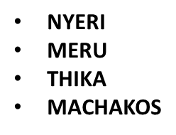
KENINDIA ASSURANCE CO. LTD.
BRANCH NETWORK
NAIROBI
BRANCH I ---
BRANCH II ---
WESTLANDS----
CBD CBD
WEST OF CBD
ENTERPRISE ROAD. --- INDUSTRIAL AREA
UPCOUNTRY
MOMBASA
KISUMU
ELDORET
NAKURU
KISII

Slide 5
FINANCIAL STRENGTH OVERVIEW

Slide 6
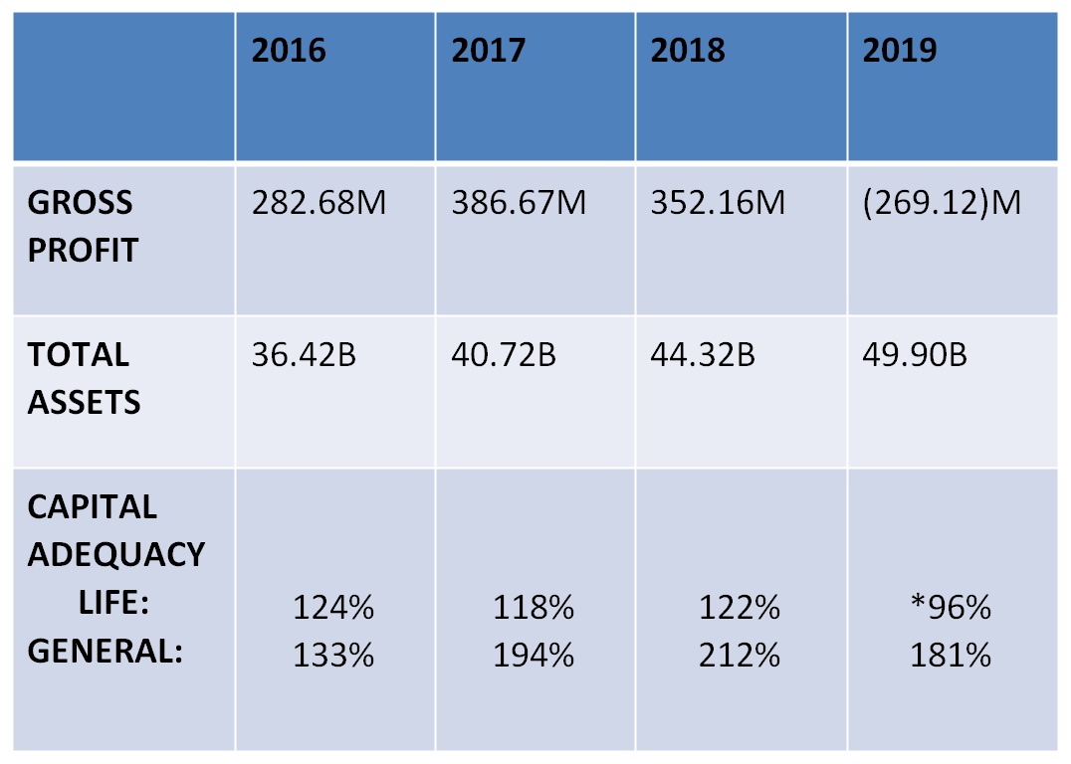

FINANCIAL STRENGTH OVERVIEW

Slide 7
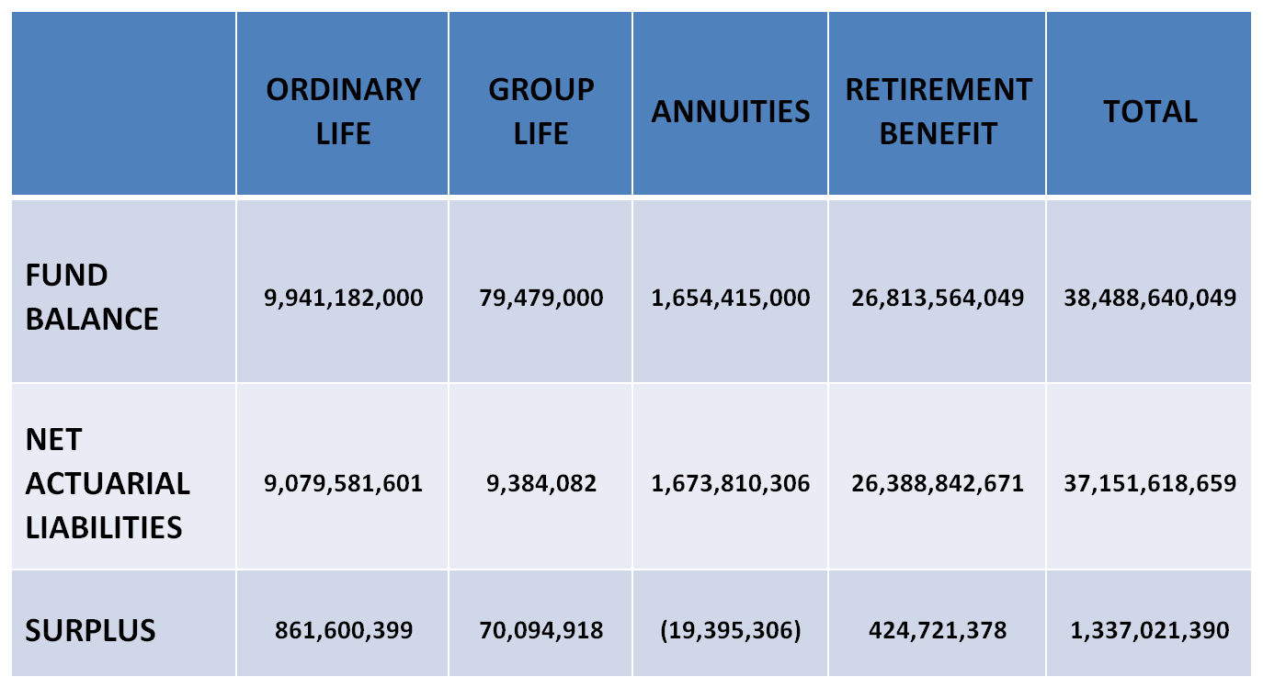
LIFE INSURANCE ACTUARIAL VALUATION
LIFE INSURANCE ACTUARIAL RECOMMENDATIONS
INTEREST ON RETIREMENT BENEFIT PLANS AT 11% (2018: 11.50%)
BONUS ON CAPITAL ADVANTAGE POLICIES AT 11.5% (2018: 11.50%)
BONUS ON BIMA ACCOUNT PLAN AT 11.5% (2018: 11.5%)
TERMINAL BONUS ON POLICIES MATURED AT 2% (2018: 2%)
SIMPLE REVERSIONARY BONUS AT 6% ( 2018: 6% )
TRANSFERRED 281 M TO SHAREHOLDER’S FUND

Slide 8
















OUR CLIENT PROFILE

Slide 9












OUR CLIENT PROFILE

