Slide 1
ANLC-754
Final project presentation
NYC Project Management Workforce Analysis
Education, Compensation & Talent Shortages in Public Sector of Project Management
Student Name: Tu Tran Tran

Slide 2
1. Business understanding
The research includes three sub-questions as below:
1. Does education level correlate with salary in NYC PM roles?
Business purpose of the question: to understand the quantity ROI of education.
2. Which education level is demanded most in PM job postings?
Business purpose of the question: to align the academic supply with the employer’s demand.
3. Which PM job titles are having the demand larger than the supply?
Business purpose of the question: to identify the priority shortages for hiring and upskilling.

Slide 3
2. Data understanding
2.1. Data overview
1. Citywide Payroll Data (Fiscal Year) of 2024 & 2025 (over 1million observations)
(https://data.cityofnewyork.us/City-Government/Citywide-Payroll-Data-Fiscal-Year-/k397-673e)
This data can be used to analyze how the City's financial resources are allocated and how much of the City's budget is being devoted to overtime.
This data is provided by Financial Information Services Agency (FISA) & Office of Payroll Administration (OPA)
2. Jobs NYC Postings (approximately 6000 observations)
(https://data.cityofnewyork.us/City-Government/Jobs-NYC-Postings/kpav-sd4t)
- This dataset contains current job postings available on the City of New York’s official jobs site (http://www.nyc.gov/html/careers/html/search/search.shtml). Internal postings available to city employees and external postings available to the general public are included.
This dataset can be used to view current and historical job postings available with the City of New York and to analyze City hiring trends.
3. PM_REGEX <- "\\b(project|program|pmo|scrum|agile|admin|coordinator|manager)\\b"
- This is a value used to identify and keep only Project-Management–related job titles in both the payroll data and the job-postings data, in order to help filter for upcoming phases.

Slide 4
2. Data understanding
2.2. data SELECTION & DATA ethics
1. Fiscal Year Payroll Data (2024 + 2025)
2023 was not selected because the labor marker was recovering from COVID -> create noise
Combining 2024 and 2025 fiscal years will produce a more stable labor market signal and avoid over-interpreting short-term volatility in postings volume or certification language
Personal information will be removed from this research because they do not have analysis value, as well as to follow data ethics rules (de-identification).
2. Jobs NYC Postings
- The time range for this dataset will be from July 1, 2023 to June 30, 2025 to avoid misalignment and leakage bias.

Slide 5
3. Data preparation
3.1. Fiscal Year (2024 + 2025)
Standardized job titles → convert to Title Case + remove extra spaces.
Converted salary text to numeric using parse_number() (handles $, commas).
Cleaned pay basis → normalize variations (“per Annum”, “Annual”, “daily”, “hourly”).
Annualized salary:
Per annum → keep value
Per day → × 260
Per hour → × 2080
Filtered invalid salaries (non-numeric or ≤ 0).
Kept only PM-related titles using PM_REGEX.
Final sample reduced from 1.1M → ~31K PM-aligned employee records.

Slide 6
3. Data preparation
3.2. NYC Job Postings
Converted posting dates into proper Date format using mdy().
Filtered postings to match FY window: July 1, 2023 → June 30, 2025.
Standardized titles → pick business title if available, otherwise civil service title.
Combined all text fields into one text_all for education/skills extraction.
Filtered to PM-related roles using PM_REGEX.
Mapped education requirements to 5 categories: Associate, Bachelor’s, Master’s, PhD, Other.
Flagged certifications: req_pmp, req_scrum.
Annualized salary ranges (hourly × 2080; daily × 260).
Calculated midpoint salary for analysis (annual_salary_mid).
Final sample reduced from 5804 → 784 PM-related job postings.

Slide 7
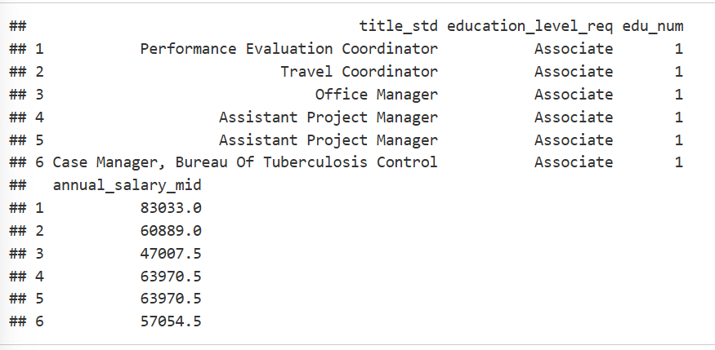
4. Modeling
4.1. Education and Salary
4.1.1. Prepare Education-Salary Dataset
Each row = one NYC PM job posting
Variables: standardized title, required degree, numeric education level, annual salary midpoint
Data filtered to PM-related roles and positive salary values
This is the base dataset for all education–salary analysis

Slide 8
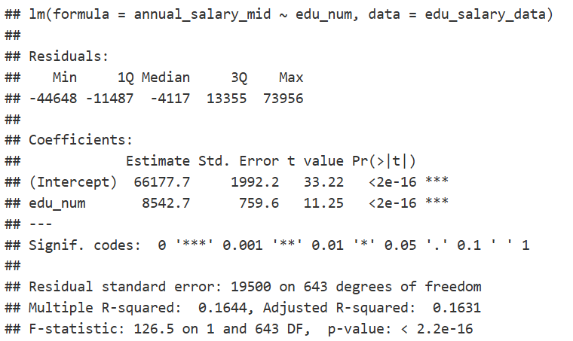
4. Modeling
4.1. Education and Salary
4.1.2. LINEAR REGRESSION
Model: annual_salary_mid ~ edu_num
Intercept ≈ $66,000 (baseline at Associate level)
Each education step adds ≈ $8,500 to salary
R² ≈ 0.16 – education explains ~16% of salary variation
Overall F-test p < 0.001 → model is statistically significant

Slide 9
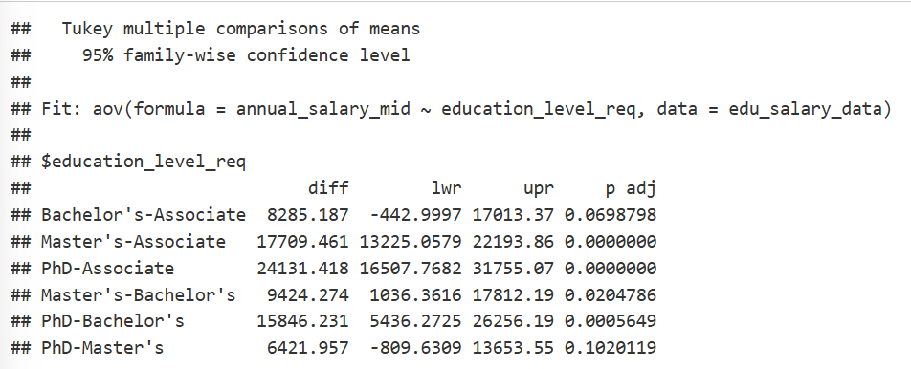
4. Modeling
4.1. Education and Salary
4.1.3. ANOVA and tukey hsd
ANOVA F ≈ 42.3, p < 0.001 → mean salaries differ by education level
Master’s and PhD postings pay significantly more than Associate
PhD postings also pay significantly more than Bachelor’s
Bachelor’s vs Associate and PhD vs Master’s are borderline / not clearly significant
Confirms salary stratification across education groups

Slide 10
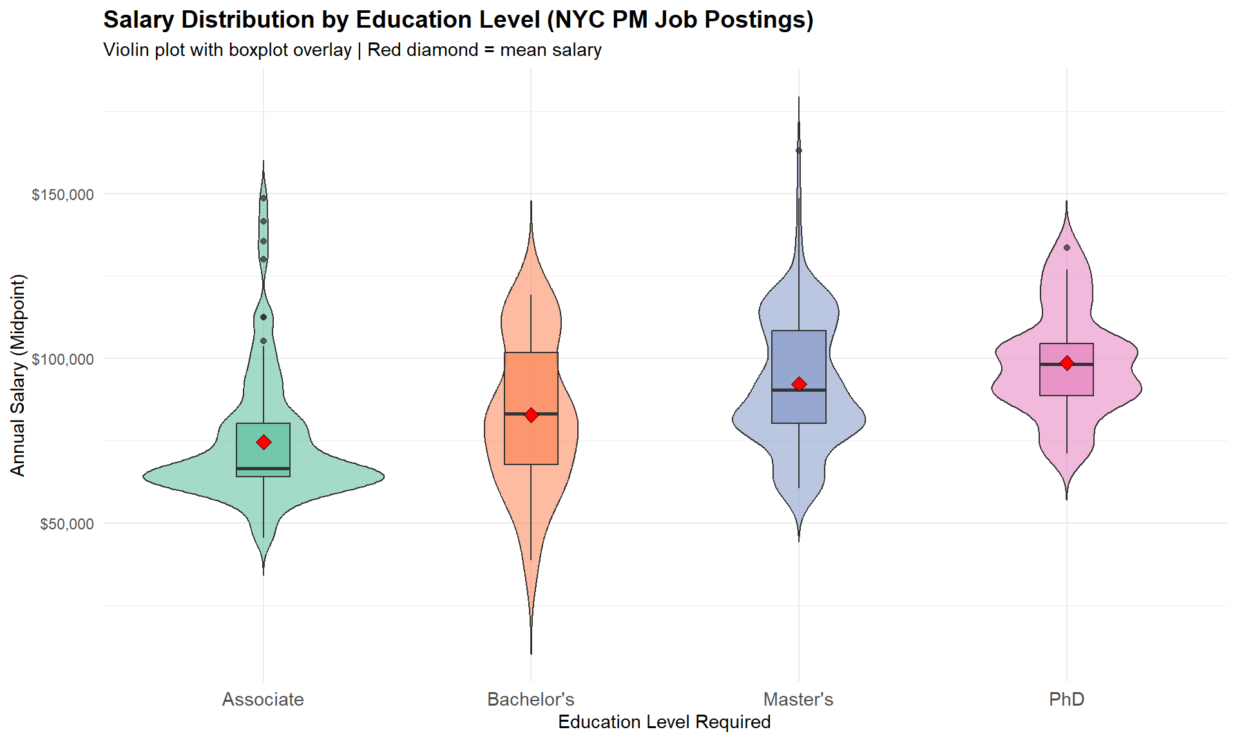
4. Modeling
4.1. Education and Salary
4.1.4. Violin + Boxplot: Salary Distribution by Education
Violin shapes shift upward from Associate → PhD
Medians and means (red diamonds) increase with education level
Master’s & PhD salaries show higher upper ranges and more variability
Visual confirmation of the positive education–salary relationship

Slide 11
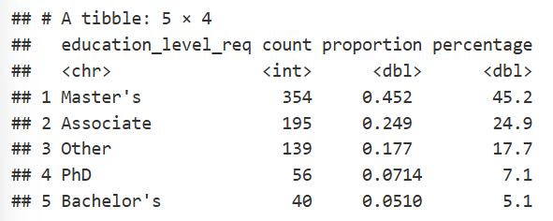
4. Modeling
4.2. Education Demand
4.2.1. Count and Proportion of Postings by Education Level
Total PM postings in sample: 784
Master’s degree: 354 postings (45.2%)
Associate degree: 195 postings (24.9%)
“Other” (non-standard / flexible requirements): 139 postings (17.7%)
PhD: 56 (7.1%), Bachelor’s: 40 (5.1%) – both minority segments

Slide 12

4. Modeling
4.2. Education Demand
4.2.2. PMP and Scrum Certification Demand
Total PM postings: 784
PMP mentioned in 10 postings (~1.28%)
Scrum mentioned in 2 postings (~0.26%)
Certification requirements are rare compared with degree requirements
NYC public PM market is degree-centric, not certification-centric

Slide 13
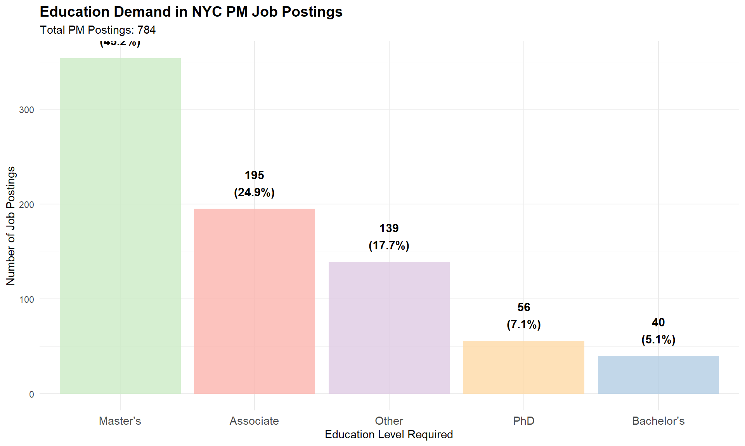
4. Modeling
4.2. Education Demand
4.2.3. Visualization: Education Demand Bar Chart
Master’s degree bar towers over all others (45.2% of postings)
Associate degree is the second-largest segment (24.9%)
“Other” (experience-based or flexible) makes up ~17.7%
PhD and Bachelor’s together account for only ~12% of postings
Confirms strong employer preference for graduate-level education

Slide 14
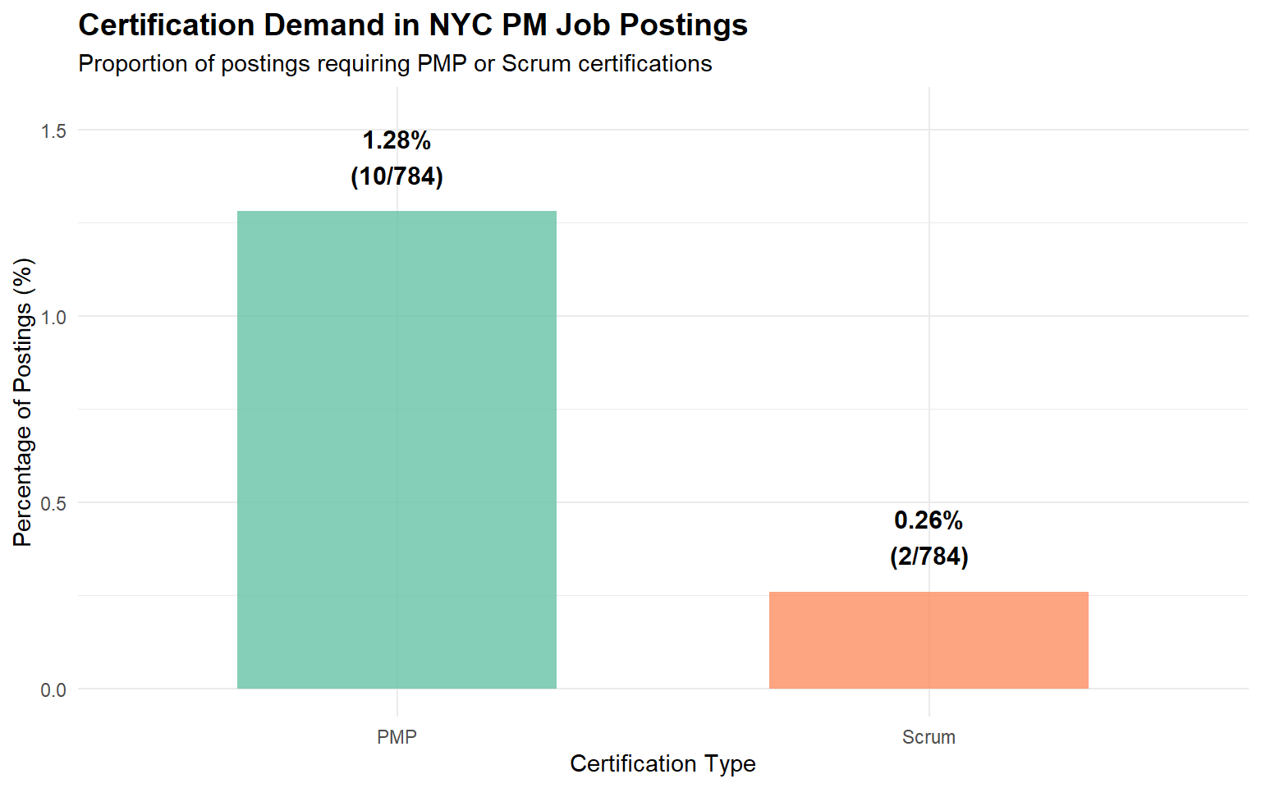
4. Modeling
4.2. Education Demand
4.2.4. Visualization: Certification Demand
PMP requirement is only 1.28% (10 out of 784 postings)
Scrum certification requirement is 0.26% (2 out of 784 postings)
NYC public agencies rarely require certifications
Hiring focus = education + experience, not PMP/Scrum
Practical implication: Candidates with Master’s degrees have a stronger advantage than certified candidates.

Slide 15
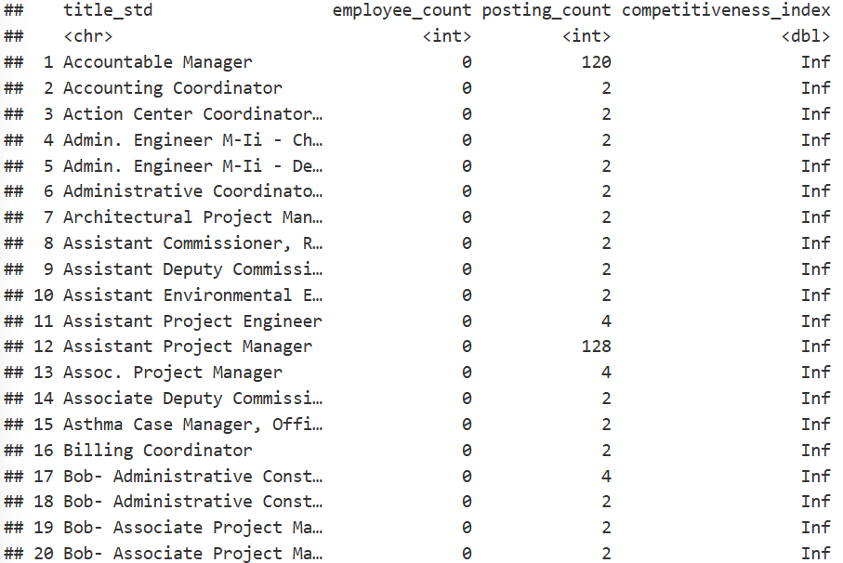
4. Modeling
4.3. Job Market Competitiveness
4.3.1. Aggregate Employee and Posting Counts by Title
Titles with 0 employees but active postings → Competitiveness Index = ∞
Indicates new roles, expansion needs, or structural workforce gaps
Represents highest hiring urgency
Key examples: Accountable Manager, Assistant Project Manager, Administrative Coordinator, etc
Recommends urgent recruitment or re-alignment of job title structures.

Slide 16
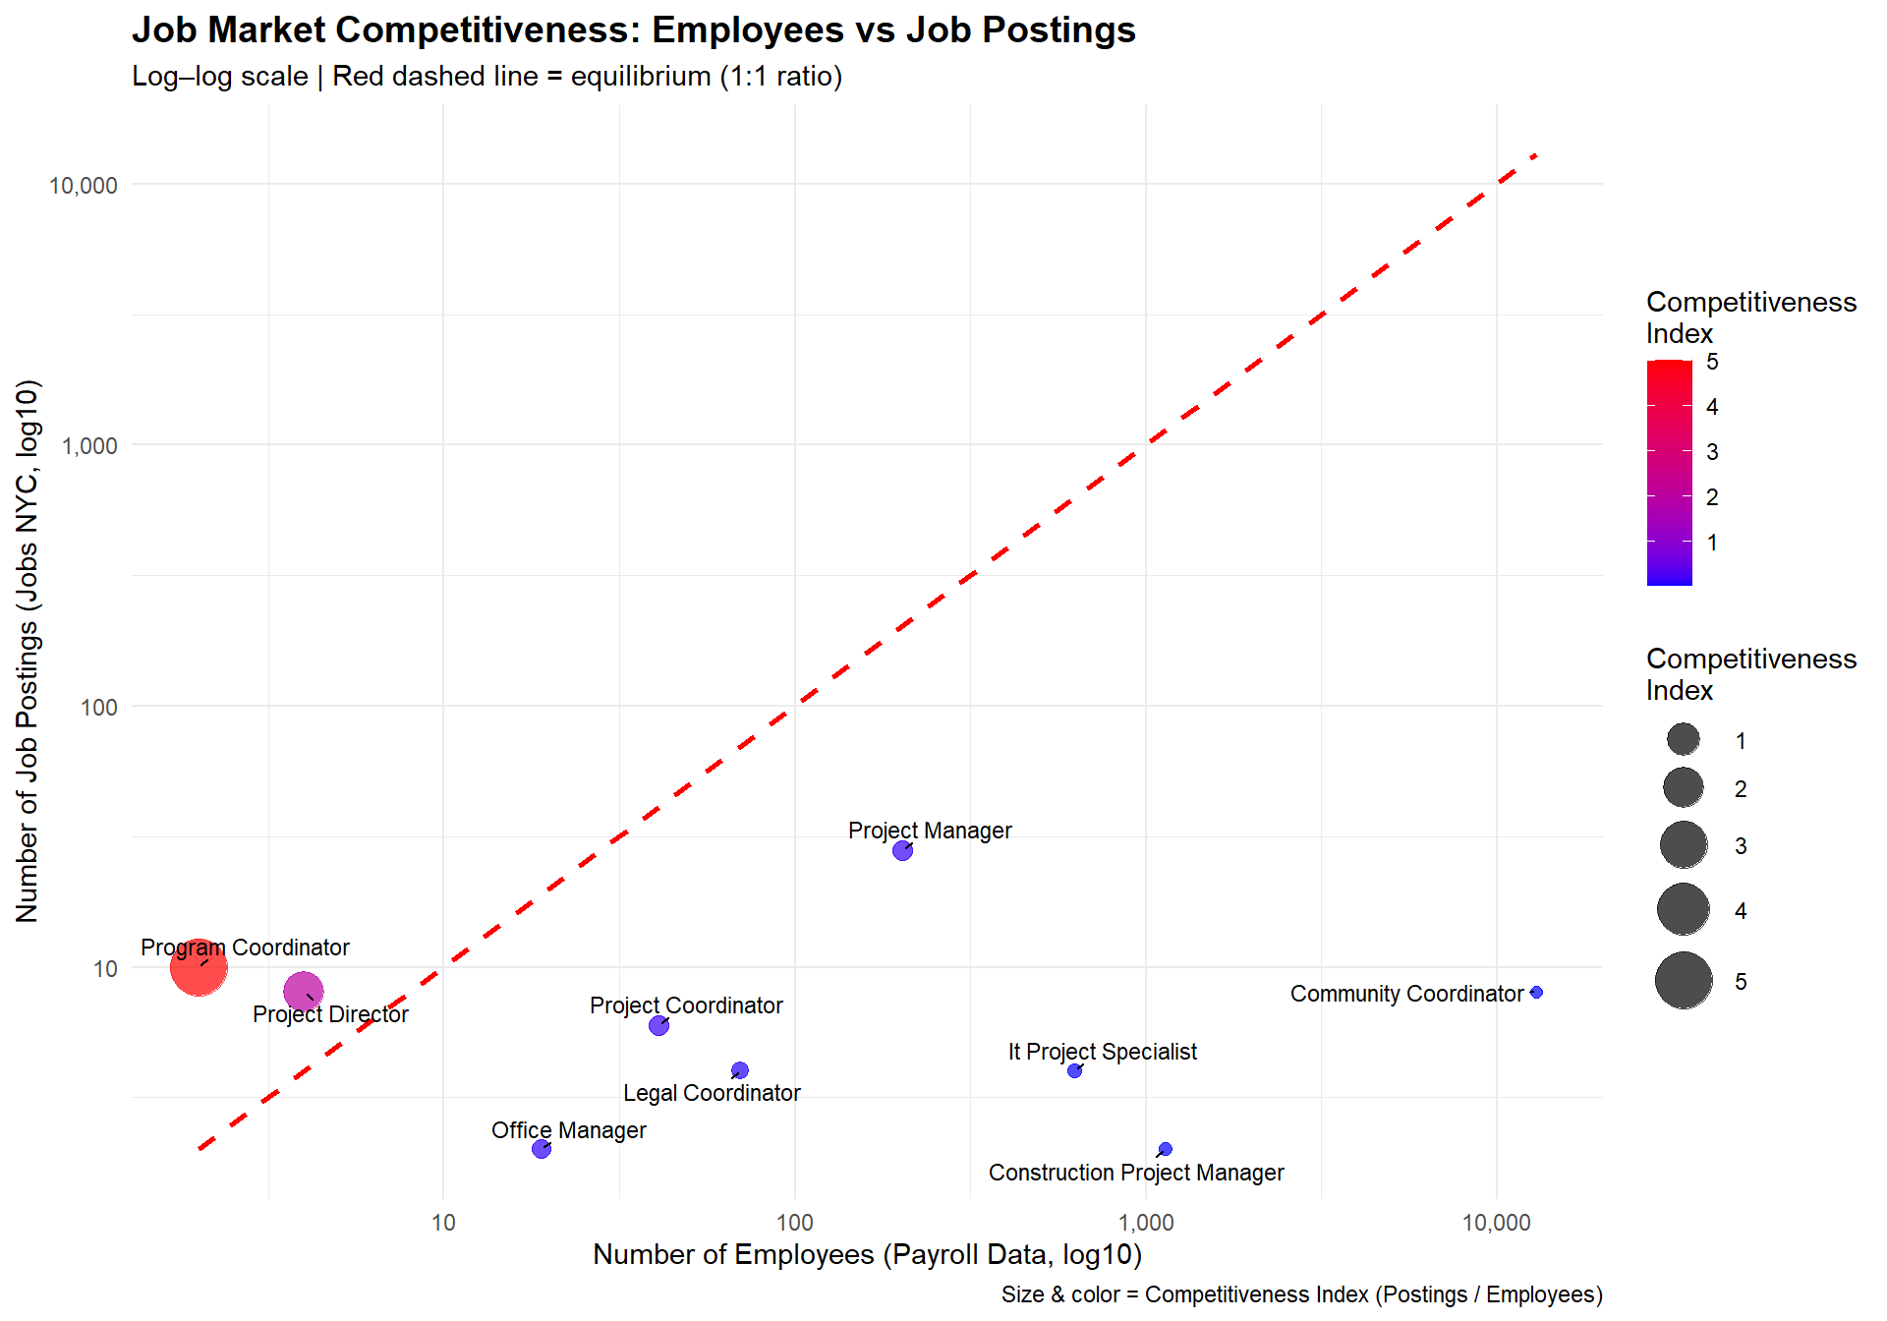
4. Modeling
4.3. Job Market Competitiveness
4.3.2. Visualization: Scatter Plot (Employees vs Postings)
Log-log scatter shows supply (employees) vs demand (postings)
Red dashed line = balance (1 posting per employee)
Points above the line → shortage, below the line → surplus
Highest shortage: Program Coordinator (CI ≈ 5)
Other strained roles: Project Director, Project Coordinator
Roles with many employees but few postings → stable staffing (e.g., Community Coordinator).

Slide 17
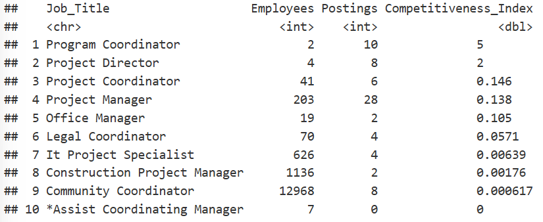
4. Modeling
4.3. Job Market Competitiveness
4.3.3. Visualization: Top 20 Competitiveness Index
Competitiveness Index = Postings ÷ Employees
Highest CI: Program Coordinator (5.0)
Strong shortages: Project Director (2.0), Project Coordinator (0.146), Project Manager (0.138)
Titles with very large employee bases but few postings → well-staffed
Identifies priority areas for recruitment & training investment.

Slide 18
5. CONCLUSION
a. Higher education reliably predicts higher salaries
Salary increases monotonically from Associate → Bachelor’s → Master’s → PhD.
Correlation (Spearman ρ ≈ 0.44, p < 0.001) and regression both confirm education level is a significant predictor of salary.
b. Master’s degree is the dominant requirement in job postings
45% of PM postings require a Master’s.
Associate (25%) and Other (18%) follow.
Bachelor’s is very rarely required (5%).
NYC PM jobs strongly prefer graduate-level education.
c. Certifications (PMP/Scrum) matter very little
Only 1.28% require PMP.
Only 0.26% require Scrum.
NYC public sector is degree-driven, not certification-driven.

Slide 19
5. CONCLUSION
d. Several PM roles show talent shortages
Program Coordinator (CI = 5) has the highest shortage.
Other strained titles: Project Director, Project Coordinator, Project Manager.
Some titles even have 0 employees but multiple postings, indicating new or unstaffed roles.
e. Implications for workforce strategy
NYC agencies should strengthen graduate-level pipelines, especially Master’s programs.
Enhance recruitment for top-shortage PM roles.
Certifications are optional—focus training on academic & experiential pathways.

Slide 20
THANK YOU

