Slide 1
Feature selection
Henry Tu, 24-sep-2015
Not part of a machine learning book
Usually a part of language processing, image processing, computer vision book
But we usually have to use them in the real-word problem

Slide 2
Image ⇒ Vector

Slide 3
Images to Vectors
Many algorithms, such as logistic regression, linear regression, kmeans, EM, work on vectors. Images and documents are not vectors
We need to convert each image into one vector

Slide 4
Feature selection
Feature extraction
Color/spatial
Training
Learning
Estimation
Image 1 -> class 1
Image 2 -> class 2
Image 3 -> class 3
vector 1 -> class 1
Vector 2 -> class 2
Vector 3 -> class 3
Learning Model
Input
image
Input
vector
Output class
Feature selection
Feature extraction
Color/spatial
Classification / categorization
Prediction
Tagging
Clustering

Slide 5


Feature selection

Slide 6
Some methods
Just turn the whole image into one vector
The image is 64x64 then the vector has 4096 entries (dimensions)
Color histogram
Color histogram + spatial information
Color Averaging
Color Averaging + spatial information

Slide 7
Color histogram
Colors are divided into bins
Two near color may results in different bins

Slide 8
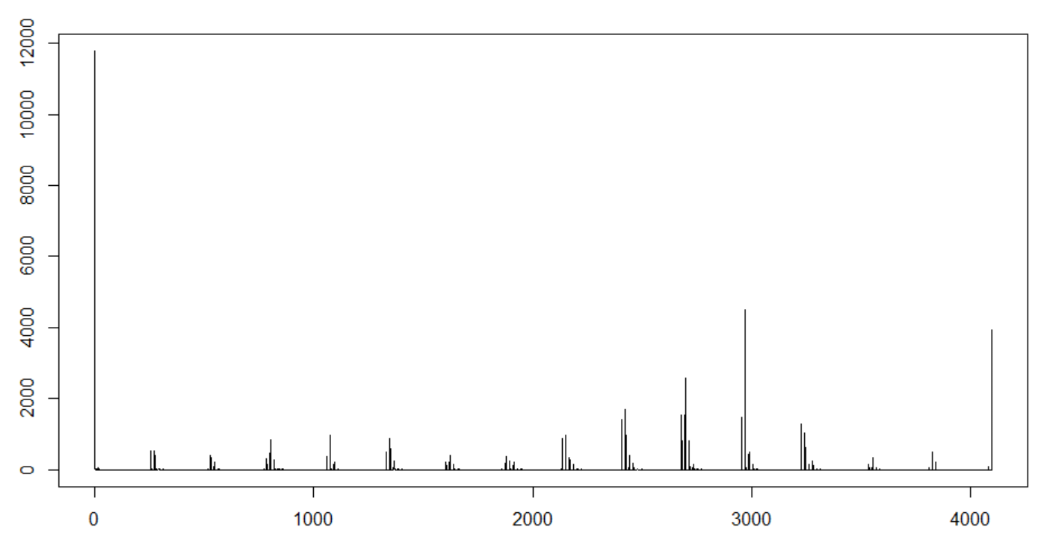
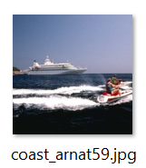

Slide 9
Testing color histogram
How do we know if color histogram work?
The retrieval test
The classification test
The clustering test

Slide 10
Flipping does not change the histogram
hist(img) = hist(fliplr(img)) = hist(flipuld(img))
Rotating with right angle
hist(img) = hist(flip90(img)) = hist(flipu180(img))
Normalizing
norm(hist(img)) ≈ norm(hist(scaled(img, 2, 2) )

Slide 11
Color histogram + Spatial
Why spatial information is important?
Is sky blue (above) different from water blue (below)?
Spatial pyramid is the simplest way to add information

