Slide 1
Deep Learning
Henry Tu, 10-oct-2015

Slide 2
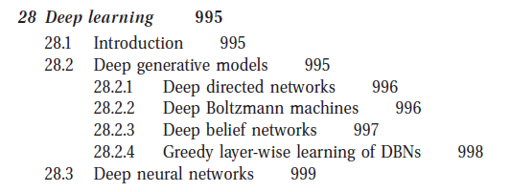
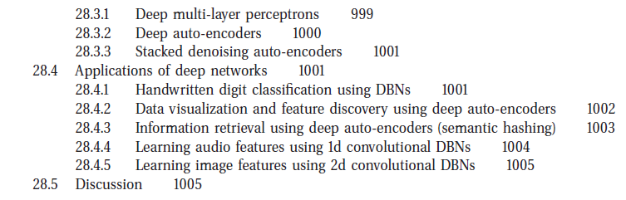
Motivation: why DL?
Model, learning, prediction
Applications: what can DL do?

Slide 3
Motivation to deep learning
Why bother deep learning? Why just using normal learning?
What is deep learning all about?
What can we do with deep learning? What can we create with this new language?

Slide 4
Motivation
Biologically functional approach (Biologically-inspired approach), trying to model the brain
General architecture (universal machine) from units.

Slide 5
Learning with new setting for hidden variables

Slide 6
Concept of hidden/observed variables
x1 -> y1
x2 -> y2
xk -> yk
x1 -> { z1, z3 } -> y1
x2 -> { z2, z7, z9 } -> y2
xk -> { zt, zh, zl } -> yk

Slide 7
Learning with hidden layers: the new setting
Training the hidden layers: what is the training setting when the hidden layer comes in?
We have xj -> zk and zk -> yj, we don't have xj->yj any more.
We may use EM
We may use back propagation

Slide 8
Some models

Slide 9
Reading PGM
p(x1, x2, x3) = p(x1) p(x2|x1) p(x3|x1, x2)
p(x1, x2, x3, x4) = p(x1) p(x2|x1) p(x3|x2) p(x4 | x3)
p(d, w, z) = sum(z) { p(d|z)p(w|z)p(z) }
A
B
C
D

Slide 10
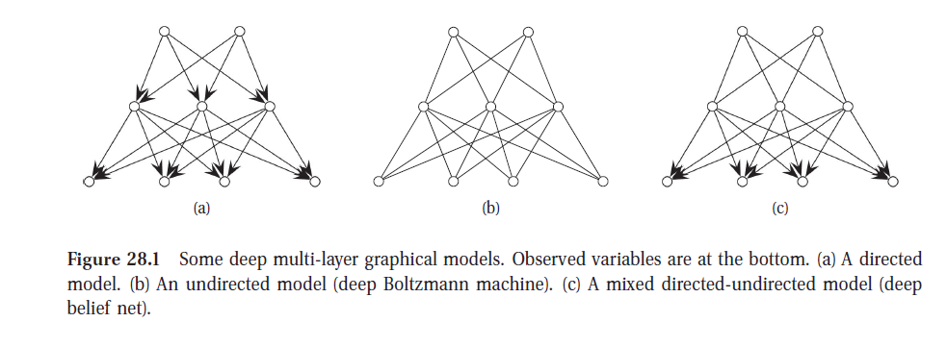
PGM
hidden
observed

Slide 11
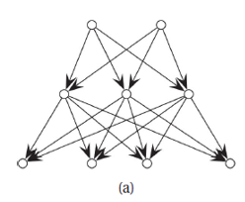
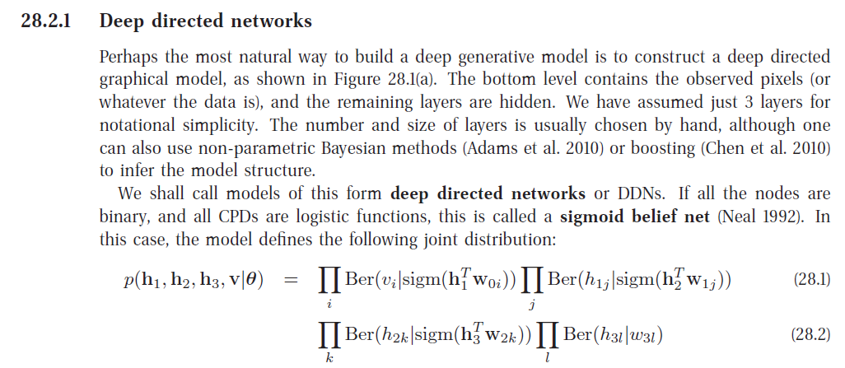
Deep directed network
Joint distribution of hidden and observed variables

Slide 12
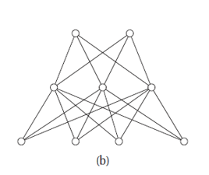
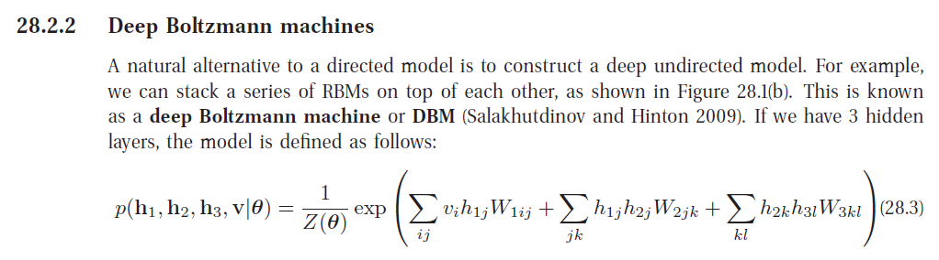
Deep Boltzmann machines
Joint distribution of hidden and observed variables
The exponential family
You can turn on/off one connection by setting W

Slide 13
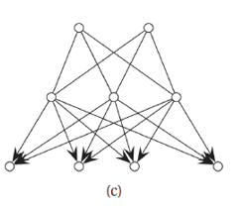
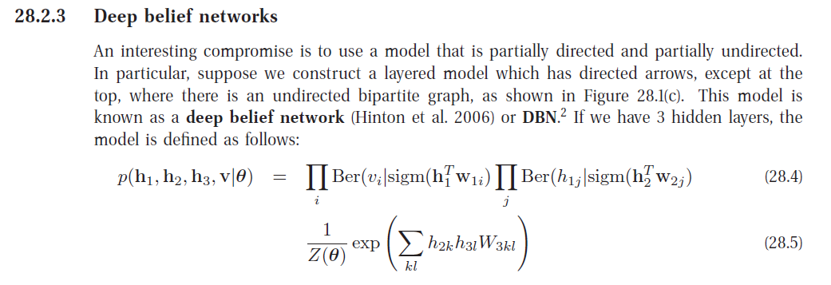
Deep belief networks

Slide 14
Prediction
Application

Slide 15
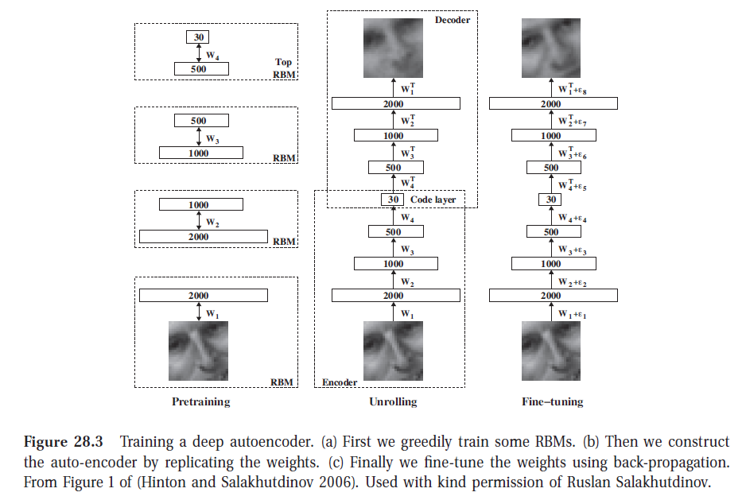

Slide 16
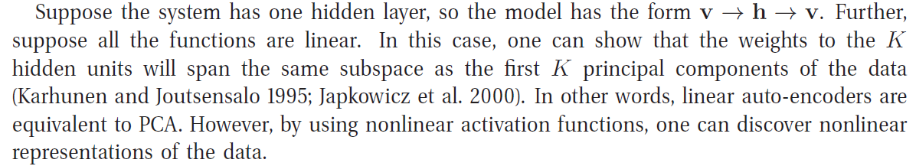
An example: PCA and vhv

Slide 17
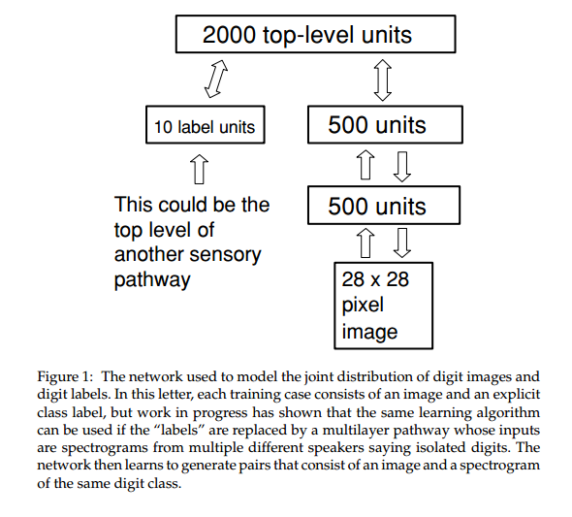
http://www.cs.toronto.edu/~fritz/absps/ncfast.pdf

Slide 18
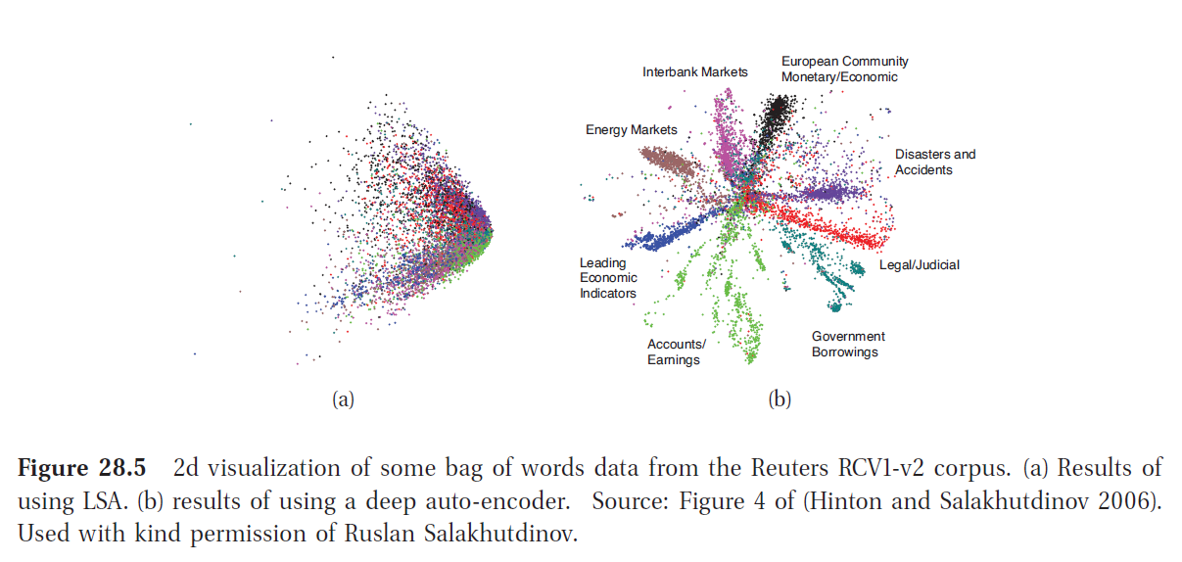
Visualization in 2D
Projection to 2D

