Slide 1
Important concepts of SVM Support vectors, kernels, linear separable
Henry Tu, 28-aug-2015

Slide 2
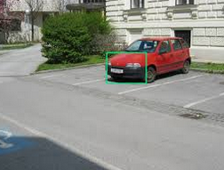
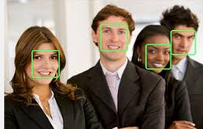
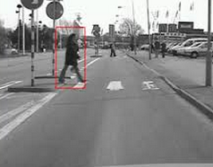
Binary classification
face
face
car
face
face
Non-car
Non-car
Nonface
Nonface
Pedestrian
NonP
NonP

Slide 3










SVM binary classification
training
testing
X1=
Y1 = +1
X1’=
Y1’ = -1 or 1
X2=
Y2 = +1
X3=
X2’=
Y2’ = -1 or 1
Y3 = +1
X4=
Y4 = +1
X3’=
Y3’ = -1 or 1
X5=
Y5 = -1
X6=
Y6 = -1
X7=
Y7 = -1

Slide 4


Framing the problem
w*x - b = 1
face
w*x - b = 0
w*x - b = -1
Non-face
Large-margin classification

Slide 5



Learning / classification
Classification just by the dot product of w and x minus b
Finding learning coefficients alpha-j and support vectors x-j for w and b
X+ is a support vectors with label +1
X- is a support vectors with label -1

Slide 6
Linearly separable
Y = w*x - b

Slide 7
Non-linearly separable
Y = w*phi(x) - b

Slide 8
Support vectors
How to simplify the instance-based classification model

Slide 9
Support vectors
Only vectors near the decision boundary (confusion area) are important or support vectors

Slide 10
Support vectors (2)

Slide 11

Support vectors (3)
Instance-based approach
But not all instance.
Sparse machine.
Only support vectors are included in the decision or classification model.
Other vectors will be removed
kNN is NOT sparse because it uses all vectors

Slide 12
To find the support vectors We use SMO algorithm
https://en.wikipedia.org/wiki/Sequential_minimal_optimization
We have to find x-j using SMO algorithm
Then we can compute w, with alpha-j and x-j (where x-j are support vectors) from the SMO results

Slide 13
_1, _2, _3 for support vectors
Support vector 2
W1
W2
W3
W4
X1_1
X2_1
x3_1
x4_1
X1_2
X2_2
x3_2
x4_2
1,2,3,4 for dimensions
= a_1*y_1*
+ a_2*y_2*
Support vector 1
X1_3
X2_3
x3_3
x4_3
+ a_3*y_3*
Support vector 3

Slide 14
Kernel method
How to classify non-linear dataset

Slide 15
If we work on the original dataset, we cannot separate
Y = x
If we work on the transformed dataset, we separate
We need to bend or transform
Y = x*x
Y = x*x

Slide 16
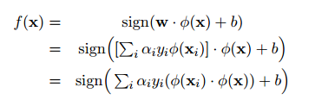

In simple/linear case, we use raw x with p dimensions, then we also have w with p dimensions
In kernel/non-linear case, we use φ(x) with q dimensions, then we also have w with q dimensions (q can be smaller or bigger than p)

Slide 17
Given a dataset D, we have to train/test again and again to select the model based on error
First, we use linear model, if small error, then we are done
If not, we have to try different transformation function φ(x) to select the model
We need the list of transformation function φ(x) to try
The transformation function captures the model structure

Slide 18

Transformation function And kernel function
K(xj, xk) = φ(xj)*φ(xk)
If we have kernel function, we don’t have to use transformation function

Slide 19
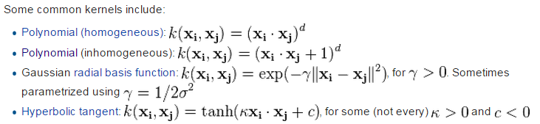
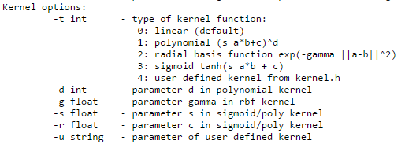
Useful kernel
Linear kernel when d = 1
ker(xj, xk) = xj*xk
Option –d in svmlight
Option –g or -s in svmlight
To specify your own kernel function, use –u “func”
To compare two strings

Slide 20
Soft margin
How to relax the hard condition in training

Slide 21
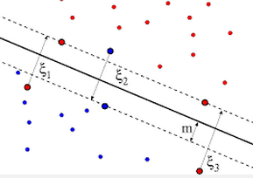
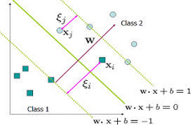


Soft/hard margin
Hard condition
Relax the hard condition by introduction slack variables ξ (psi)
Soft condition
http://www.cs.berkeley.edu/~jordan/courses/281B-spring04/lectures/lec6.pdf

