Slide 1
Sampling methods
Henry Tu, 28-sep-2015

Slide 2
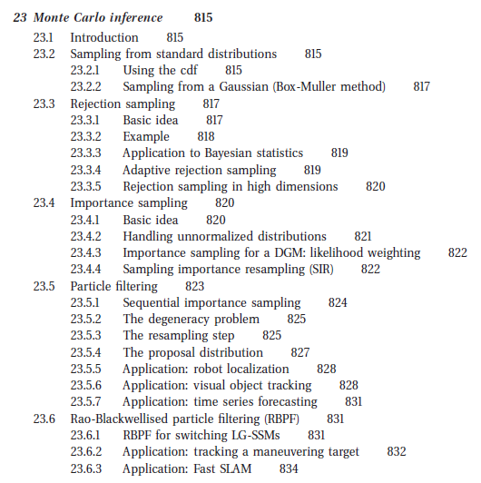

Slide 3
Sampling methods
Draw sample from the distribution, when we have the list of samples then we are done
Make sure that the samples come from the original distribution (by drawing histogram and by test, like chi-square test)
Exploring methods does not require samples to form original distributions but they are guided by the original distributions
Applications in simulation (dataset generation) and optimization

Slide 4
Sampling
Original Distribution f(x)
Samples
{ x1, x2, .., xn }
Reconstruction

Slide 5
Univariate
One-dimension

Slide 6
Sampling from U(a, b)
x <- runif(9000, 0, 1);
print(data.frame(
key=c("min", "max", "mid"),
val=c(min(x), max(x), mean(x))
));

Slide 7
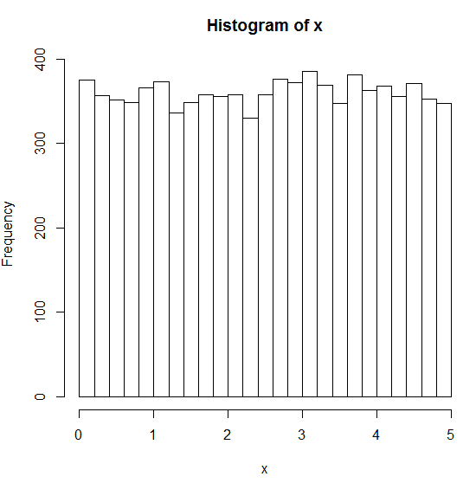
setwd("C:/Users/hieutt9/Desktop");
graphics.off();
x <- runif(1000, 0, 5);
hist(x, breaks=30);
x <- runif(5000, 0, 5);
dev.new(); hist(x, breaks=30);
x <- runif(9000, 0, 5);
dev.new(); hist(x, breaks=30);

Slide 8
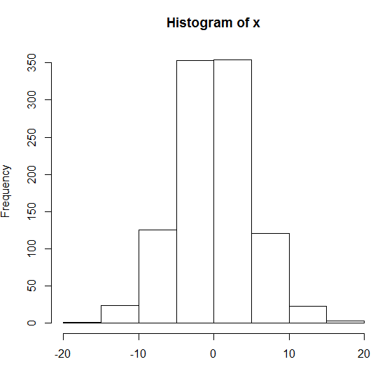
Sampling from N(mu, sigma)
x <- rnorm(1000, 0, 5);
hist(x);

Slide 9
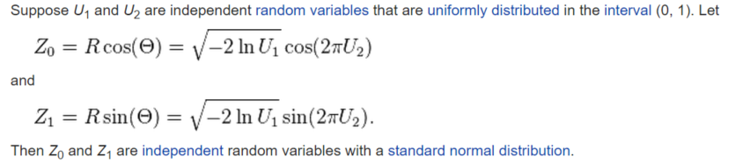
Box-Muller
U1 <- runif(5000, 0, 1);
U2 <- runif(5000, 0, 1);
x <- sqrt(-2*log(U1))*cos(2*pi*U2);
hist(x, breaks=30);

Slide 10
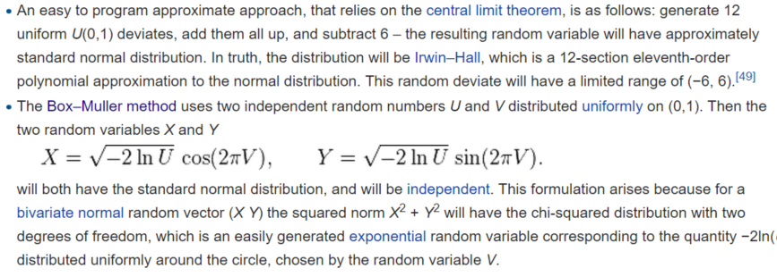
12U-6
x <- -6;
for(k in 1:12) x <- x + runif(5000, 0, 1);
hist(x, breaks=30);
https://en.wikipedia.org/wiki/Normal_distribution#Generating_values_from_normal_distribution

Slide 11


Why does 12U-6 works?
https://en.wikipedia.org/wiki/Uniform_distribution_(continuous)

Slide 12
Transformation method
(Lookup method)

Slide 13
x <- runif(9000, 0, 1);
print(data.frame(
key=c("min", "max", "mid"),
val=c(min(x), max(x), mean(x))
));
y <- ifelse(x<0.5, "red", "green");
head(data.frame(y))
table(y)
y <- ifelse(x<0.1, "red", "green");
head(data.frame(y))
table(y)
y <- ifelse(x<0.3, "red", "green");
head(data.frame(y))
table(y)

Slide 14
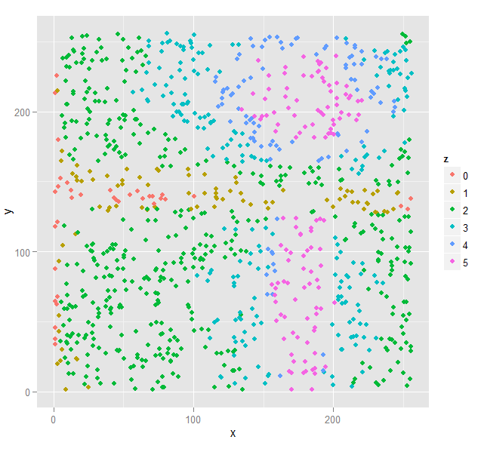
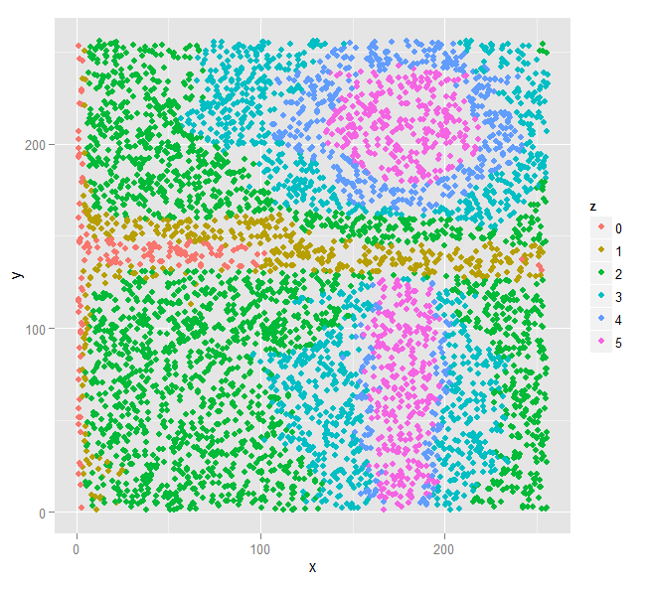
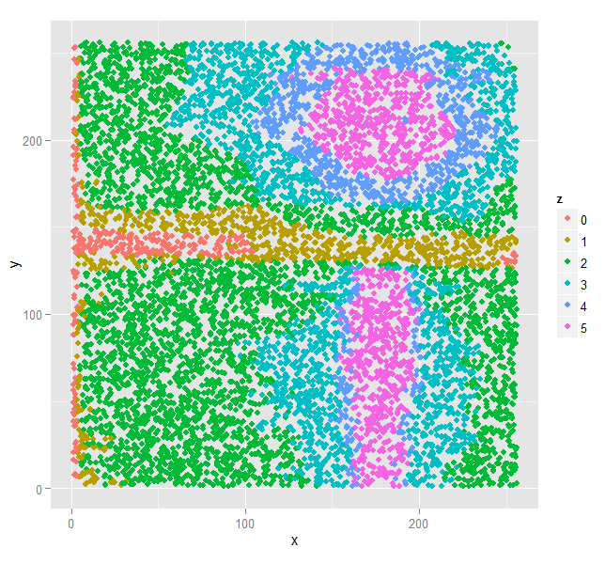


Slide 15
Rejection sampling

Slide 16
Rejection sampling
We cannot sample from complicated distribution p(x)
But we can explore it by using the simpler distribution q(x), which is called the proposal distribution.
Sample (x, y) and keep the pair if y < f(x)
Then we can check the integration

Slide 17
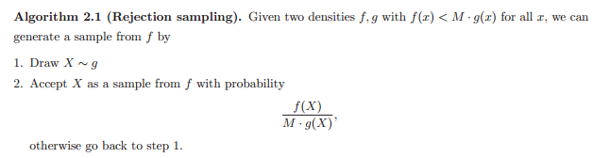
rm(list=ls());
setwd("C:/Users/hieutt9/Desktop");
graphics.off();
library(ggplot2);
sampleReject <- function(n, f, g)
{
x <- rep(NA, n);
cnt <- 0;
while(cnt < n)
{
xk <- g();
uk <- runif(1, 0, 1);
if( uk < f(xk) ) { cnt <- cnt + 1; x[cnt] <- xk; }
}
return(x);
}
f <- function(x){ 0.3*dnorm(x, -5, 1) + 0.1*dnorm(x, 0, 0.5) + 0.6*dnorm(x, 5, 0.5) }
g <- function(x){ runif(1, -10, 10) }
X <- sampleReject(1000, f, g);
hist(X, breaks=70, xlim=c(-10, 10) );
http://web.maths.unsw.edu.au/~peterdel-moral/teaching-notes-levers-johansen.pdf

Slide 18
Importance Sampling

Slide 19
Importance sampling
We cannot sample from complicated distribution p(x)
But we can explore it by using the simpler distribution q(x), which is called the proposal distribution.
Keeping the weights for each sample
xj and wj = p(xj)/q(xj)
Check the integration

Slide 20

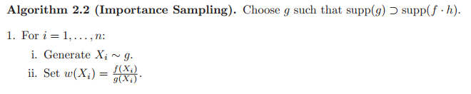
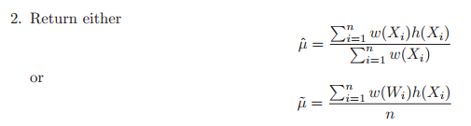
http://web.maths.unsw.edu.au/~peterdel-moral/teaching-notes-levers-johansen.pdf

Slide 21
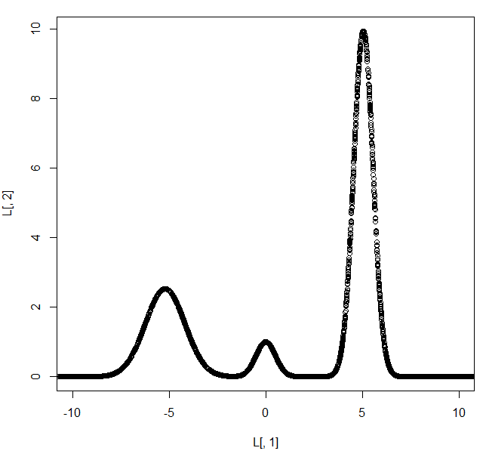
rm(list=ls());
setwd("C:/Users/hieutt9/Desktop");
graphics.off();
library(ggplot2);
sampleImp <- function(n, f, g)
{
x <- rep(NA, n);
w <- rep(NA, n);
for(k in 1:n)
{
xk <- g$samp();
x[k] <- xk
w[k] <- f(xk) / g$eval(xk);
}
return( cbind(x=x, w=w) );
}
f <- function(x){ 0.3*dnorm(x, -5, 1) + 0.1*dnorm(x, 0, 0.5) + 0.6*dnorm(x, 5, 0.5) };
g <- list(
eval=function(x) { dunif(x, -10, 10) },
samp=function() { runif(1, -10, 10) }
);
g <- list(
eval=function(x) { dnorm(x, 0, 5) },
samp=function() { rnorm(1, 0, 5) }
);
L <- sampleImp(5000, f, g);
plot(L[,1], L[, 2], xlim=c(-10, 10) );

Slide 22
Generating datasets

Slide 23
Line
Generate linear data for linear model
Generate non-linear data for learning quadric model

Slide 24
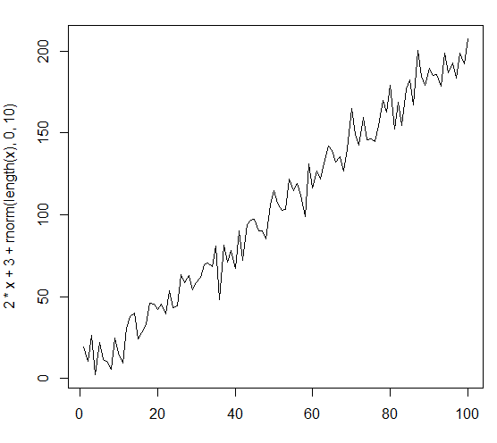
setwd("C:/Users/hieutt9/Desktop");
graphics.off();
x <- 1:100;
plot(x, 2*x + 3, xlim=c(0, 100), ylim=c(0, 200)));
x <- 1:100;
dev.new(); plot(x, 2*x + 3 + rnorm(length(x), 0, 2), type="l");
x <- 1:100;
dev.new(); plot(x, 2*x + 3 + rnorm(length(x), 0, 5), type="l");
x <- 1:100;
dev.new(); plot(x, 2*x + 3 + rnorm(length(x), 0, 10), type="l");

Slide 25
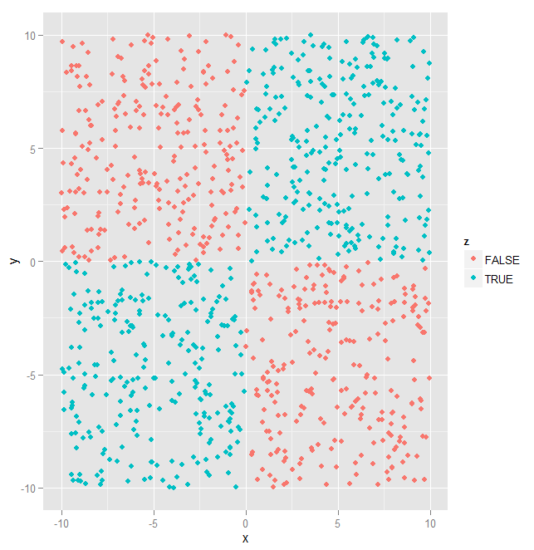
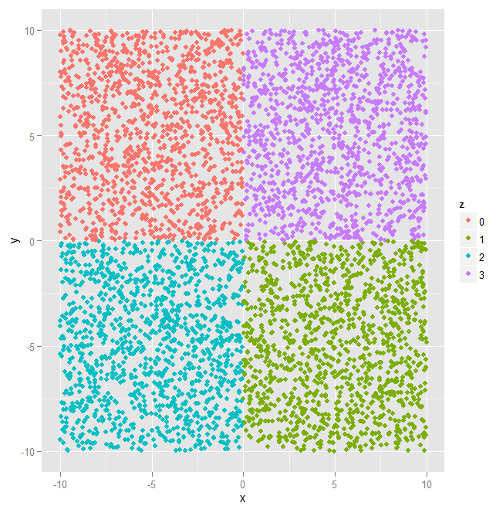
XOR datasets
x <- runif(5000, -10, 10);
y <- runif(5000, -10, 10);
z <- as.factor( x*y > 0 );
qplot(x, y, color=z);
z <- as.factor( 2*(x*y > 0) + (x>0) );
dev.new(); qplot(x, y, color=z);

Slide 26
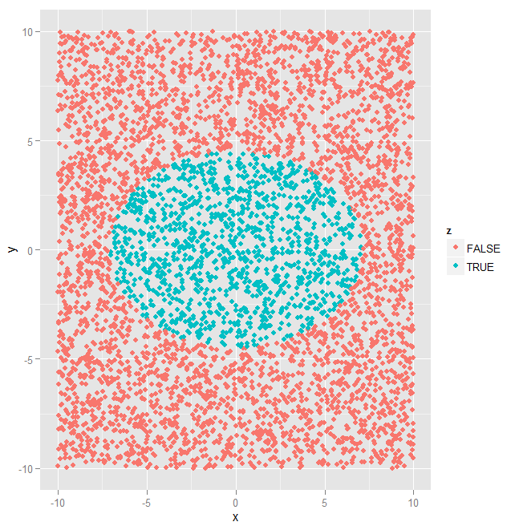
Elliptic dataset
x <- runif(5000, -10, 10);
y <- runif(5000, -10, 10);
z <- as.factor( x*y > 0 );
qplot(x, y, color=z);
z <- as.factor( 2*(x*y > 0) + (x>0) );
dev.new(); qplot(x, y, color=z);
z <- as.factor( 0.02*x*x + 0.05*y*y < 1 );
dev.new(); qplot(x, y, color=z);

Slide 27
Multivariate
d-dimension

Slide 28
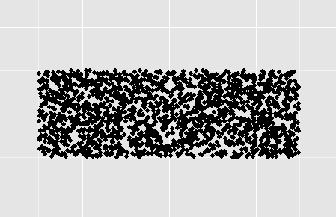
Multivariate U(a, b)
setwd("C:/Users/hieutt9/Desktop");
graphics.off();
library(ggplot2);
x <- runif(2000, -3, 3);
y <- runif(2000, -1, 1);
z <- round(10*exp( -x*x -y*y ));
z <- as.factor(z);
W <- c(-4, 4);
qplot(x, y, xlim=W, ylim=W);

Slide 29
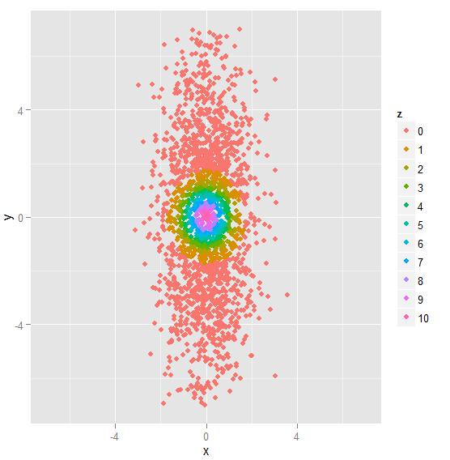
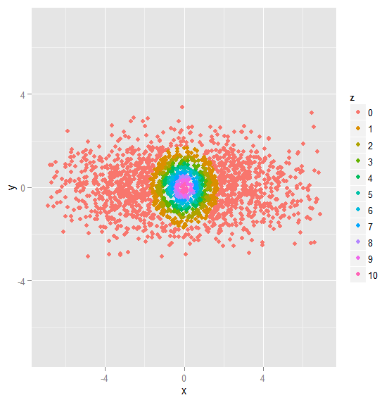
Independent gaussian
setwd("C:/Users/hieutt9/Desktop");
graphics.off();
library(ggplot2);
x <- rnorm(2000, 0, 1);
y <- rnorm(2000, 0, 3);
z <- round(10*exp( -x*x -y*y ));
z <- as.factor(z);
W <- c(-7, 7);
qplot(x, y, color=z,
xlim=W, ylim=W);

Slide 30
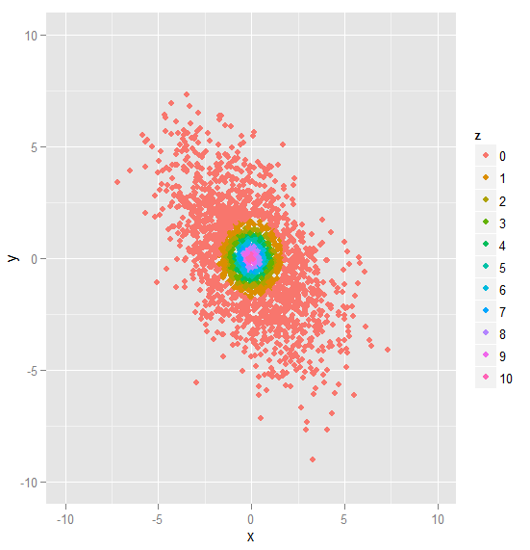
setwd("C:/Users/hieutt9/Desktop");
graphics.off();
library(ggplot2); library(Matrix);
x <- rnorm(2000, 0, 1);
y <- rnorm(2000, 0, 1);
L <- chol( rbind(
c(3, -2),
c(-2, 7)
));
xy <- L %*% rbind(x, y);
x <- xy[1, ];
y <- xy[2, ];
z <- round(10*exp( -x*x -y*y ));
z <- as.factor(z);
W <- c(-10, 10); qplot(x, y, color=z, xlim=W, ylim=W);

Slide 31
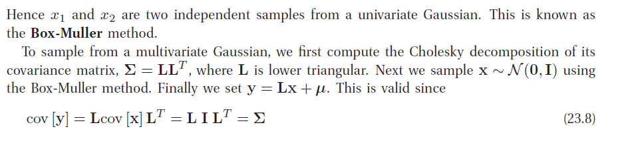
Multivariate gaussian N(mu, sigma)

