Slide 1
Optimization for machine learning
Henry Tu, 02-oct-2015

Slide 2
In general, in machine learning
finding the optimal value of f(x) subject to the constraint (x ∈ R is the simplest one).
x* = argmax(x ∈ R){ f(x) }

Slide 3
In machine learning
in machine learning, we only care about optimizing the cost function (or we want to find the function with minimal error).
optimizing the linear function -> gradient descending method
optimizing the SVM cost function -> the SMO method
find the minimal vocab to encode vectors -> the kmeans method
find the set of GMM parameters to maximize the probability of the dataset -> the EM method for GMM
find the best state sequence given the symbol/observed sequence -> the Viterbi method

Slide 4
Convex functions

Slide 5
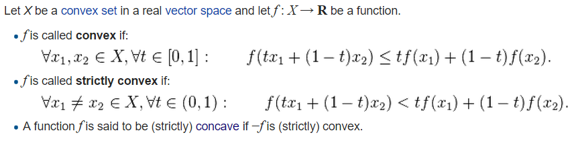
Convex/concave function
When we have convex function, we can have global optima.
L2-cost function is usually convex.

Slide 6
Transformation
some transformations preserve convexity.
f(x, y) = x^2 + y^2 is convex
exp( f(x, y) ) = exp( x^2 + y^2 ) is still convex
log( f(x, y) ) = log( x^2 + y^2 ) is still convex

Slide 7
Discrete search space

Slide 8
1
x2
1
x1
x3
1
1
A
B
4
2
x4
4
1
x5
3
x6

Slide 9
1
x2
1
x1
x3
1
1
A
0.2
B
4
2
x4
4
1
0.2
x4
3
x5

Slide 10
Enumeration
And uniform sampling

Slide 11
Enumeration / uniform sampling
We explore all the places of the same importance
Example, maximizing H(x, y) = exp( -x*x - y*y )
Example, minimizing H(a, b) = (a*1 + b - 2)^2 + (a*2 + b - 4)^2 + (a*3 + b – 6.1)^2 + (a*4 + b - 7.9)^2
Example, drawing 1000 samples from N(1, 3) and try to learn the parameters by enumeration.

Slide 12
Gaussian sampling

Slide 13
Gaussian sampling
We emphasize on certain region
Sigma can be used to control the range

Slide 14
Gaussian sampling
Example, maximizing H(x, y) = exp( -x*x - y*y )
Example, minimizing H(a, b) = (a*1 + b - 2)^2 + (a*2 + b - 4)^2 + (a*3 + b - 6.1)^2 + (a*4 + b - 7.9)^2

Slide 15
Gibbs sampling

Slide 16
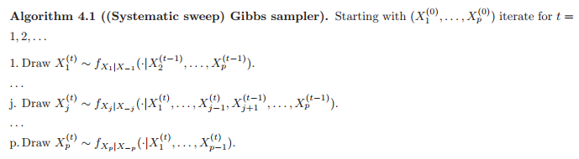
Gibbs sampling
Start from one initial state / vector
Moving to the next state by sampling in one dimension
Rotate the dimension
http://web.maths.unsw.edu.au/~peterdel-moral/teaching-notes-levers-johansen.pdf

Slide 17
Gibbs sampling
Sample in one dimension using the technique we have known
Rejection sampling
Importance sampling

Slide 18
Simulated Annealing

Slide 19
Simulated Annealing
We start from one state x0 and moving to next state using the neighboring function (random walk)
We try to escape local optimal by accepting the next state with certain probability controlled by the temperature T

Slide 20
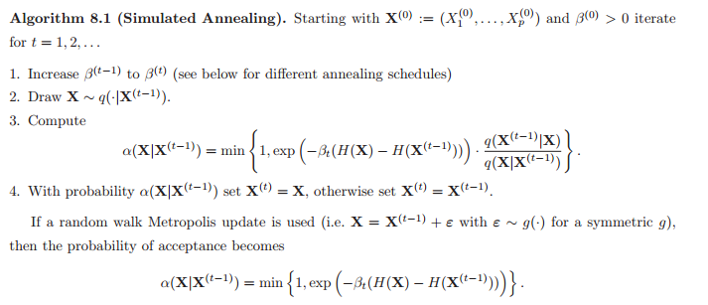
http://web.maths.unsw.edu.au/~peterdel-moral/teaching-notes-levers-johansen.pdf

Slide 21
Gradient Ascending

Slide 22
Gradient ascending
We don’t move freely, we move along the gradient direction
Not all function has gradient function
The alpha step size is still the problem with gradient ascending

