Slide 1
Decision Tree, Boosting, Bagging, Random Forest
Henry Tu, 24-sep-2015

Slide 2
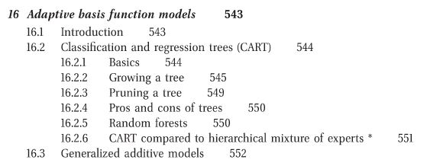
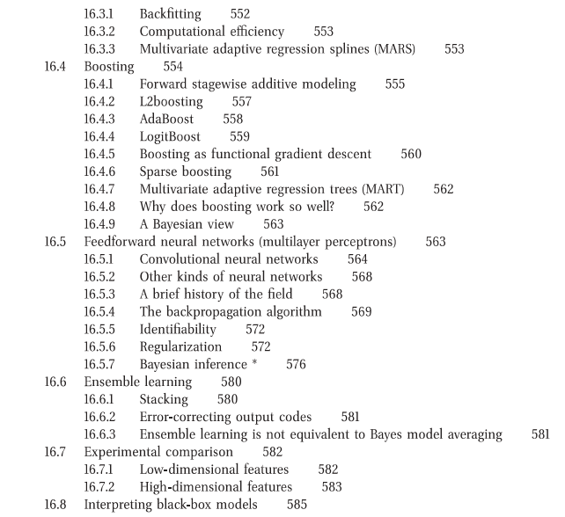

Slide 3
Decision Tree
Fast depending on the tree height
Divide the pattern space based on the output class, not the input
Using the output field to divide
Seek for the homogeneity in division
Understanding the contribution of input fields to output (X -> Y)

Slide 4
Tree Learning Algorithm
CART
C4.5
ID3

Slide 5
Experiment 1: IRIS
library(ggplot2); library(caret);
h1 <- function(msg) { cat("\n", msg, "\n"); }
main <- function()
{
h1("-------------loading data");
data(iris);
cat("\n"); print( names(iris) );
cat("\n"); print( table(iris$Species) );
h1("-------------splitting data");
S <- createDataPartition(y=iris$Species, p=0.7, list=FALSE)
A <- iris[S,]; B <- iris[-S,];
cat("\n"); print(head(A));
cat("\n"); print(head(B));
h1("-------------plotting data");
dev.new();
print( qplot(Petal.Width, Sepal.Width, colour=Species, data=A) );
dev.new();
print( qplot(Petal.Width, Petal.Length, colour=Species, data=A) );
h1("-------------model fitting");
M <- train(Species ~ ., method="rpart", data=A)
cat("\n"); print(M$finalModel)
dev.new(); plot(M$finalModel, uniform=TRUE, main="Classification Tree");
text(M$finalModel, use.n=TRUE, all=TRUE, cex=.8)
h1("-------------testing if it fits");
y <- A$Species;
y1 <- predict(M, newdata=A);
e1 <- abs(y != y1);
cat("\n"); print(head(data.frame( y, y1, e1 )));
cat("\n"); print(table( y1, y ));
h1("-------------testing if it handles new input");
y <- B$Species;
y1 <- predict(M, newdata=B);
e1 <- abs(y != y1);
cat("\n"); print(head(data.frame( y, y1, e1 )));
cat("\n"); print(table( y1, y ));
}
cat(rep("\n", 10)); main();

Slide 6
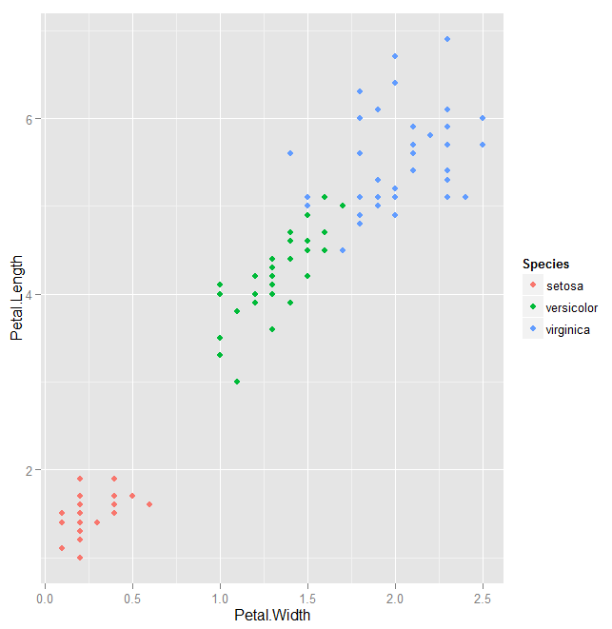
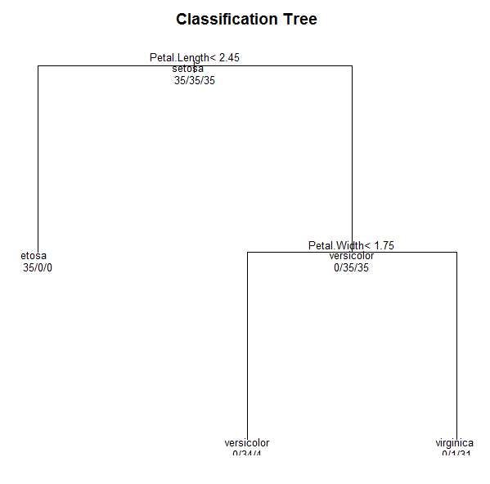
What does the tree tell us?

Slide 7
Pental.Width = 1.75
Pental.Length = 2.45

Slide 8
Experiment 2: XOR4 dataset
rm(list=ls()); dev.off();
library(ggplot2); library(caret);
h1 <- function(msg) { cat("\n", msg, "\n"); }
main <- function()
{
h1("-------------loading data");
x <- runif(7000, -10, 10);
y <- runif(7000, -20, 20);
z <- as.factor( 2*(x*y > 0) + (x>0) );
A <- data.frame(x, y, z);
h1("-------------rendering data");
print( qplot(x, y, color=z) );
h1("-------------model fitting");
M <- train(z ~ ., method="rpart", data=A)
cat("\n"); print(M$finalModel)
dev.new(); plot(M$finalModel, uniform=TRUE, main="Classification Tree");
text(M$finalModel, use.n=TRUE, all=TRUE, cex=.8)
h1("-------------testing if it fits");
y <- A$z;
y1 <- predict(M, newdata=A);
e1 <- abs(y != y1);
cat("\n"); print(head(data.frame( y, y1, e1 )));
cat("\n"); print(table( y1, y ));
}
cat(rep("\n", 10)); main();

Slide 9
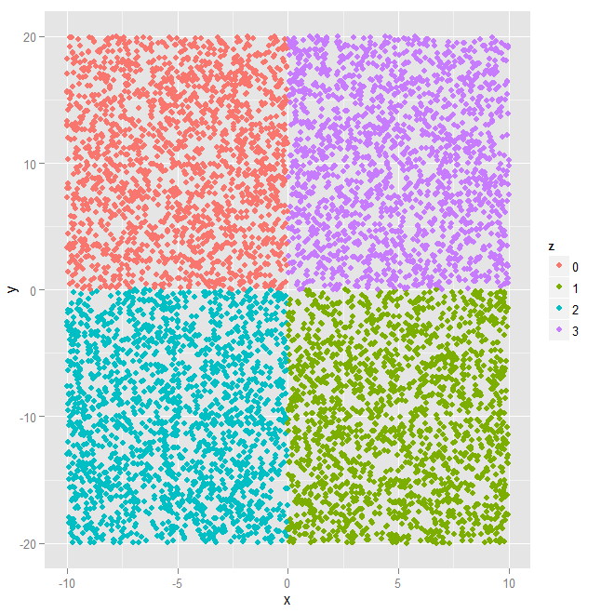
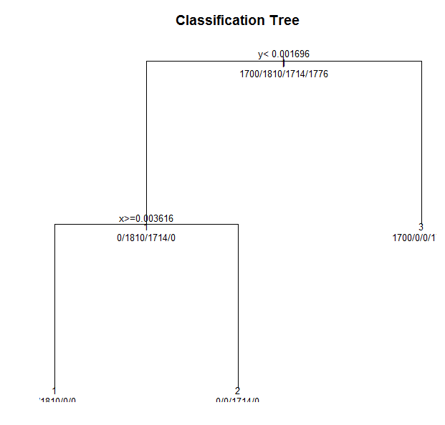
Results

Slide 10
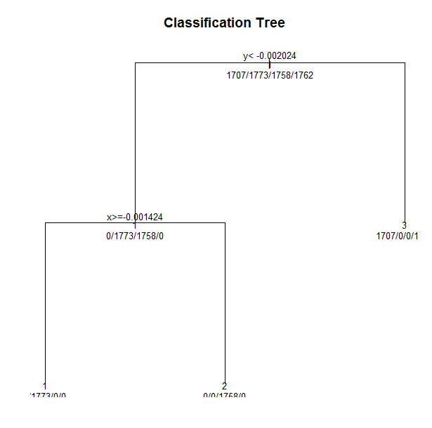
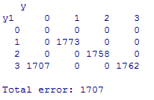
Result analysis

Slide 11
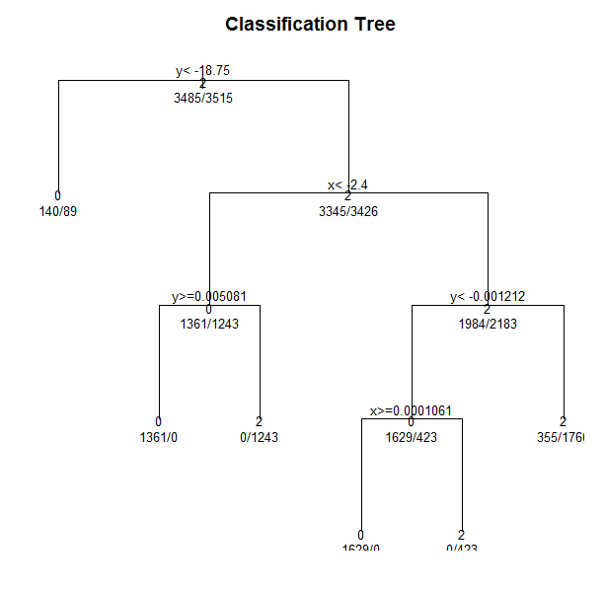
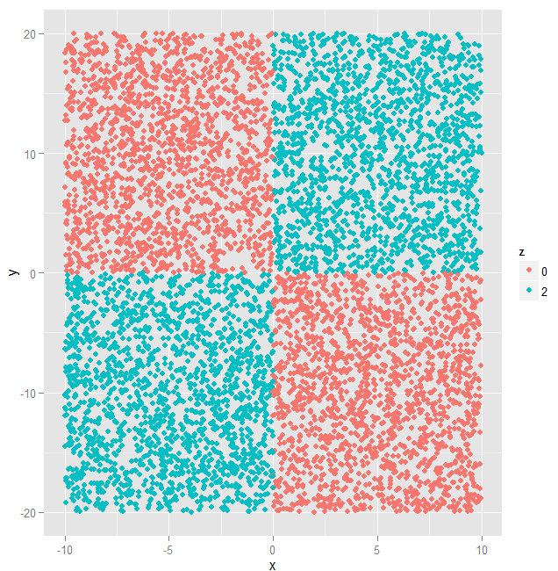
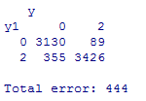
Decision Tree for xor2

Slide 12
Bagging

Slide 13
Bagging
D1
y1 = c(x|D1)
Original dataset D
y2 = c(x|D2)
y = cmb(y1, y2, .., yk)
D2
Dk
yk = c(x|D2)
Bootstrapping
Learning components model
Averaging or voting

Slide 14
Bootstrapping
Drawing sample from one dataset with replacement
The data can be repeated especially when number of trials / draws is bigger than that of rows (samples)
data(iris);
mr <- nrow(iris);
x <- as.integer( runif(100, 1, mr) );
print(x); cat("Summary:", min(x), max(x), mr, "\n");
x <- as.integer( runif(100, 1, mr) );
print(x); cat("Summary:", min(x), max(x), mr, "\n");

Slide 15
Training/testing models
rm(list = ls());
trainBag <- function(D, kpar)
{
mr <- nrow(D);
M <- list();
for(k in 1:kpar)
{
x <- unique( as.integer( runif(100, 1, mr) ) );
M[[k]] <- train(Species ~ ., method="rpart", data=D)
}
return(M);
}
predictBag <- function(M, D)
{
mc <- length(M);
mr <- nrow(D);
for(k in 1:mc)
{
D[, paste("y", k, sep="")] <- predict(M[[k]], D);
}
return(D);
}
data(iris);
M <- trainBag(iris, 5);
y <- predictBag(M, iris);
print(y[1:20, ]);

Slide 16
Random forest

Slide 17
Random Forest
Combining many trees from many bootstrap datasets
Bootstrapping both rows and input columns

Slide 18
Experiment in R
rm(list=ls()); dev.off();
library(ggplot2); library(caret);
h1 <- function(msg) { cat("\n", msg, "\n"); }
main <- function()
{
h1("-------------loading data");
x <- runif(1000, -10, 10);
y <- runif(1000, -20, 20);
z <- as.factor( ifelse(x*y > 0, "face", "back") );
A <- data.frame(x, y, z);
h1("-------------rendering data");
print( qplot(x, y, color=z) );
h1("-------------model fitting");
M <- train(z ~ ., method="rf", data=A)
print(M);
h1("-------------testing if it fits");
y <- A$z;
y1 <- predict(M, newdata=A);
e1 <- abs(y != y1);
cat("\n"); print(head(data.frame( y, y1, e1 )));
cat("\n"); print(table( y1, y ));
cat("\n"); cat("Total error:", sum(e1), "\n");
h1("-------------testing if it handles new input");
x <- runif(5000, -100, 100);
y <- runif(5000, -200, 200);
z <- as.factor( ifelse(x*y > 0, "face", "back") );
B <- data.frame(x, y, z);
y <- B$z;
y1 <- predict(M, newdata=B);
e1 <- abs(y != y1);
cat("\n"); print(head(data.frame( y, y1, e1 )));
cat("\n"); print(table( y1, y ));
cat("\n"); cat("Total error:", sum(e1), "\n");
}
cat(rep("\n", 10)); main(); cat("\n");

Slide 19
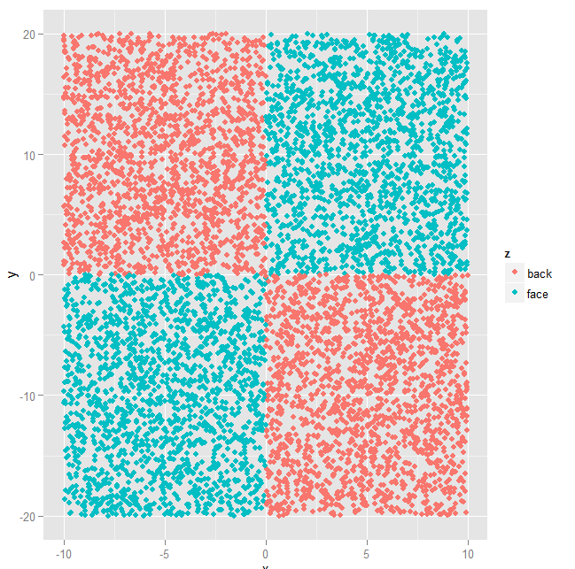
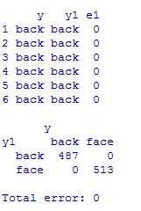
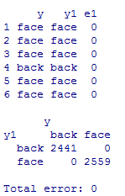

Slide 20
Boosting

Slide 21
Boosting
Can we combine weak learners to create a powerful classifier?
Soft-modify the dataset by weights and learn the weak classifier over the data

Slide 22
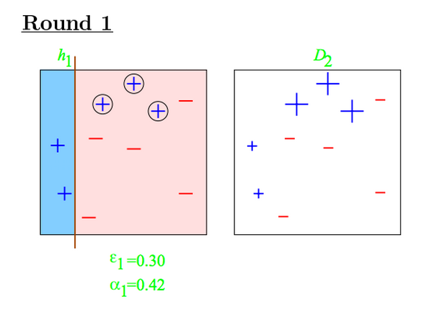
http://datasciencespecialization.github.io/courses/08_PracticalMachineLearning/022boosting/#7
http://webee.technion.ac.il/people/rmeir/BoostingTutorial.pdf

Slide 23
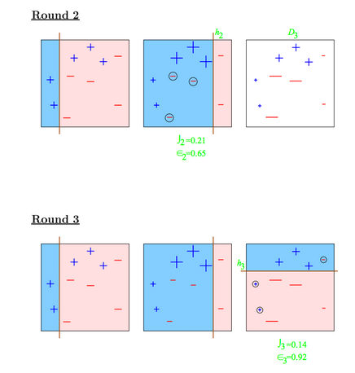
http://datasciencespecialization.github.io/courses/08_PracticalMachineLearning/022boosting/#7
http://webee.technion.ac.il/people/rmeir/BoostingTutorial.pdf

Slide 24
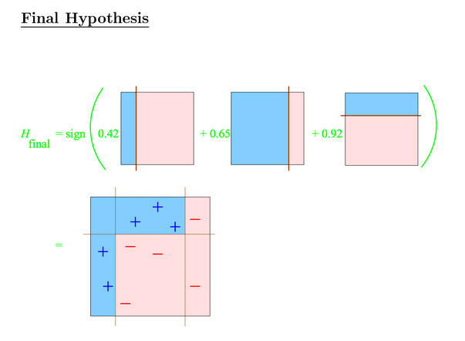
http://datasciencespecialization.github.io/courses/08_PracticalMachineLearning/022boosting/#7
http://webee.technion.ac.il/people/rmeir/BoostingTutorial.pdf

Slide 25
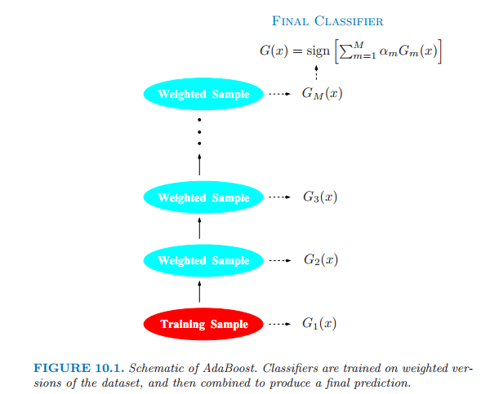
Elements of Statistical Learning

Slide 26
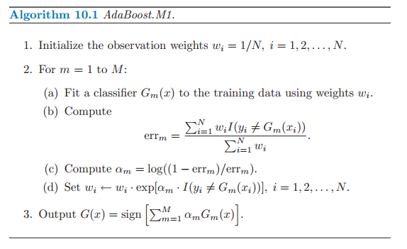
Elements of Statistical Learning

Slide 27
Model averaging methods
We have many weak models and we combine them to make a final powerful model
We need to build weak models from the different datasets by bootstrapping and weighting

