Slide 1
HMM
Henry Tu, 26-sep-2015

Slide 2
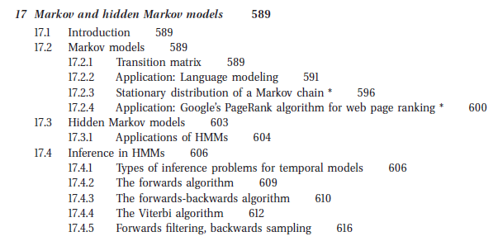
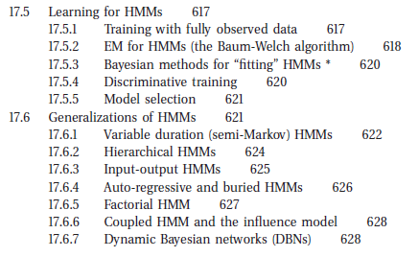

Slide 3
Chain Rule
p(x1, x2, x3, x4, x5)
= p(x5|x1, x2, x3, x4)p(x1, x2, x3, x4)
= p(x5|x1, x2, x3, x4)p(x4|x1, x2, x3)p(x1, x2, x3) = p(x5|x1, x2, x3, x4)p(x4|x1, x2, x3)p(x3|x1, x2)p(x1, x2) = p(x5|x1, x2, x3, x4)p(x4|x1, x2, x3)p(x3|x1, x2)p(x2|x1)p(x1)

Slide 4
Assumptions
p(x1, x2, x3, x4, x5)
= p(x5|x1, x2, x3, x4)p(x4|x1, x2, x3)p(x3|x1, x2)p(x2|x1)p(x1) ≈ p(x5)p(x4)p(x3)p(x2)p(x1)
≈ p(x5|x4)p(x4|x3)p(x3|x2)p(x2|x1)p(x1)
Independent
Markov Assumption
(Local dependent)

Slide 5



Hidden Markov Model

Slide 6
R language
rm(list=ls()); library(HMM);
# Initialise HMM
M <- initHMM(
c("A","B", "C"),
c("x1", "x2", "y1", "y2", "z1", "z2"),
startProbs=c(1, 0, 0),
transProbs=rbind(c(0, 1, 0), c(0, 0, 1), c(1, 0, 0)),
emissionProbs=rbind(
c(0.7, 0.3, 0, 0, 0, 0),
c(0, 0, 0.1, 0.9, 0, 0),
c(0, 0, 0, 0, 0.4, 0.6) )
);
print(M);

Slide 7
Inference from the model

Slide 8
Inference from the model
We have sample sequence Y, can we find the state sequence X
X* = argmax(X) { p(Y|X)p(X) }
Viterbi algorithm
We have the sample sequence Y, can we find the probability p(Y) given the model?
p(Y) = sum(X){ p(Y|X)p(X) }
Can we sample from the model?
Y ~ p(Y|X)p(X)

Slide 9
Viterbi algorithm

Slide 10
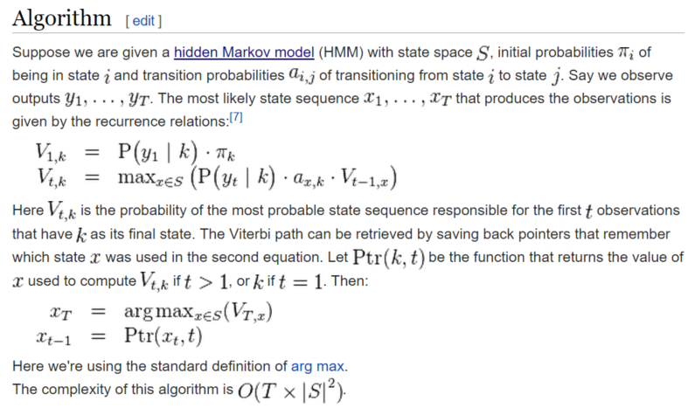
https://en.wikipedia.org/wiki/Viterbi_algorithm

Slide 11
rm(list=ls()); library(HMM);
# Initialise HMM
M <- initHMM(
c("A","B", "C"),
c("x1", "x2", "y1", "y2", "z1", "z2"),
startProbs=c(1, 0, 0),
transProbs=rbind(c(0, 0.9, 0.1), c(0, 0, 1), c(1, 0, 0)),
emissionProbs=rbind(
c(0.7, 0.3, 0, 0, 0, 0),
c(0, 0, 0.1, 0.9, 0, 0),
c(0, 0, 0, 0, 0.4, 0.6) )
);
print(M);
X <- c("x1", "y2", "z1", "x2", "z1");
z = viterbi(M, X);
print(z);

Slide 12
Sampling from the model

Slide 13
The method
We want to sample Y of length n
Choose X1 via pi
Choose Y1 via b(Y| x1)
Choose X2 via a(x2 | x1)
Choose y2 via b(Y|x2)
..
Choose Xn via a(x | x(n-1))
Choose Yn via b(Y | Xn)

Slide 14
Learning HMM model
The Baum-Welch method

Slide 15
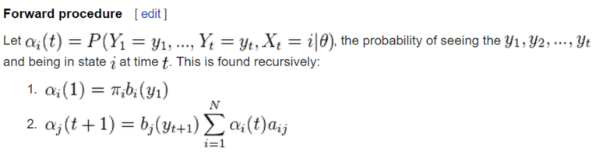
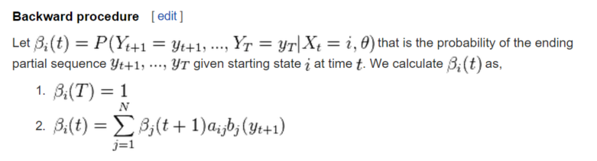
Learning HMM, E-step

Slide 16





Learning HMM, M-step
https://en.wikipedia.org/wiki/Baum%E2%80%93Welch_algorithm

Slide 17
$hmm
$hmm$States
[1] "A" "B" "C"
$hmm$Symbols
[1] "x1" "x2" "y1" "y2" "z1" "z2"
$hmm$startProbs
A B C
1 0 0
$hmm$transProbs
to
from A B C
A 0 1 0
B 0 0 1
C 1 0 0
$hmm$emissionProbs
symbols
states x1 x2 y1 y2 z1 z2
A 1 0 0 0 0 0
B 0 0 1 0 0 0
C 0 0 0 0 1 0
$States
[1] "A" "B" "C"
$Symbols
[1] "x1" "x2" "y1" "y2" "z1" "z2"
$startProbs
A B C
1 0 0
$transProbs
to
from A B C
A 0 0.9 0.1
B 0 0.0 1.0
C 1 0.0 0.0
$emissionProbs
symbols
states x1 x2 y1 y2 z1 z2
A 0.7 0.3 0.0 0.0 0.0 0.0
B 0.0 0.0 0.1 0.9 0.0 0.0
C 0.0 0.0 0.0 0.0 0.4 0.6

