Slide 1

Hasan Atakan Bedel
Summer Practice Presentation (29 July – 17 September)

Slide 2
OUTLINE
BLE
Thermal Array

Slide 3
What is BLE?
Bluetooth Low Energy (~Bluetooth Smart)
Bluetooth Low Energy is the power and application-friendly version of Bluetooth.
Built mainly for Internet of Things (IoT) devices.

Slide 4
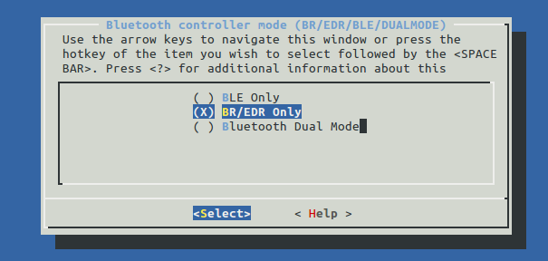
BR/EDR → Basic Rate / Enhanced Data Rate

Slide 5
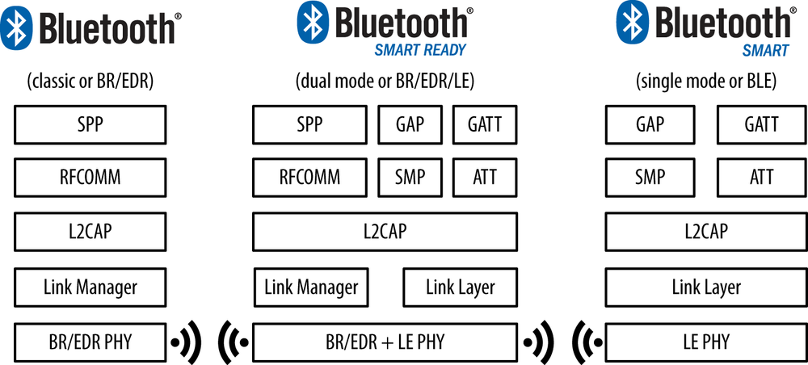

Slide 6
Energy consumption
ESP32 (Power consumption test results)
MAX cpu frequency = 80MHz
ADV(adv_interval = 1000.0ms) average current 2.55mA, max 114.81mA, min 0.79mA
SCAN(scan_window = 500.0ms, scan_interval = 1000.0ms) average current 49.05mA, max 123.80mA, min 0.85mA
CONNECTION(connection_interval = 960.0ms, slave_latency = 0) average current 2.11mA, max 106.01mA, min 0.94mA
Whereas
NRF52810: average current 9.3 µA

Slide 7
Network Topology
BROADCASTING AND OBSERVING
CONNECTIONS
Example : Beacons
Example : Monitoring Sensors

Slide 8
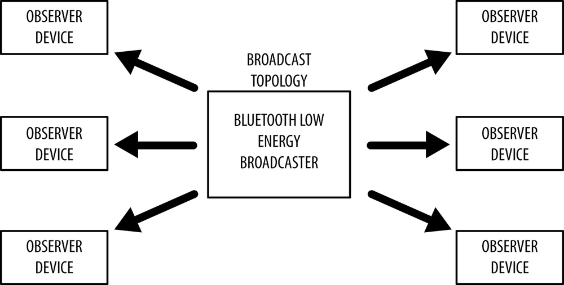
Broadcast / Observer

Slide 9
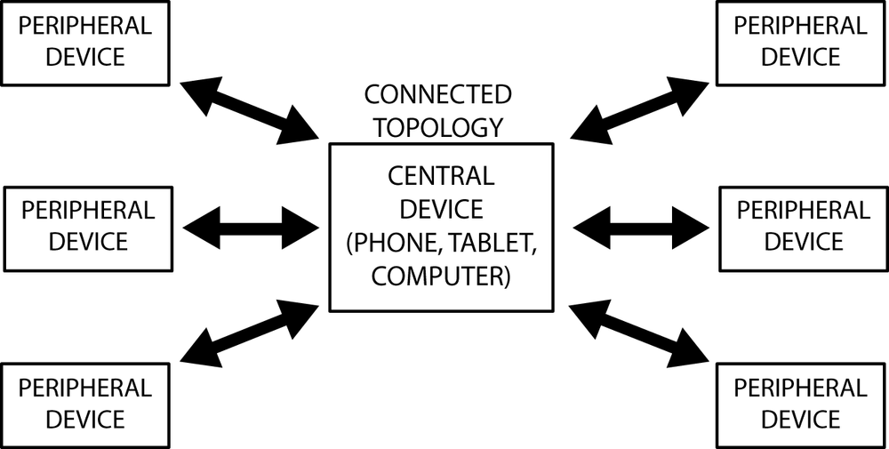
Connection

Slide 10
Connection Modal
Server(Slave,Peripheral) ---- Client(Master,Central)

Slide 11
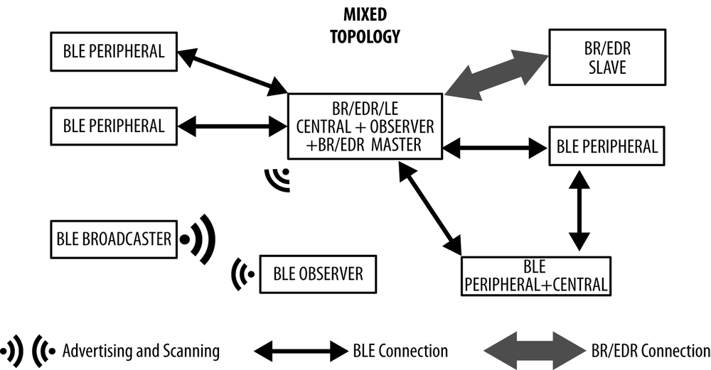
Mixed

Slide 12
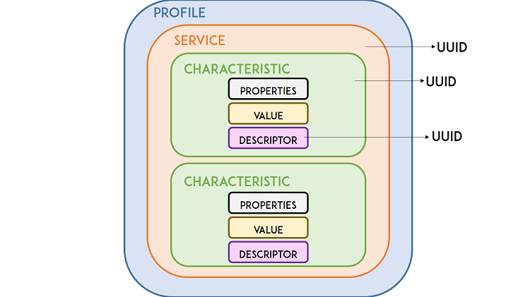
Profiles

Slide 13
Main Profiles
Generic Access Profile (GAP)
Generic Attribute Profile (GATT)

Slide 14
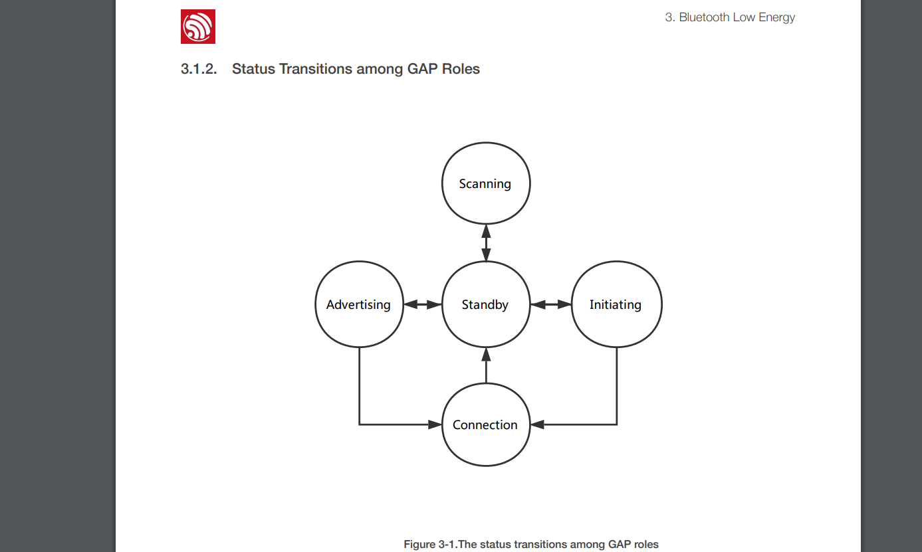
Generic Access Profile (GAP)

Slide 15
Generic Attribute Profile (GATT)
It defines the way that two Bluetooth Low Energy devices transfer data back and forth using concepts called Services and Characteristics.

Slide 16
Predefined Profiles and Services
Examples :
Battery Service, Insulin Delivery, Device Information

Slide 17
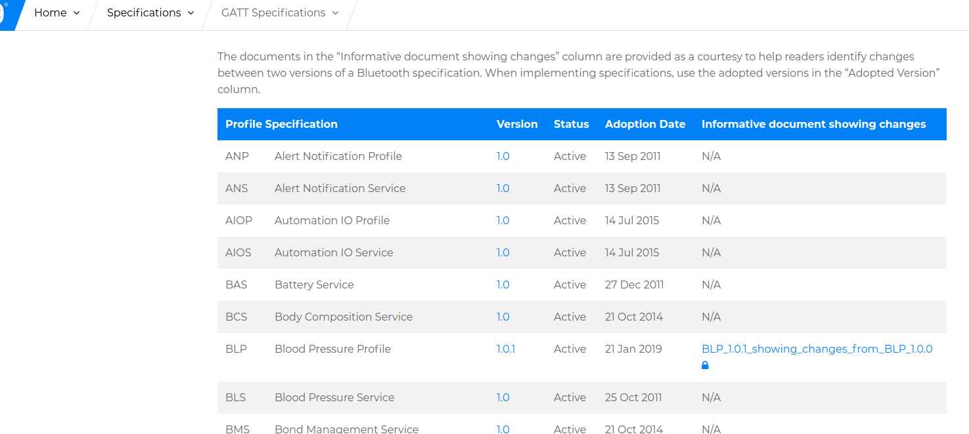
Example(Battery Service)

Slide 18
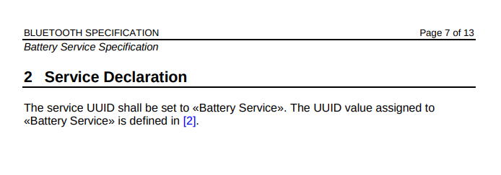
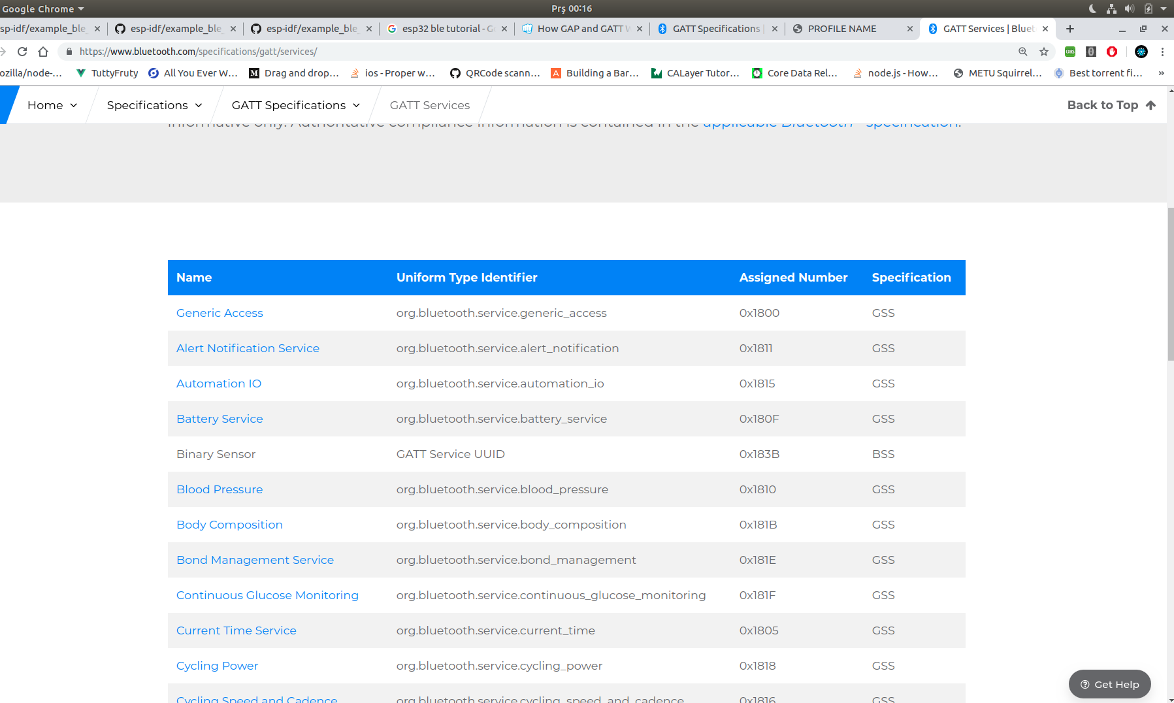
Assigned Number : 0x180F

Slide 19
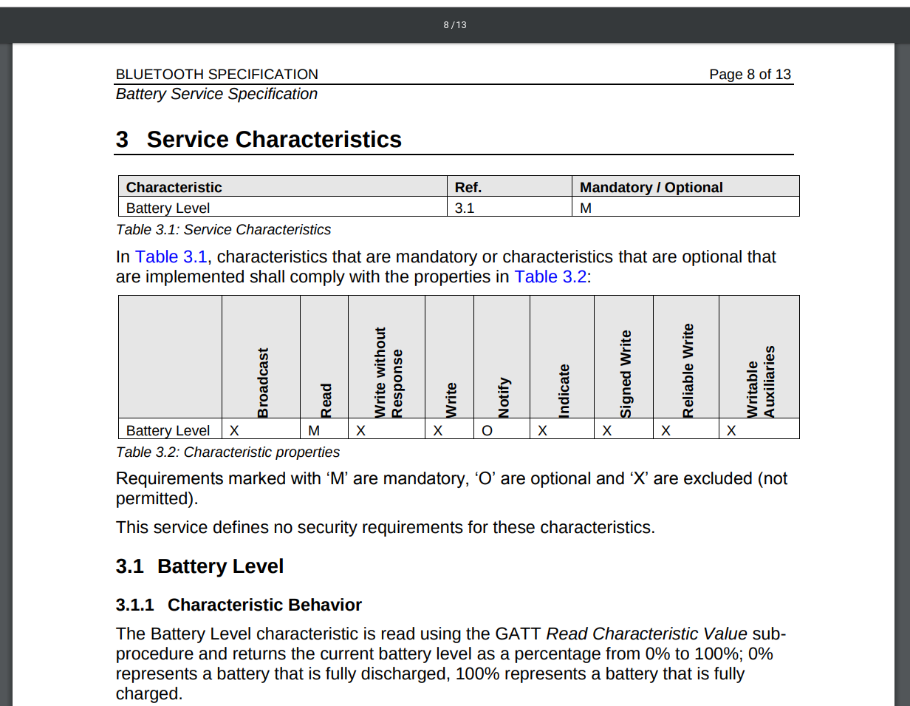

Slide 20
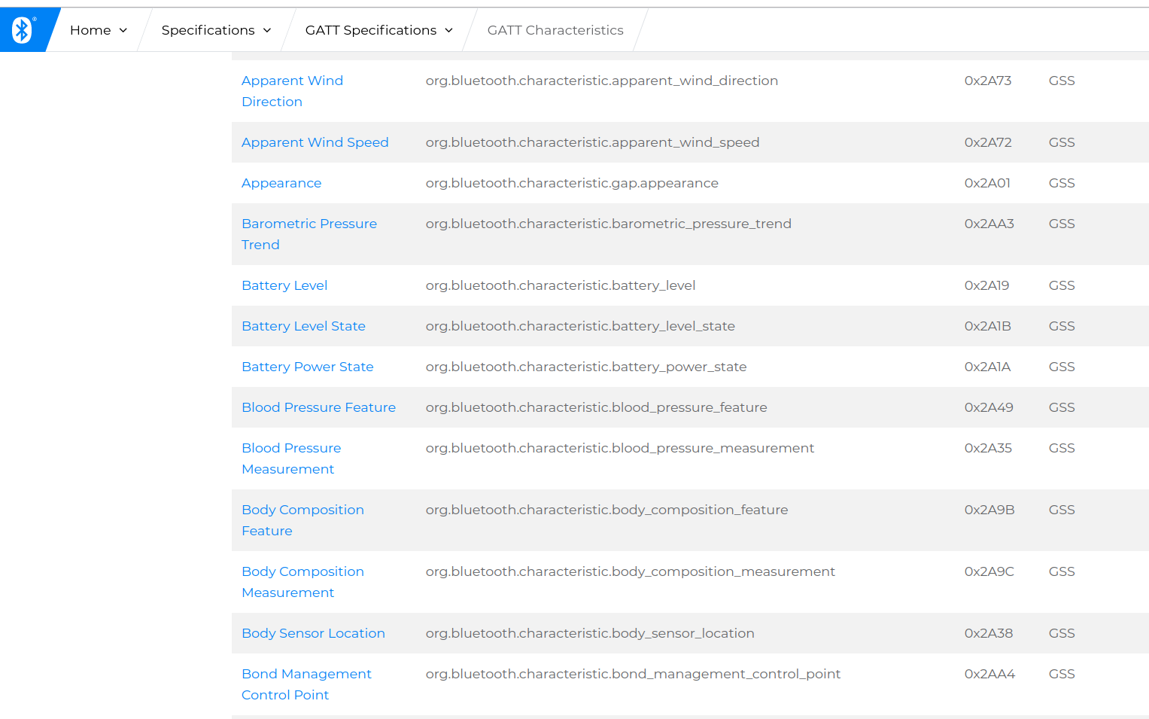

Slide 21
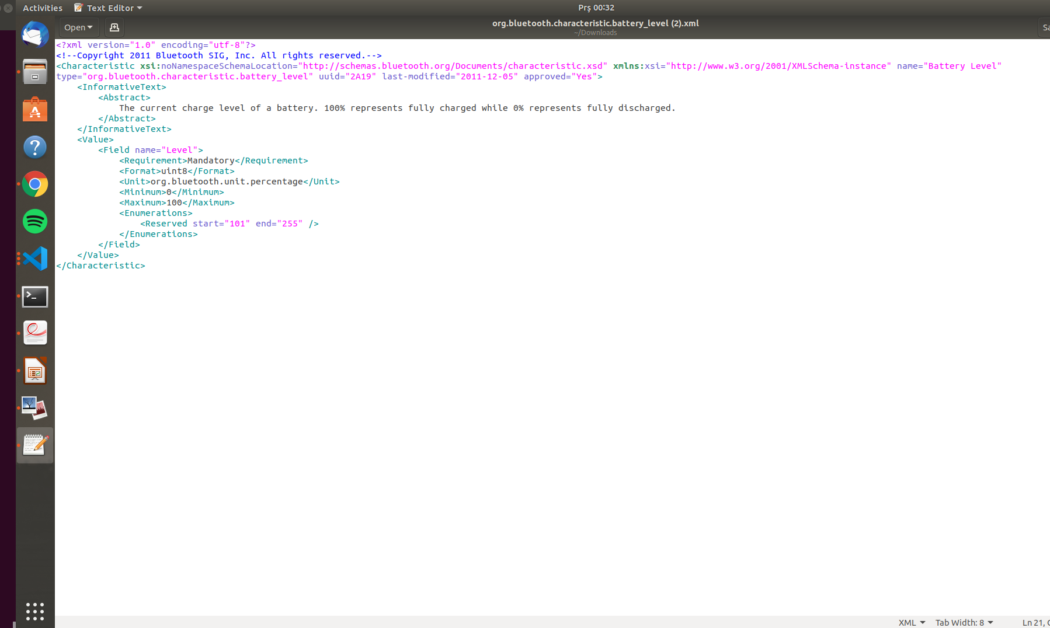
Value → Format : Uint8, Unit : percentage

Slide 22
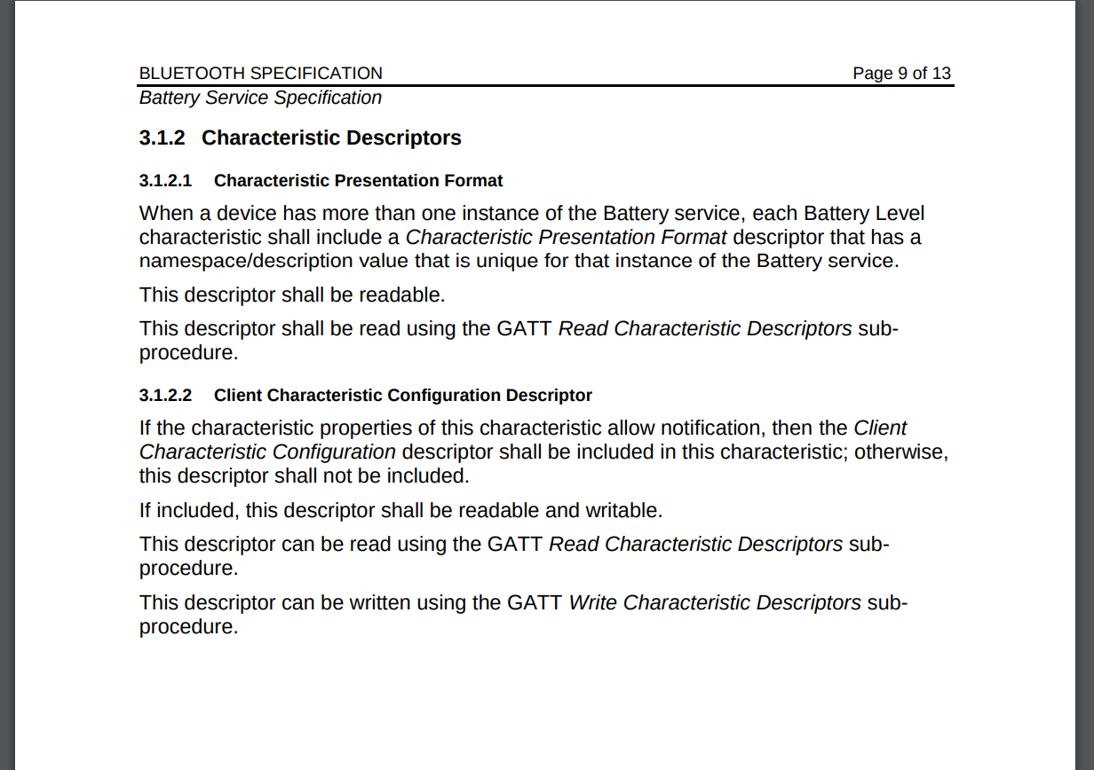
Find it from Bluetooth Core(documentation)

Slide 23
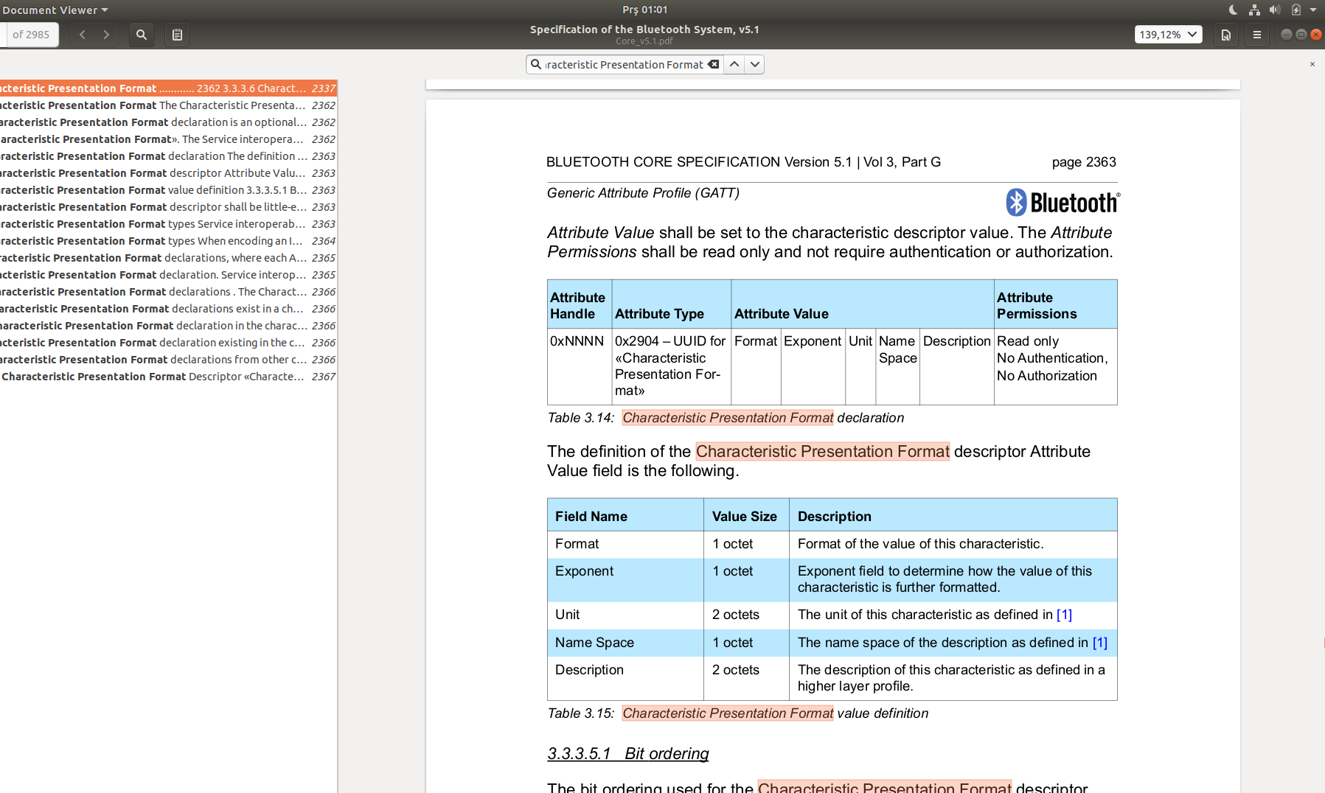
Character Presentation Format Descriptor

Slide 24
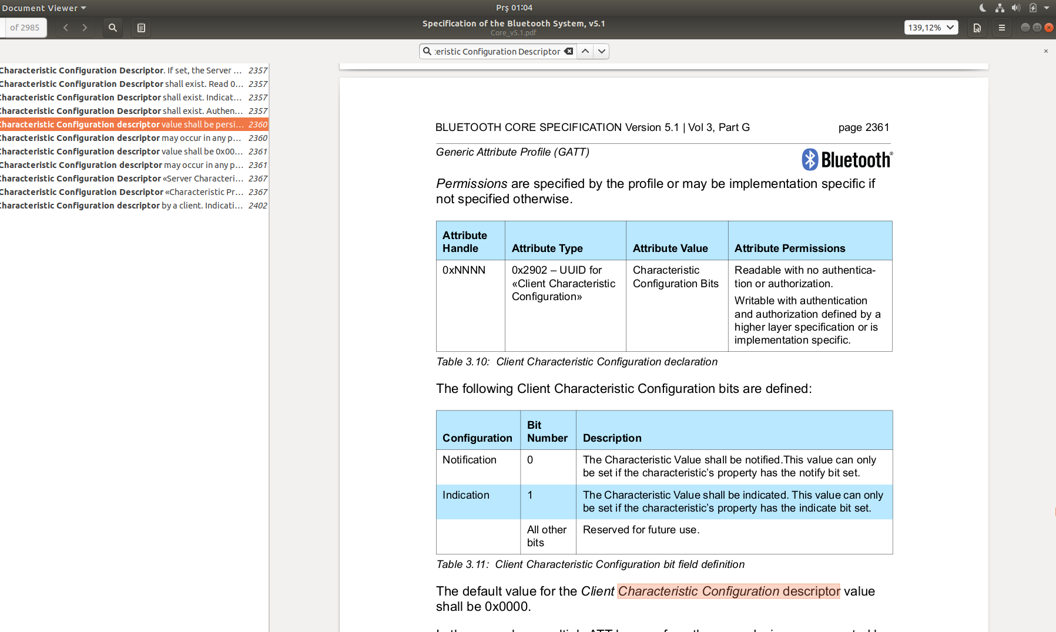
Client Characteristic Configuration Descriptor

Slide 25

Recommends
Software( for both mobile and desktop application)
nRF Connect Software for testing purposes
Website to learn more about BLE
https://www.oreilly.com/library/view/getting-started-with/9781491900550/ch01.html

Slide 26
Rssi (Received signal strength indication) Measurement
Perform 2000 measurements for each distance and recorded
3m
2m
4m
5m
1m
5+ m

Slide 27
Put rssi graph here

