Slide 1
ESP32 BLE
(Bluetooth Low Energy)
Hasan Atakan Bedel

Slide 2
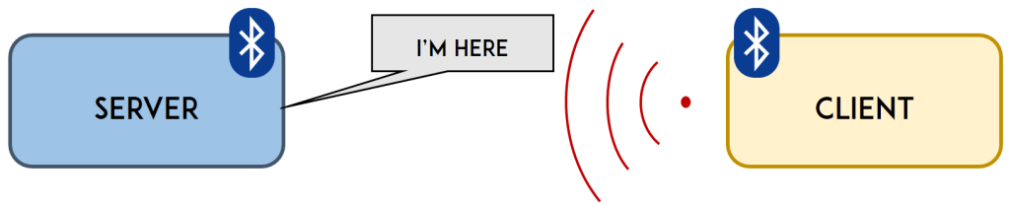
Broadcast Mode

Slide 3
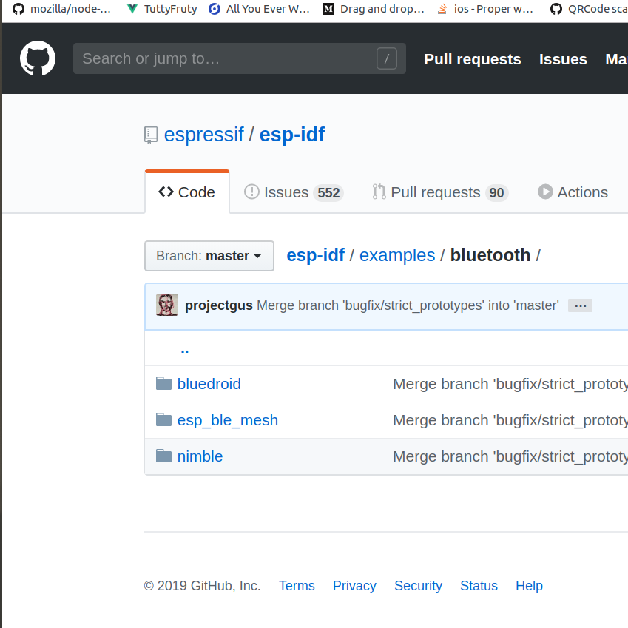


Slide 4
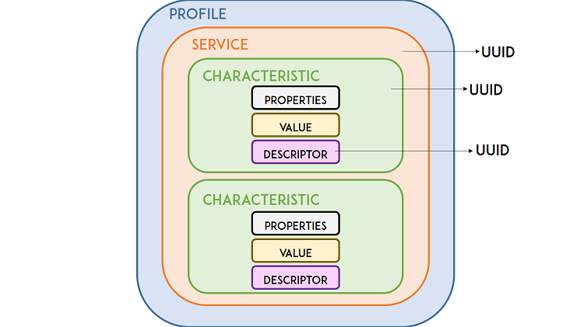

Slide 5
Generic Access Profile (GAP)
Generic Attribute Profile (GATT)

Slide 6
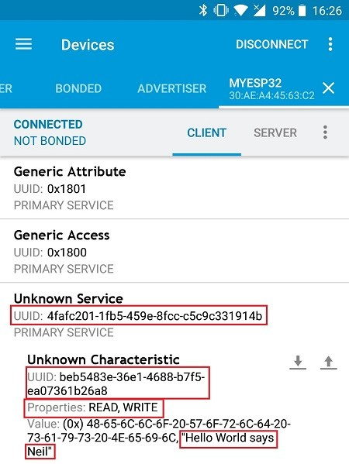

Slide 7
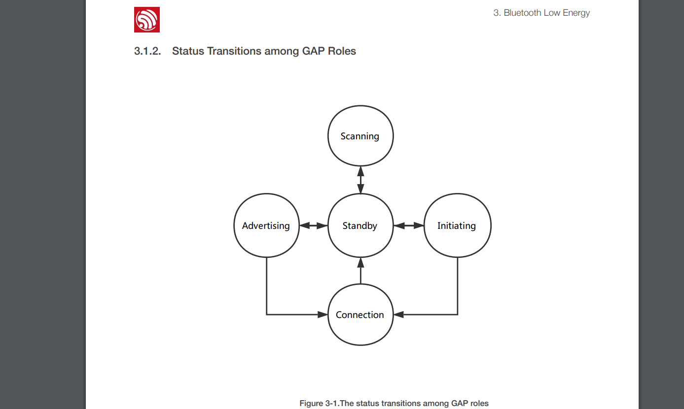
Generic Access Profile (GAP)
Generic Access Profile (GAP)
Generic Access Profile (GAP)

Slide 8
ATT (Attributes)
The data inside the BLE architecture exists in the form of Attributes that consist of four basic elements
(ESP32 Bluetooth Architecture Guide P.25)

Slide 9
Attribute Handle: locate any Attribute, 0x0001 and the second one is 0x0002, and so on, up to 0xFFFF
Attribute Type: type of the data, 0x2A09 is for Battery Level and UUID 0x2A6E is for Temperatur
Attribute value: key information, Battery Level , i.e. 0-100
Attribute Permission: control the read/write access of its local data

Slide 10
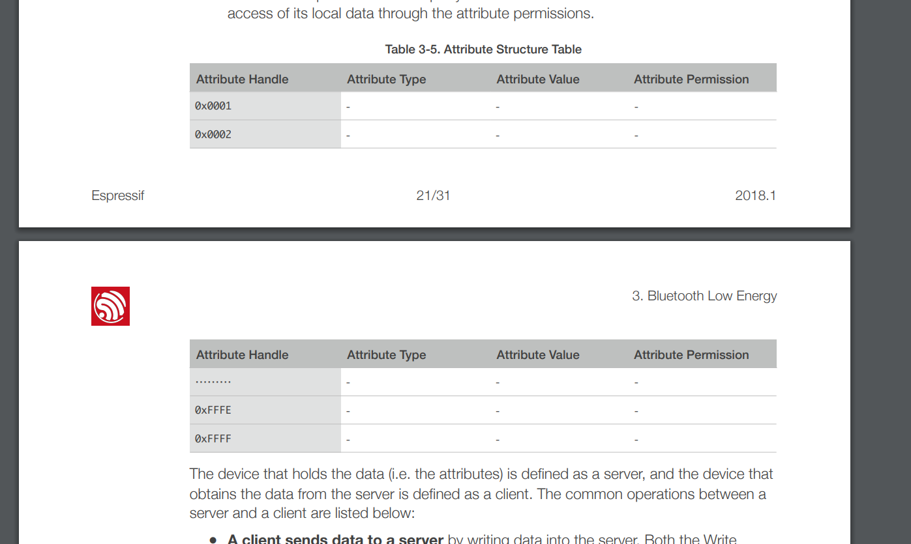

Slide 11
Generic Attribute Profile(GATT)
The GATT introduces the concept of Characteristics

Slide 12
Characteristics
Characteristic Declaration: informing a peer device about characteristic value content . The write and read properties are included in a declaration.
Characteristic Value: a characteristic value is the main part of a characteristic, which carries the most important information of a characteristic.
Descriptor: Descriptors can further describe characteristics (e.g. providing configuration information) and a characteristic can have multiple or no descriptors.

Slide 13
Predefined Profiles and Services
Examples : Battery Service, Insulin Delivery, Device Information

Slide 14
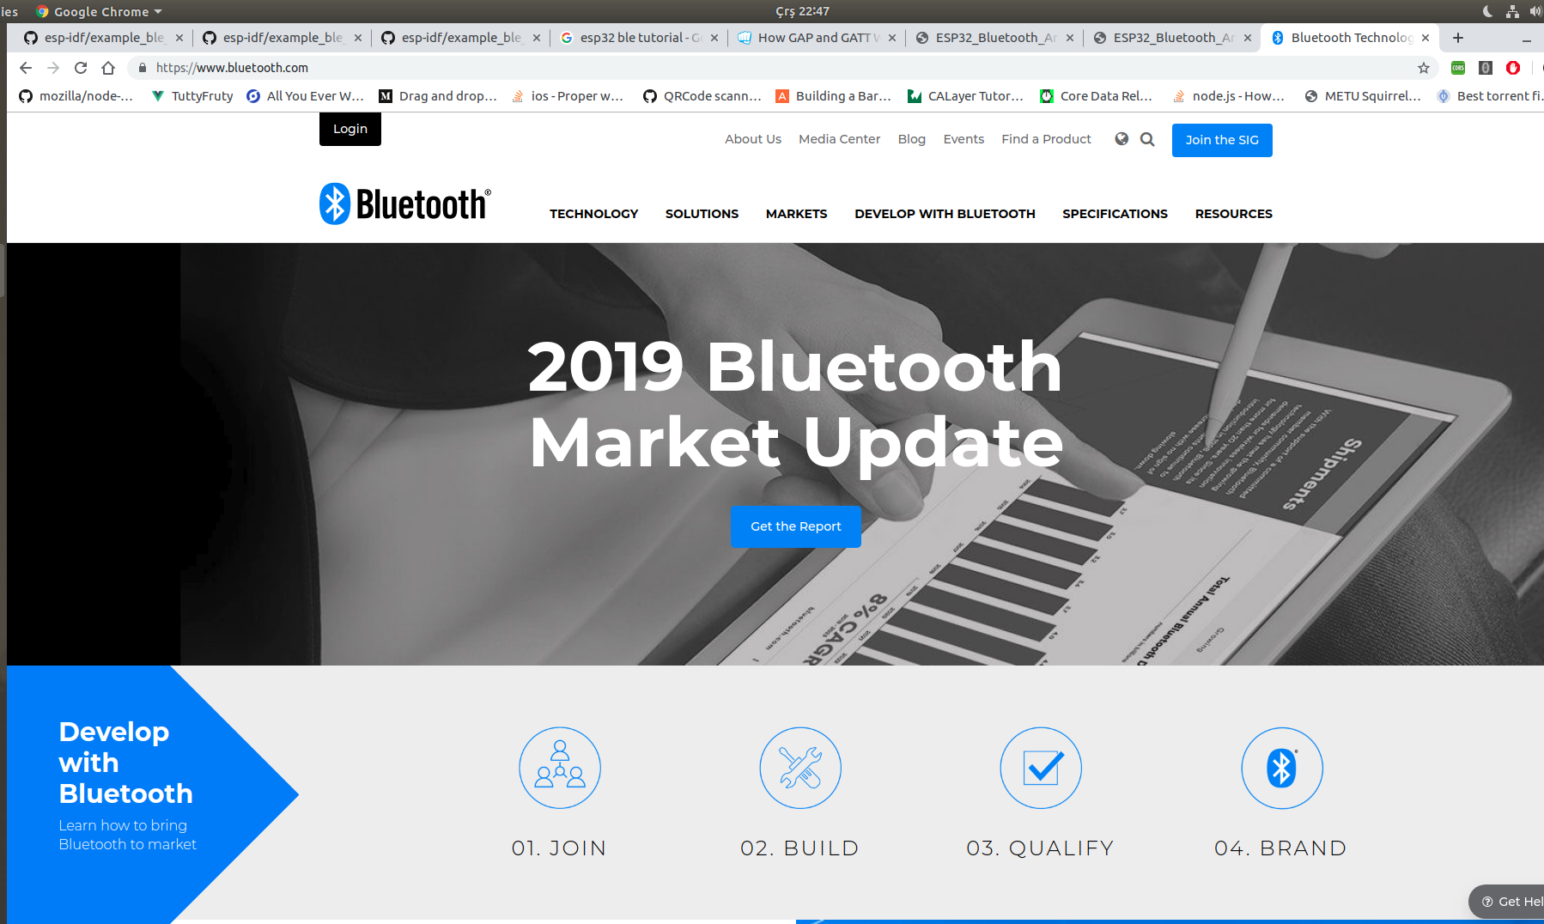


Slide 15
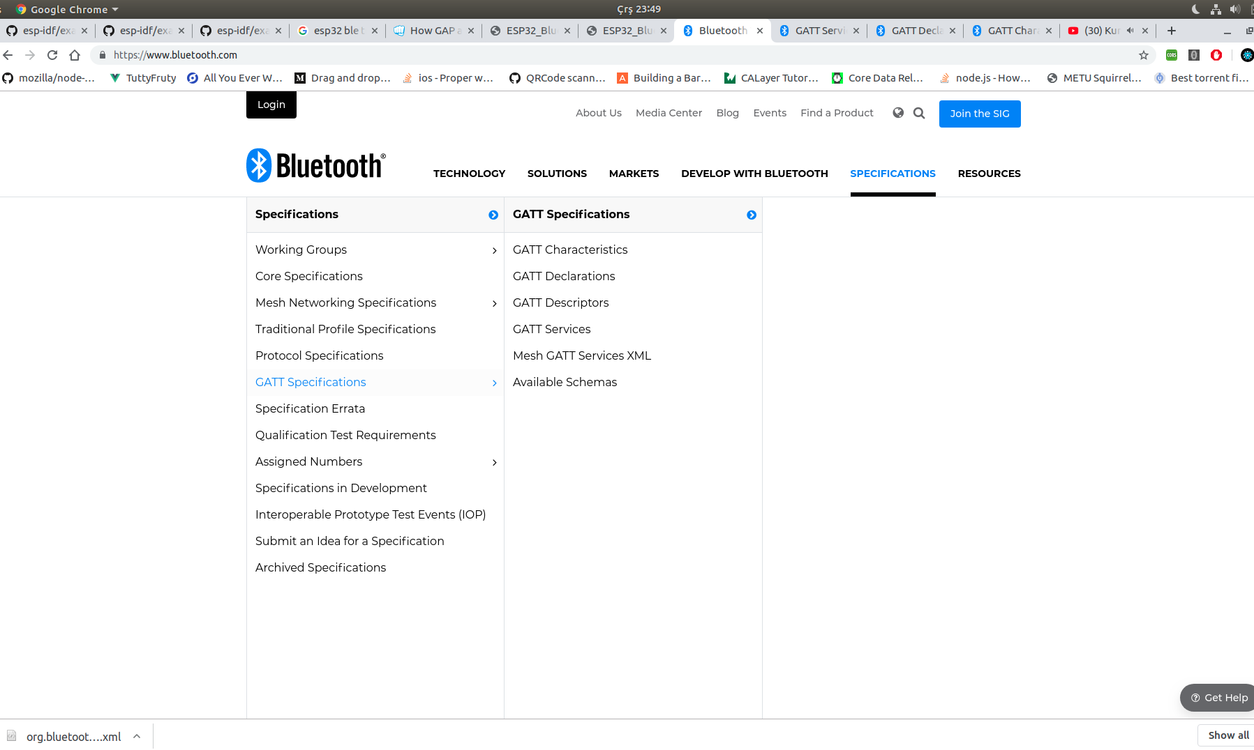

Slide 16
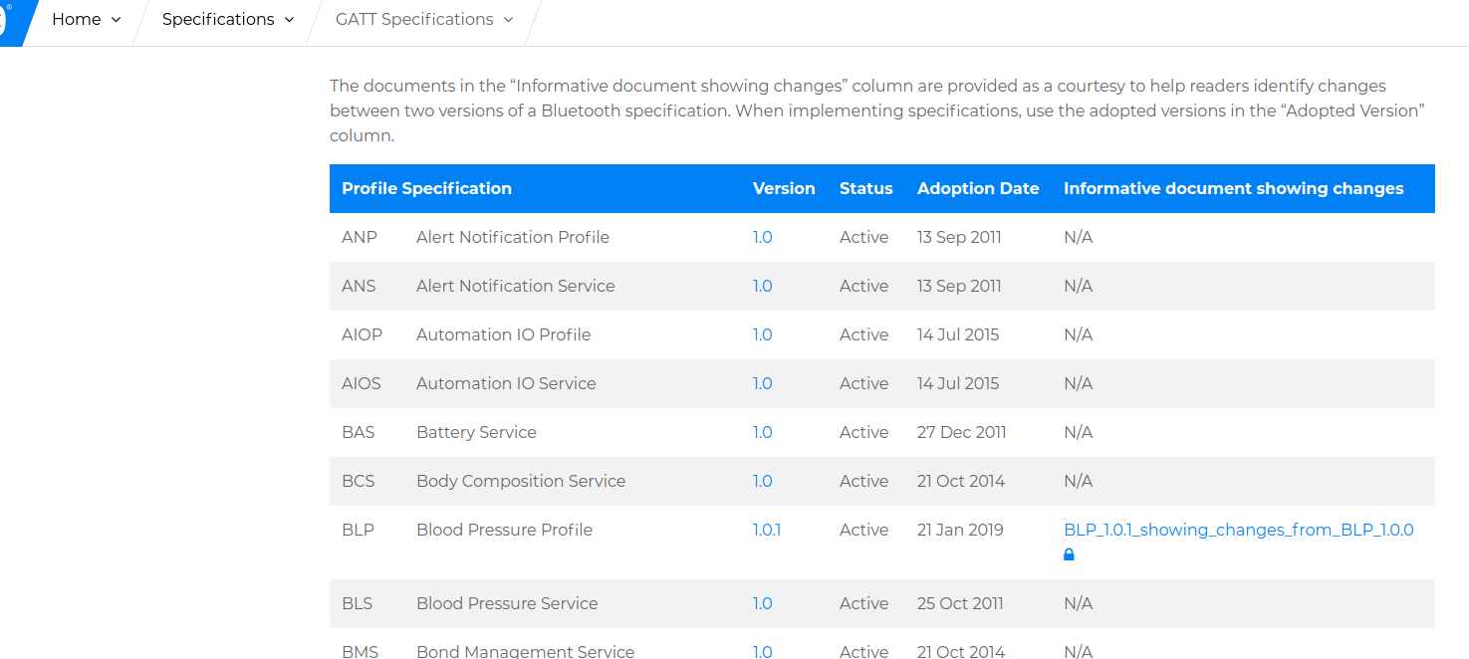
Example(Battery Service)

Slide 17
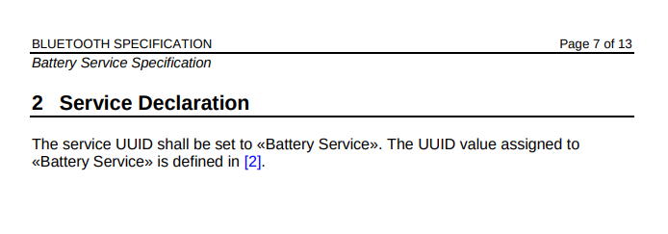
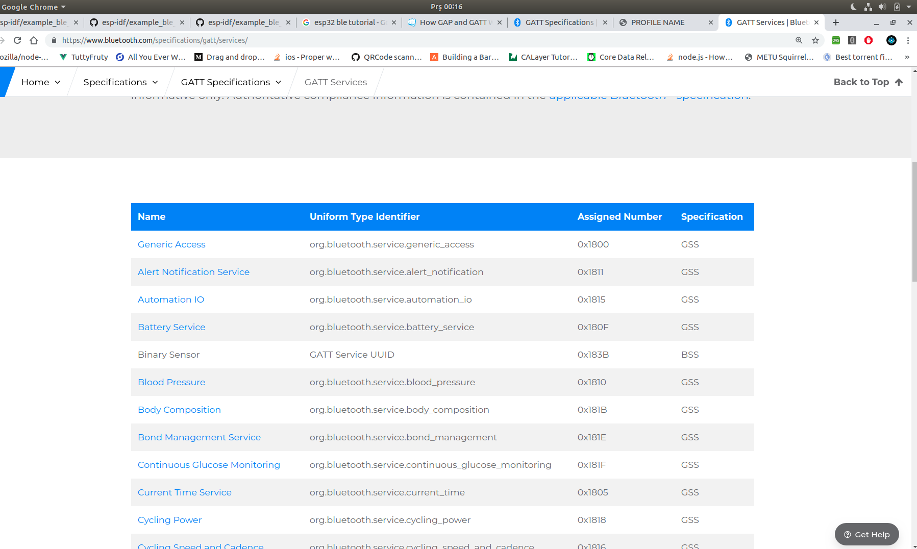
Example(Battery Service)
Assigned Number : 0x180F

Slide 18
UUID 16 bit → 128 bit (conversion)
UUID 16 bit : 0x180F
UUID 128 bit : 0xfb, 0x34, 0x9b, 0x5f, 0x80, 0x00, 0x00, 0x80, 0x00, 0x10, 0x00, 0x00, 0x18, 0x0F, 0x00, 0x00
LSB(last sign. bit) <--------------> MSB(most sign. bit)

Slide 19
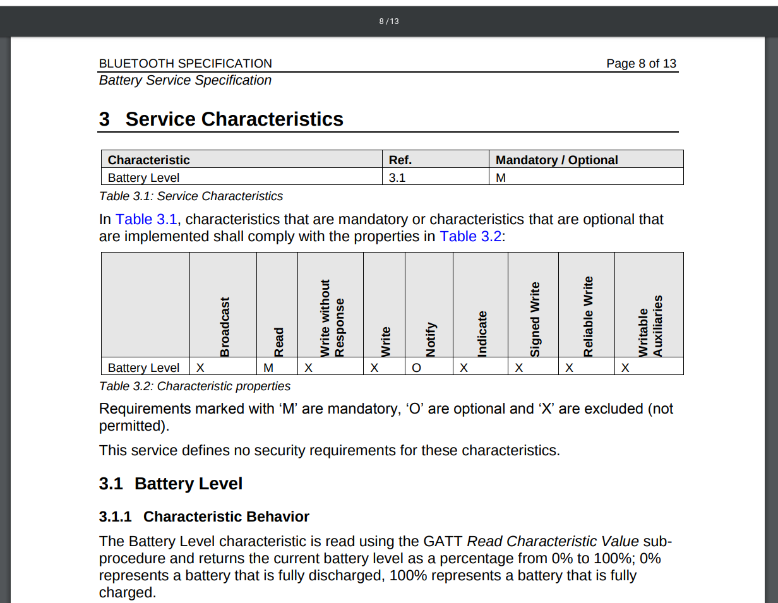

Slide 20
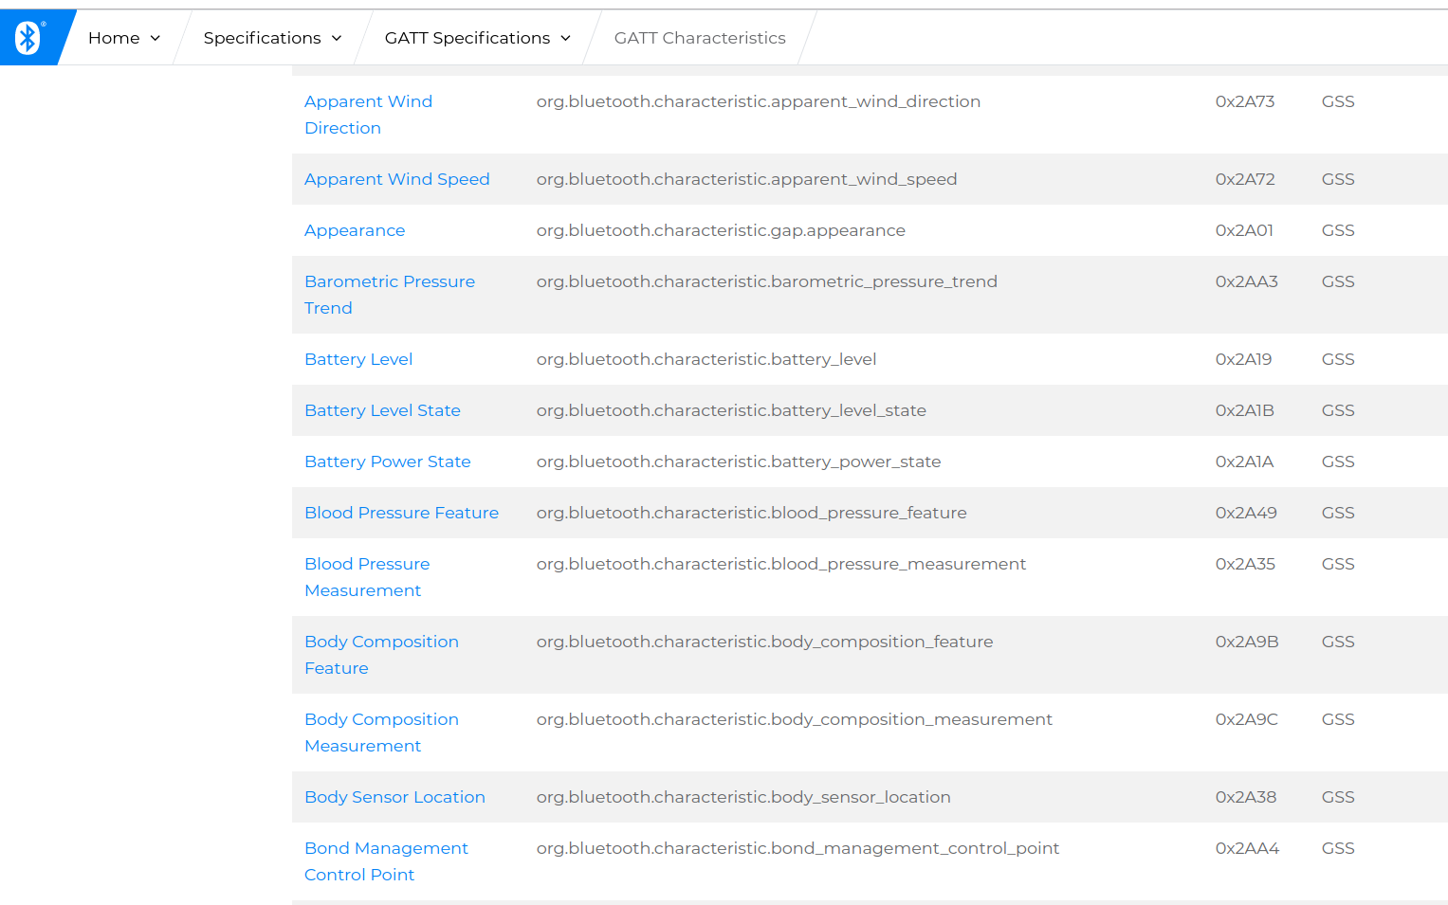

Slide 21
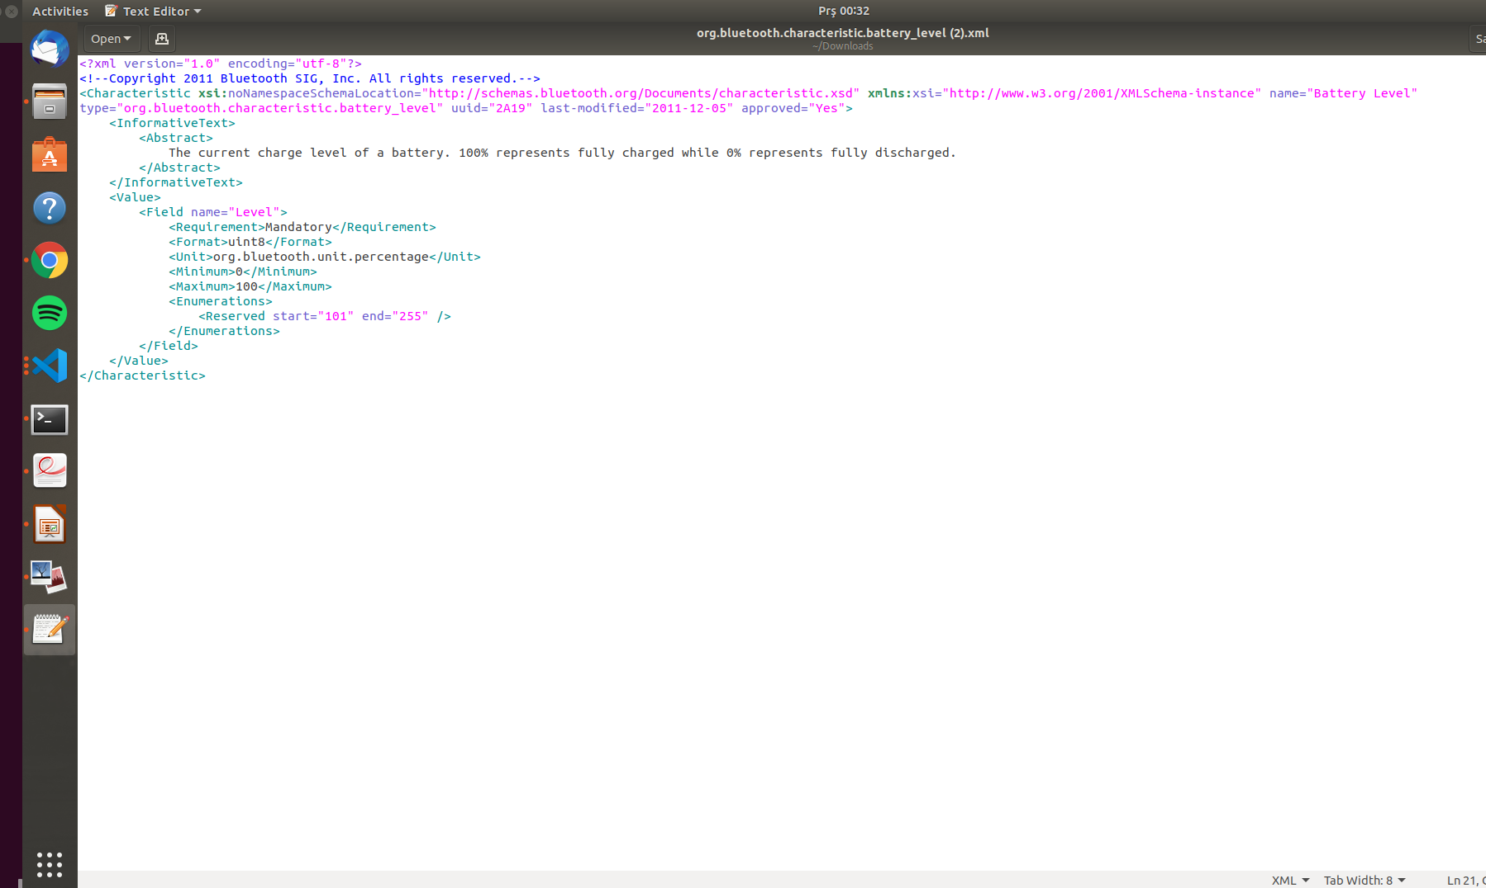
Value → Format : Uint8, Unit : percentage

Slide 22
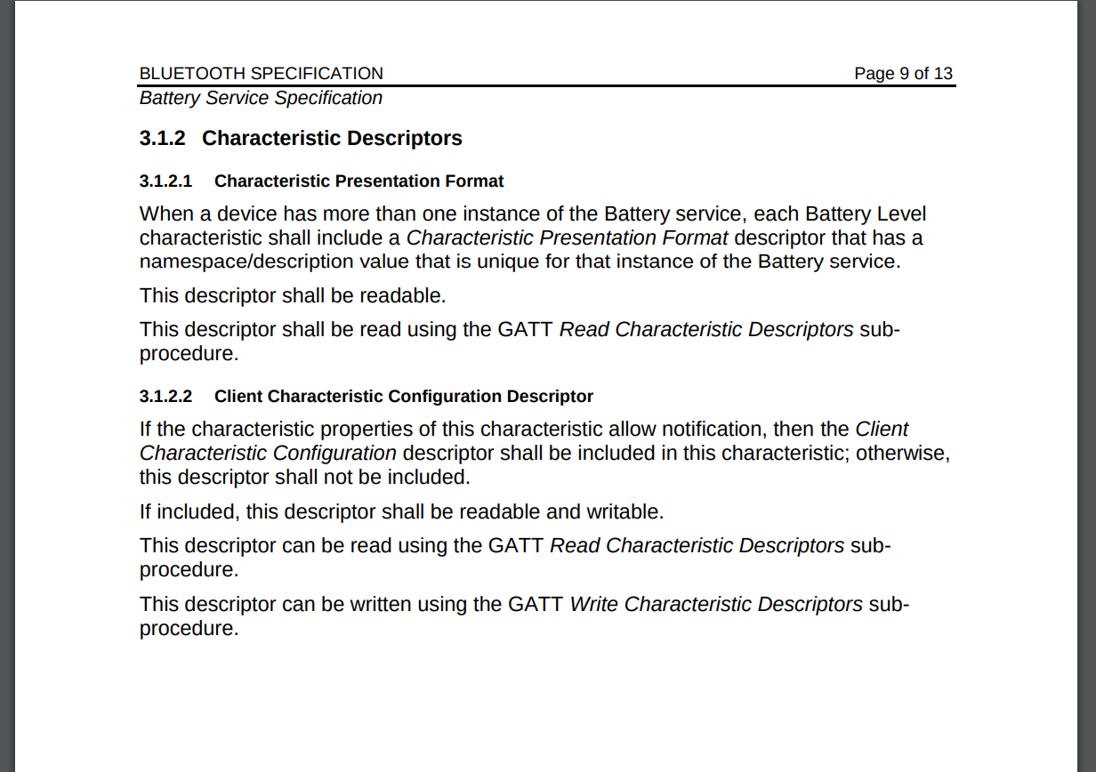
Find it from Bluetooth Core(documentation)

Slide 23
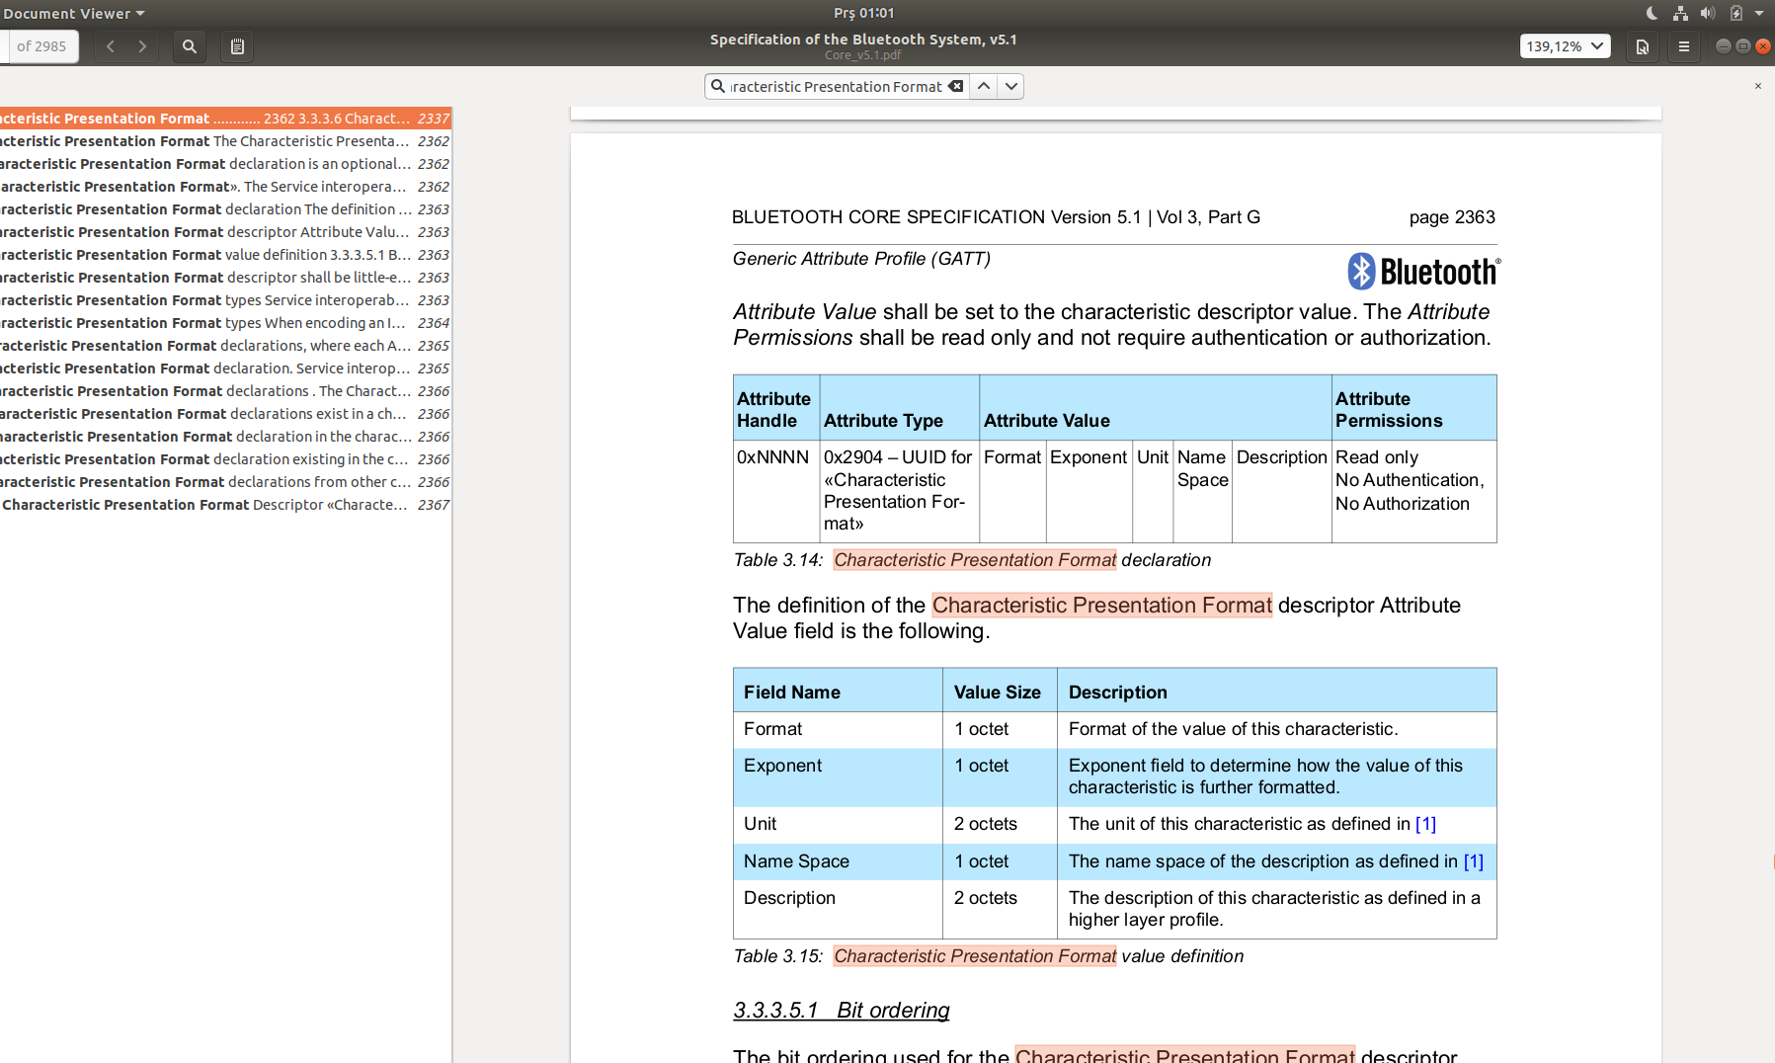
Character Presentation Format Descriptor

Slide 24
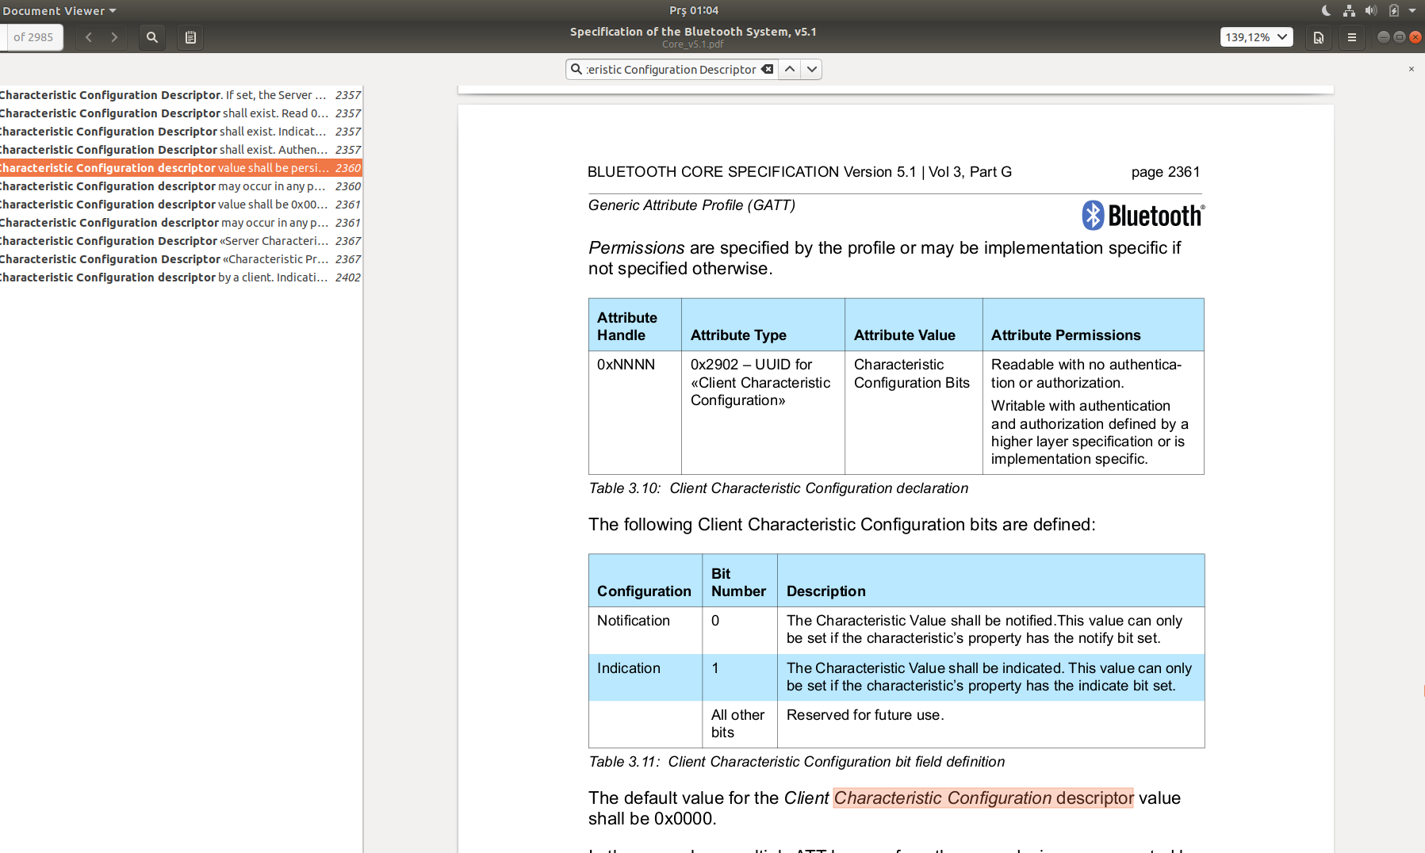
Client Characteristic Configuration Descriptor

Slide 25
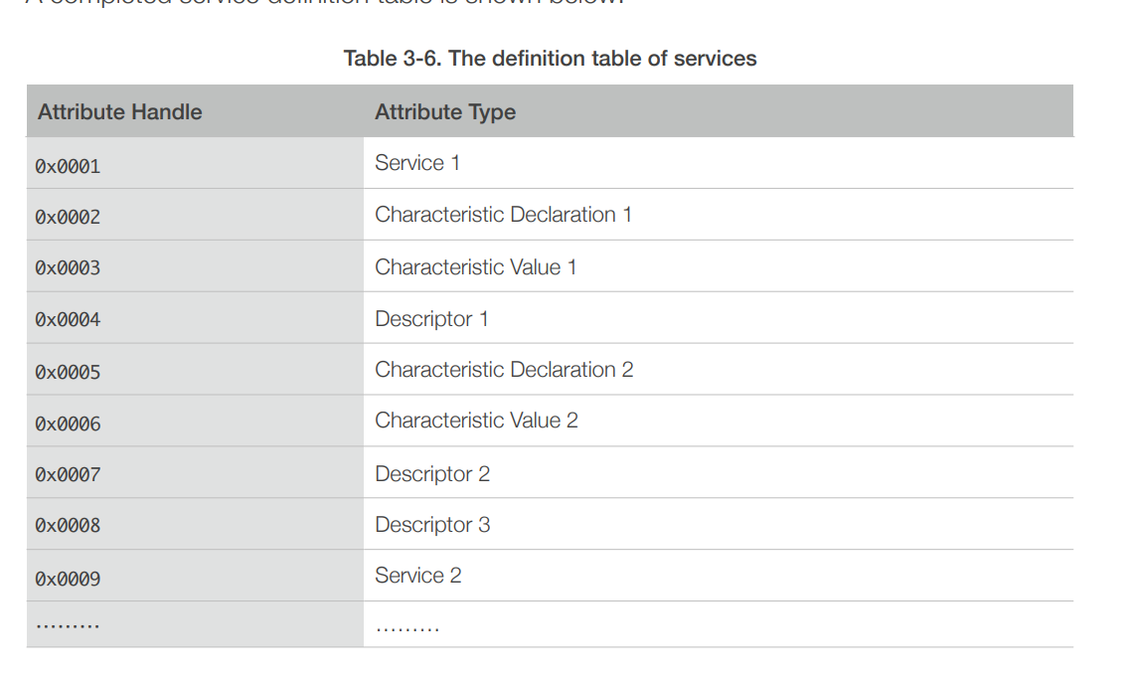

Slide 26
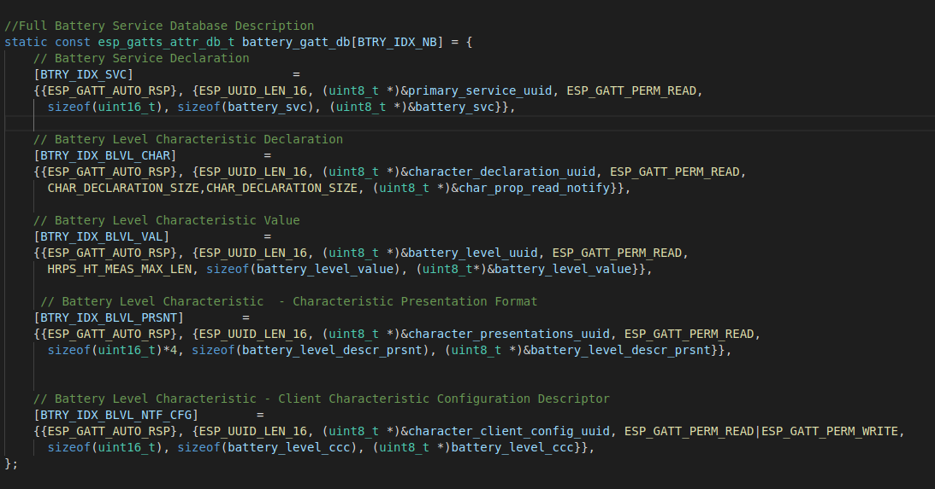

Slide 27

Strongly Recommended
Use nRF Connect Software for testing purposes
Available at all platforms(both pc and phones)

Slide 28
Some notes...
This part is about things I considered as odd with esp32 ble framework...

Slide 29
Gatt_server vs Gatt_secure_server
Gatt_server just doesn't connect to phone from settings, but can be connected via an native app, whereas gatt_secure_server can be connected from both phone bluetooth settings and with an app.
Opened an Github issue for this : https://github.com/espressif/esp-idf/issues/3903

Slide 30
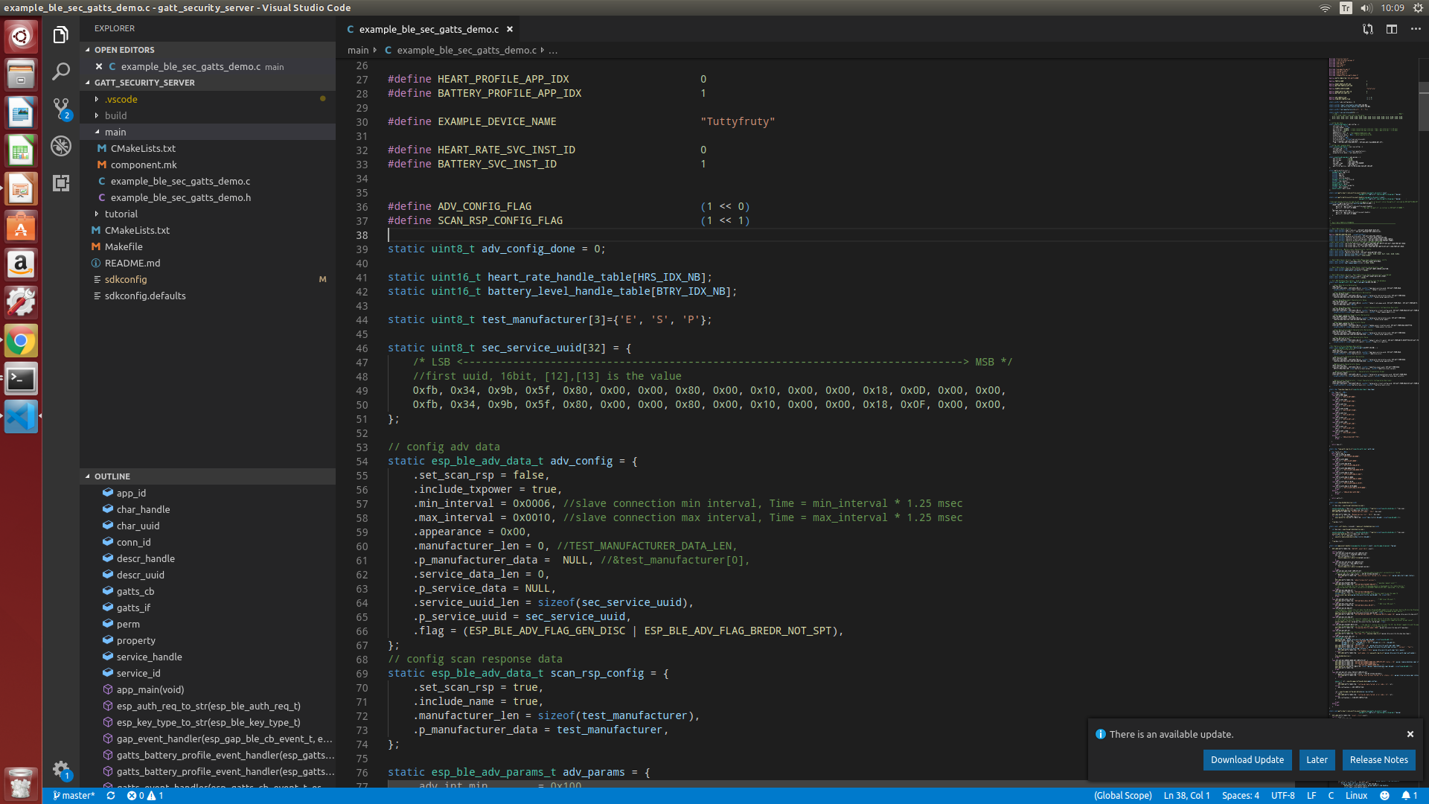
Service UUIDs inside adv config
They have no power. Changing them doesn't change the services presented to other devices

