Slide 1
BLE
(from espressif documentation)
Hasan Atakan Bedel

Slide 2
BLE Modes
Connectable Scannable Undirected Mode
High Duty Cycle Directed Mode and Connectable Low Duty Cycle Directed Mode
Scannable Undirected Mode
Non-connectable Undirected Mode

Slide 3
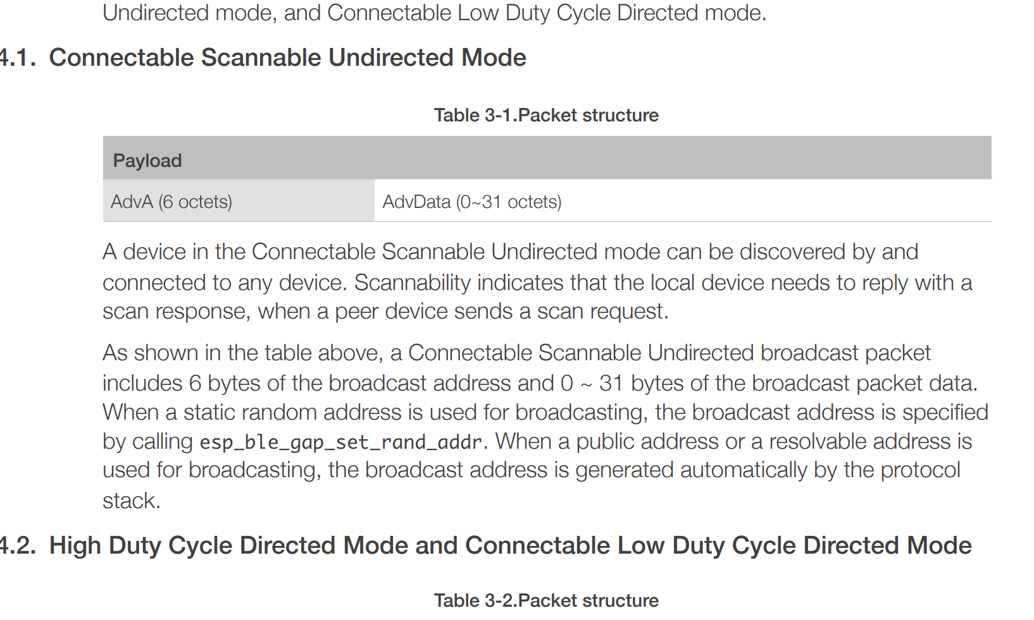

Slide 4
. BLE Broadcast Filtering Policy
ADV_FILTER_ALLOW_SCAN_ANY_CON_ANY
(Can be scanned and connected to any device (no white list)
ADV_FILTER_ALLOW_SCAN_WLST_CON_ANY
ADV_FILTER_ALLOW_SCAN_ANY_CON_WLST
ADV_FILTER_ALLOW_SCAN_WLST_CON_WLST

Slide 5
Server And Client
Server(Slave,Peripheral) ---- Client(Master,Central)

Slide 6
Common Operations
A client sends data to a server by writing data into the server. Both the Write Request and Write Command can be used to write an attribute value.
However, a write Response is only prompted when a Write Request is used

Slide 7
Common Operations
A server sends data to a client by sending an Indication or Notification to the client. The only difference between an Indication and a Notification is that a
Confirmation is prompted only when an Indication is used. This is similar to thedifference between a Write Request and a Write Command.

Slide 8
Common Operations
A client can also obtain data from the server by initiating a Read Request.
For detailed information regarding the common operations between a server and a client, please refer to
Core_V5.0, Vol3. Part F, Chapter 3.4 “Attribute Protocol PDUs”

Slide 9
More Info
The common operations between a server and a client are achieved by using ATT PDU.
Each device can specify its supported MTU, which is the maximum length of an ATT message. In ESP32 IDF, the MTU can be 23 - 517 bytes, and the total length of an attribute value is not limited

Slide 10
If the length of the user’s packet is greater than (MTU-3), a Prepare Write Request is required to write data.
Similarly, if the length of the packet is greater than (MTU-1), a Read Blob Request is required to read the remaining data.

