Slide 1

WELCOME
Project cost
TO OUR PRESENTATION
about
follow
Project name
Shopping Address
Project Equipment
PRESENTED BY RAKIB HASSAN & MD. TUTUL HOSSAIN

Slide 2

follow
Project cost
Project name
about
Shopping Address
Project Equipment
RAKIB HASSAN
CSE060 07262
STUDENT OF COMPUTER SCIENCE AND ENGINEERING
STAMFORD UNIVERSITY BANGLADESH

Slide 3
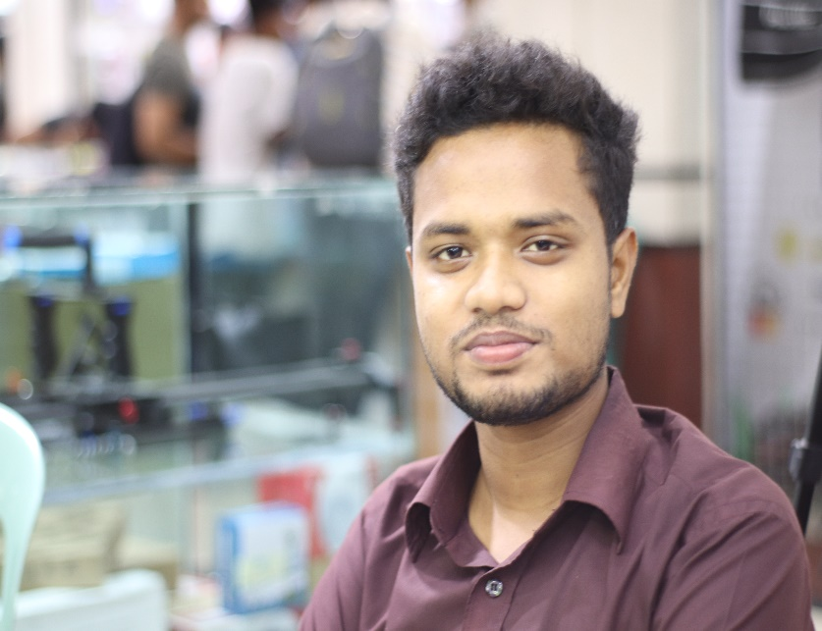
follow
Project cost
Project name
about
Shopping Address
Project Equipment
MD. TUTUL HOSSAIN
CSE060 07270
STUDENT OF COMPUTER SCIENCE AND ENGINEERING
STAMFORD UNIVERSITY BANGLADESH

Slide 4
Automated Door Bell With Object Detection
Project cost
Project name
follow
Project Equipment
about
Shopping Address

Slide 5
Project Equipment
1. Breadboard - 1
2. Led -10
3. Buzzer -2
4. 4*4 Keypad -1
5. Arduino Uno R3 -1
6. PIR(Motion Sensor) -2
7 Led Display 16-02 -1
8. I2C Drive -1
9. ESP8266 -1
10. SG90R SERVO -1
11. 220 ohm Resistor (100Pcs) -1
12. Jumper Wire:
M.M,M,F(capper) -4
F.F(Metal) -1
13. Plastic wood(6pcs)
14. Super Blue -1
15. 9V Rechargeable Battery -1
.
follow
about
Project cost
Project name
Shopping Address
Project Equipment

Slide 6
Project Cost
1. Breadboard - 60 Taka
2. Led -10 Taka
3. Buzzer -20 Taka
4. 4*4 Keypad -60 Taka
5. Arduino Uno R3 -350 Taka
6. PIR(Motion Sensor) -120 Taka
7 .Led Display 16-02 -100 Taka
8. I2C Drive -50 Taka
9. ESP8266 -300 Taka
10. SG90R SERVO -90 Taka
11. 220 ohm Resistor (100Pcs) -15 Taka
12. Jumper Wire:
M.M,M,F(capper) - 230 Taka
F.F(Metal) - 40 Taka
13. Plastic wood(6pcs) - 150 Taka
14. Super Blue -60 Taka
15. 9V Rechargeable Battery -290 Taka
Total Cost: 1990 Taka
.
Shopping Address
Project cost
follow
about
Project name
Project Equipment

Slide 7
Shopping Address:
Telecom Spares (Hossain Market,2nd Floor,36 Patuatuly,Dhaka-1100,Bangladesh)
Web: www.tspares-bd.com
Shopping Address
Project Equipment
follow
about
Project name
Project cost

Slide 8



Project Equipment
follow
about
Project cost
Project name
Shopping Address
Finished the First Part of our Project

