Slide 1

WELCOME
TO OUR PRESENTATION
about
follow
Project name
Shopping Address
Project Diagram
Project pin list
PRESENTED BY RAKIB HASSAN & MD. TUTUL HOSSAIN

Slide 2

follow
Project pin list
Project name
about
Shopping Address
Project Diagram
RAKIB HASSAN
CSE060 07262
STUDENT OF COMPUTER SCIENCE AND ENGINEERING
STAMFORD UNIVERSITY BANGLADESH

Slide 3
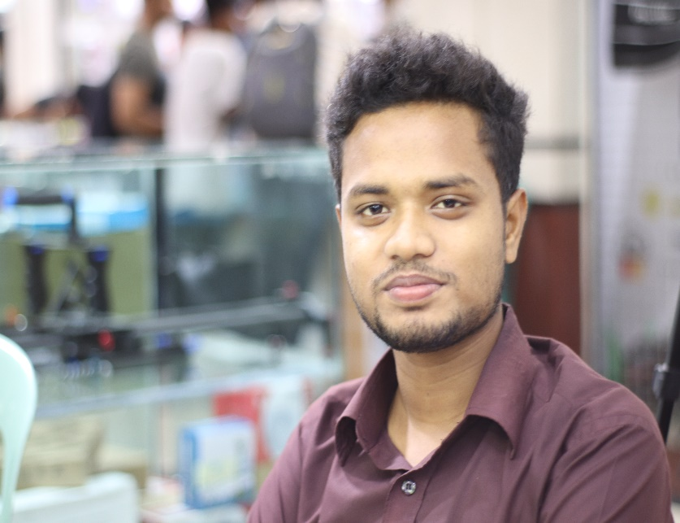
follow
Project cost
Project name
about
Shopping Address
Project Equipment
MD. TUTUL HOSSAIN
CSE060 07270
STUDENT OF COMPUTER SCIENCE AND ENGINEERING
STAMFORD UNIVERSITY BANGLADESH

Slide 4
Automated Door Bell With Object Detection
Project pin list
Project name
follow
Project Diagram
about
Shopping Address

Slide 5
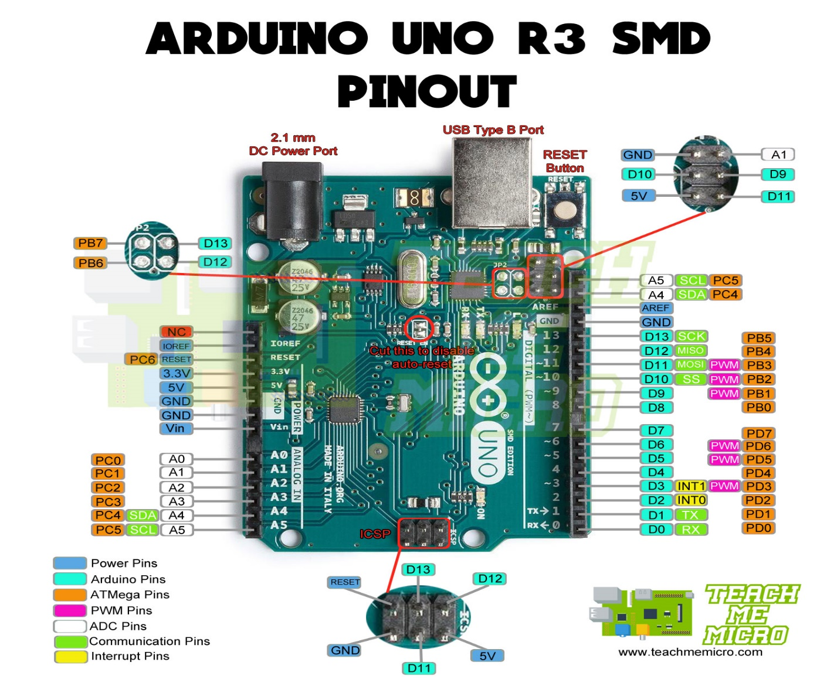
Arduino Uno R3
follow
about
Project pin list
Project name
Shopping Address
Project Diagram

Slide 6
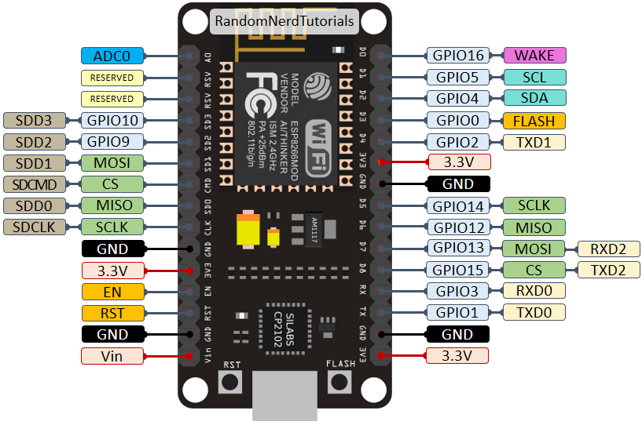
ESP8266 (NODE MCU)
follow
about
Project pin list
Project name
Shopping Address
Project Diagram

Slide 7
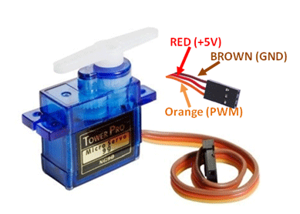
SG90R Servo Motor
follow
about
Project pin list
Project name
Shopping Address
Project Diagram

Slide 8
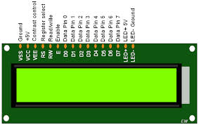
LCD DISPLAY 16-02
follow
about
Project pin list
Project name
Shopping Address
Project Diagram

Slide 9
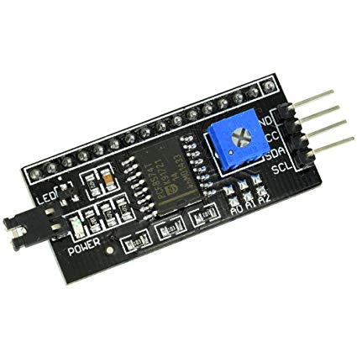
I2C DRIVE
follow
about
Project pin list
Project name
Shopping Address
Project Diagram

Slide 10
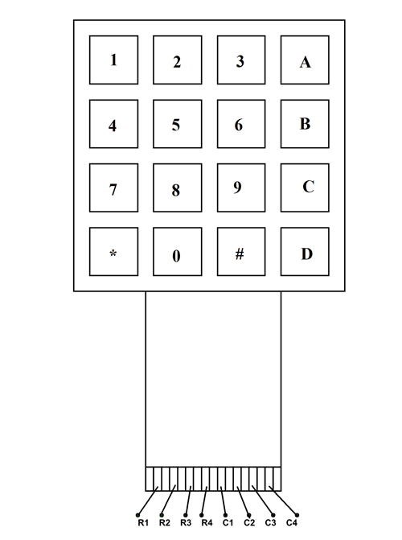
4*4 Keypad
follow
about
Project pin list
Project name
Shopping Address
Project Diagram

Slide 11
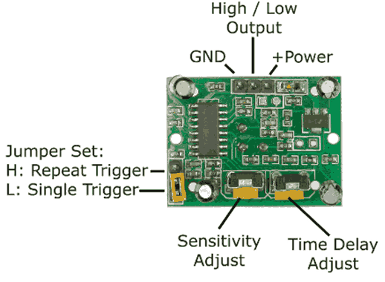
PIR(Motion Sensor)
follow
about
Project pin list
Project name
Shopping Address
Project Diagram

Slide 12
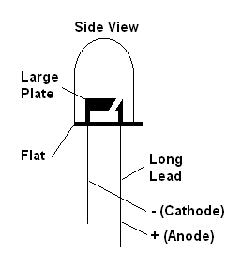
LED
follow
about
Project pin list
Project name
Shopping Address
Project Diagram

Slide 13
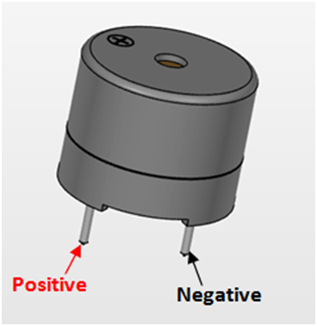
BUZZER
follow
about
Project pin list
Project name
Shopping Address
Project Diagram

Slide 14
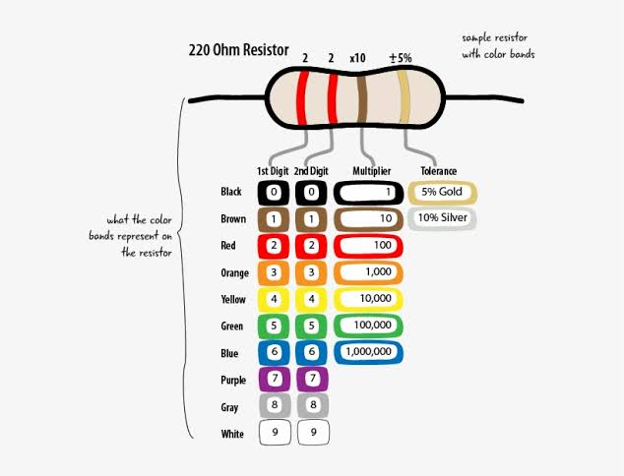
220 Ohm Resister
follow
about
Project pin list
Project name
Shopping Address
Project Diagram

Slide 15
Project Pin List
Two Buzzer positive site shorted and then - connect Arduino Uno digital pin -2
Two Buzzer Negative site - Connect Breadboard (-) site
Arduino GND – Connect Breadboard (-) site
And Vin – Connect Breadboard(+) site
Arduino GND – Connect Breadboard (-) other site And +5v – Connect Breadboard(+) other site
LCD 16-02 DISPLAY - Connect I2C DRIVE And
I2C DRIVE GND - Connect Breadboard (-) other site
I2C DRIVE +5v - Connect Breadboard (+) other site
I2C DRIVE SDA - Connect A4 Arduino Uno
I2C DRIVE SCL - Connect A5 Arduino Uno
.
Shopping Address
Project pin list
follow
about
Project name
Project Diagram

Slide 16
Project Pin List
KEYPAD – R1 Connect Arduino Uno 10 Digital pin
KEYPAD – R2 Connect Arduino Uno 9 Digital pin
KEYPAD – R3 Connect Arduino Uno 8 Digital pin
KEYPAD – R4 Connect Arduino Uno 7 Digital pin
KEYPAD – C1 Connect Arduino Uno 6 Digital pin
KEYPAD – C2 Connect Arduino Uno 5 Digital pin
KEYPAD – C3 Connect Arduino Uno 4 Digital pin
KEYPAD – C4 Connect Arduino Uno 3 Digital pin
LED Positive site – positive site shorted with 220 ohm resister and then - connect Arduino Uno digital pin -11
Resister other site and LED Negative site - Connect Breadboard (-) site
.
Shopping Address
Project pin list
follow
about
Project name
Project Diagram

Slide 17
Project Pin List
Servo motor Positive site –Connect (+) 5V Arduino Uno Default +5v pin
Servo motor GND site –Connect (-) Breadboard
Servo motor OUTPUT Pin site –Connect Arduino Uno digital pin -1
PIR(Motion Sensor) VCC – Connect Breadboard +5v site
PIR(Motion Sensor) GND – Connect Breadboard -v site
PIR(Motion Sensor) OUT – Connect Arduino Uno digital pin -12 (Inside House)
PIR(Motion Sensor) VCC – Connect Breadboard +5v site
PIR(Motion Sensor) GND – Connect Breadboard -v site
PIR(Motion Sensor) OUT – Connect Arduino Uno digital pin -13 (Outside House)
.
Shopping Address
Project pin list
follow
about
Project name
Project Diagram

Slide 18
Project Pin List
9V Battery + pin Connect Vin (+ v) Breadboard
9V Battery - pin Connect Vin (- v) Breadboard
.
Shopping Address
Project pin list
follow
about
Project name
Project Diagram

Slide 19
Shopping Address:
Telecom Spares (Hossain Market,2nd Floor,36 Patuatuly,Dhaka-1100,Bangladesh)
Web: www.tspares-bd.com
Project Diagram
follow
Shopping Address
about
Project name
Project pin list

Slide 20



Project Diagram
follow
about
Project pin list
Project name
Shopping Address
Finished the Second Part of Our Project

