Slide 1
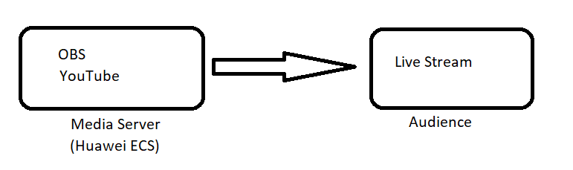
In this project, I used OBS, YouTube and Huawei Cloud. OBS stands for Open Broadcaster Software. OBS is a media tool used for both live broadcasting and video recording. Operating systems used are Microsoft Windows, macOS and Linux operating systems. There are many social media platforms that we will broadcast live on OBS. (Twich, YouTube, Twitter etc.) YouTube is a social media platform where we will broadcast my live broadcast. In order to integrate these two, I will first rent a Virtual Private Cloud from Huawei Cloud and install Elastic Cloud Server on it. Then I will install OBS inside this ECS and do the live broadcast over the cloud. I will broadcast this broadcast live on YouTube. The 3 technology tools I use are reliable tools that have proven their success and maturity in their fields .

Slide 2
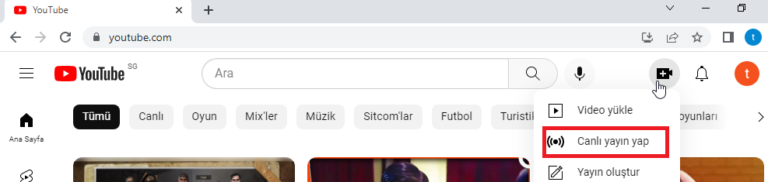
Firstly, when we enter the site for the Youtube section, we click on the camera icon on the upper right and click on the live broadcast tab.

Slide 3
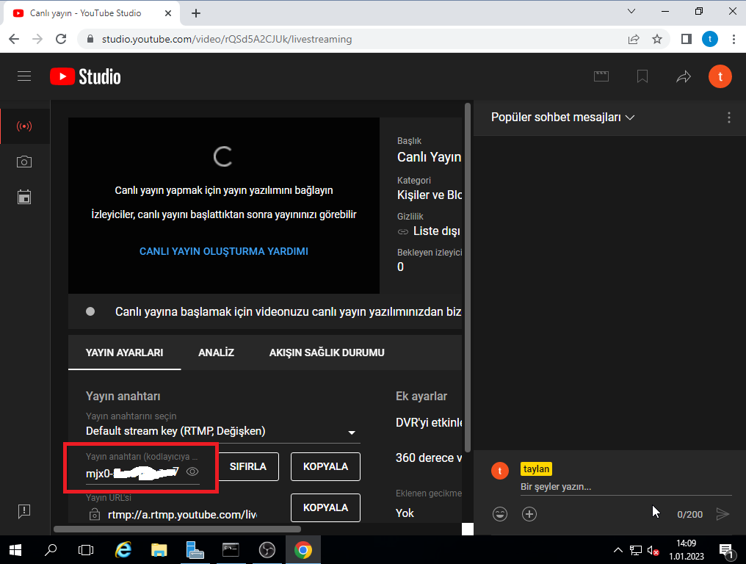
Here, the necessary settings are ready, for OBS settings, it is enough to enter the broadcast key in the lower left.

Slide 4
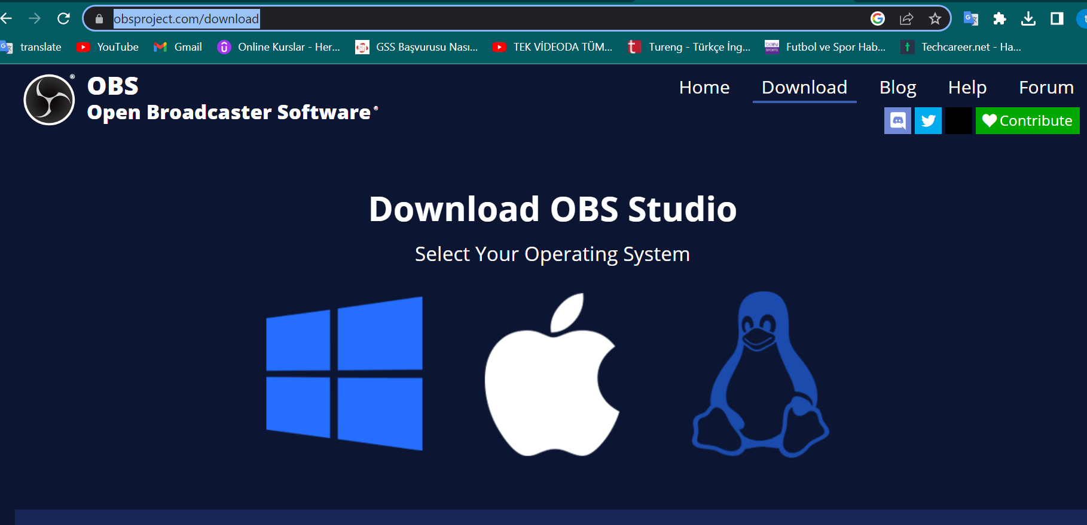
After, we download the OBS application and install it on our machine. (OBS is free open source program) https://obsproject.com/download https://github.com/obsproject/obs-studio.git

Slide 5
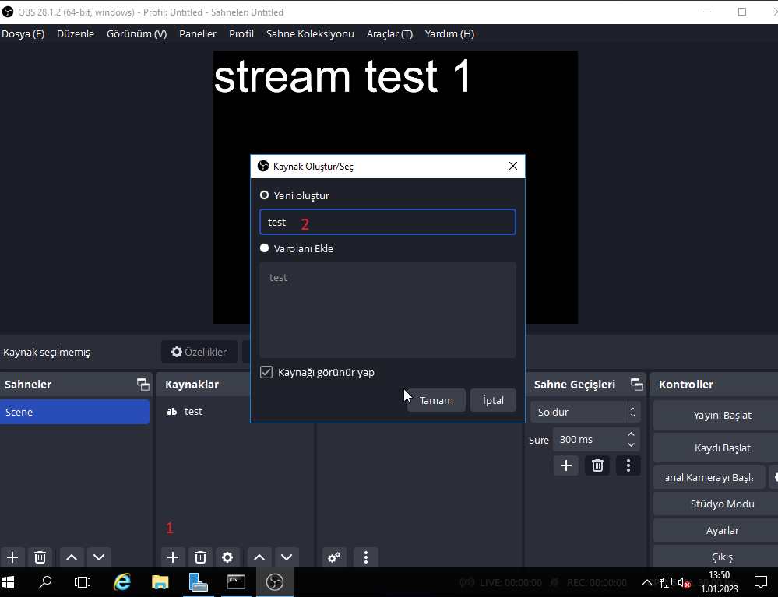
After installing the application, we add a test article for live broadcast testing.

Slide 6
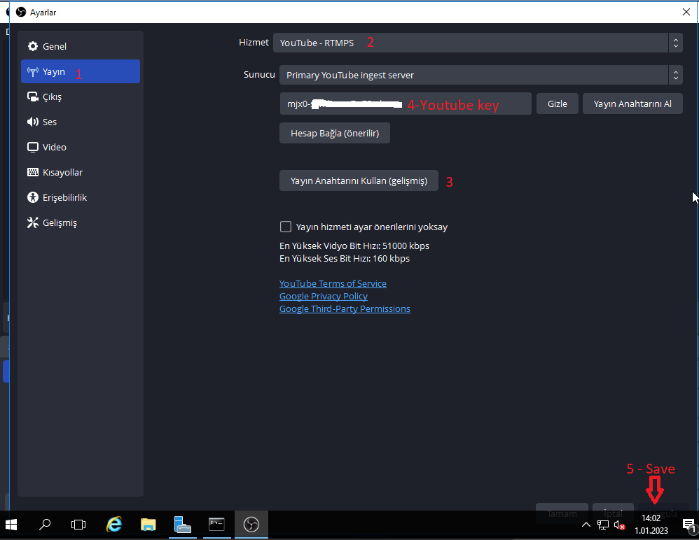
Then, in the broadcast tab in the settings section, Youtube is selected from the Service section and by pressing the use broadcast key button below, we enter the broadcast key that youtube gave us in the relevant section. Finally, we save the settings we made with the save button in the lower right corner.

Slide 7
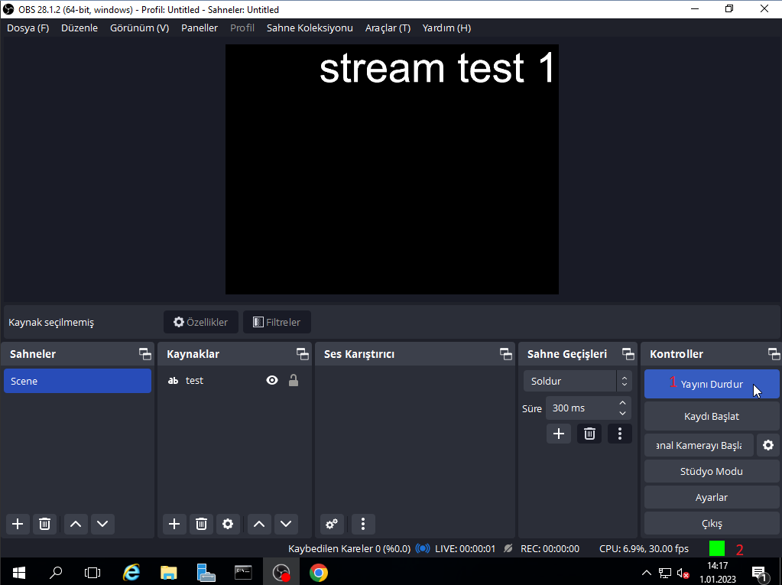
We have connected the two applications, now we start the live broadcast by pressing the start broadcast button. The green icon in the lower left indicates that the broadcast was made without any problems. If the color turns red, it indicates a problem with the settings.

Slide 8
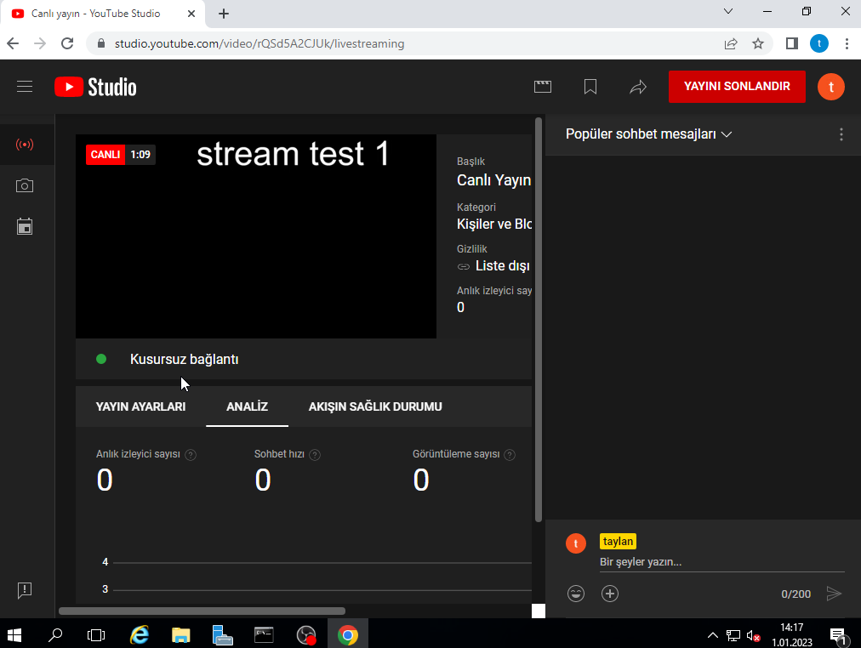
The live broadcast we started has started on the youtube interface.

Slide 9
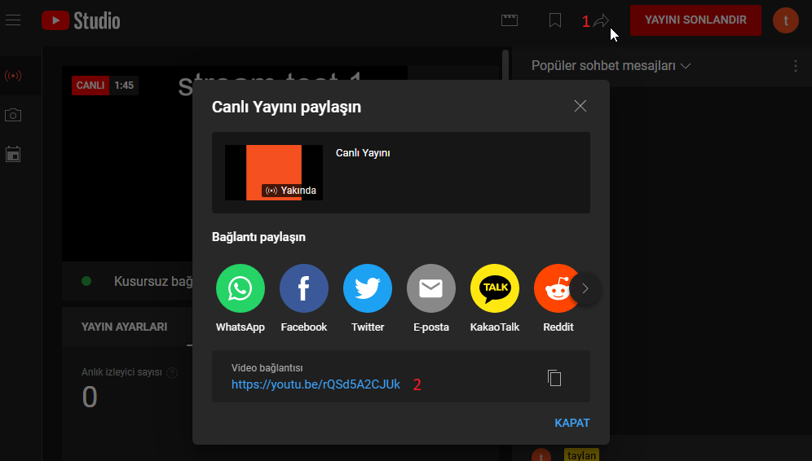
By sharing the link of our live broadcast, we can enable outside users to participate and watch. We can share the link wherever we want by pressing the share icon as in the image.

Slide 10
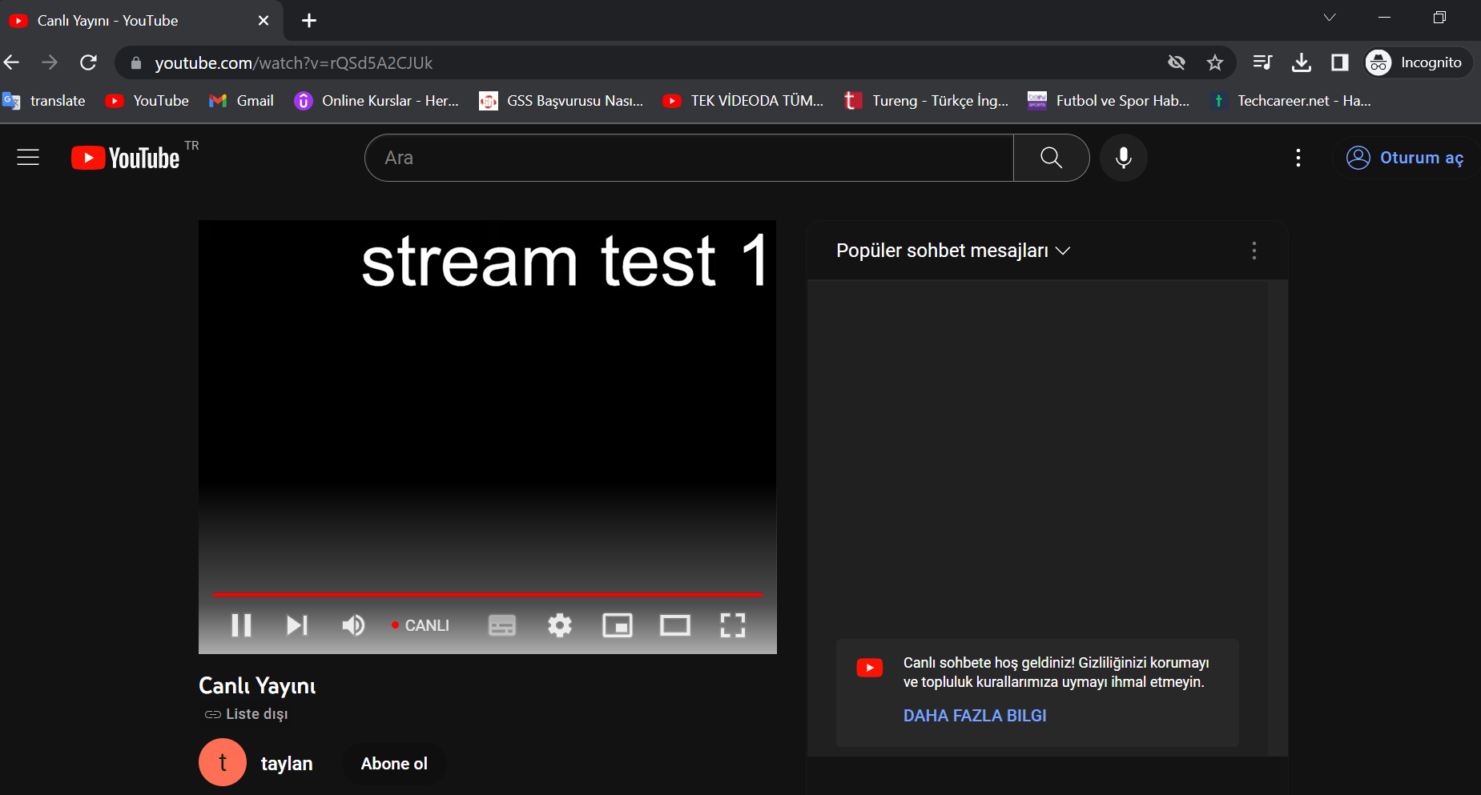
Viewers will be able to access the live broadcast when they click the link.

