Slide 1


SMART INDIA HACKATHON 2024
Problem Statement ID: SIH1554
Problem Statement Title: Smart Irrigation System for Precision Farming
Theme: Agriculture, FoodTech & Rural Development
PS Category: Hardware
Team ID: *replace*
Team Name: IrriGo

Slide 2
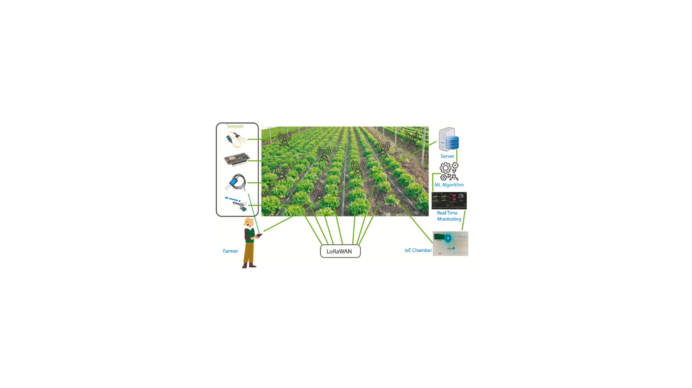
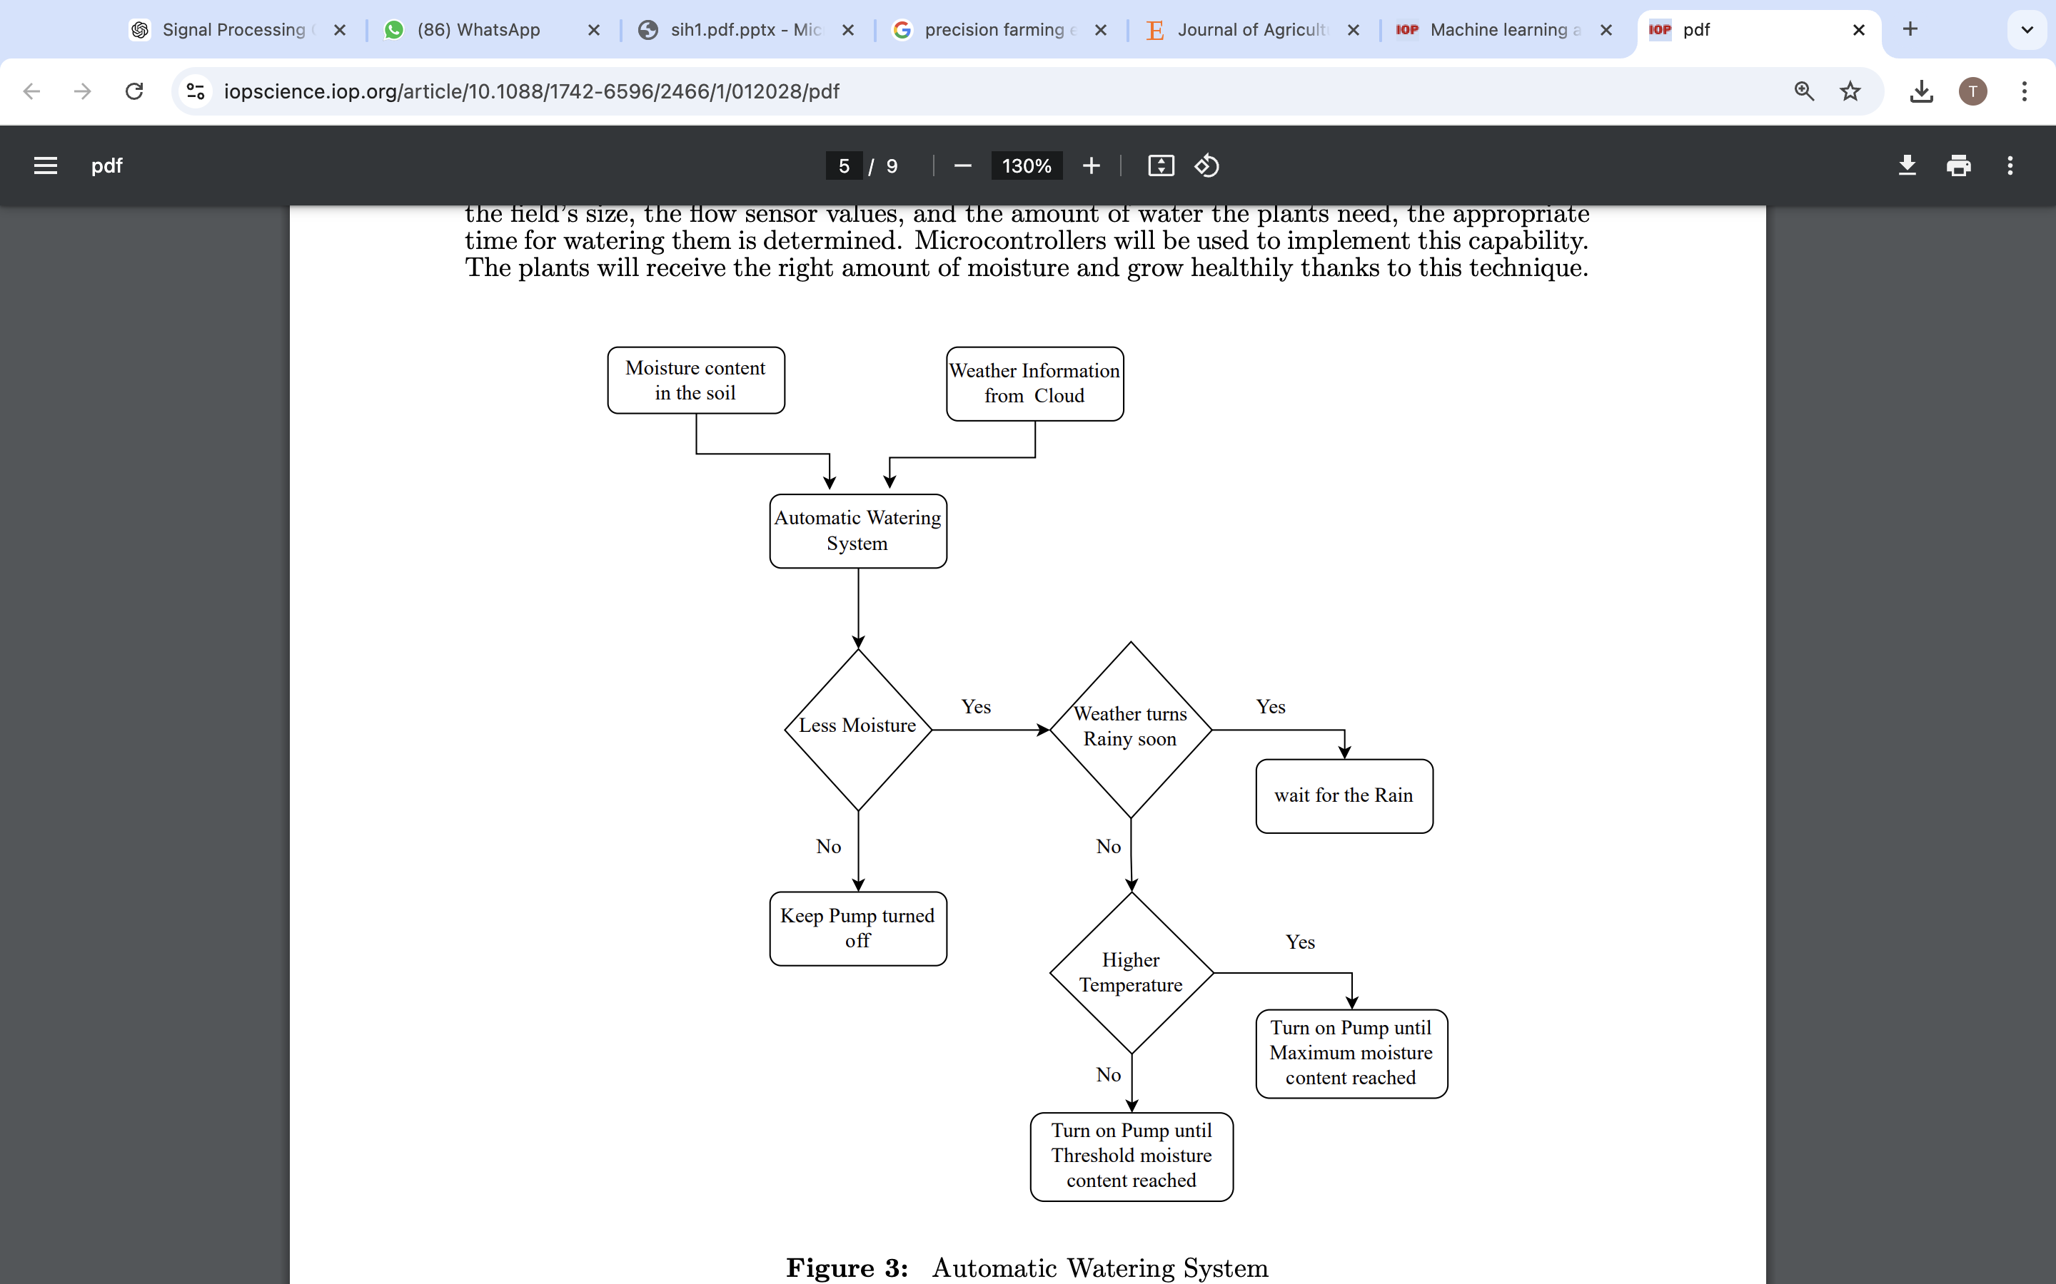
IDEA TITLE
IrriGo
Sensor-Based Irrigation: Soil moisture is monitored by a capacitive soil sensor to automate sprinkler activation via a solenoid valve.
Relay Control: A relay switches the 12V sprinkler system using a 5V microcontroller output.
GSM Module: Sends SMS alerts and allows remote control of the irrigation system.
Fertilizer Marketplace: Recommends fertilizers and crop suggestions based on soil data and planting history.
Water Usage Graph: Tracks and displays water consumption for efficient irrigation management.
Automation & Timer: Automated sprinkler schedule with a manual override and a disclaimer for inaccuracies.
Security & Troubleshooting: Secure communication and automatic troubleshooting for system errors.

Slide 3
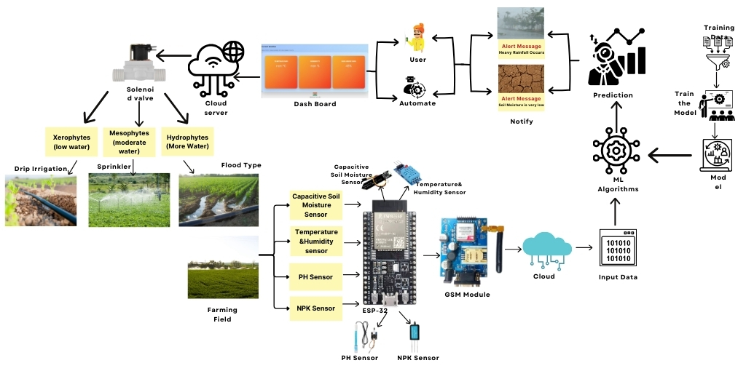








TECHNICAL APPROACH
IrriGo
Components:
Soil moisture sensor
Temperature sensor
Humidity sensor
GSM Module
NPK sensor
PH Sensor
Relay
ESP32
3

Slide 4
FEASIBILITY AND VIABILITY
IrriGo
Challenges
Solution
Technical Literacy
Environmental Variables
Farmers Understanding about the app
Regional Language Support
Including Temperature and Humidity data in the app
Technical Mentor(Agriculture sector) is assigned for certain crop.
4

Slide 5
IMPACT AND BENEFITS
IrriGo

Slide 6
RESEARCH AND REFERENCES
IrriGo
https://www.sciencedirect.com/journal/journal-of-agriculture-and-food-research
https://www.mdpi.com/1424-8220/23/1/403
https://iopscience.iop.org/article/10.1088/1742-6596/2466/1/012028
https://www.mdpi.com/1424-8220/22/16/6299
6

