Slide 1
Timeseries

Slide 2

How computers represent time and date?

Slide 3

How computers represent time and date?

Slide 4
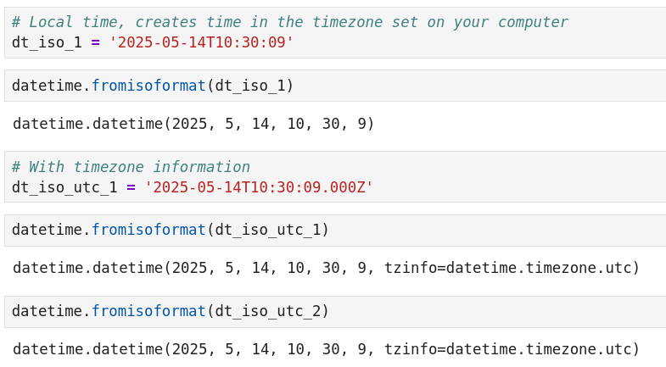
ISO 8601

Slide 5
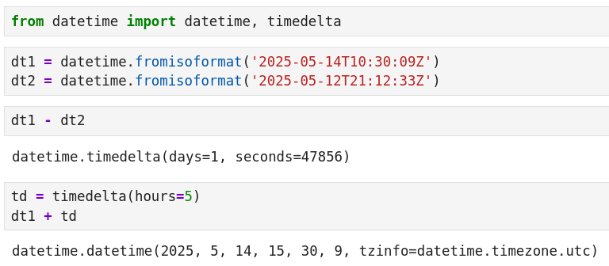
Performing calculations on datetime

Slide 6
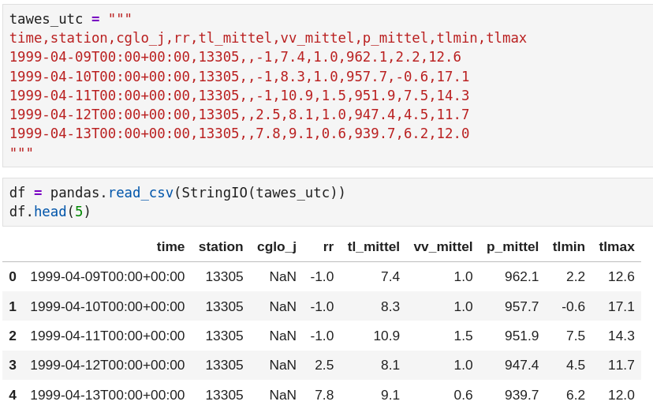
Reading timeseries in pandas

Slide 7
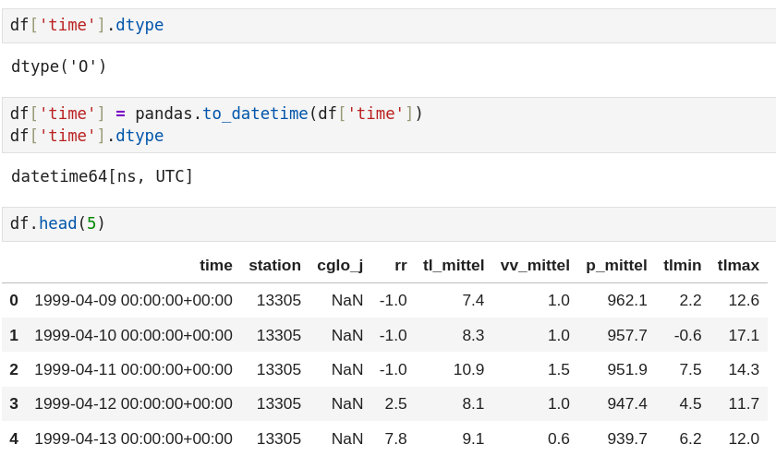
Reading timeseries in pandas

Slide 8
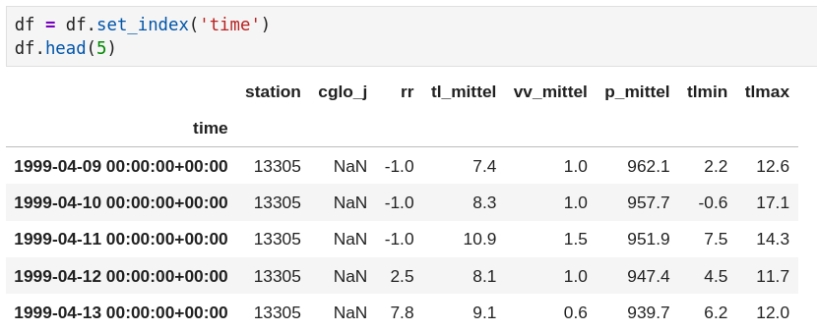
Pandas timeseries index

Slide 9
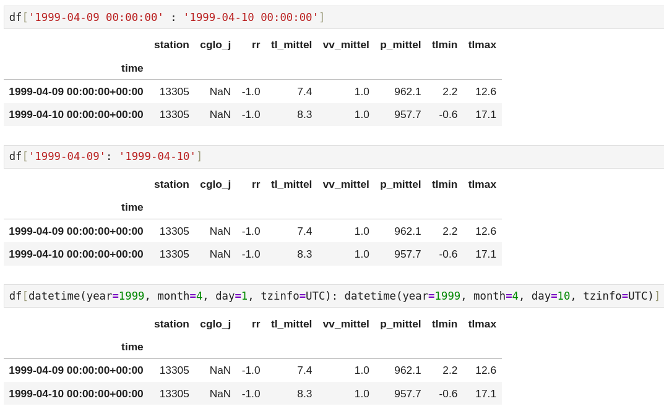
Indexing

Slide 10

Resampling

Slide 11


Resampling

Slide 12
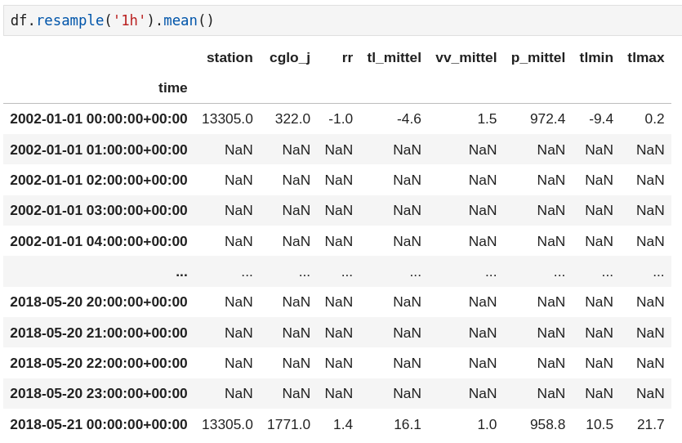
Upsampling

Slide 13
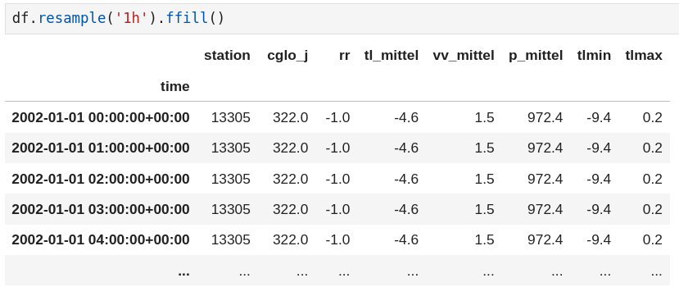
Upsampling

Slide 14

Upsampling

