Slide 1


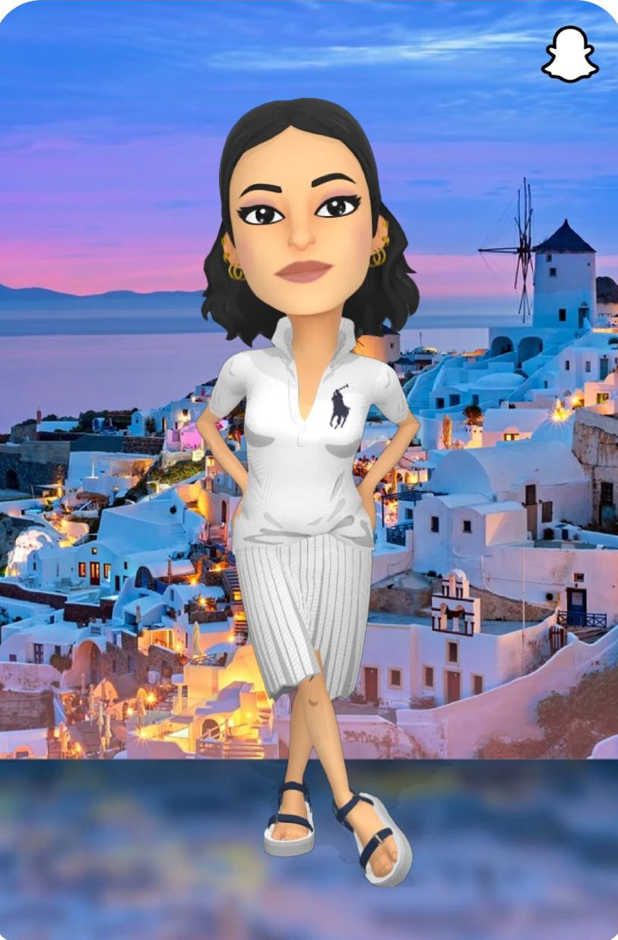
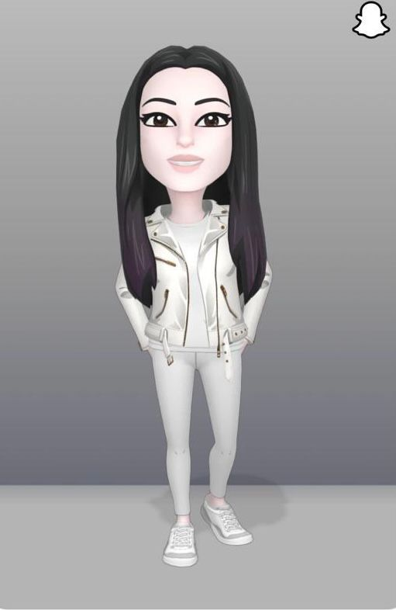
Snapchat By👻:
Mohammed Al-Bahal
Deema Alkamdi
Hanan Yahia Asiri

Slide 2

Snapchat App
Overview:
The Snapchat application through which the user can access his page or sign in a new one and then go to the chat page and start the conversation, and there is a camera to photograph the most beautiful clips .. and he can determine his location on the map and use TikTok.

Slide 3
Contents
Introduce Team
Project Name & Overview
Introduction
How to use the app
Timeline
Live Demo
Database Schema
Conclusion
Refrences & Credits
Any Questions & Suggestions ?

Slide 4
Introduction
The Snapchat application is an important application for communicating with other people and sending pictures and videos ..
The application is used for other purposes such as commercial, profit and volunteer purposes ..
The Snapchat application is one of the most important applications at this time.

Slide 5
How to use the app
Go to the application interface and then log in with the user name and email .
Go to the chat page and start chatting with friends .
Use the camera for photography .
You can use the Tik Tok .
The user’s profile and status can be modified .
Locate the user.

Slide 6
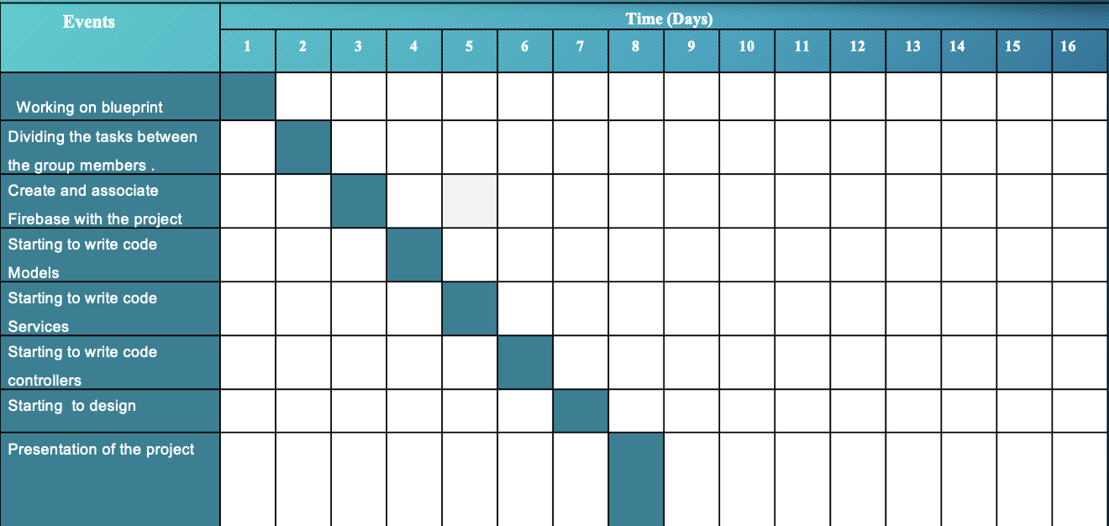
Timeline

Slide 7
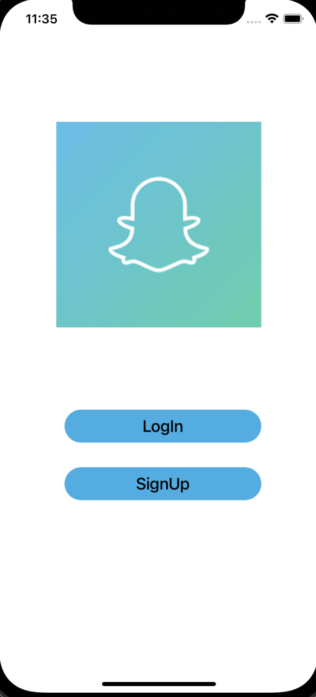
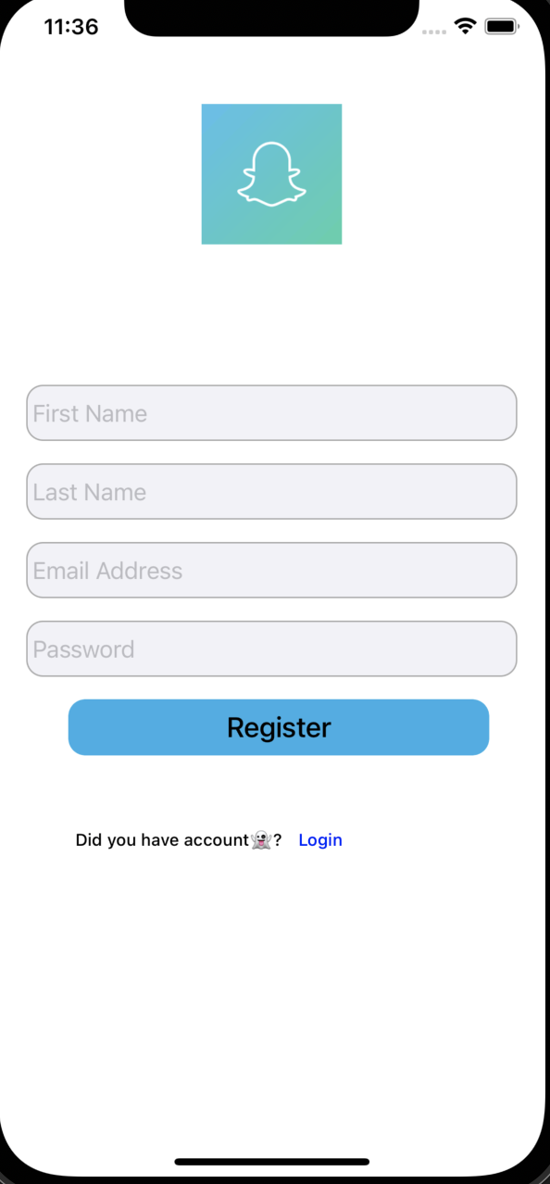
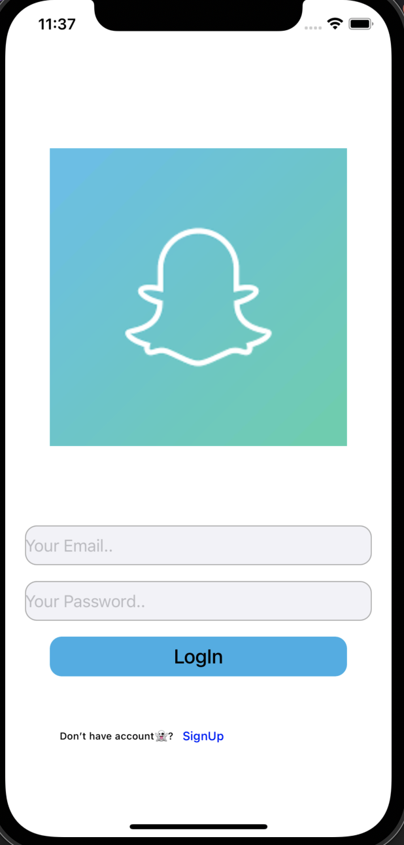
Demo

Slide 8
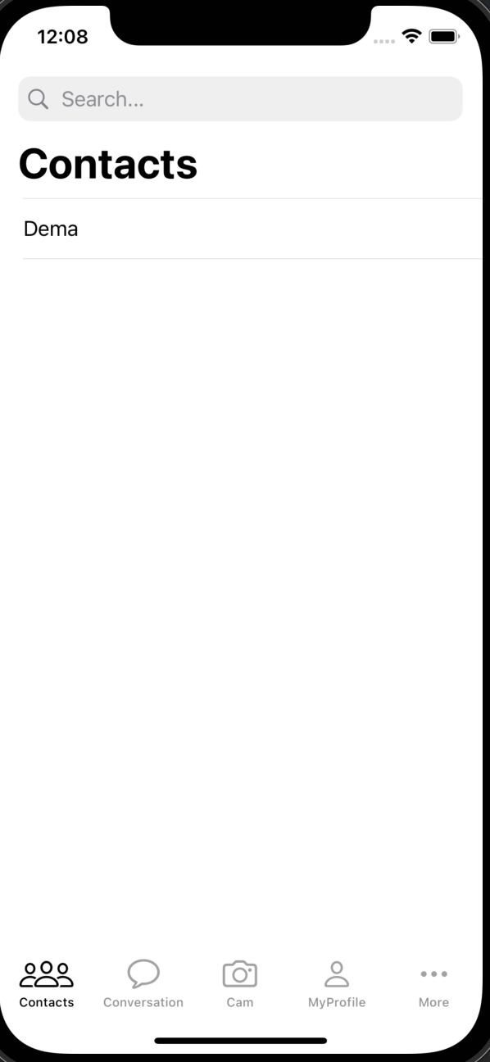
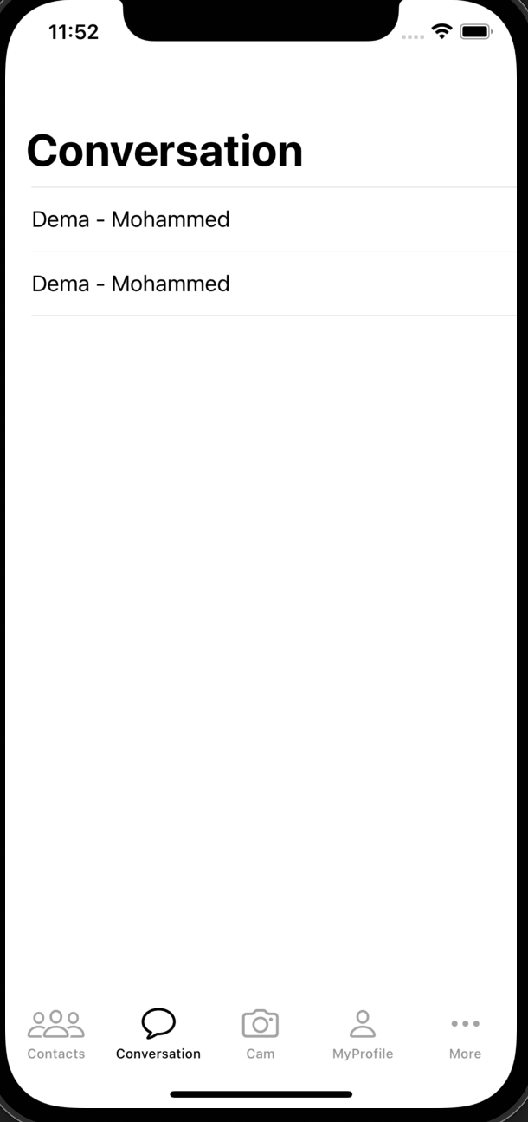
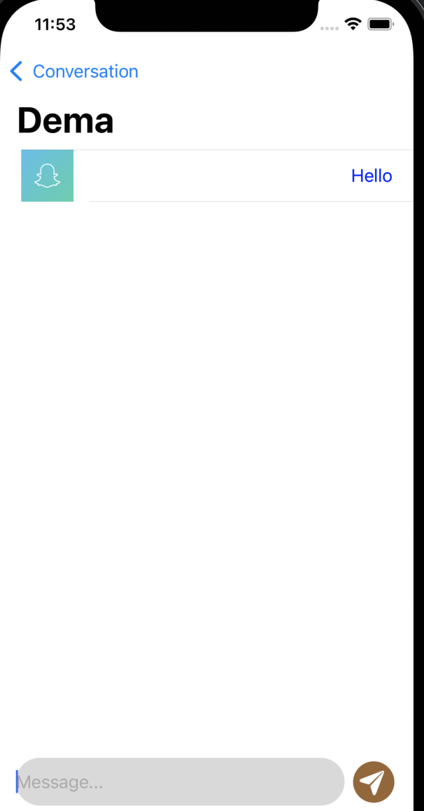
Demo

Slide 9
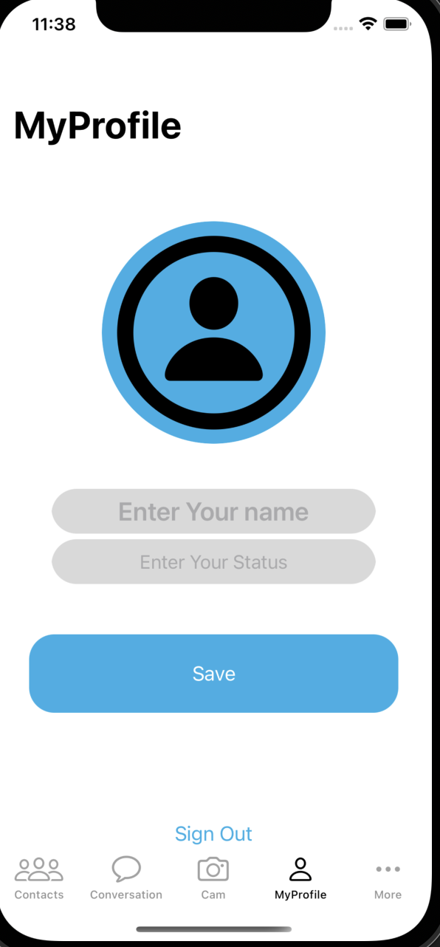
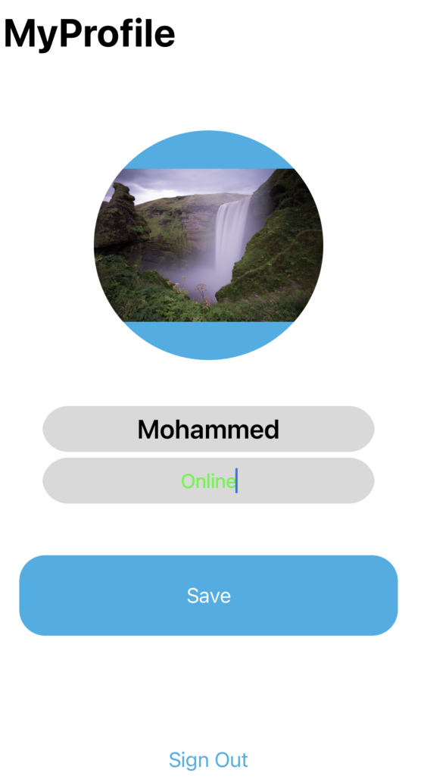
Demo

Slide 10
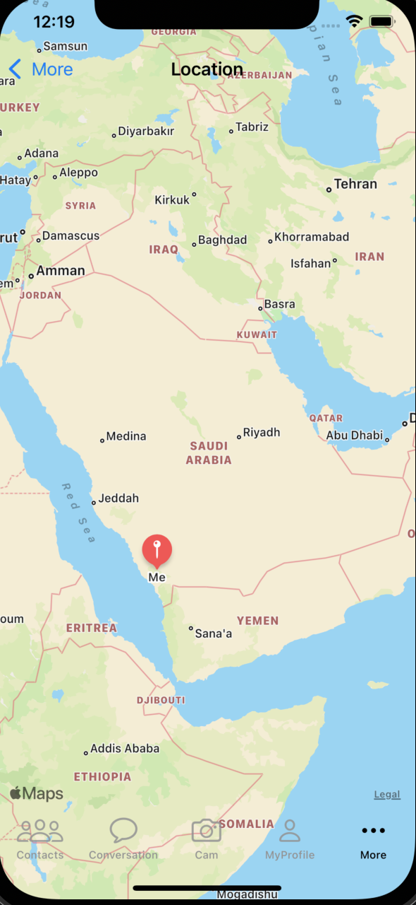

Demo

Slide 11
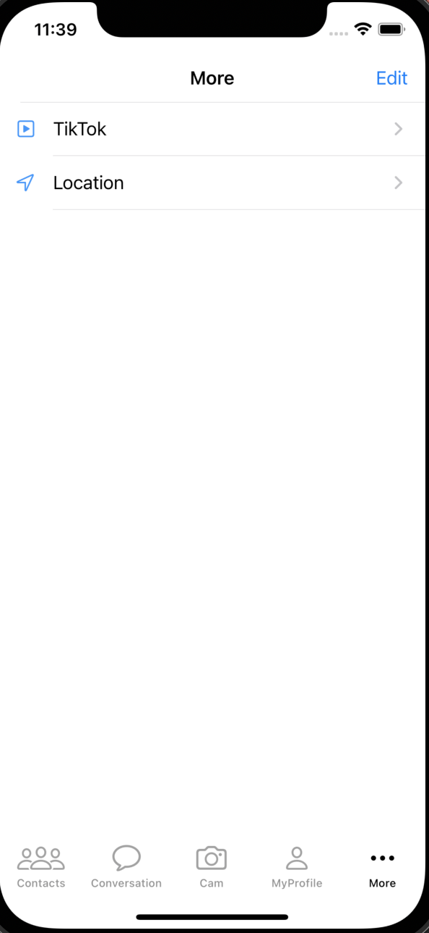
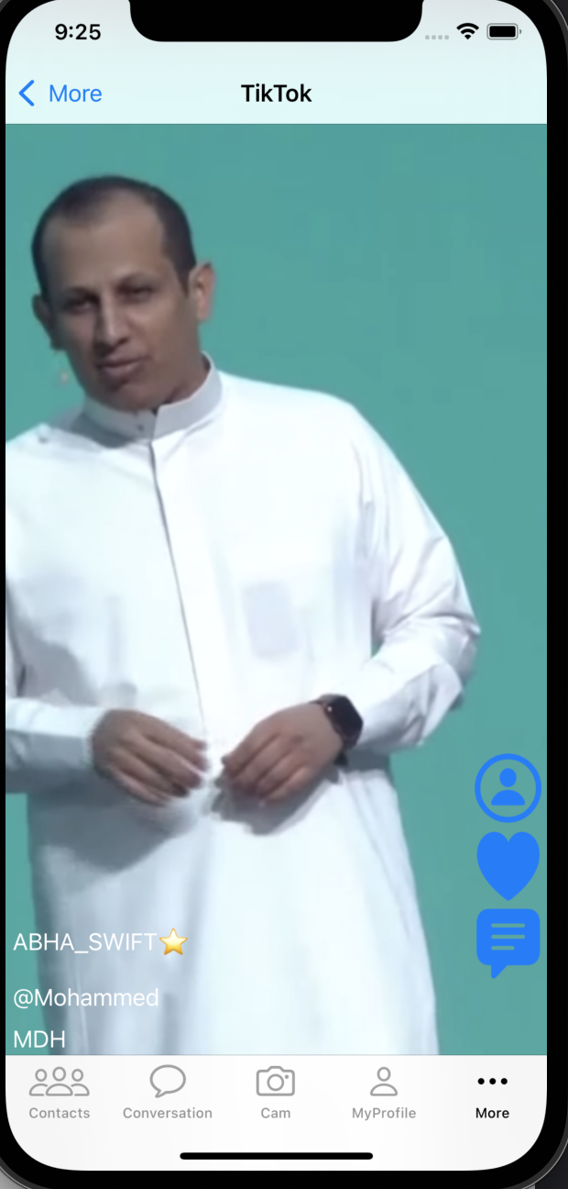
Demo

Slide 12
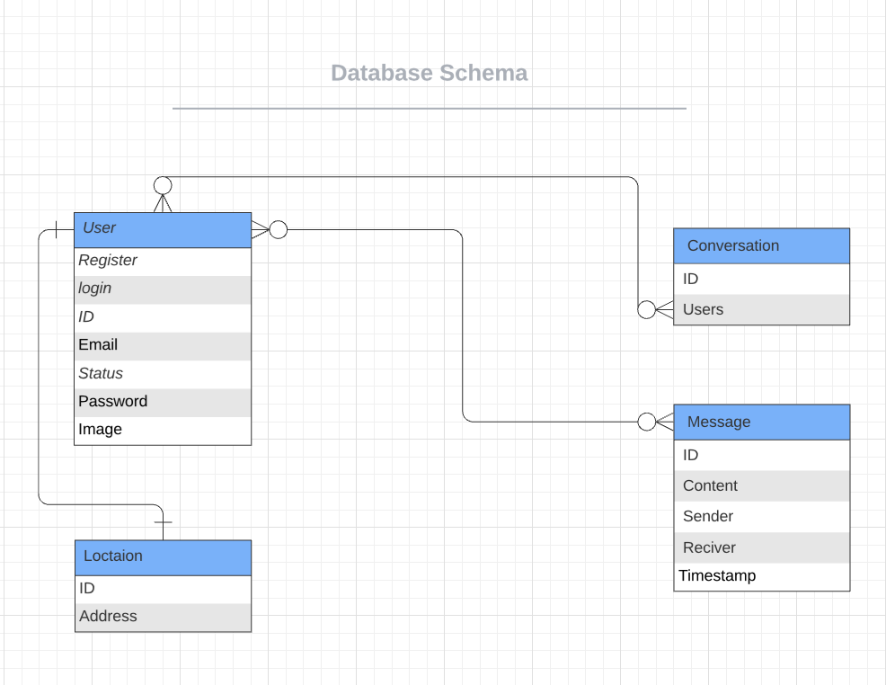
Database Schema

Slide 13
Conclusion
In this project, we linked the application to the Firebase and presented the idea of ​​an application such as the Snapchat application.. It connects the user with his friends, communicates with them, sends his location, and we added a wonderful feature, as the application is a feature of Tik Tok.

Slide 14
Refrences & credits
https://lucid.app/lucidchart/65eaf76c-cee3-4f71-9fc9-76046d5e5439/edit?beaconFlowId=D438D126B405DA32&invitationId=inv_a2497303-690b-4c34-9233-4752de250f06&page=0_0#
https://tuwaiq.edu.sa
https://www.youtube.com/watch?v=6kD1IZfGsWQ

Slide 15


Slide 16
THANK YOU FOR YOUR ATTENTION! 🤩🤍

