Slide 1
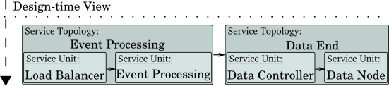
Pilot Application

Slide 2
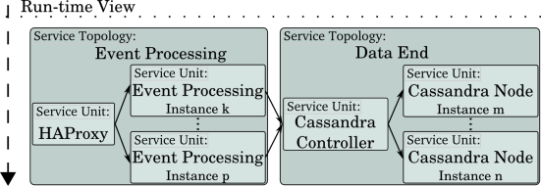
Pilot Application
Load

Slide 3
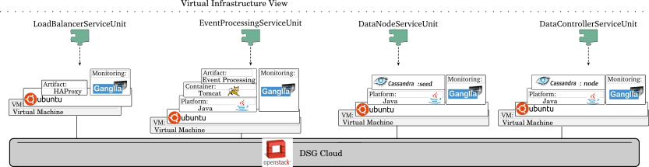
Pilot Application

Slide 4

COMOT: – platform for cloud native elastic services

Slide 5
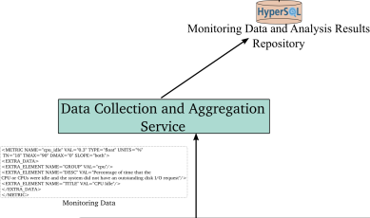
COMOT: – platform for cloud native elastic services

Slide 6

COMOT: – platform for cloud native elastic services

Slide 7
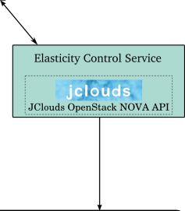
COMOT: – platform for cloud native elastic services

