Slide 1
Amazon E-Commerce: what the data says and what to do next
NEWTON SCHOOL · POWER BI CAPSTONE
Business insights and recommendations from 113K orders, 2015 to 2020
Presented by Tushar Naha
Notes:
Introduce yourself and the project: an analysis of Amazon e-commerce orders in Power BI, with SQL for the customer questions and a three-tab dashboard.

Slide 2
Agenda
ROADMAP
01
02
03
Problem and data
Cleaning and data model
Key metrics and findings
04
05
06
Loyalty program design
Power BI dashboard tour
Recommendations
Amazon E-Commerce · Power BI capstone
02
Notes:
Walk through the six parts quickly: context, data preparation, the findings, the loyalty idea, the dashboard, then recommendations.

Slide 3
Keep performing well, and find new ways to reward customers
THE BRIEF
QUESTIONS THIS DECK ANSWERS
PROBLEM STATEMENT
Which products, categories and regions drive revenue?
As a business analyst, I was asked to help stakeholders keep the company’s strong performance and improve on it. They want new strategies, such as more discounts and membership perks, and ways to identify and reward customers.
Where do delivery time and returns hurt customers?
How should customers be grouped and rewarded?
Amazon E-Commerce · Power BI capstone
03
Notes:
State the problem in your own words, then the three questions the rest of the deck answers.

Slide 4
Two tables: orders and customers
THE DATA
Orders table · 17 columns
113K
OrderID, OrderDate, Delivery Date, CustomerID, Location, Zone, Delivery Type, Product Category, SubCategory, Product, Unit Price, Shipping Fee, Order Quantity, Sale Price, Status, Reason, Rating
orders, one per customer
44
unique products
Customers table · 3 columns
CustomerID, Customer Age, Customer Gender
2015–2020
order dates covered
Amazon E-Commerce · Power BI capstone
04
Notes:
Orders hold the sales facts; Customers hold age and gender. Every customer has exactly one order, which matters later for the loyalty discussion.

Slide 5



Cleaned in Power Query, linked in one model
PREPARATION
CLEANING STEPS
DATA MODEL
Removed five fully blank trailing columns
Customers
Corrected data types: dates, whole numbers, decimals, text
one row per customer
Rounded Sale Price to two decimals to remove float noise
one to many, CustomerID
Removed blank rows from every column
Orders
fact table
Replaced blank Reason with “Not Applicable”
one to many, date
DateTable
marked as date table
Amazon E-Commerce · Power BI capstone
05
Notes:
Cleaning took place in Power Query. The model links Customers to Orders on CustomerID, single-direction, and a date table supports time intelligence such as previous-year sales.

Slide 6
Six numbers that frame the business
KEY METRICS
₹107.24M
603K
113K
total revenue
units sold
unique customers
9.41
30.5K
2.73
average days to deliver, delivered orders only
orders returned, about 27% of all orders
average customer rating
Amazon E-Commerce · Power BI capstone
06
Notes:
Top row is scale: revenue, units and customers. Bottom row is experience: delivery speed, returns and rating. Revenue is SUM of Sale Price; returns are orders with status Returned.

Slide 7
Customer count stayed flat for five years, then jumped 43% in 2020
CUSTOMERS BY YEAR
25,179
Flat base. About 17.4K to 17.7K customers a year from 2015 to 2019.
17,624
17,634
17,672
17,354
17,537
One growth year. 2020 reached 25,179, the only real jump in the data.
Action. Find what drove 2020 so it can be repeated.
2015
2016
2017
2018
2019
2020
Amazon E-Commerce · Power BI capstone
07
Notes:
Unique customers per year use DISTINCTCOUNT on CustomerID. The five yearly figures plus 2020 add up to about 113,000, matching the Customers table.

Slide 8
Two categories earn two-thirds of all revenue
REVENUE BY CATEGORY
High value. Phones and Tablet and Electronics together earn ₹71.4M.
Phones and Tablet
₹38.5M
Electronics
₹32.8M
High volume. Health and Beauty and Fashion sell the most units but earn about ₹12M each.
Fashion
₹12.4M
Health and Beauty
₹11.9M
Home and Office
₹11.5M
Action. Protect stock of high-value lines, and bundle the high-volume ones.
Amazon E-Commerce · Power BI capstone
08
Notes:
Revenue by category comes from the Product tab table. Popularity by units, from the objective question on the most popular categories, puts Health and Beauty and Fashion first, which is why volume and value tell different stories.

Slide 9
June and September are the weakest months, 20% below January
SEASONALITY
10.1
9.9
9.7
9.9
Strongest. January at ₹10.1M, in line with post-holiday buying.
8.8
8.6
8.5
8.7
8.3
8.6
8.1
8.1
Weakest. June and September at ₹8.1M each, with no big shopping occasion.
Action. Run a mid-year sale in June and a back-to-season sale in September.
Jan
Feb
Mar
Apr
May
Jun
Jul
Aug
Sep
Oct
Nov
Dec
Revenue in ₹M, all years combined
09
Notes:
Monthly revenue aggregated across all years. The gap between January and the two weakest months is roughly 20 percent, so these are the best candidates for promotions.

Slide 10
Four locations bring in about ₹80M of ₹107M
REVENUE BY LOCATION
Concentrated. Greater Accra alone earns more than the bottom 13 locations combined.
Greater Accra
₹27M
Ashanti
₹23M
Western
₹17M
Long tail. The remaining locations earn only ₹1M to ₹3M each.
Weija
₹13M
Upper West
₹5M
Action. Reinforce the top four, and test local promotions in the tail.
Volta
₹5M
Top six locations shown, revenue in ₹M
10
Notes:
Revenue is heavily concentrated. A single national marketing budget would be inefficient, so weight spend toward the proven markets while reserving a test budget for the long tail.

Slide 11
Delivery type drives the wait: 3.5 days by Express, 15 from abroad
DELIVERY TIME
Not the category. Every category averages 9.4 to 9.5 days.
AVERAGE DAYS TO DELIVER
Express
3.5
4.3× gap. Shipping from abroad takes more than four times as long as Express.
Standard Delivery
10.0
Shipped from Abroad
Action. Show honest delivery windows at checkout, and stock nearer to customers.
15.0
Delivered orders only
11
Notes:
The overall average of 9.41 days hides a very wide spread by delivery type. Category differences are only about 0.1 day, so staffing or scheduling by category would not help.

Slide 12
Health and Beauty and Fashion cause over 60% of returns
RETURNS
Expectation gap. “Not fitting expectation” and “description mismatch” make up about 40% of real returns.
RETURNED ORDERS BY CATEGORY
Health and Beauty
9.8K
Fashion
9.0K
Slow shipping adds to it. About a third of Fashion revenue ships from abroad.
Phones and Tablet
4.7K
Home and Office
4.2K
Action. Fix descriptions, sizing guides and images for these two categories.
Electronics
2.7K
30.5K returned orders in total
12
Notes:
Total Returns is a CALCULATE and COUNTROWS measure filtered to Status equal to Returned. Fashion's ₹4.14M from Shipped from Abroad is about a third of its ₹12.4M revenue, which links the long wait to its high returns.

Slide 13
Two Canon cameras earn big revenue from very few sales
PRODUCTS
Low volume. The 60D bundle sold 2.6K units, the lowest in the catalog. The 600D sold 5.1K. The rest sell 13K or more.
TOP FIVE PRODUCTS BY REVENUE
Canon EOS 600D DSLR
₹13.9M
Canon EOS 60D bundle
₹12.1M
High value. Each unit is premium, so a small price cut can lower the barrier.
Amazon Fire HD 8 Kids tablet
₹11.2M
Samsung Galaxy A02
₹9.0M
Action. Offer 5 to 10% off, then track units before extending it.
Infinix Smart HD X612
₹6.3M
Revenue in ₹M
13
Notes:
This is a low volume, high value pattern, not a failing product. The goal of the discount is reach, not rescue, so keep it modest and pair it with visibility such as a limited-time offer badge.

Slide 14
A three-tier program based on spend
LOYALTY PROGRAM
Gold
Silver
Bronze
Revenue more than 30% above the average customer
At or above average, below the Gold line
Spending below the average customer
Welcome discount for a second order
Promotions in June and September
Category offers to lift order value
Early access to launches
Free or expedited shipping
Dedicated discount code and priority support
Discount on their top category
Birthday offers
Free-shipping threshold
Why spend, not frequency. Every customer placed exactly one order, so repeat buying can’t be measured yet. The first goal is a second order.
Amazon E-Commerce · Power BI capstone
14
Notes:
The SQL work showed the maximum order count for any customer is one, so frequency-based tiers are impossible. Tiers use total revenue against the dataset average. Success is measured first by whether Bronze and Silver customers return for a second order.

Slide 15
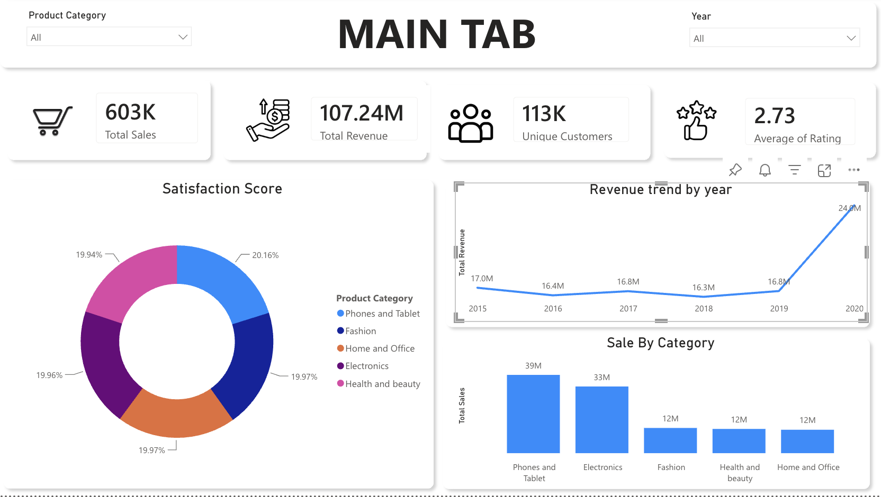
Main tab: the whole business at a glance
DASHBOARD TOUR · 1 OF 3
Four KPI cards: units, revenue, customers, rating
Three charts: satisfaction by category, revenue by year, sales by category
Slicers: Product Category and Year
Built for overall stakeholders
15
Notes:
The Main tab is for overall stakeholders. The cards show units sold, revenue, unique customers and average rating. The Year slicer filters every visual on the page.

Slide 16
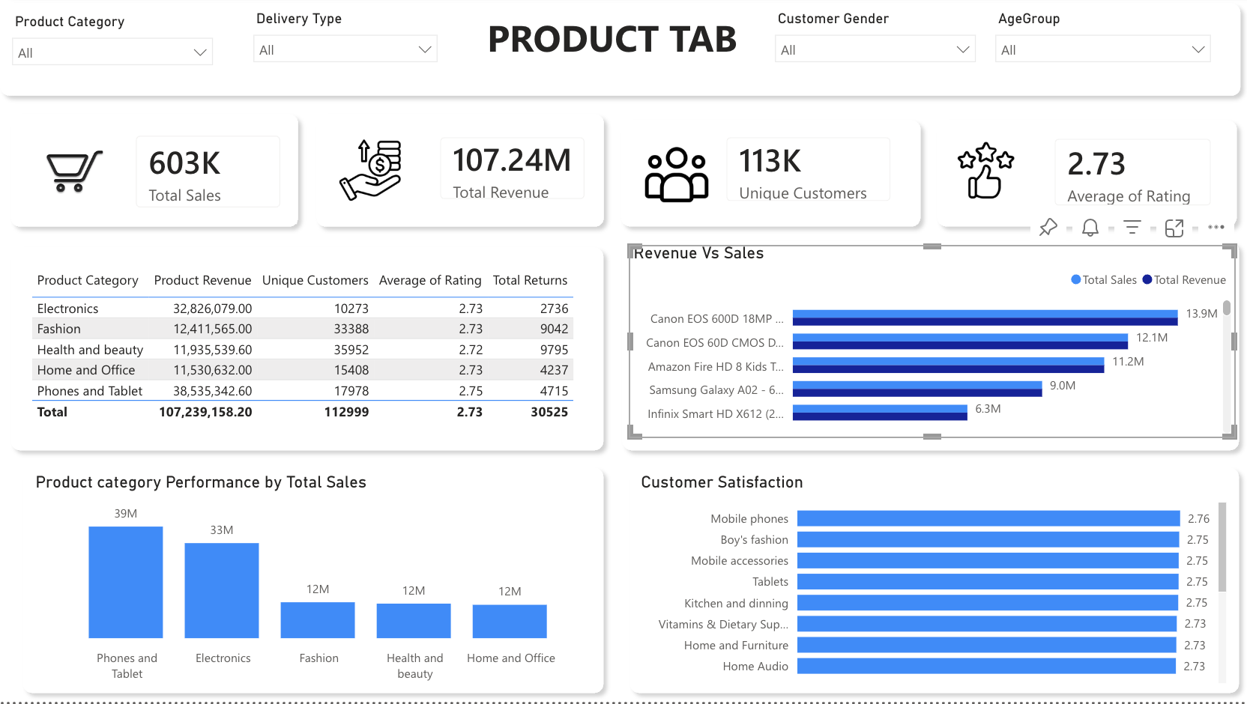
Product tab: category performance and satisfaction
DASHBOARD TOUR · 2 OF 3
Four slicers: category, delivery type, gender, age group
Category table: revenue, customers, rating, returns
Reconciles: the table total matches ₹107.24M
Built for category managers
16
Notes:
The Product tab is for category managers. Four slicers cut every visual. Age group is a calculated column on the Customers table. The table total of 107,239,158 matches the revenue card.

Slide 17
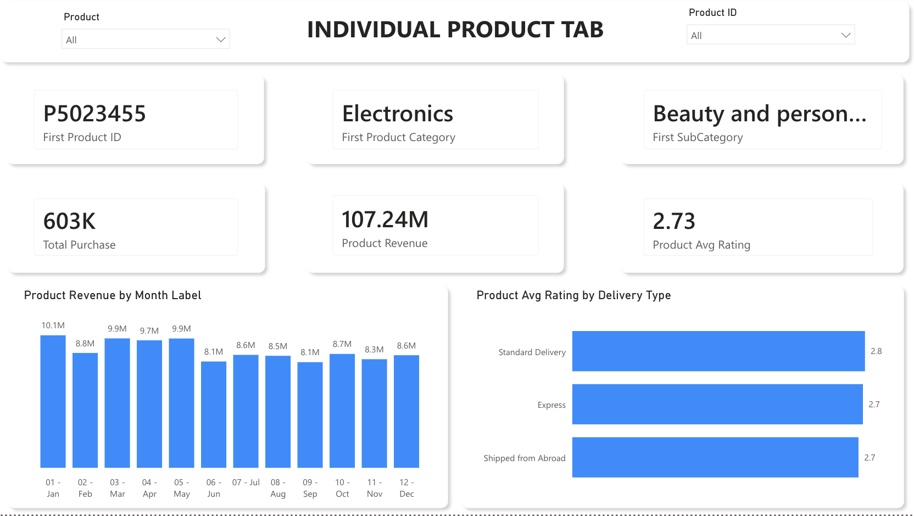
Individual product tab: one product in detail
DASHBOARD TOUR · 3 OF 3
Pick a product by name or by product ID
Six cards: ID, category, sub-category, units, revenue, rating
Field parameter: switch the monthly chart between revenue, units and rating
Built for product-level decisions
17
Notes:
The data had no product ID, so one was created as a calculated column in the Orders table. A metric selector built with a field parameter lets one chart show revenue, units or average rating by month.

Slide 18
Six recommendations
WHAT TO DO NEXT
1
2
3
Protect stock of Phones and Tablet and Electronics. Offer 5 to 10% off premium Canon cameras.
Bundle high-volume Health and Beauty and Fashion items.
Run promotions in June and September, the weakest months.
4
5
6
Show honest delivery windows and reduce reliance on shipping from abroad.
Improve descriptions, sizing guides and images to cut returns.
Launch the spend-based loyalty program, then measure second orders.
Amazon E-Commerce · Power BI capstone
18
Notes:
Order of priority: delivery honesty and listing quality first, since they hit returns and ratings together. Pricing is not a lever for ratings because ratings barely differ by price. Promotions and the loyalty program follow.

Slide 19
Thank you
AMAZON E-COMMERCE · POWER BI CAPSTONE
Questions and discussion
Tushar Naha · tusharnaha9@gmail.com
Notes:
Close by repeating the three findings: value is concentrated, delivery type drives the wait, and returns come from expectation gaps.

