Slide 1


Spreadsheet Project: Zomato Restaurants Analysis
Submitted By: Tushar Naha

Slide 2
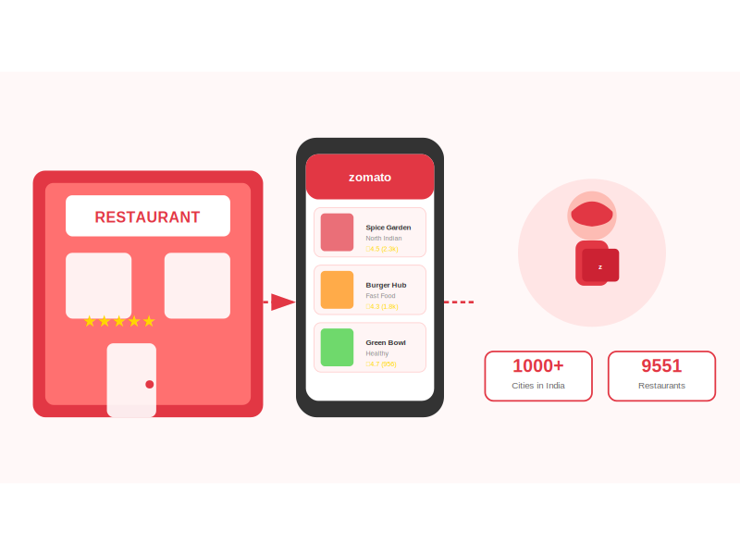
ABOUT ZOMATO
Zomato provides information, menus and user-reviews of restaurants as well as food delivery options from partner restaurants in more than 1,000 Indian cities and towns

Slide 3
AGENDA
01
02
03
04
05
Problem Statement
Data Description
Objective Key Metrics and Visualizations
Insights from Subjective Question
Strategic Recommendation and Dashboard

Slide 4
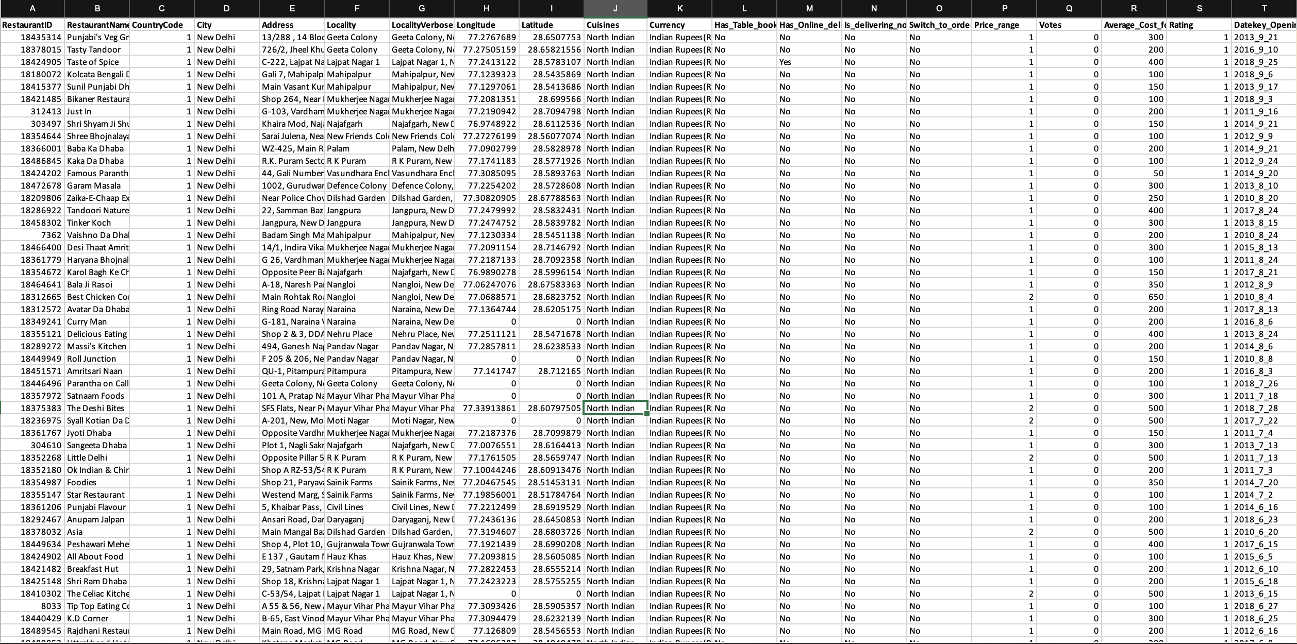
PROBLEM STATEMENT
You are hired as a consultant data analyst by Zomato where the team is looking for expansion and opening restaurants. Your task is to come up with strategies/suggestions about opening newer restaurants.

Slide 5
DATA DESCRIPTION
The dataset contains information about 9,551 restaurants with 20 columns detailing various attributes of these establishments. Below is an overview of the dataset:
Restaurant ID: Unique identifier for each restaurant.
Restaurant Name: The name of the restaurant.
CountryCode: Country code of the location where the restaurant is situated.
City: The city where the restaurant is located.
Address: The specific address of the restaurant.
Locality: The locality or neighbourhood where the restaurant is situated.
Locality Verbose: Detailed information about the locality.
Longitude: The geographical longitude coordinate of the restaurant.
Latitude: The geographical latitude coordinate of the restaurant.
Cuisines: The type of cuisine offered by the restaurant.
Currency: The currency used for transactions in the restaurant.
Has_Table_booking: Indicates whether the restaurant has a table booking option (Yes/No).
Has_Online_delivery: Indicates whether the restaurant offers online delivery (Yes/No).
Is_delivering_now: Indicates whether the restaurant is currently delivering (Yes/No).
Switch_to_order_menu: Indicates whether users can switch to the order menu (Yes/No).
Price_range: A numeric value indicating the price range category of the restaurant.
Votes: The number of votes or ratings/(feedback) received by the restaurant.
Average_Cost_for_two: The average cost for two people dining at the restaurant.
Rating: The overall rating of the restaurant is based on user reviews.
Datekey_opening: The date when the restaurant was opened.

Slide 6
Detailed Restaurant Information:
Covers IDs, names, addresses, and locations.
2. Geographical Data:
Provides longitude and latitude for precise location mapping.
3. Categorical Data:
Includes location (CountryCode, City), cuisine types, and currency.
4. Service Indicators:
Shows availability of table booking, online delivery, and current delivery status.
5. Financial Metrics:
Contains price range, average cost for two, and rating.
6. Temporal Aspect:
Includes the opening date of each restaurant.
DATA SNAPSHOT
Total restaurants | 9551
Total Country | 15
Total Cities | 139
Total Cuisines | 1825
Service offered | Table booking , Online Delivery
Average Rating | 2.9
Average Price in INR | Rs. 828

Slide 7
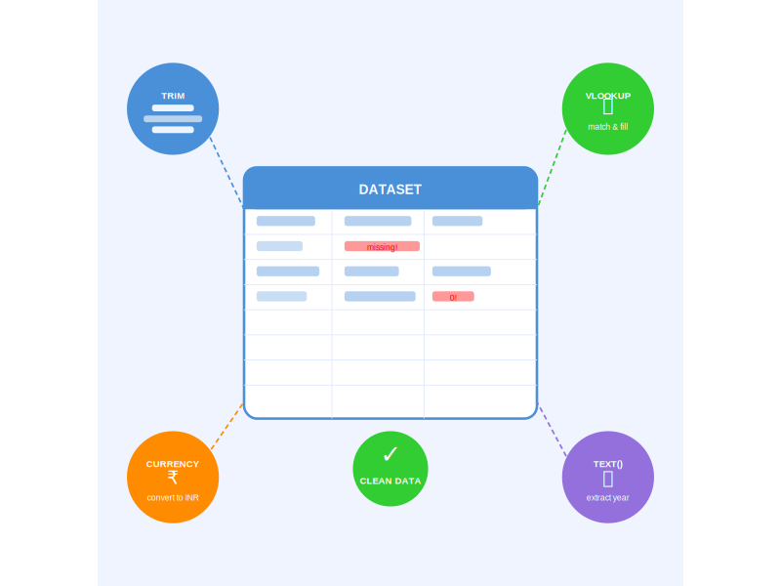
Data Cleaning
Removed the rows with missing Cuisines.
Removed the rows having Average price for two = 0.
Pre-processing:
Corrected cities name spellings in the city column by creating a new corrected_city column using V-Look Up
Added the country for respective country code using V-lookup Function
Changed all the ‘average price for two’ currency into INR and then categorized them under Range in new column ‘Average_Cost_for_Two_INR’
Extracted the opening year, ‘Date key opening’ using TEXT function

Slide 8
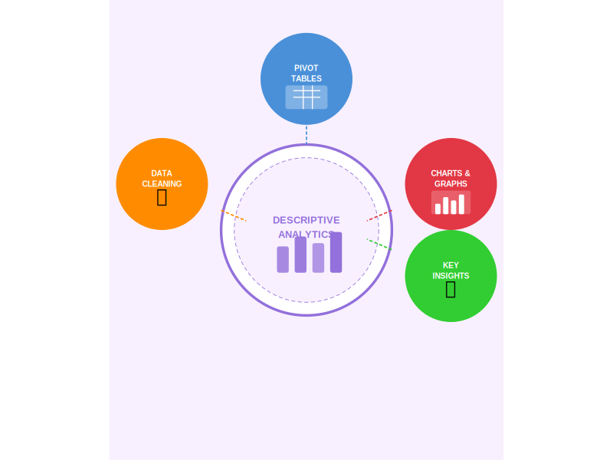
DATA CLEANING: Used TRIM function, Conditional Formatting, Removed missing data to make data accurate
DATA ENRICHMENT: Used TEXT function, V-lookup to add few columns to better efficiently understanding the data.
DESCRIPTIVE ANALYSIS: Used PIVOT TABLES understand the country- wise, cuisines wise, price wise, rating wise data
VISUALIZATION: Created different types of chart for data representation and data exploration

Slide 9
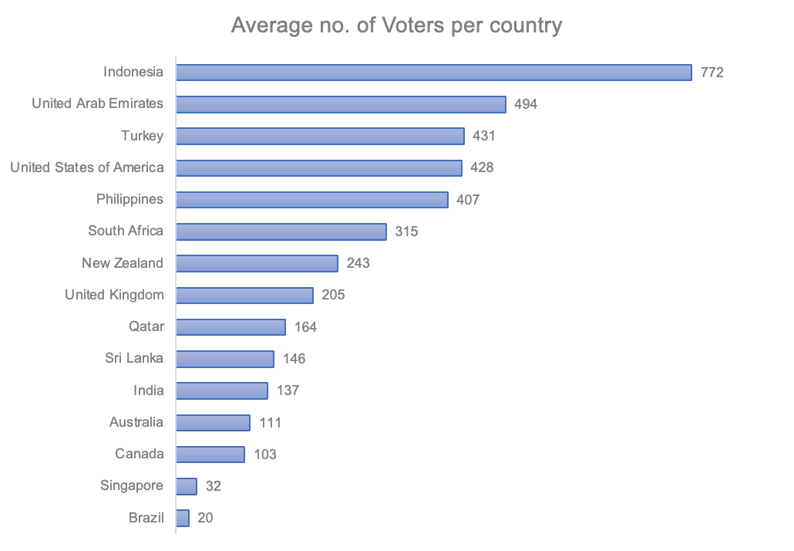
KEY METRICS AND VISUALIZATION
NUMBER OF VOTERS
Evaluated operational aspects such as the average number of voters per restaurant by country, providing a comparative analysis of customer engagement.
Countries with high no. of voters depicts higher interaction with customers.
Like : Indonesia Turkey
United Arab Emirates
Philippines

Slide 10
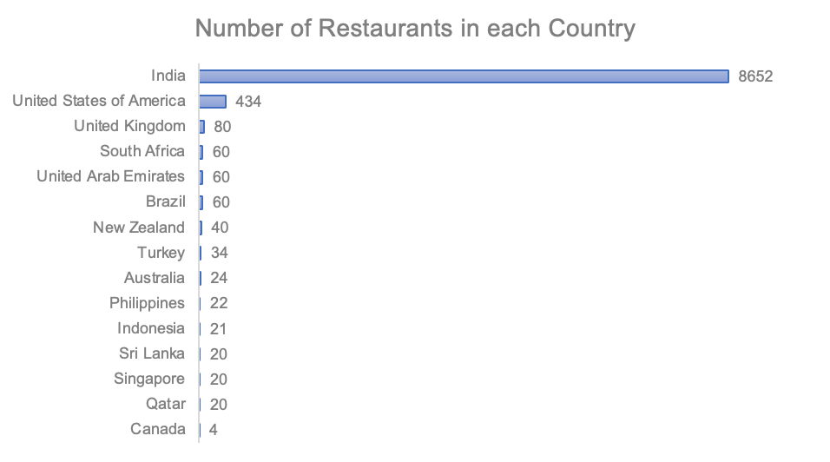
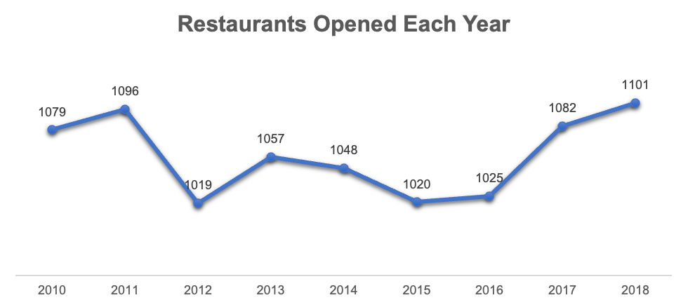
COUNT OF RESTAURANTS
Calculated the total number of restaurants per country and explored yearly trends, visualizing these insights through intuitive charts for better Strategic Decision Making.
It will be very advisable to open up the new restaurants. Like- Indonesia, Philippines

Slide 11
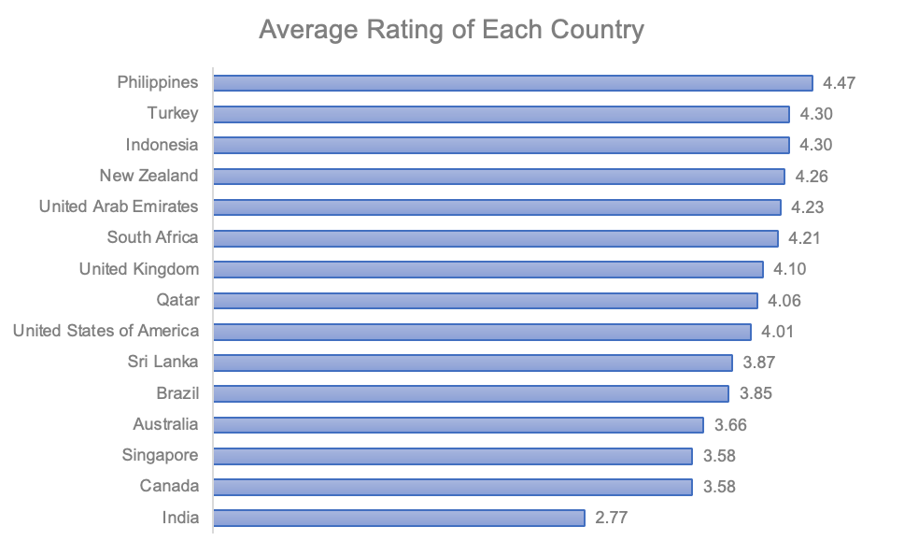
AVERAGE RATING OF RESTAURANTS IN EACH COUNTRY
Utilized statistical methods to calculate critical metrics such as average ratings for guiding operational improvements and strategic adjustments.
Country with high rating and low rating have their won reasons to be considered for opening new restaurants:
HIGH RATING- Such countries have high market appeal.
LOW RATING- Such countries have opportunity for improvement

Slide 12
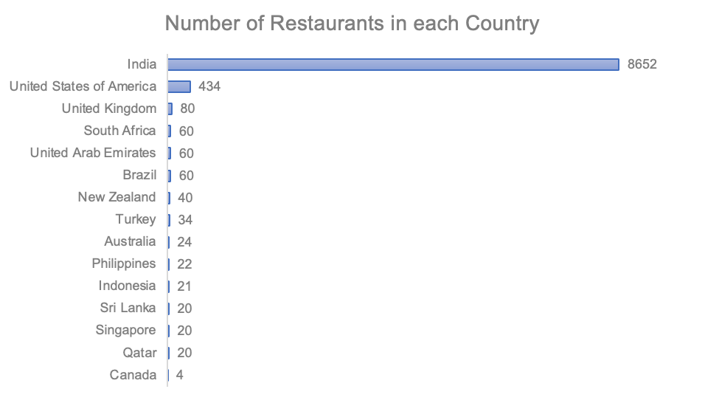
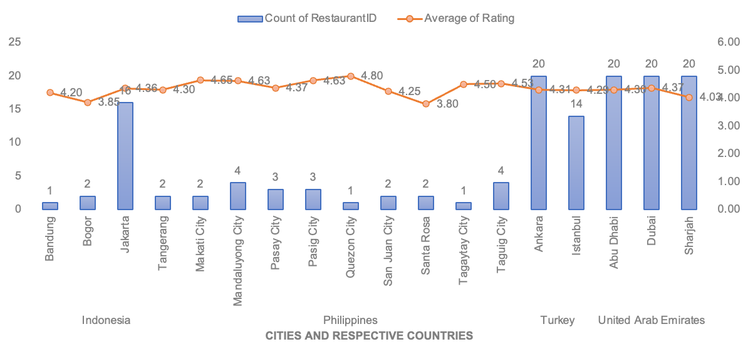
SUGGESTIONS FOR THE COUNTRY
To determine the lesser competition, I used following parameters to visualize through pivot table and make recommendations for country to open new restaurants
Density of restaurants:
1. Count of restaurants in Country 2. Count of Restaurants in Cities of selected countries

Slide 13
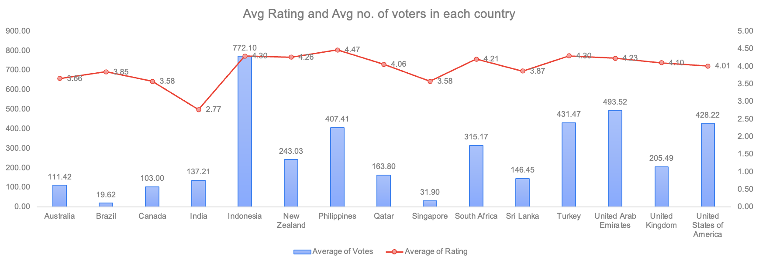
Position of Restaurant in Market
Average Rating
Average no. on interaction- total no. of votes

Slide 14
SUGGESTED COUNTRIES
INDONESIA
Less no. of restaurants and bigger in geographical size as compare to all other countries having same no. of restaurants
One of the highest average rating of restaurants with impressive data of customer interactions
Conclusion: New Restaurants can be opened because of less no. of restaurants and high market appeal
PHILIPPINES
22 Restaurants in 9 different cities.
One of the highest average rating of restaurants with impressive data of customer interactions
Conclusion: New Restaurants can be opened because of less competition and high market appeal
TURKEY
34 restaurants spread across 2 major cities, showing limited city-level presence with potential for expansion into new urban areas.
Strong average ratings reflecting positive customer sentiment and good market acceptance.
Conclusion: New Restaurants can be opened because of limited city coverage and strong customer feedback indicating good potential for growth.
TOTAL RESTAURANTS | 21
NO. OF CITIES | 4
AVERAGE RATING | 4.3
AVERAGE NO. OF VOTES | 772
TOTAL RESTAURANTS | 22
NO. OF CITIES | 9
AVERAGE RATING | 4.5
AVERAGE NO. OF VOTES | 407
TOTAL RESTAURANTS | 34
NO. OF CITIES | 2
AVERAGE RATING | 4.3
AVERAGE NO. OF VOTES | 431

Slide 15
SUGGESTIONS FOR THE STATE AND CITY
I suggested the cities having less no. of restaurants holding high potential of expanding there.
Suggested Country | State | City 1 | City 2 | City 3 | City 4 | City 5
Indonesia | Banten
 | West Java | Bandung | Bogor | Tangerang
Turkey
 | Marmara | Istanbul | Ankara
Philippines | Laguna
 | Metro Manila | Tagaytay City | Quezon City | Makati City | San Juan City | Santa Rosa

Slide 16
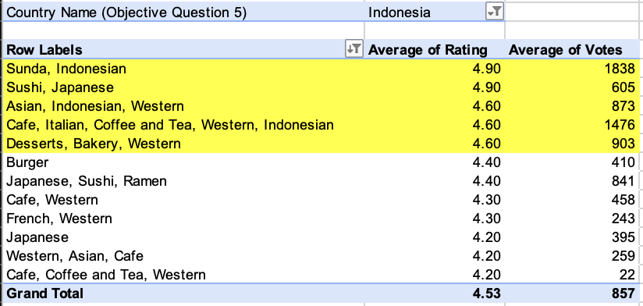
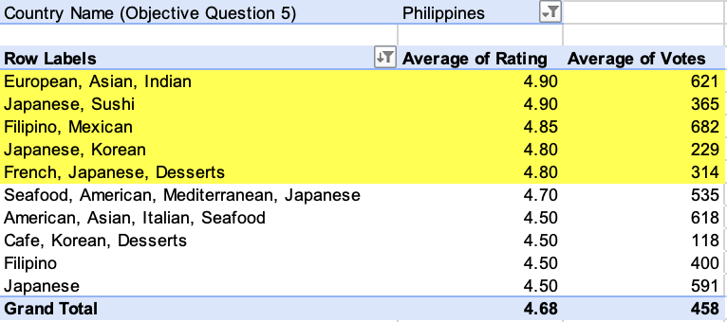
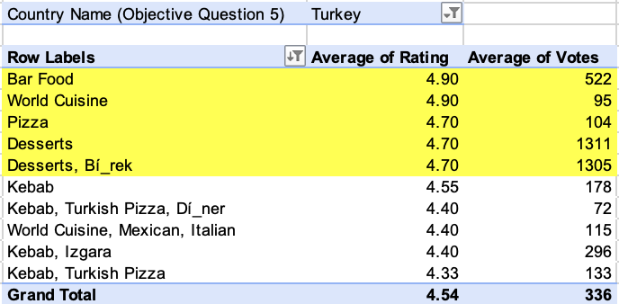
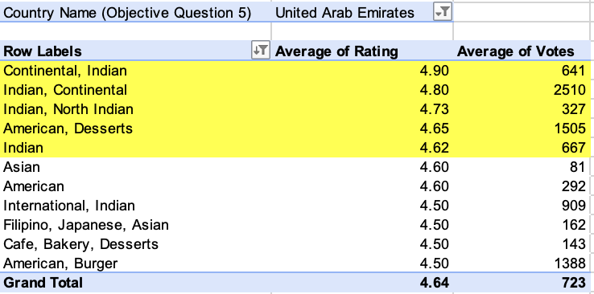
CUISINES TO FOCUS IN NEWER RESTAURANTS
To decide Which Cuisines, we should focus on in the newer Restaurant, We will focus on two factors: Cuisine’s rating & total votes each cuisines got. Highlighted cuisines should be focused in the respective countries
Reason: a. With fewer votes, a 4.9 rating might be more susceptible to fluctuation.
b. 4.5 rating with many votes suggests a more stable and reliable average

Slide 17
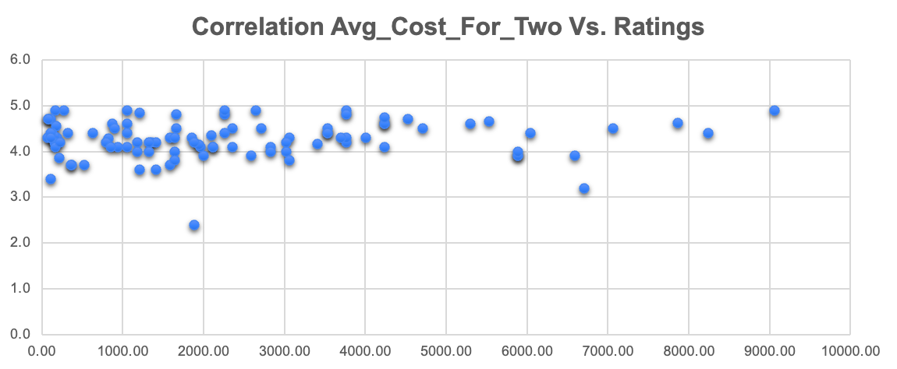
HOW PRICING OF CUISINES AFFECT THE RATING?
A positive correlation of +0.08 shows a very slight tendency for higher-priced cuisines to receive better ratings, but the relationship is extremely weak.
This means price has almost no meaningful impact on customer satisfaction. Other factors such as taste, food quality, presentation, service, and overall dining experience play a much bigger role in influencing ratings.
Correlation is 0.08

Slide 18
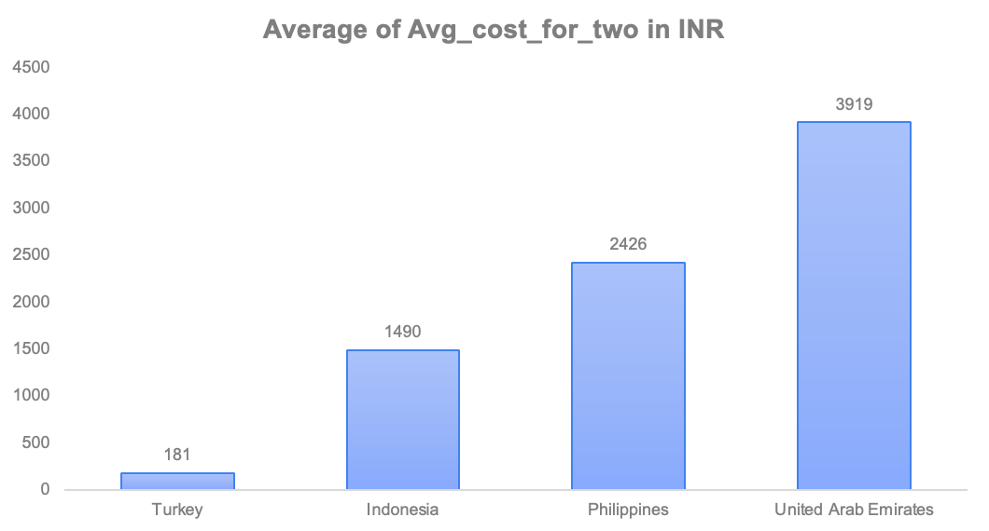
CURRENT EXPENDITURE ON FOOD IN SUGGESTED COUNTRIES
Recommendations
Use premium pricing selectively in United Arab Emirates and Philippines, where higher average spending indicates stronger acceptance of premium dining experiences.
In Indonesia, maintain moderate pricing with strong value offerings to match mid-range customer spending behavior.
In Turkey, keep pricing affordable and value-focused, as the average cost for two is lowest among the selected countries.
Overall, pricing strategy should align with each country’s spending capacity while maintaining food quality and customer satisfaction.

Slide 19
BOOKING AND DELIVERY OPTIONS
CONCLUSION: Most restaurants do not provide table booking or online delivery services. However, restaurants offering these facilities tend to improve customer convenience and overall satisfaction. Providing both services can help restaurants attract more customers and achieve better ratings

Slide 20
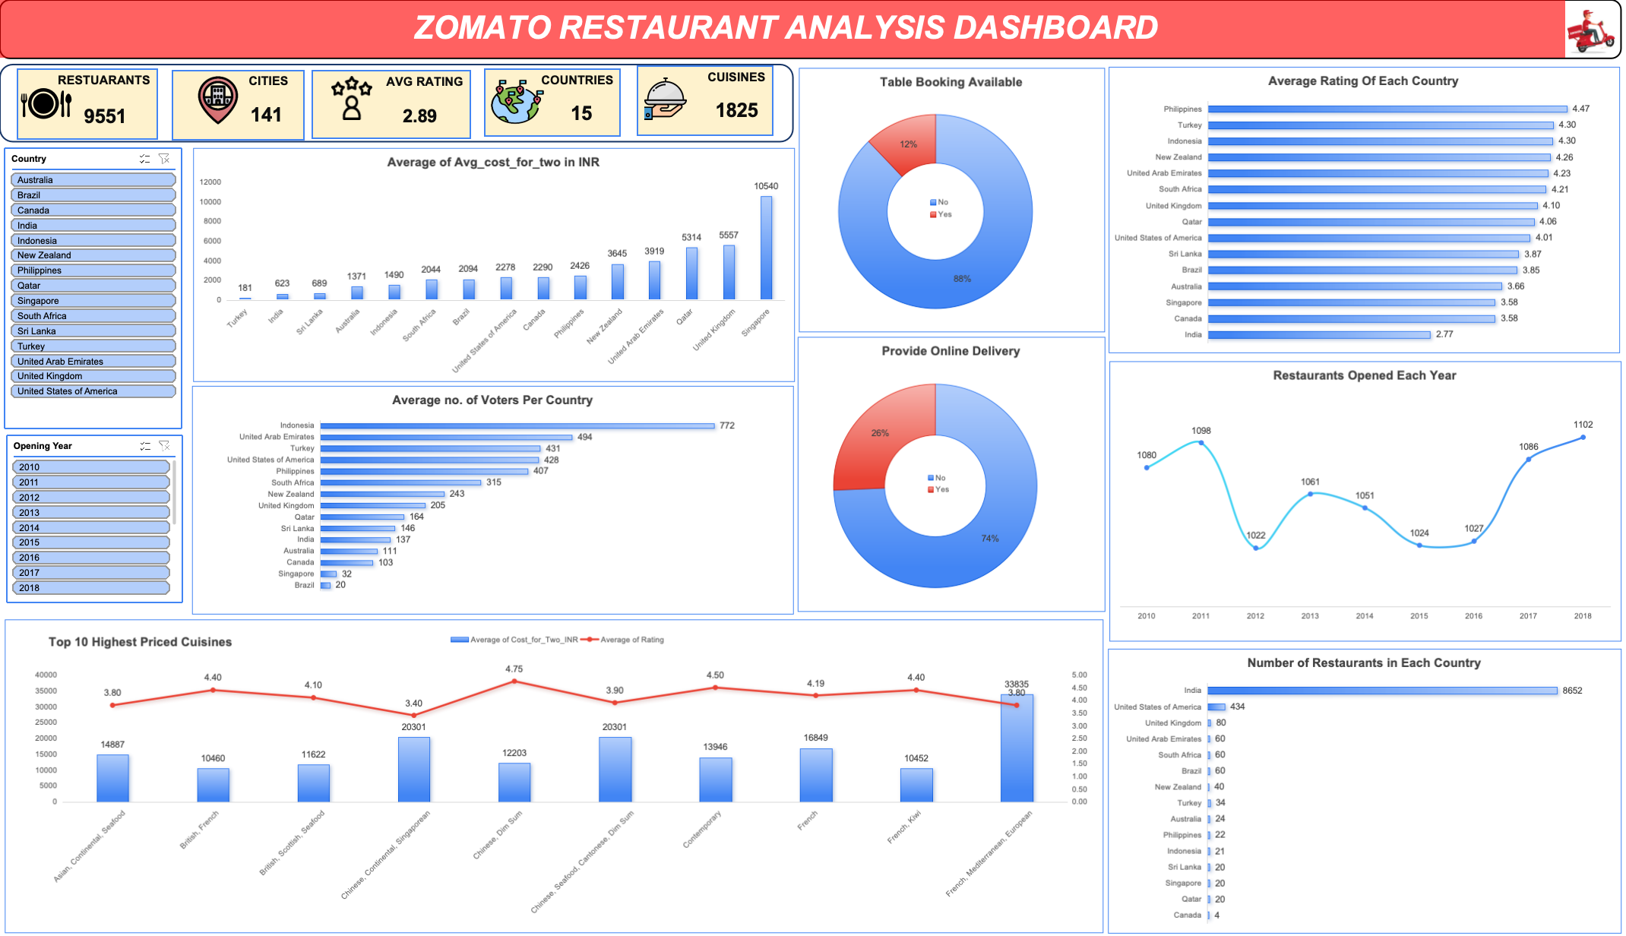

Slide 21
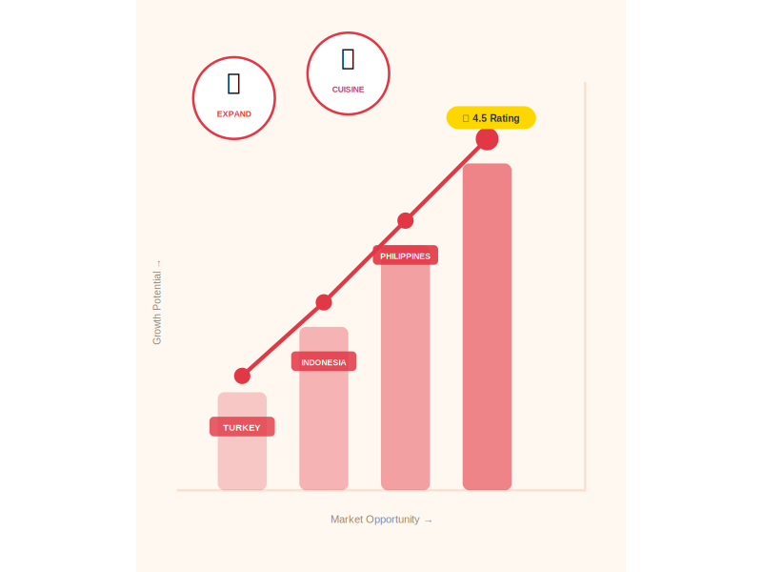
RECOMMENDATIONS
Target Indonesia, Philippines, and Turkey for new restaurant openings - these markets combine low restaurant density, high average ratings (4.3-4.5), and strong customer engagement.
Prioritize cities with minimal competition: Bandung, Bogor, Tangerang (Indonesia); Makati City, Quezon City, Tagaytay City (Philippines); Istanbul and Ankara (Turkey).
Differentiate by offering unique local-fusion cuisines with high vote counts and stable ratings above 4.5, ensuring strong customer trust from day one.
Mandatory implementation of online delivery and table booking: 74% of restaurants currently lack delivery, and 88% lack table booking - adding these services directly improves ratings and customer reach.
Apply country-specific pricing strategy: premium pricing in UAE and Philippines (higher spending capacity), moderate pricing in Indonesia, and affordable value-focused pricing in Turkey.
Focus on cuisines with stable ratings and high vote counts - avoid low-vote cuisines regardless of high ratings, as fewer than 50 votes makes averages statistically unreliable.

Slide 22
CONCLUSION
Indonesia (21 restaurants, avg rating 4.3, 772 avg votes), Philippines (22 restaurants, avg rating 4.5, 407 avg votes), and Turkey (34 restaurants, avg rating 4.3, 431 avg votes) are the strongest expansion markets based on low competition, high ratings, and strong engagement.
Entering cities like Bandung, Bogor (Indonesia), Makati City, Tagaytay City (Philippines), and Istanbul (Turkey) offers a clear first-mover advantage with minimal direct competition.
Pricing strategy must be market-specific: premium pricing in UAE and Philippines, moderate in Indonesia, and affordable in Turkey - aligning with each country's average spending capacity.
Online delivery and table booking are non-negotiable: 74% of restaurants lack delivery and 88% lack table booking - offering both from launch creates immediate competitive differentiation.
Cuisine selection should prioritize dishes with 4.5+ ratings backed by 100+ votes - statistically reliable indicators of sustained customer satisfaction and market acceptance.
Acting now in these identified markets maximizes visibility, secures market share ahead of competitors, and lays a data-backed foundation for sustainable long-term growth across Asia and the Middle East.

Slide 23


