Slide 1
From Concept to System
What's been built since January
The architecture from the first presentation was a sketch. Over the last months it became a working, multi-service application — every component you are about to see is implemented and runs locally.
9

Slide 2
The Pipeline
Five stages, in order
1.
Detect
— find the PII
2.
Tokenize
— replace and encrypt it
3.
Train
— fine-tune the LLM on tokens only
4.
Decrypt
— release plaintext per user role
5.
Serve
— chat over the whole flow
10

Slide 3
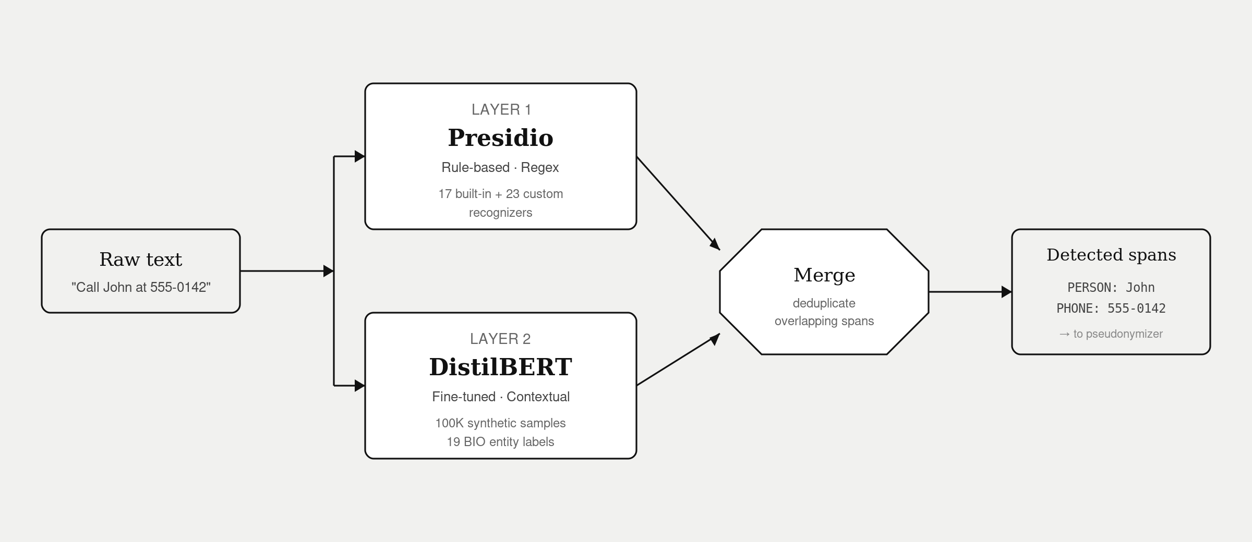
Detection
Step 1 · Finding PII before anything else can
Layer 1 — Presidio (rules). 17 built-in entity types plus 23 custom regex recognizers for API keys, medical record numbers, badges, license plates, and more.
Layer 2 — DistilBERT (AI). Fine-tuned on 100,000 BIO-tagged synthetic samples; catches contextual PII that rigid patterns miss — informal names, unusual phone formats, organizations.
Merge. Both layers run in parallel. Overlapping spans are deduplicated; either source may contribute to the final result.
11

Slide 4
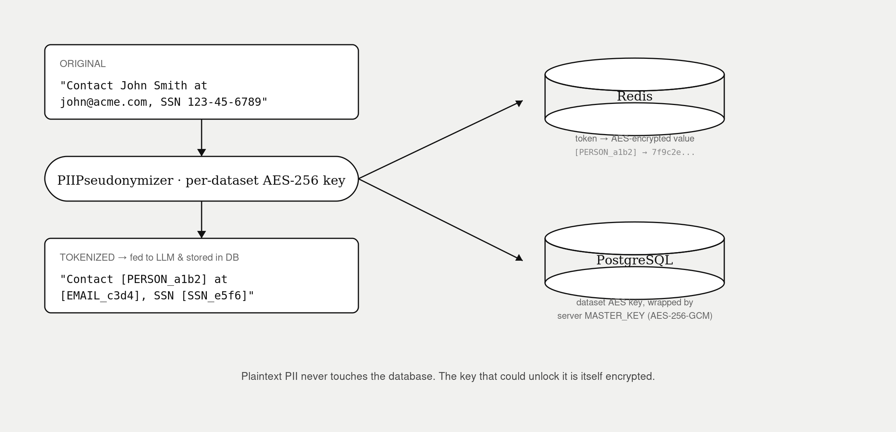
Tokenization
Step 2 · From John Smith to [PERSON_a1b2]
Each detected span is replaced with a short placeholder [LABEL_hexid]. The label says what kind of thing it is; the hex id says which one.
The original value is encrypted with AES-256 using a per-dataset key and stored in Redis as a token → ciphertext map.
The per-dataset key itself is wrapped with a server MASTER_KEY (AES-256-GCM) and stored in PostgreSQL. Plaintext PII never reaches the database.
12

Slide 5
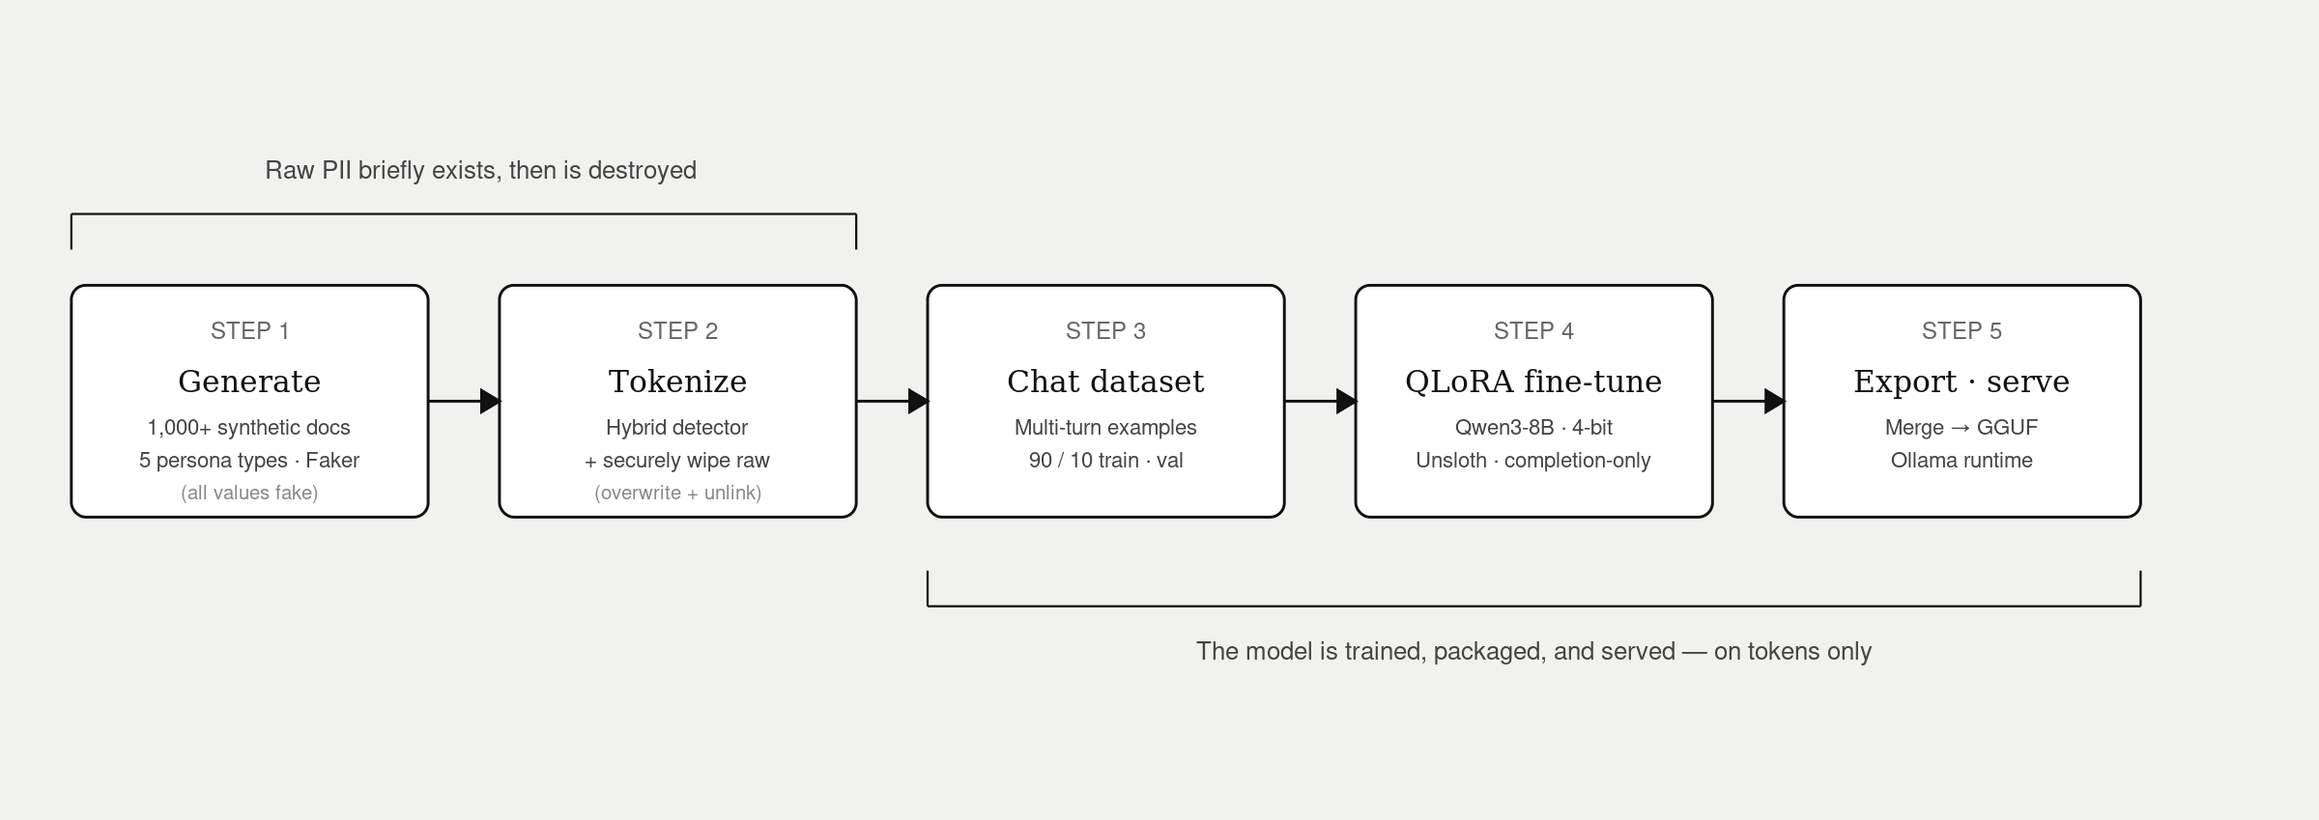
Training
Step 3 · A chat model that never saw real PII
Synthetic corpus — 1,000+ documents across 5 personas (banking, healthcare, government contractor, tech startup, international business). All values fake.
Tokenize, then wipe — each document is run through the detector and pseudonymized. The raw originals are then overwritten and securely deleted from disk.
QLoRA fine-tune of Qwen3-8B — the model is trained on tokenized text only. It learns the shape of conversations about [PERSON_a1b2] without ever seeing the values.
13

Slide 6
Decryption
Step 4 · One model, many views
Roles
Guarantees
Admin
— every token decrypted in plaintext (wildcard grant)
Decryption happens on the way out, per streamed chunk, against the live RBAC table.
Every decryption is written to a Postgres audit log: token, user, dataset, timestamp.
Revoking a grant takes effect on the next chunk — no model re-run needed.
Analyst
— only the entity types they have been granted (e.g. PERSON, EMAIL)
Viewer
— all PII remains as [LABEL_hexid] placeholders
14

Slide 7
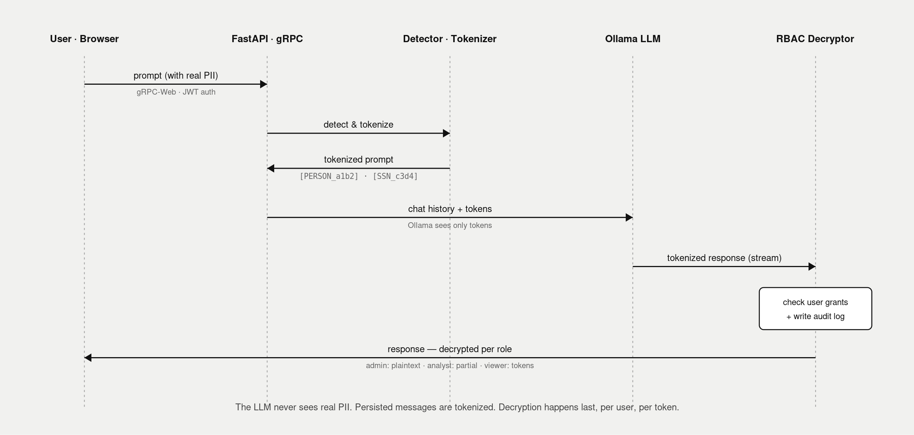
End-to-End
Step 5 · A prompt's life, from keystroke to display
1. Browser sends a prompt over gRPC-Web. JWT authenticates.
2. Backend detects and tokenizes the prompt — the LLM only ever receives placeholders.
3. Qwen3-8B (via Ollama) streams its reply — also in tokens.
4. Each chunk passes through the RBAC decryptor and is audit-logged.
5. The tokenized message is persisted to Postgres. Plaintext never touches storage.
15

Slide 8
Stack & Scale
Implementation footprint
Stack
Scale
Backend — Python · FastAPI · gRPC · SQLAlchemy
LLM — Qwen3-8B · Unsloth/QLoRA · Ollama
Detector — DistilBERT · HuggingFace · Presidio
Data — PostgreSQL · Redis · Envoy
Frontend — React · TypeScript · Tailwind · gRPC-Web
Crypto — AES-256-GCM · bcrypt · JWT
23
custom PII recognizers
19
AI model entity labels
100,000
detector training samples
1,000+
LLM training documents
~6,000
lines of Python
7
services in Docker Compose
16

Slide 9
Demo
17

