Slide 1
nightlife spot LOCATIONs & VANUES DATA ANALYSYS of NEWYOrk
Tuyen Truong – Capstone Project

Slide 2
Introduction: Business Problem
In this project I will try to find an optimal location for a Nightlife Spot for someone who is looking for open it in Newyork City, US. Especially, this project is targeted to stakeholders who want to open a Bar in Newyork City in US.
I will focus on the boroughs of Manhattan (40 neighborhoods) and Brooklyn (70)

Slide 3
DATA
With the definition of my problem, these are the factors that will affect my decision:
The distance of neighborhood to city center
Number of and distance to Nightlife Spots in the neighborhood
Number of and distance to Bars in the neighborhood (any type of bar)
Following data sources will be needed to extract/generate the required information:
Centers of candidate areas will be generated algorithmically and approximate addresses of centers of those areas will be obtained using Google Maps API reverse geocoding
Number of coffee shops and their type and location in every neighborhood will be obtained using Foursquare API
Coordinate of Newyork center will be obtained using Google Maps API geocoding of well known NewYork location (New York City, NY, USA)

Slide 4
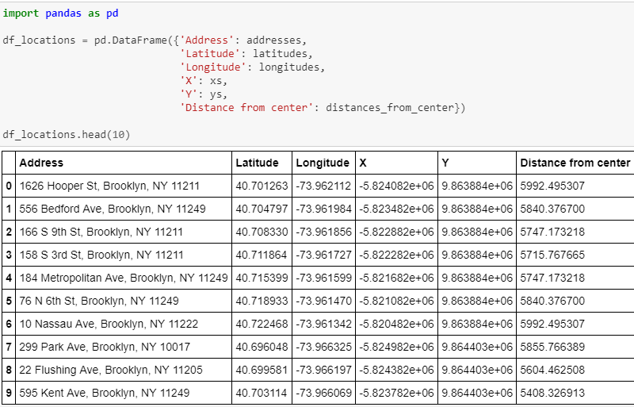
DATA
Let's now place all this into a Pandas dataframe.

Slide 5
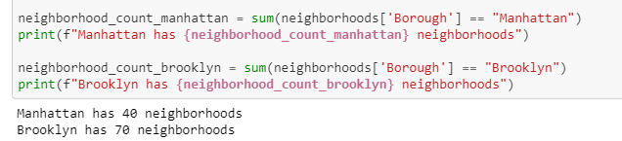
Methodology : Analysis
First let's count the number of neighborhoods in every area candidate:

Slide 6
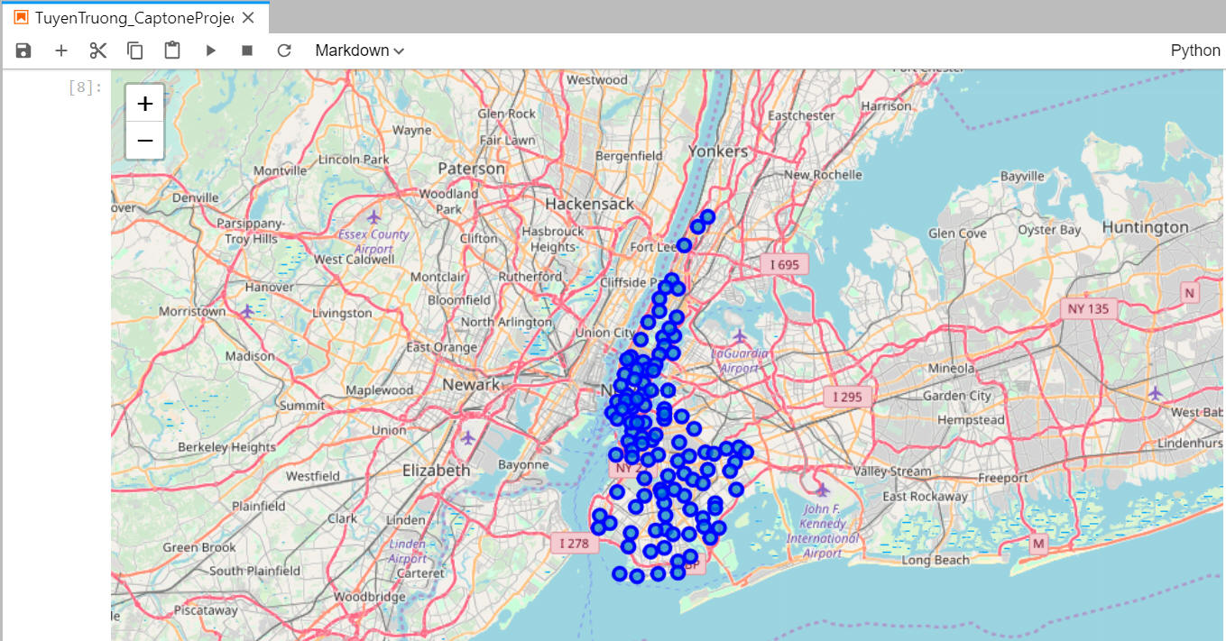
Visualization setup
Get coordinates of Manhattan / Brooklyn The geograpical coordinate of Manhattan/Brooklyn are 40.720095349999994, -73.9547059.
Populate raw Folium map

Slide 7
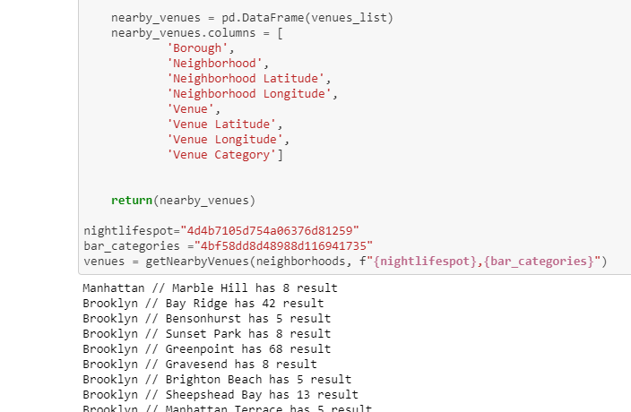
Request and compute Foursquare data

Slide 8
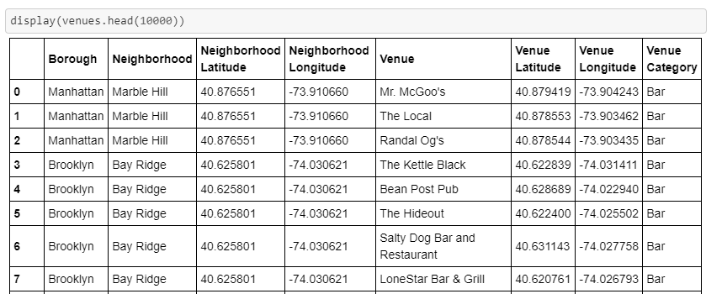
Request and compute Foursquare data

Slide 9
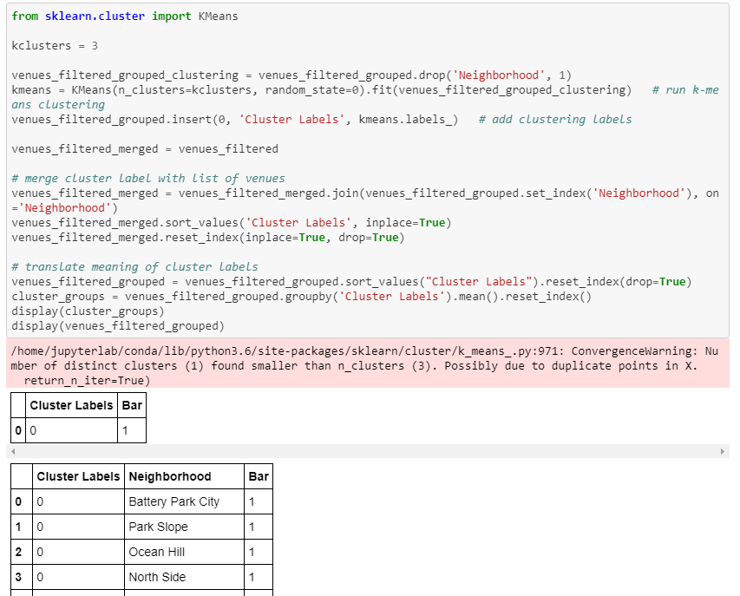
Methodology: Model Selection
I apply a KMeans(n=3): Clustering analysis. I tried various values (n=3..7) and noticed that there are really just one big group, namely...

Slide 10
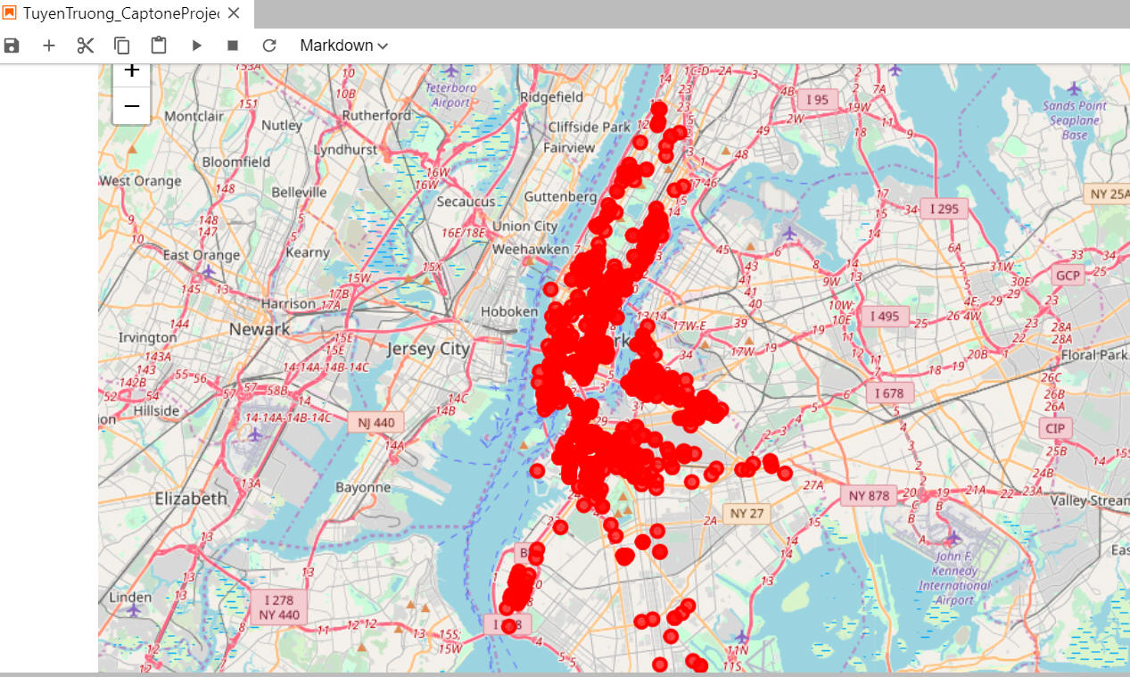
Results: Visualization & Conclusion
The clustering shows a very clear pattern. We have all bars are kind of nightlife spots. So we just have one cluster.
So we can suggest that the stakeholders can open any bar in any location in NewYork. They will have a successful business.

