Slide 1
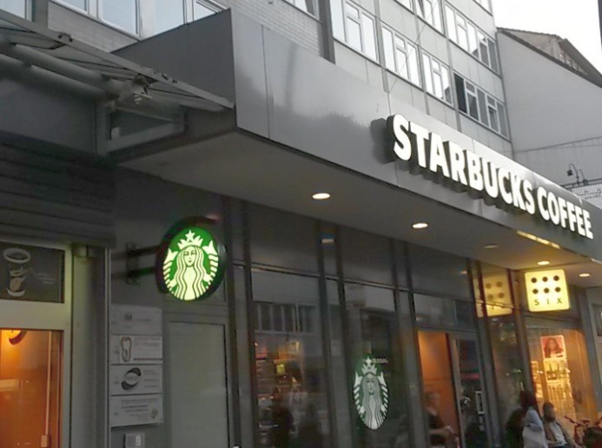
tchibo
starbucks-text
starbucks-symbol
six
starbucks-symbol

Slide 2
tchibo
starbucks-text
starbucks-symbol
six
starbucks-symbol

Slide 3
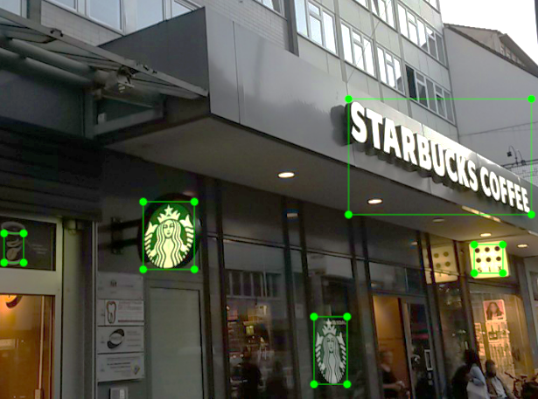
starbuckscoffee
tchibo
six
starbucks-symbol
starbucks-symbol

