Slide 1
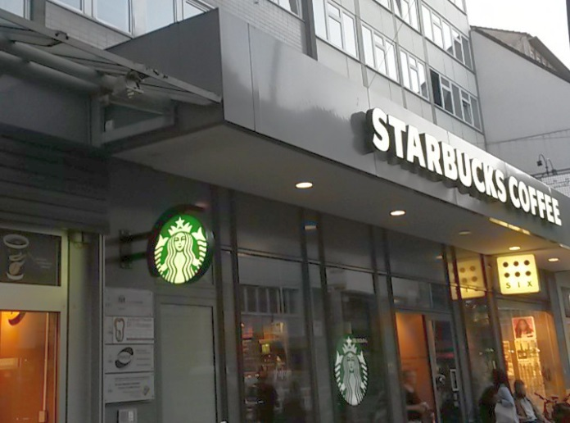
starbuckscoffee
tchibo
six
starbucks-symbol
starbucks-symbol

Slide 2
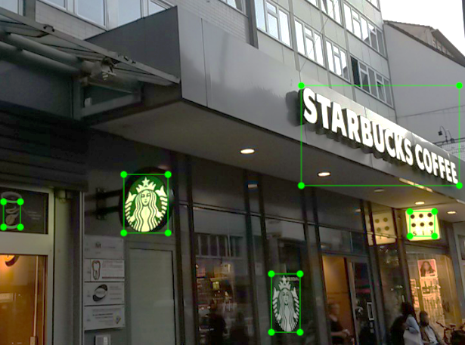
starbuckscoffee
tchibo
six
starbucks-symbol
starbucks-symbol

