Slide 1






















$$P_{1}^{′}$$
$$P_{1}^{′}$$
$$P_{1}$$
$$P_{1}$$
$$P_{0}^{′}$$
$$B(t)$$
$$P_{0}^{′}$$
$$P_{1}^{′′}$$
$$P_{2}^{′}$$
$$dn_{0}$$
$$dn_{2}$$
$$P_{2}^{′}$$
$$dn_{0}$$
$$dn_{2}$$
$$P_{0}$$
$$−dn_{0}$$
$$−dn_{2}$$
$$P_{2}$$
$$P_{0}$$
$$P_{2}$$
$$P_{0}^{′′}$$
$$P_{2}^{′′}$$

Slide 2

























$$P_{1}^{′}$$
$$P_{1}$$
$$P_{1}^{′′}$$
$$P_{0}^{′}$$
$$P_{2}^{′}$$
$$P_{0}$$
$$P_{2}$$
$$P_{0}^{′′}$$
$$P_{2}^{′′}$$
$$P_{0}^{′′}$$
$$P_{2}^{′′}$$
$$P_{1}^{′}$$
$$P_{1}^{′}$$
$$P_{0}^{′}$$
$$P_{1}^{′′}$$
$$P_{0}^{′}$$
$$P_{1}^{′′}$$
$$P_{2}^{′}$$
$$P_{2}^{′}$$
$$P_{0}^{′′}$$
$$P_{2}^{′′}$$
$$P_{0}^{′′}$$
$$P_{2}^{′′}$$
$$P_{0}^{′′}$$
$$P_{2}^{′′}$$

Slide 3











$$P_{1}^{′}$$
$$P_{0}^{′}$$
$$P_{0}^{′}$$
$$P_{0}^{′}$$
$$P_{2}^{′}$$
$$P_{2}^{′}$$
$$P_{2}^{′}$$
$$P_{0}^{′′}$$
$$P_{2}^{′′}$$
$$P_{0}^{′′}$$
$$P_{2}^{′′}$$

Slide 4





$$P_{1}$$
$$φ$$
$$B(t)$$
$$P_{0}$$
$$P_{2}$$

Slide 5










$$β(0)$$
$$B^{′}\left(0\right)=2(P_{1}−P_{0})$$
$$β(ξ)$$
$$B′(ξ)$$
$$β(0.5)$$
$$φ$$
$$B^{′}\left(0.5\right)=\frac{{B^{′}\left(0\right)+B}^{′}\left(1\right)}{2}$$
$$B^{′′}\left(0\right)=B^{′}\left(1\right)−B′(0)$$
$$B^{′}\left(1\right)=2(P_{2}−P_{1})$$
$$β(1)$$

Slide 6
























$$φ_{0}$$
$$φ_{0}$$
Δ
$$φ_{0}$$
0
$$φ_{0}$$
$$φ_{0}$$
$$P_{1}^{′}$$
$$φ_{0}$$
$$P_{1}^{′}$$
$$B(t)$$
$$P_{1}$$
$$P_{0}^{′}$$
$$P_{0}^{′}$$
$$P_{0}^{′}$$
$$t$$
$$P_{2}^{′}$$
$$0$$
$$1$$
$$P_{0}^{′}$$
$$P_{2}^{′}$$
$$P_{2}^{′}$$
$$P_{1}^{′′}$$
$$P_{2}^{′}$$
$$dn_{0}$$
$$dn_{2}$$
$$S$$
$$P_{0}$$
$$−dn_{0}$$
$$−dn_{2}$$
$$P_{2}$$
$$P_{2}^{′′}$$
$$0$$
$$l$$
$$P_{0}^{′′}$$
$$P_{0}^{′′}$$
$$P_{2}^{′′}$$
$$P_{0}^{′′}$$
$$P_{2}^{′′}$$

Slide 7
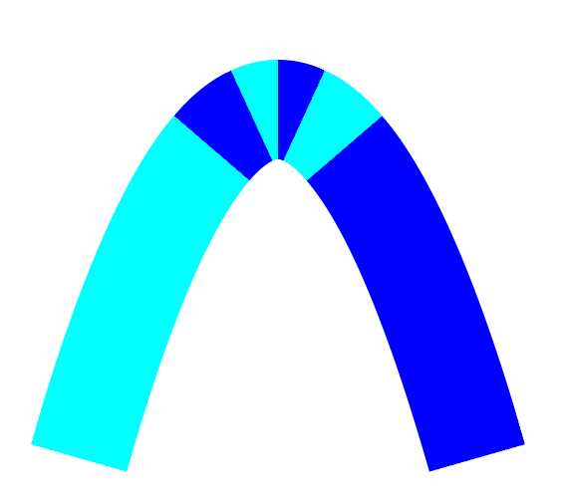
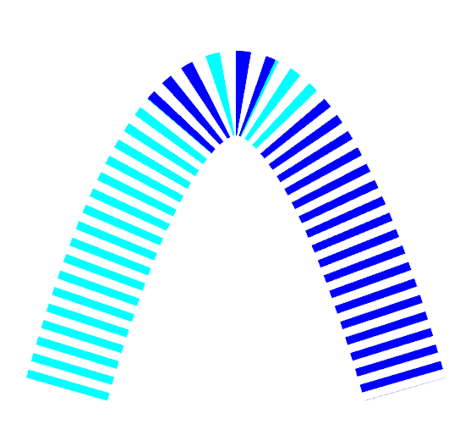
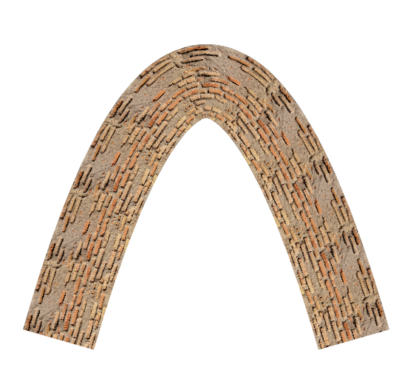
























Arc-length parametrization by Newton iteration with guaranteed rapid convergence
Input: piecewise quadratic curves with stroke width, dash pattern, etc.
Curvature-guided adaptive subdivision
Δ
$$φ_{0}$$
$$φ_{0}$$
$$φ_{0}$$
$$φ_{0}$$
If require dash or arc-length guided texture filling
$$B(t)$$
$$t$$
$$φ_{0}$$
$$0$$
$$1$$
$$φ_{0}$$
$$S$$
$$0$$
$$l$$
$$P_{1}^{′}$$
$$P_{1}^{′}$$
$$P_{1}$$
$$P_{0}^{′}$$
$$P_{0}^{′}$$
$$P_{0}^{′}$$
$$P_{0}^{′}$$
$$P_{1}^{′′}$$
$$P_{2}^{′}$$
$$P_{2}^{′}$$
$$P_{2}^{′}$$
$$P_{2}^{′}$$
$$dn_{0}$$
$$dn_{2}$$
$$P_{0}$$
$$−dn_{0}$$
$$−dn_{2}$$
$$P_{2}$$
$$P_{2}^{′′}$$
$$P_{0}^{′′}$$
$$P_{2}^{′′}$$
$$P_{0}^{′′}$$
$$P_{2}^{′′}$$
$$P_{0}^{′′}$$
Offset approximation
Implicit equation-based rendering
Output: rendered stroke with user defined styles

Slide 8
Input
GPU Pipeline Highlight
Quadratic Curves with Styles
Subdivision (Curvature-Guided)
Arc-Length Parameterization (Newton, Fast)
Rendering (Implicit Equation-Based)
Output
Rendered Stroke Variants

Slide 9













Input
Subdivision
Arc-Length Parametrization
$$φ_{0}$$
$$φ_{0}$$
Δ
$$φ_{0}$$
$$φ_{0}$$
$$B(t)$$
$$t$$
$$φ_{0}$$
$$0$$
$$1$$
$$φ_{0}$$
$$S$$
$$0$$
$$l$$
$$P_{1}^{′}$$
$$P_{1}$$
$$P_{0}^{′}$$
$$P_{1}^{′′}$$
$$P_{2}^{′}$$
$$P_{0}$$
$$P_{2}$$
$$P_{0}^{′′}$$
$$P_{2}^{′′}$$
Offset Approximation
Output

