Slide 1
Multimedia Systems
Group C-WG3#1
Lauri Majamaa, Antti Lampela, Tuomas Vähänen, Pasi Keski-Korsu, Antti Väyrynen

Slide 2
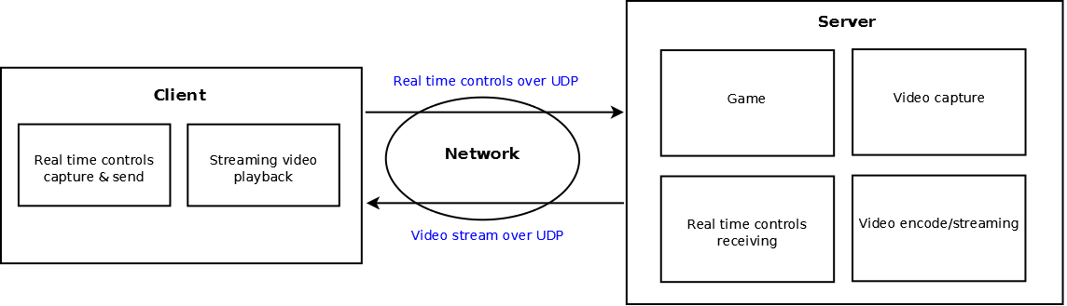
Introduction
Cloud gaming platform capable of delivering games to a low-end client.

Slide 3
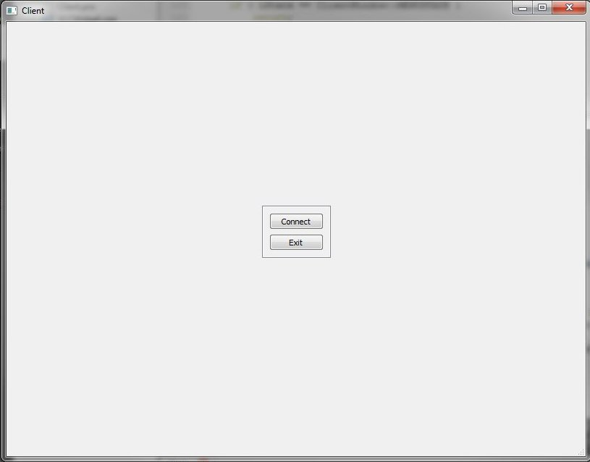
Client
Simple GUI built with Qt

Slide 4
Server
Server
Inputserver script
Game
Stream
User controls receiving

Slide 5
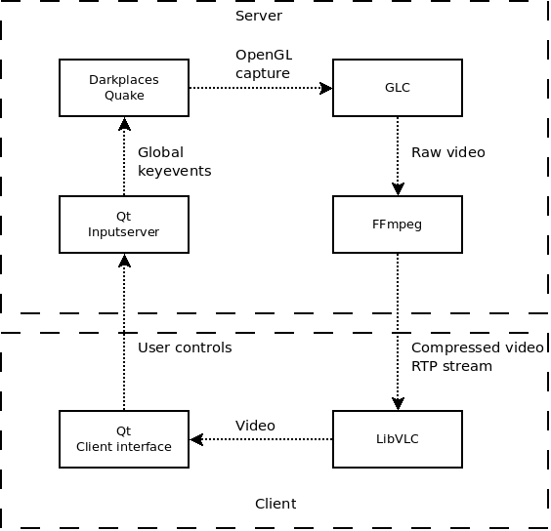
Technologies used

Slide 6
Solutions
Client uses LibVLC to view the video stream
Operating system pipes to encode and stream video without a file buffer.
Automatic act on connect

Slide 7
Results
Playable cloud game with performance platform
Bad video stream quality with low bandwidth connection
User control transmit works perfect

Slide 8
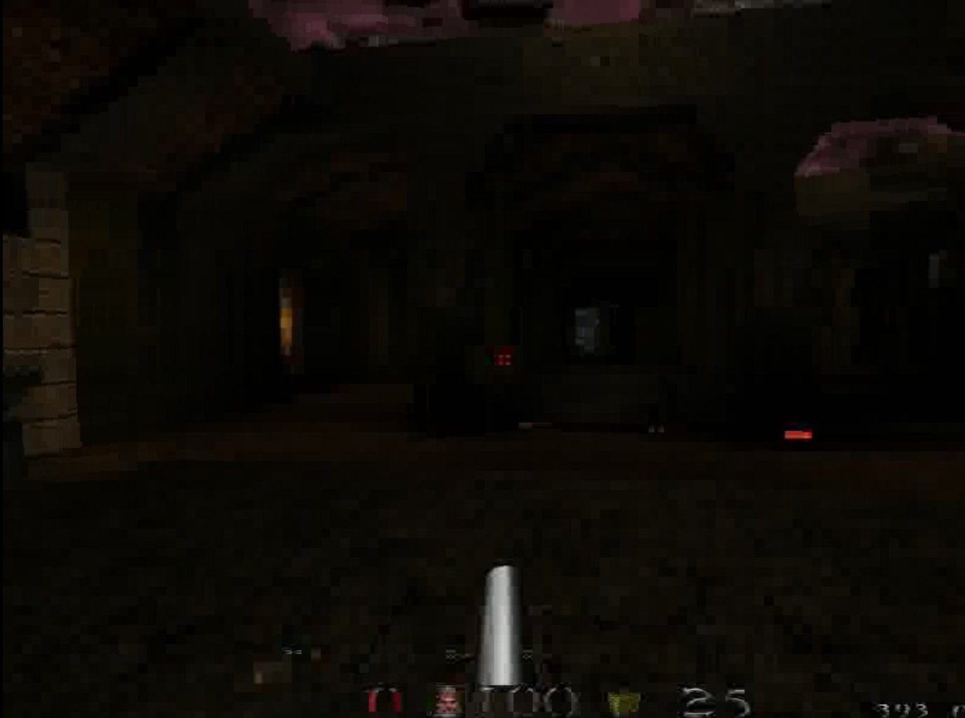
Game stream screenshot

Slide 9
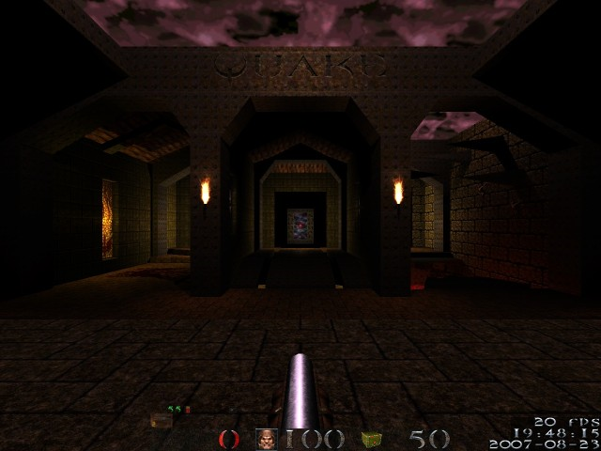
Game screenshot

Slide 10
Experiences
Stream quality and optimizing latency were main issues
Game running and video streaming are power consuming.
High bandwidth is needed to achieve good stream quality
Latency is the main issue
Overall the project was challenging

