Slide 1
The Future of Unity Web Development
Arturo Nunez - @ArturoNereu
Field Engineer at Unity Technologies

Slide 2
Agenda
Unity on the Web today.
Unity WebGL (the future today).
Q&A

Slide 3

Unity Web Player
Plugin to run Unity content on any supported web browser.
350 million installs and counting.
Been part of Unity since 1.0 in 2005.
Highest quality gaming experience on web.
Webplayer stats: http://stats.unity3d.com/web/

Slide 4
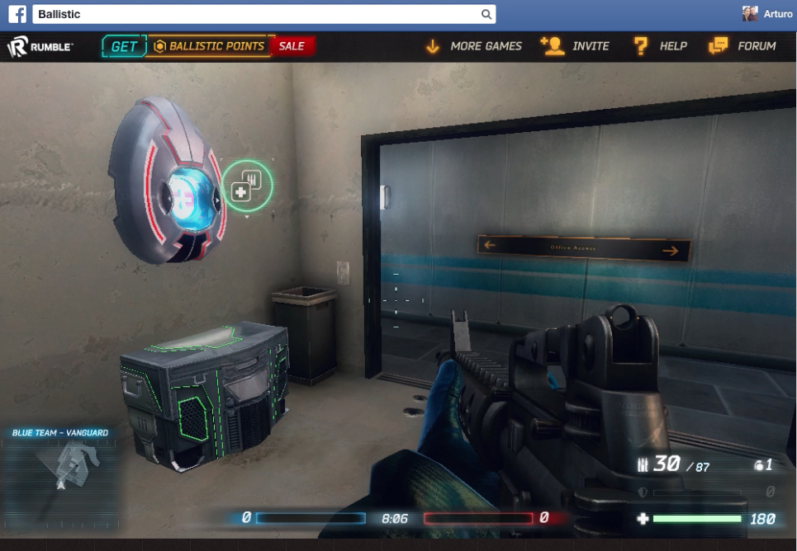

Slide 5
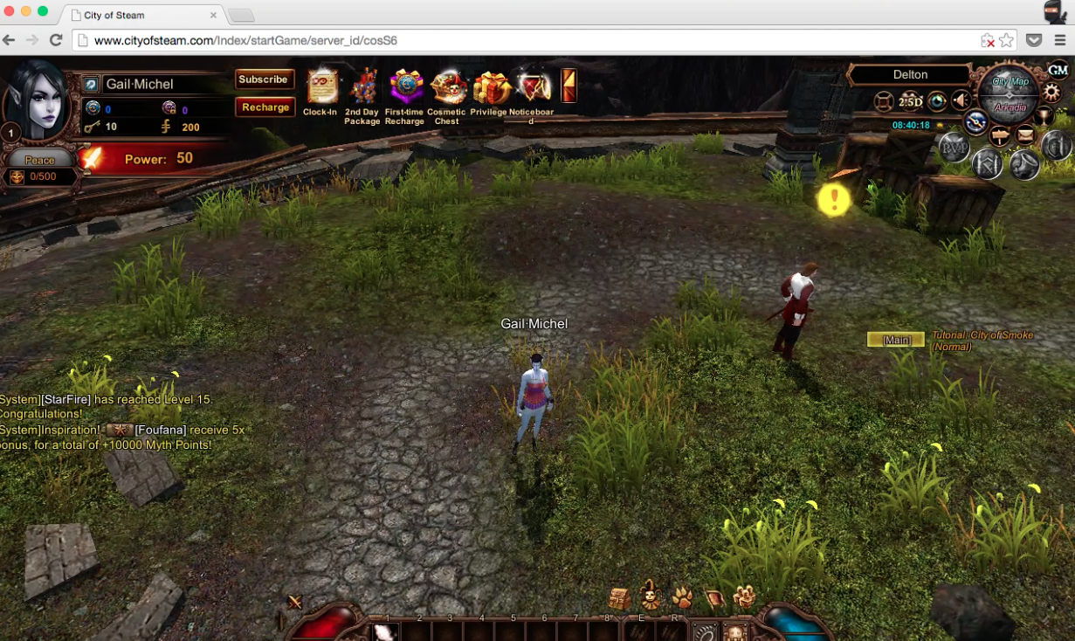

Slide 6
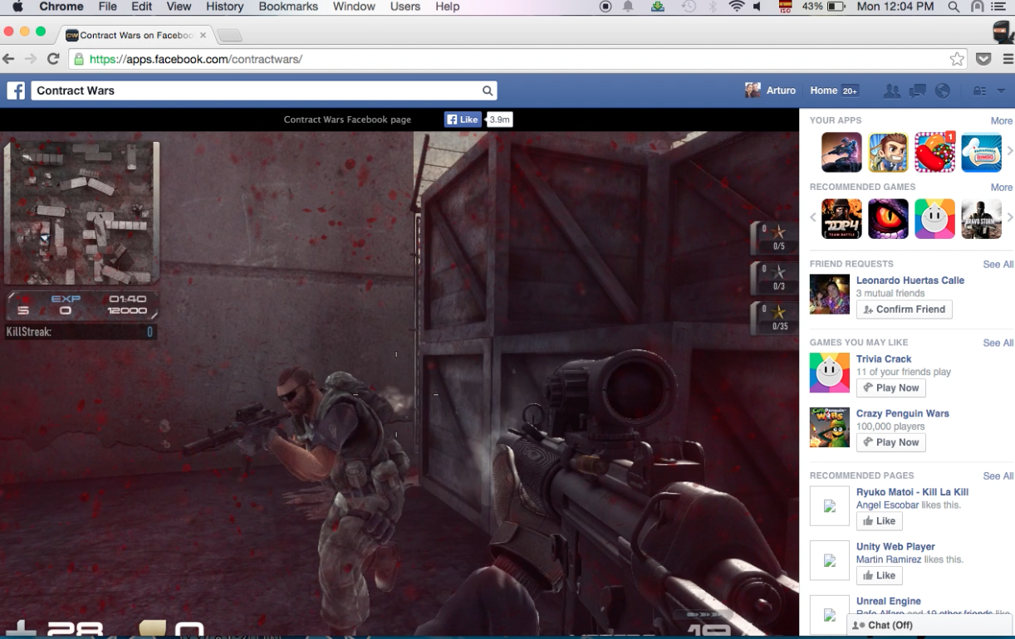

Slide 7

The Web is Evolving
Plug-ins used to be the only way to deploy advanced content formats.
HTML5 has made more and more formats available without a plugin.
Browser vendors steering away from plugins.
Google deprecated NPAPI plug-ins in Chrome.

Slide 8

Let's look at our New Web Deployment Tool we announced for Unity 5.0

Slide 9
WebGL
Hardware-accelerated 3D rendering in the browser, without the need to install a Plug-in, using JavaScript.
API is based on OpenGL ES 2.0.
Open web standard.
Currently implemented in Firefox, Chrome, Internet Explorer and Opera.

Slide 10

WebGL & Unity
Perfect fit for Unity on the web.
Started as an experiment during a HackWeek two years ago.
Mozilla sent an engineering team to our HackWeeks to join the fun.
After a few HackWeeks, we began to see potential and started full production.

Slide 11
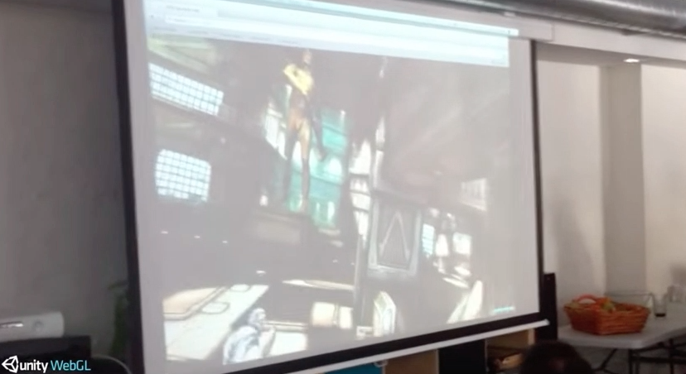
Notes:
First versions were very slow in loading and executing.
The dead trigger demo involved no scripting.

Slide 12

WebGL and Unity

Slide 13
How does it works?
WebGL is a JavaScript API. To use it, all our code needs to be in JavaScript.
We need to convert our code to JavaScript.
Unity engine code written in C/C++.
User scripts, written in C# or UnityScript.

Slide 14


Slide 15
emscripten is a C++ to JavaScript cross-compilation toolchain.
Uses clang to compile C++ code to LLVM bitcode, and then provides a custom LLVM backend to emit JavaScript as a result.
Open source project by Mozilla.
Provides wrappers for common Web APIS.
We use empscripten to cross-compile our Unity Engine code to asm.js JavaScript.

Slide 16
asm.js
JavaScript is typically JIT-compiled by the browser's JavaScript Engine.
The nature of the JavaScript language can make it hard for the JS JIT engine to make the best guesses on optimizations.
asm.js is a statically-typed subset of JavaScript, designed to allow a JavaScript engine AOT compile asm.js code into well-optimized native code.
asm.js retains full compatibility with classic JIT JS engines.
asm.js is currently enabled in Firefox

Slide 17
IL2CPP
emscripten let's us compile our engine to JS, but what about user scripts(C# / UnityScript)?
Over the course of the past two years, our scripting team has been developing a new code compilation technology codenamed: IL2CPP.
IL2CPP takes .NET Bytecode (CIL) and generates the corresponding C++ source files.
These generated C++ source files can then be cross-compiled to JS (with asm.js) by emscripten.

Slide 18
Cross-compilation of scripts.
C#/UnityScript => {MonoCompiler} => Assembly => {Patch}
=> Assembly => {Stripper} => Assembly => {IL2CPP}C++
=> {emscripten} => LLVM BC => JavaScript => {node.js}
=> JavaScript

Slide 19
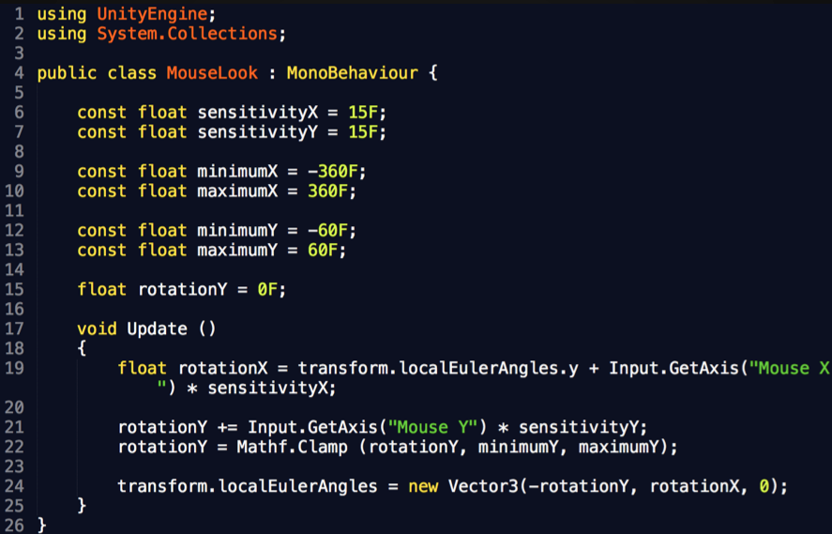
Code conversion process example with a C# script.

Slide 20
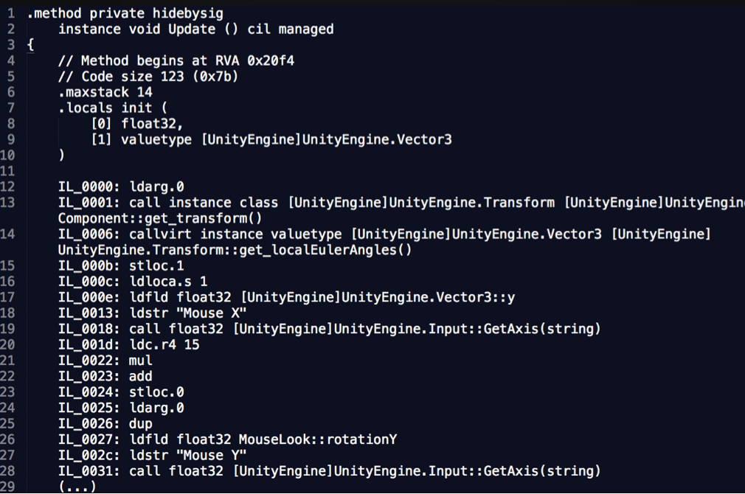
That gets compiled into CIL bytecode by mcs:

Slide 21
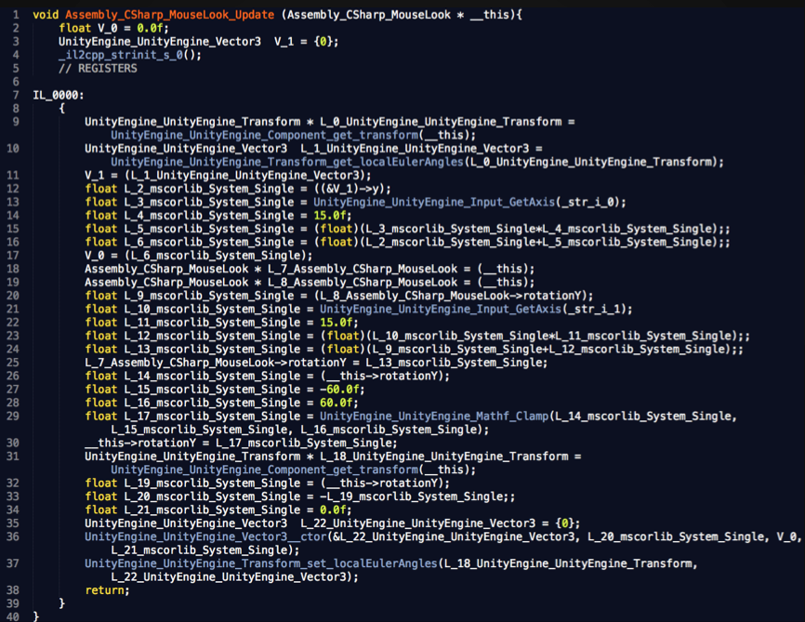
That gets compiled into C++ code by IL2CPP

Slide 22
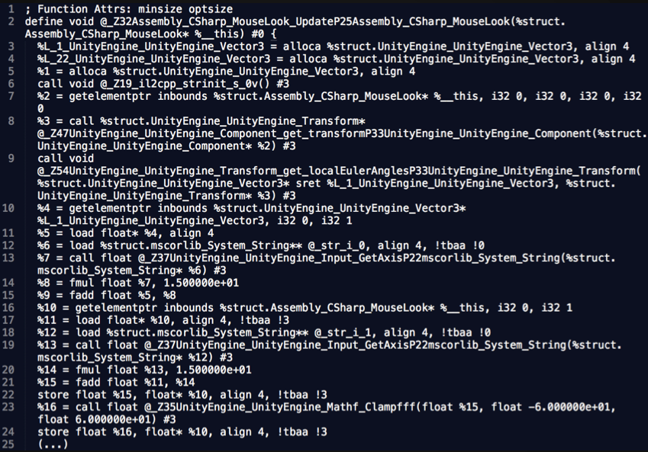
That gets compiled into LLVM Bitcode using clang:

Slide 23
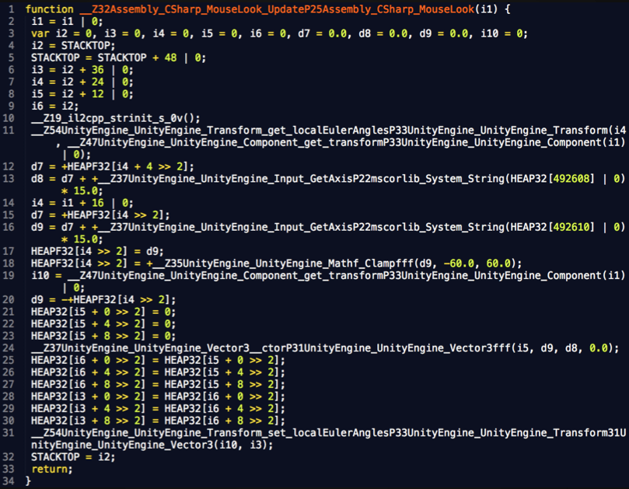
That gets compiled into JavaScript with asm.js by emscripten:

Slide 24
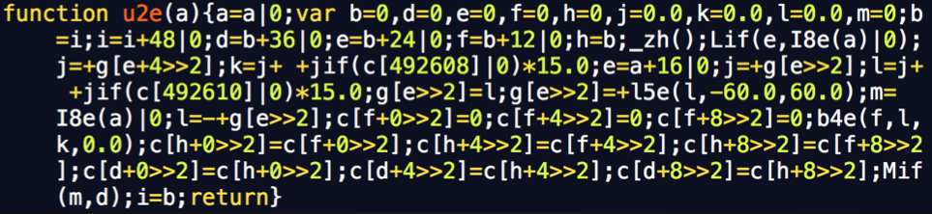
Finally empscripten will run an optimization and minification pass on the JavaScript code.
The result looks like this:

Slide 25
Plugin Support in Unity WebGL
You can write a plugin directly in JS and call that from your C# scripts.
You can add C++ source files to your project, and call functions from them from your game scripts.
You can use Application.ExternalCall or Application.ExternalEval, as you would do in the Web Player.

Slide 26
Unity WebGL
It won't be faster as the WebPlayer (yet) but performance is very good.
No support for threads.
Will support desktop versions of Firefox and Chrome for now.
WebGL 2.0 is expected in the course of this year and will have a feature set matching OpenGL ES 3.0.
SIMD and Threads being discussed by vendors.

Slide 27
Not supported by WebGL in 5.0
Video.
Runtime Substance generation.
Networking (WWW supported, but no .net sockets).
Microphone and webcam.
Most of the non basic audio features.
Script debugging.
Scripting will be limited by AOT compilation.

Slide 28


Notes:
http://files.unity3d.com/jonas/WebGLBenchmark/
https://www.humblebundle.com/?sel=aaaaaa_fortheawesome_asm_demo

Slide 29
Q&A

