Slide 1
Assignment 1
Atmospheric pressure and temperature variation

Slide 2
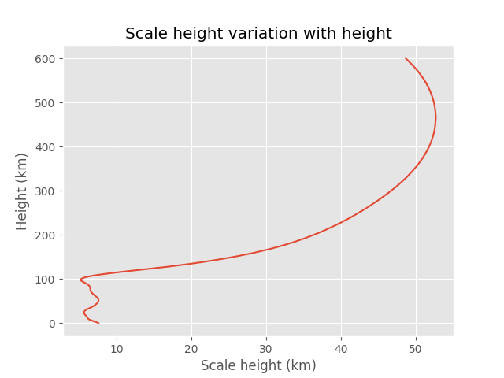
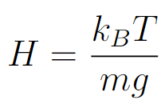
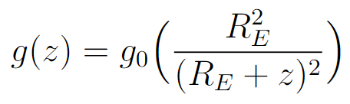
Task 1: Make functions that calculate the altitude vari- ation of the atmospheric scale-height
Scale height:
Gravitational acceleration:

Slide 3
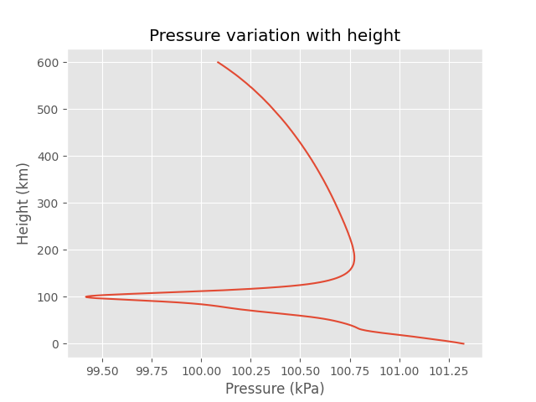

Task 2: Use the barometric equation to calculate atmo- spheric pressure variation.
Barometric equation:

Slide 4
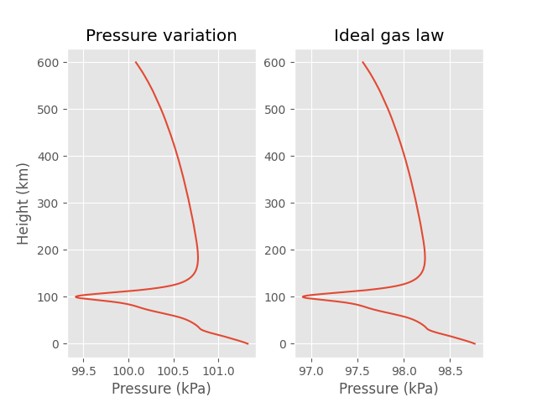
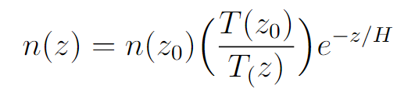

Task 3: Compare your pressure-profile with the ideal gas-law
Density variation:
Ideal gas law:

Slide 5
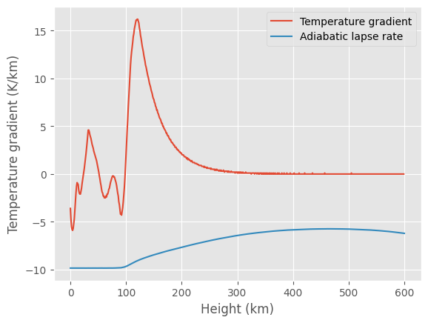
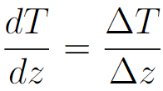
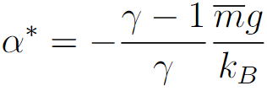
Task 4: Check the temperature-gradient for regions of instability to convective instability
Temperature-gradient:
Adiabatic lapse-rate:

Slide 6
Assignment 2
Optical depth

Slide 7
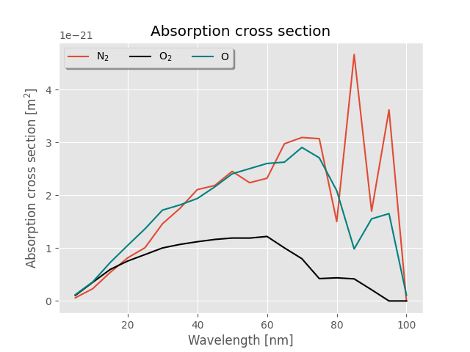
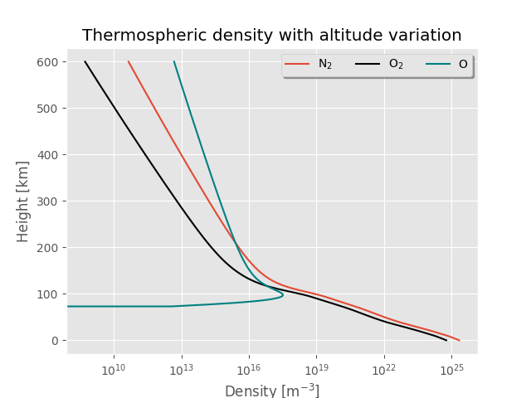
Task 1: Make functions that calculate the optical depth as a function of altitude and wavelength, for vertical incidence, and for variable zenith-angle of the incident light.

Slide 8
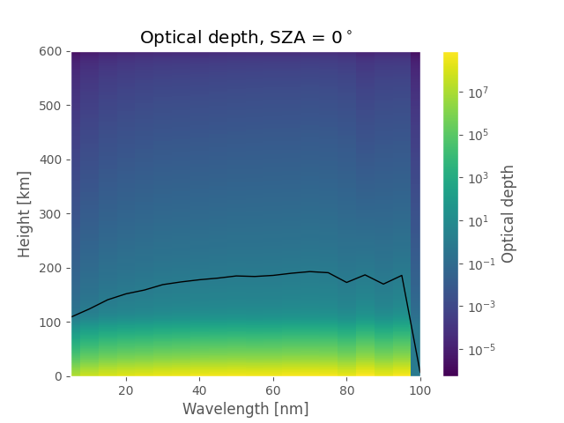
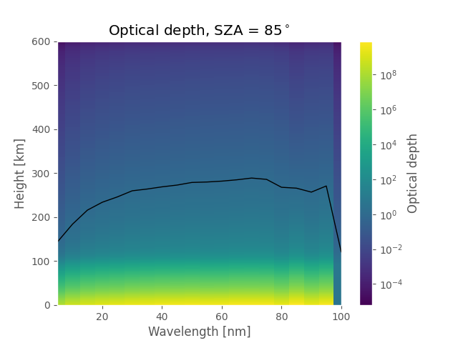
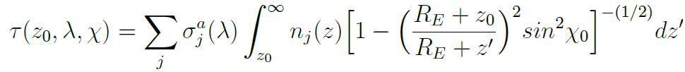

Task 1: Make functions that calculate the optical depth as a function of altitude and wavelength, for vertical incidence, and for variable zenith-angle of the incident light.
Optical depth:

Slide 9
Task 1: Make functions that calculate the optical depth as a function of altitude and wavelength, for vertical incidence, and for variable zenith-angle of the incident light.
, 100km

Slide 10
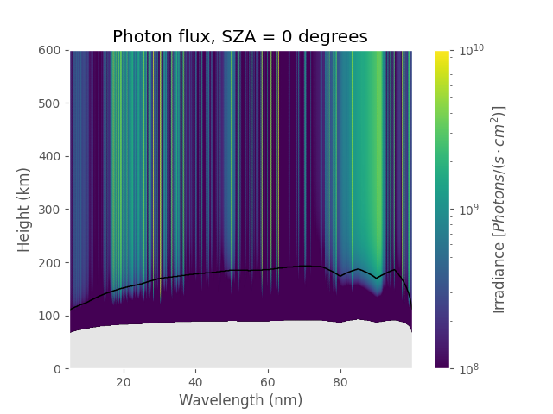
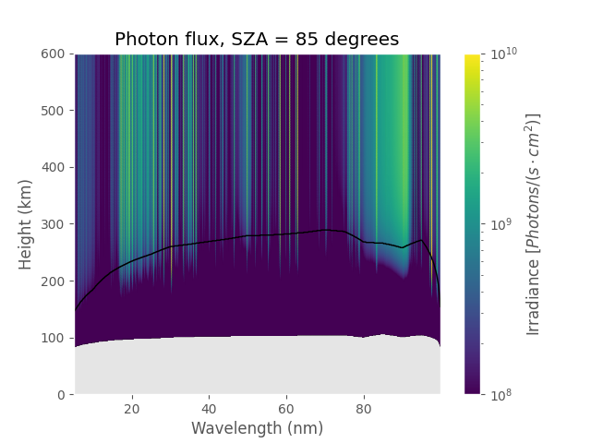

Task 2: Calculate the EUV-photon flux as a function of wavelength and height.
Photon-flux:

Slide 11
Assignment 3
Photo-ionization

Slide 12


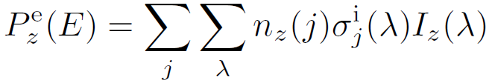
Photo-ionization
Little bit of theory
Photo-ionization reactions:
Photo-electron energy:
Photo-electron production rate:
Notes:
Hehhehehehehehhehehehehehhehehehhehe

Slide 13
Task 1: Make functions that calculate the production rate of photo-electrons as a function of altitude and energy.

