Slide 1
Assignment 1
Atmospheric pressure and temperature variation

Slide 2
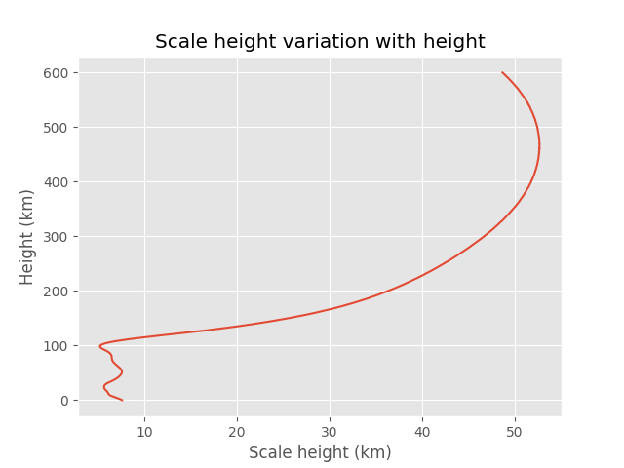
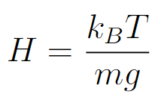
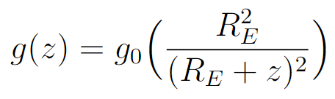
Task 1: Make functions that calculate the altitude vari- ation of the atmospheric scale-height
Scale height:
Gravitational acceleration:

Slide 3
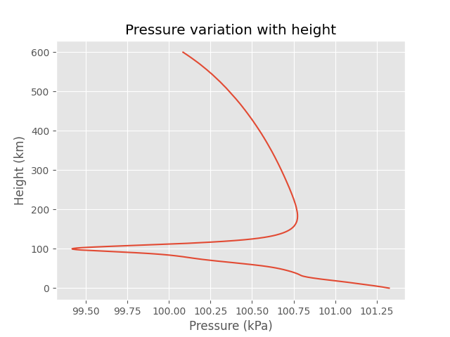

Task 2: Use the barometric equation to calculate atmo- spheric pressure variation.
Barometric equation:

Slide 4
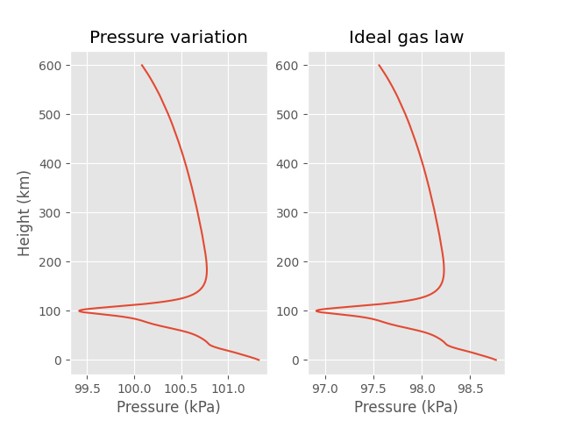
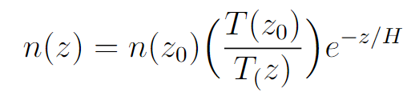

Task 3: Compare your pressure-profile with the ideal gas-law
Density variation:
Ideal gas law:

Slide 5
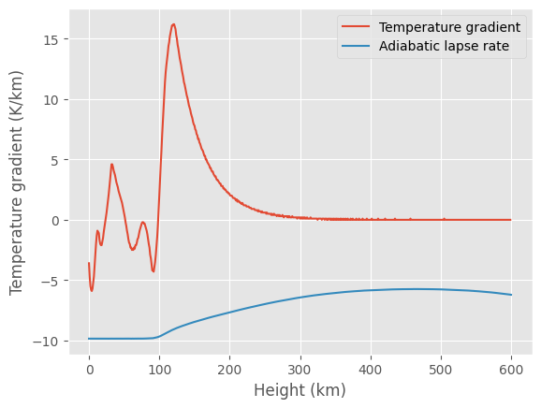
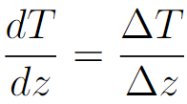
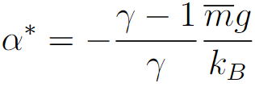
Task 4: Check the temperature-gradient for regions of instability to convective instability
Temperature-gradient:
Adiabatic lapse-rate:

Slide 6
Assignment 2
Optical depth

Slide 7
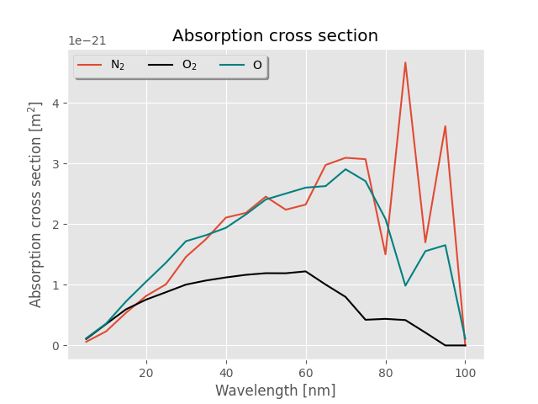
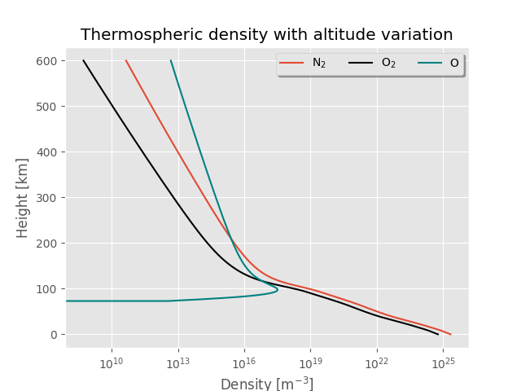
Task 1: Make functions that calculate the optical depth as a function of altitude and wavelength, for vertical incidence, and for variable zenith-angle of the incident light.

Slide 8
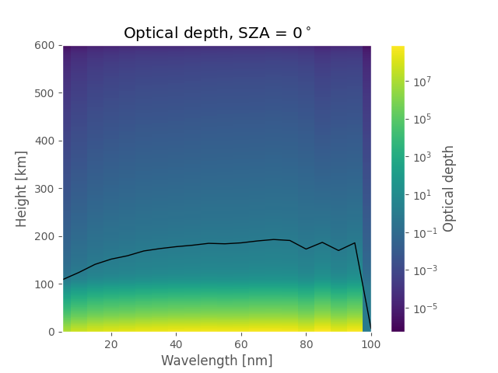
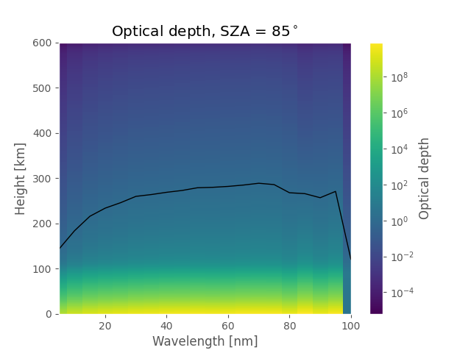
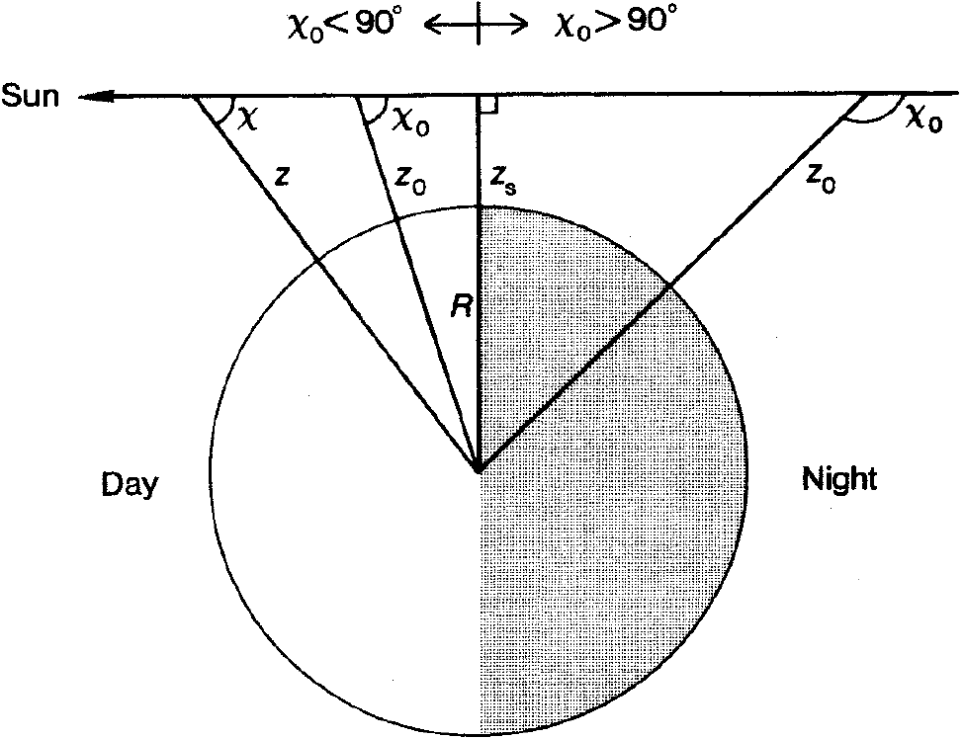
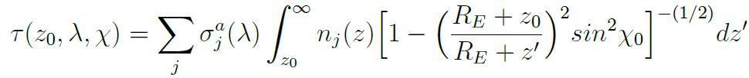

Task 1: Make functions that calculate the optical depth as a function of altitude and wavelength, for vertical incidence, and for variable zenith-angle of the incident light.
Optical depth:

Slide 9
Task 1: Make functions that calculate the optical depth as a function of altitude and wavelength, for vertical incidence, and for variable zenith-angle of the incident light.
, 100km

Slide 10
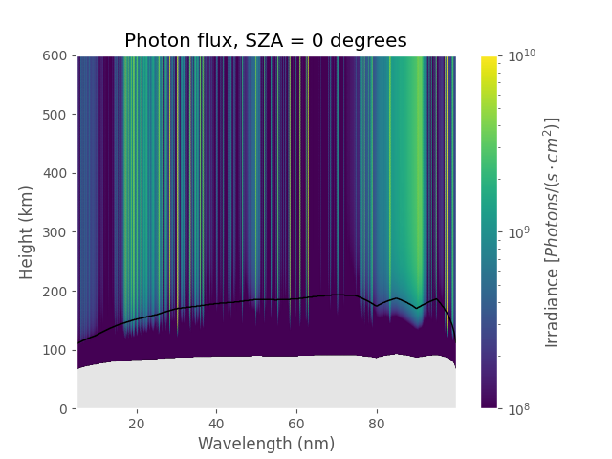
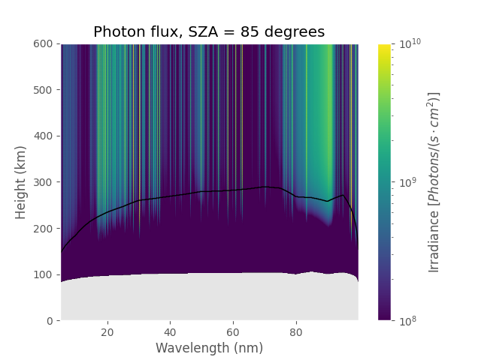

Task 2: Calculate the EUV-photon flux as a function of wavelength and height.
Photon-flux:
Notes:
If we had plotted the solar irriadiance, we would se two peaks in that plot, at where photo-flux is at it heighest.

Slide 11
Assignment 3
Photo-ionization

Slide 12
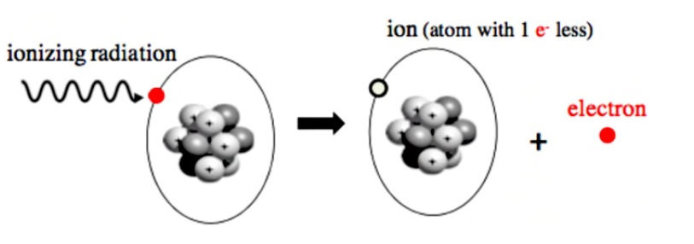


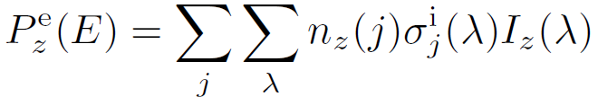


Photo-ionization
Little bit of theory
Photo-ionization reactions:
Photo-electron energy:
Number of photo-ionization event:
Photo-electron production rate:
Total photo-ionization rate:
=1

Slide 13
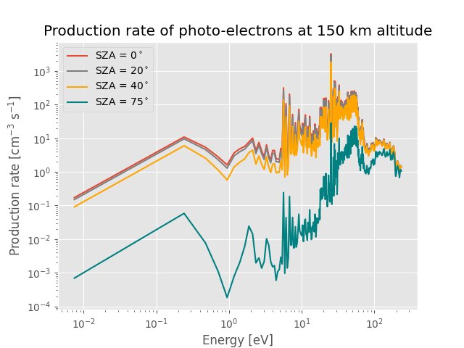
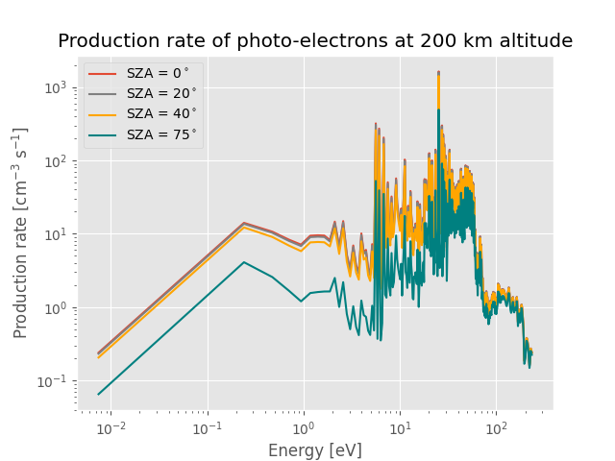
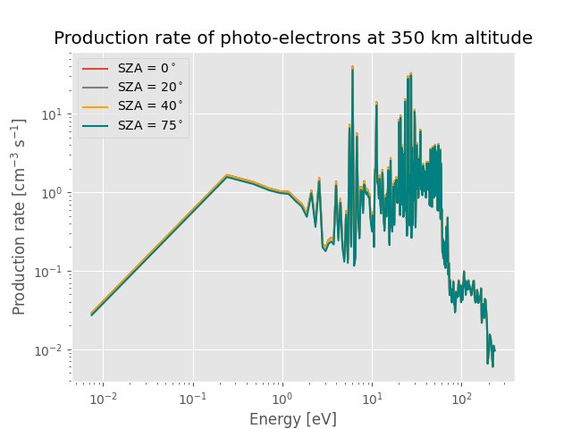

Task 1: Make functions that calculate the production rate of photo-electrons as a function of altitude and energy.
Photo-electron energy:
Photo-electron production rate:

Slide 14
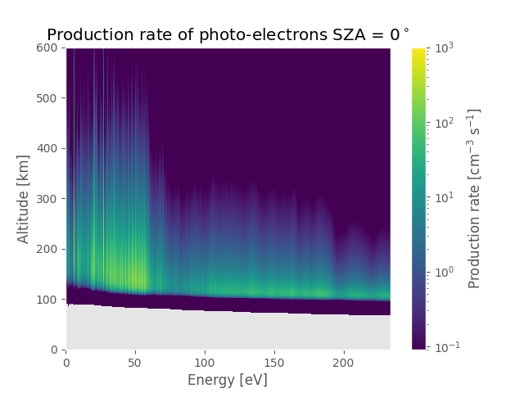
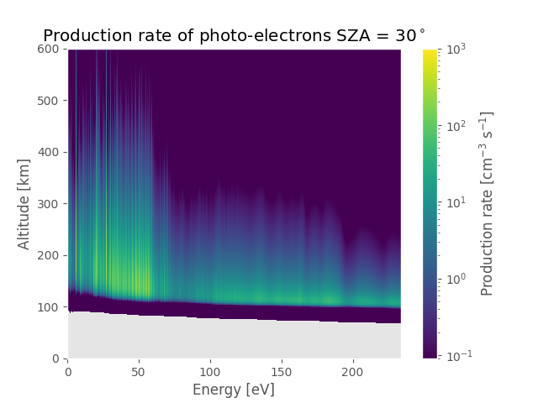
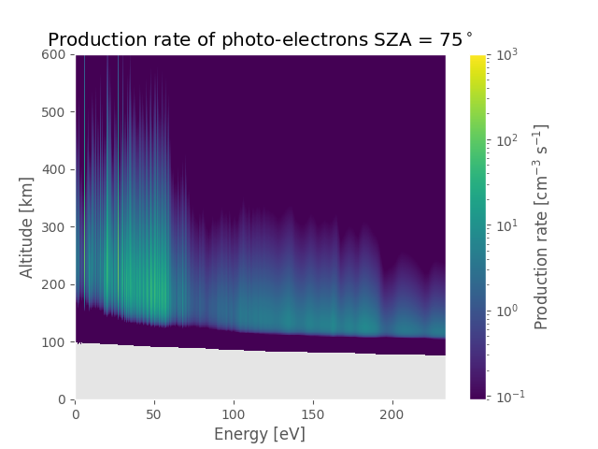
Task 1: Make functions that calculate the production rate of photo-electrons as a function of altitude and energy.
Photo-electron energy:
Photo-electron production rate:

Slide 15
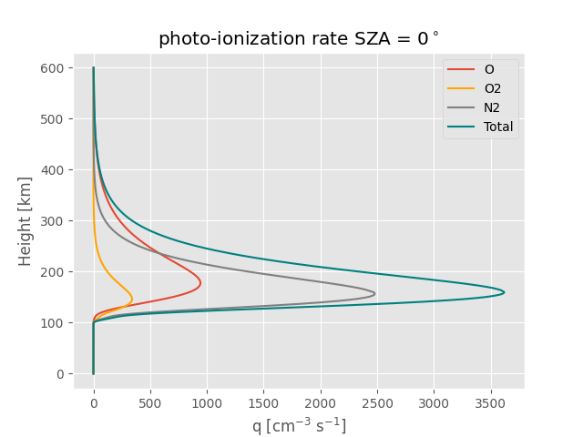
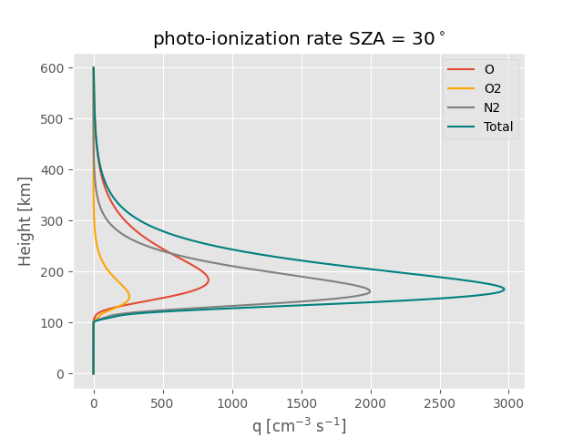
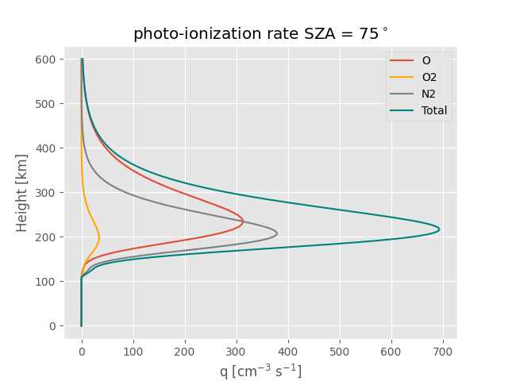
Task 2: Make functions that calculate the photo-ionization profiles as a function of altitude.
Total photo-ionization rate:

Slide 16
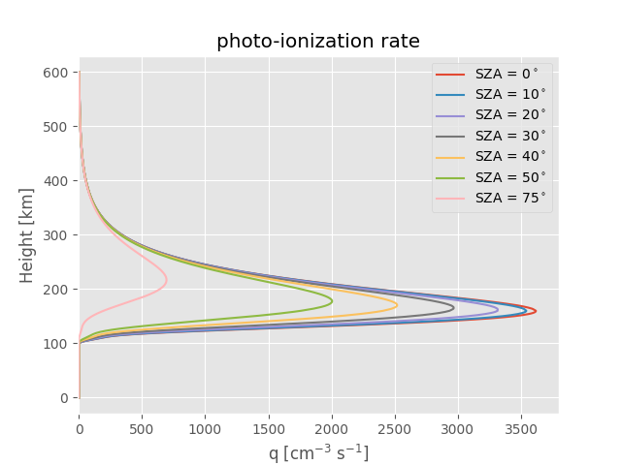
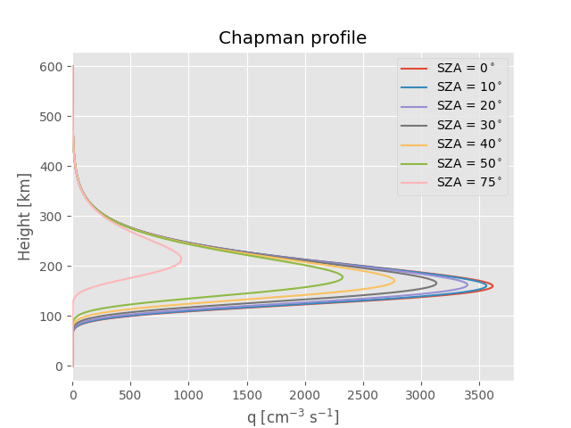

Task 2: Make functions that calculate the photo-ionization profiles as a function of altitude.
Chapman profile:
, where

Slide 17
Assignment 4
Ion Chemistry

Slide 18
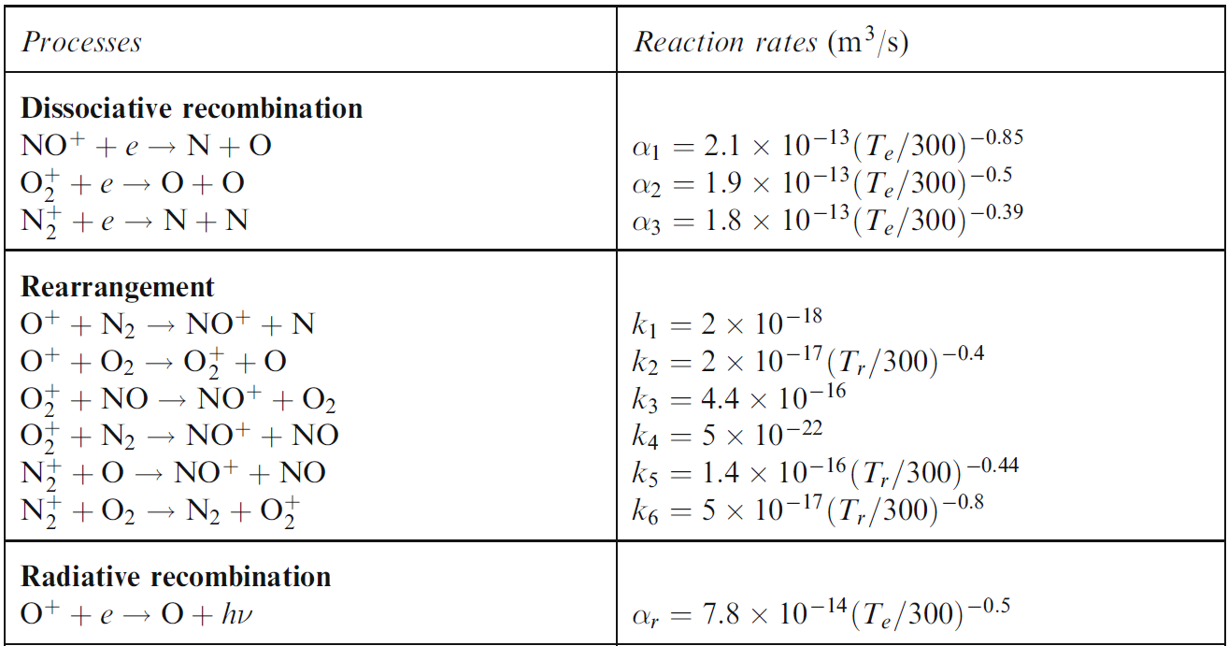
(1)
(2)
(3)
(4)
(5)
(6)
(7)
(8)
(9)
(10)
Table source: Physics of the upper polar atmosphere, Asgeir Brekke
Notes:
rearrangement temperature Tr and we see that the rearrangement processes basically takes
place due to reaction between an ion and a neutral species, so we can roughly estimate Tr
by taking the mean of the ion and neutral temperature.

Slide 19


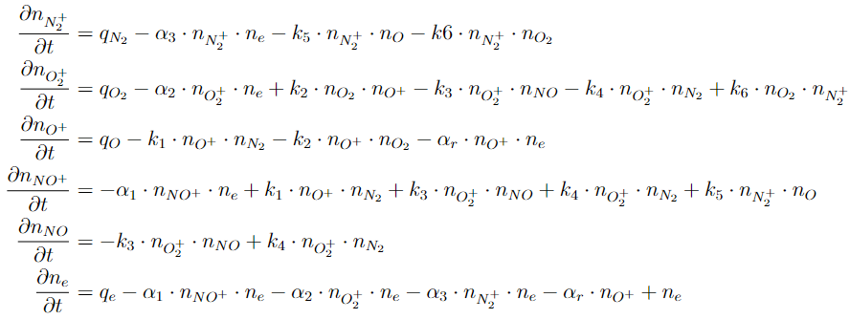

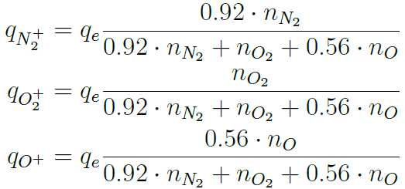
Task 1: Integrate the continuity equations
Continuity equation for ion species formed:
The loss of a ion:
Couple ODEs:
Production of :
Notes:
In the first task we have a continuity equation defined for a 3600s with a constant ionization rate to obtain a stable background to use for initial condition of the different densities.

Slide 20
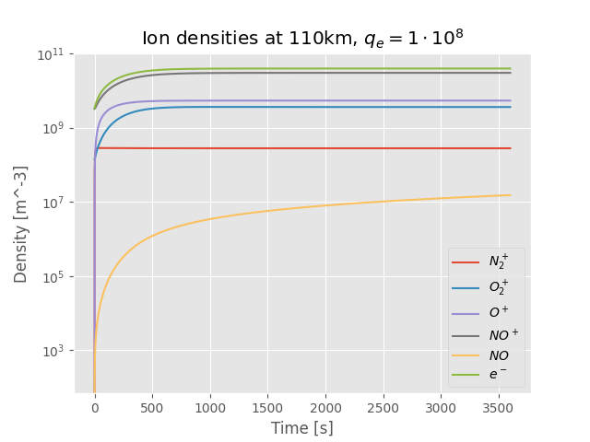
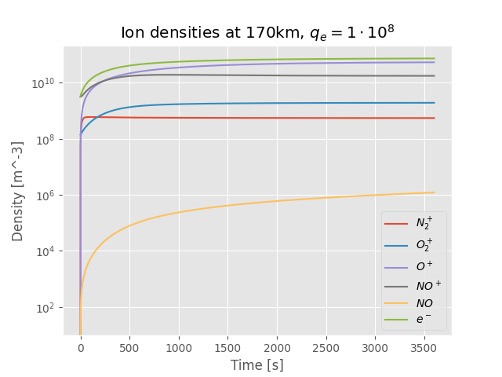
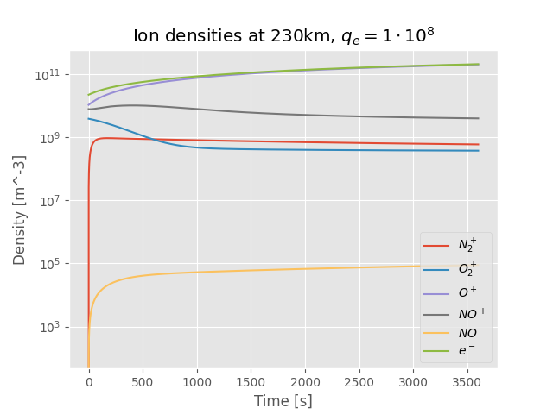
Task 1: Integrate the continuity equations

Slide 21
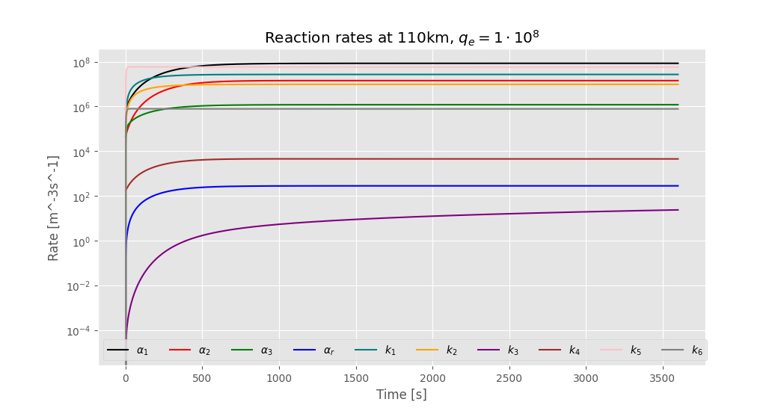
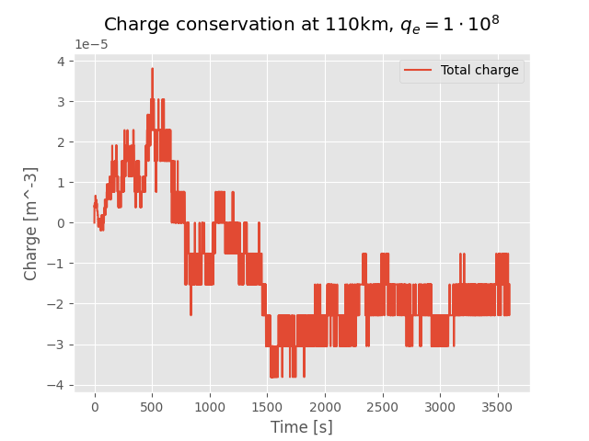
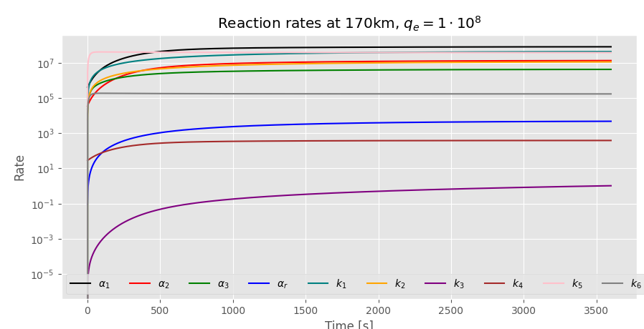
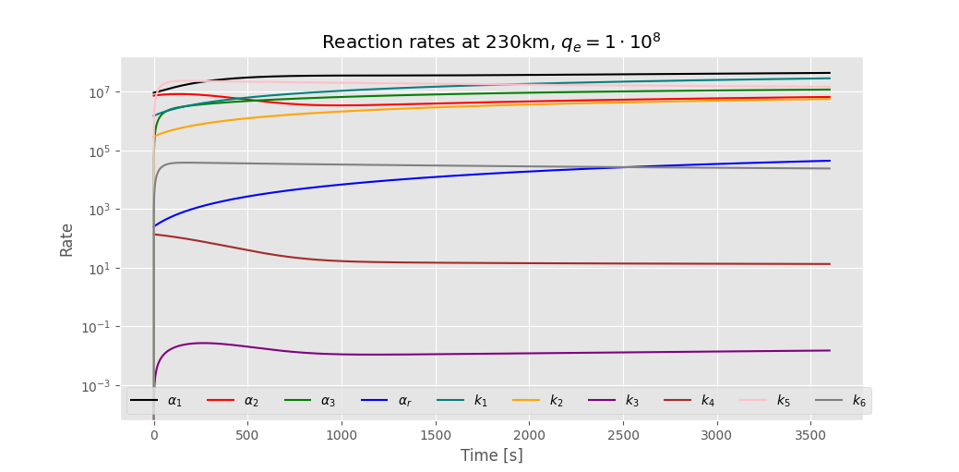
Task 1: Some extras

Slide 22
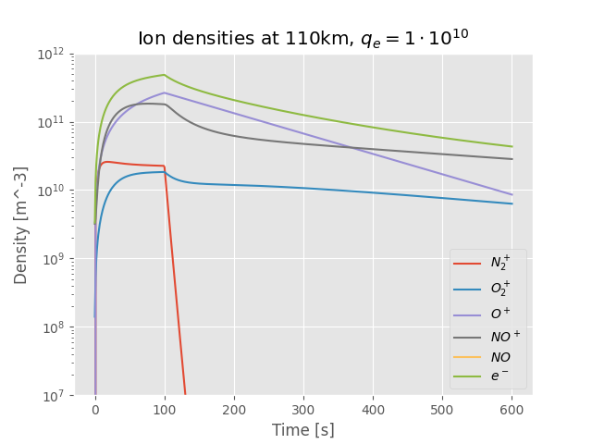
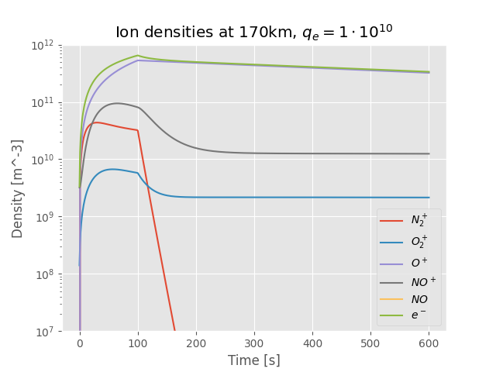
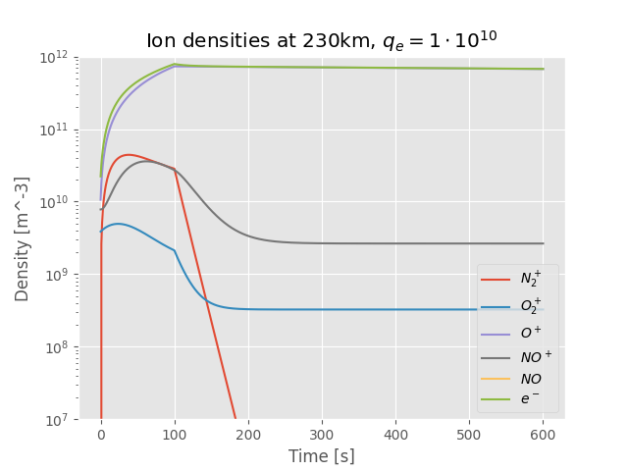

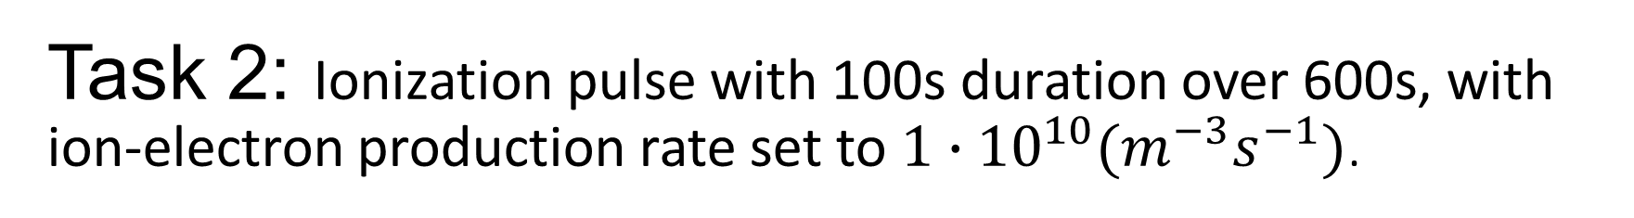
Task 2: Ionization pulse with 100s duration over 600s, with ion-electron production rate set to $1∙{10}^{10}(m^{−3}s^{−1})$.
Reaction (9) in the table:
Notes:
Here we have done the same as in the previous task, but now we have an ion pulse with a 100s duration of the first 100s of the 600s time span.

Slide 23
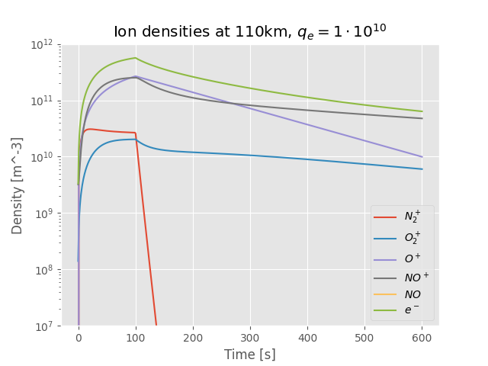
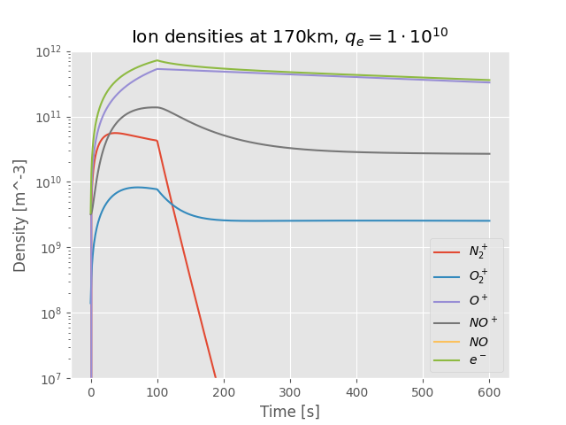
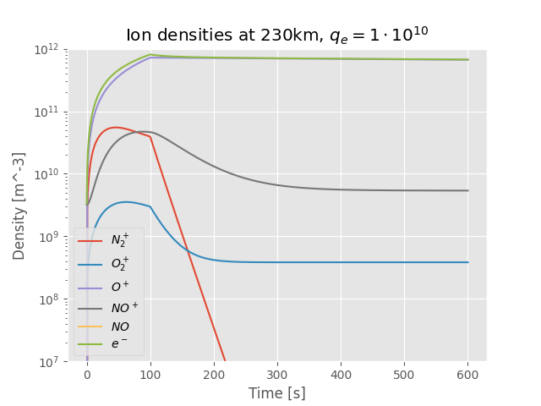
Task 3: Same as task 2, with a change.
Notes:
Now we gone reapet what we did in the previous task, but now we have a increase the electron and ion temperature by 1000k below 150km and by 2000k at altitueds above.

Slide 24






Task 4: Compare the electron-density decay with the expected decrease characteristic α and β.
β-decay (exponential decay), $l_{r}∝n_{e}$
α-decay, $l_{r}∝n_{e}^{2}$
Notes:
Now we gone compare the electron-density decay with the expected decrease characteric alpha and beta decay.

Slide 25
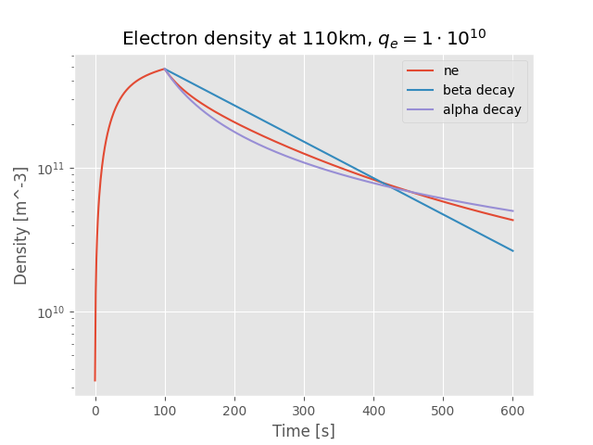
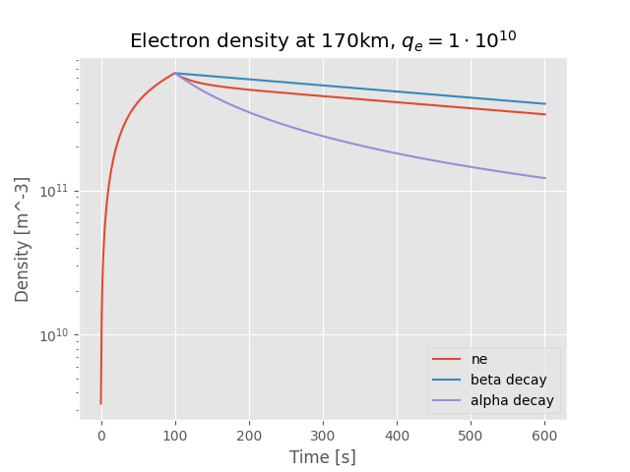
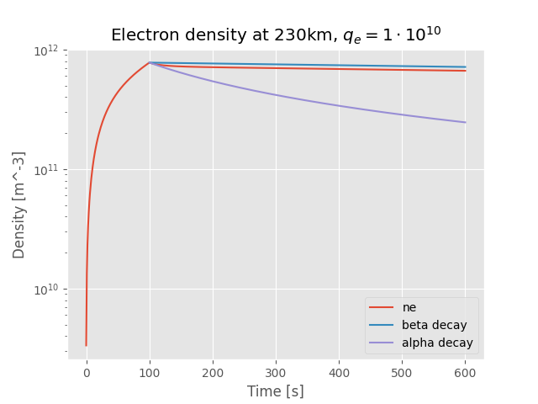
Task 4: Compare the electron-density decay with the expected decrease characteristic α and β.

Slide 26





Task 5: Ionization that varies.
Ionization that varies as:
Notes:
Now we have that the respons to ionization that varies is defined as. For the first 100s.
This is interesting since, the periodic variation of ion and electrons can effect the behavior of plasma in the ionosphere

Slide 27
EISCAT Experiment

Slide 28




UHF (Pointing in approx South 189 degrees with 78 degrees elevation)

Slide 29




VHF (Pointing North at 30 degrees of elevation)

