Slide 1
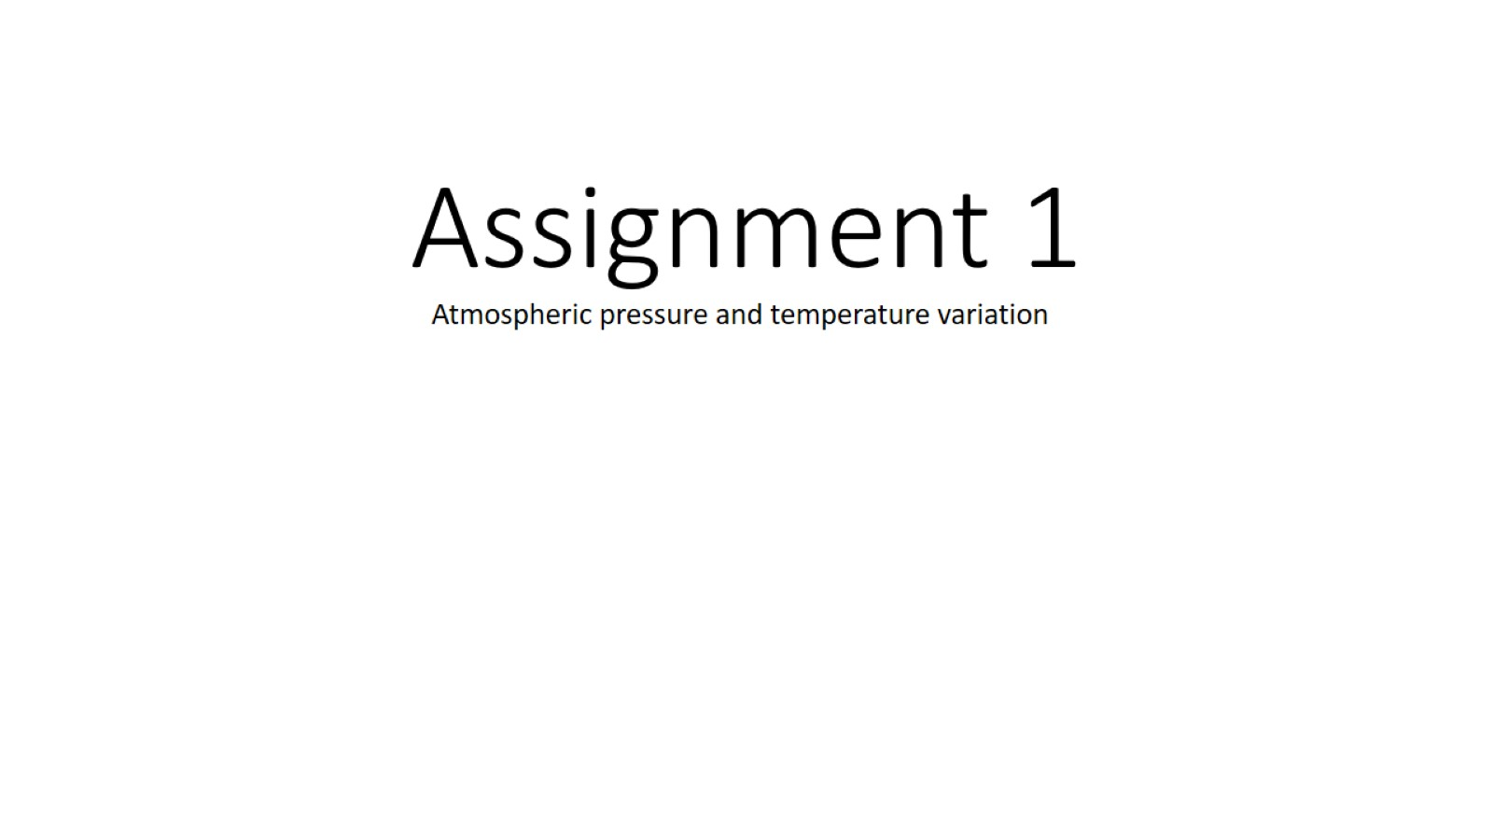
Assignment 1

Slide 2
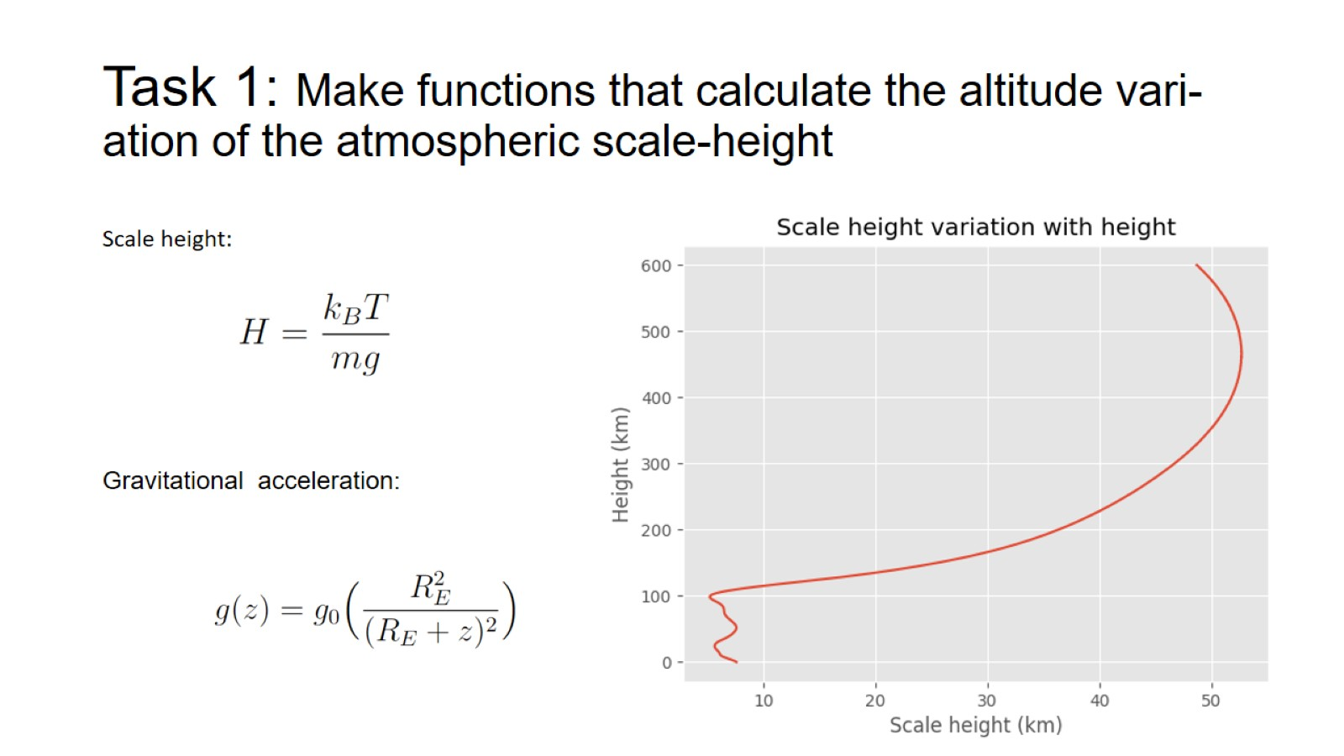
Task 1: Make functions that calculate the altitude vari- ation of the atmospheric scale-height

Slide 3
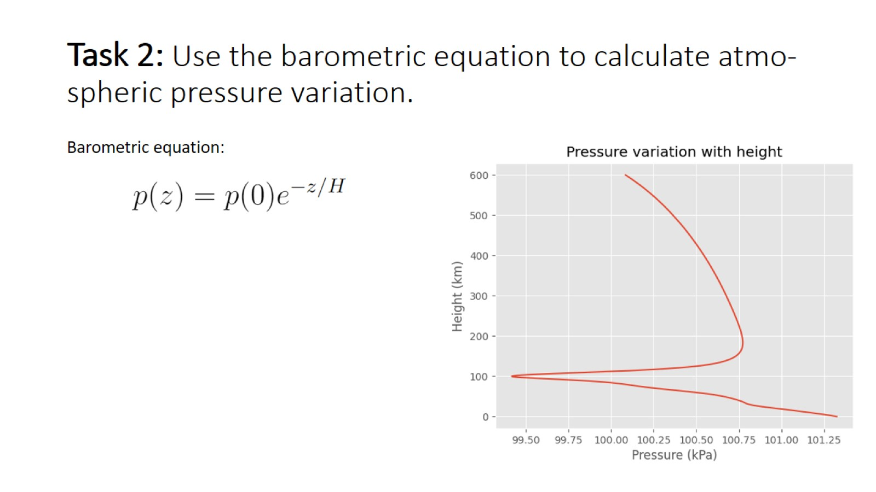
Task 2: Use the barometric equation to calculate atmo- spheric pressure variation.

Slide 4
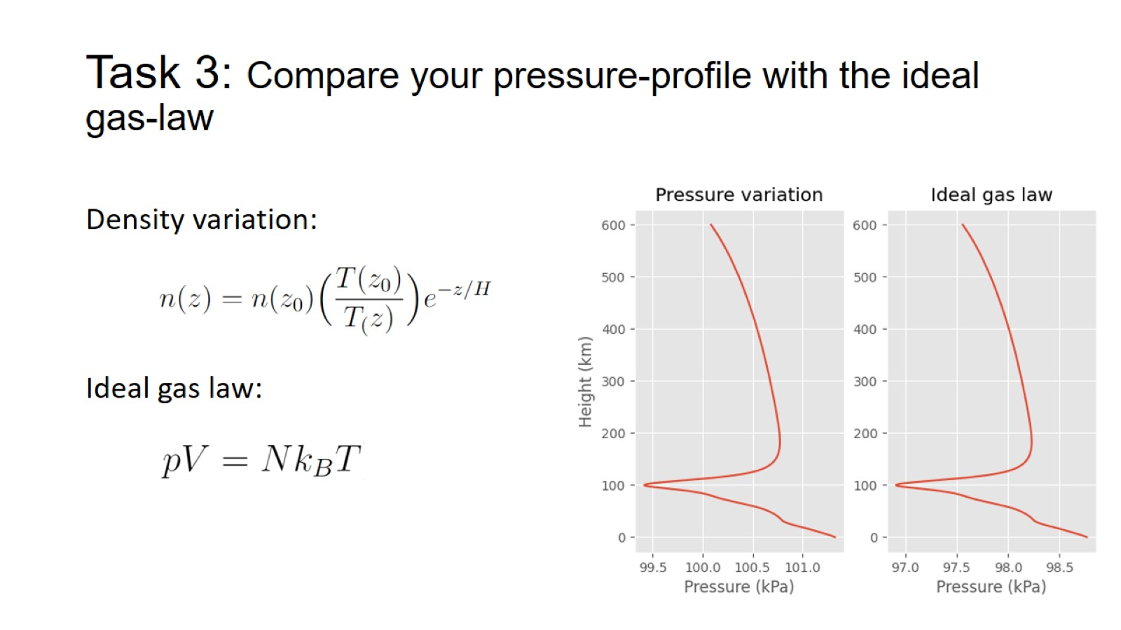
Task 3: Compare your pressure-profile with the ideal gas-law

Slide 5
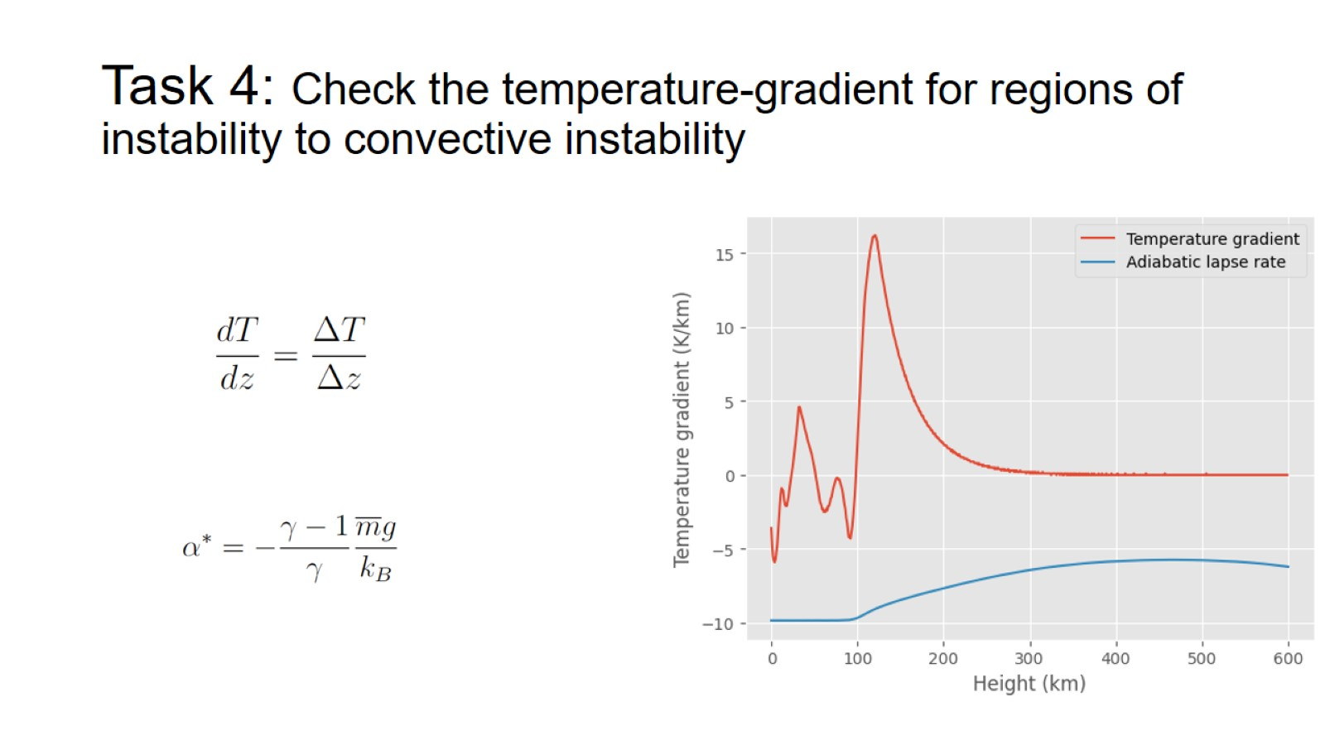
Task 4: Check the temperature-gradient for regions of instability to convective instability

