Slide 1
Tech Club
CMR Institute of Technology
JS Talk
04 Oct 2016

Slide 2
Vamsi Sai Turlapati
Been fiddling with JavaScript for at least 3 years.
Have worked on frontend on my previous industry engagements. All 2 off 2 internships.
Full Stack Development, Driven by Ideas

Slide 3
Discussions & Resources
http://jstalk.tvamsisai.com

Slide 4
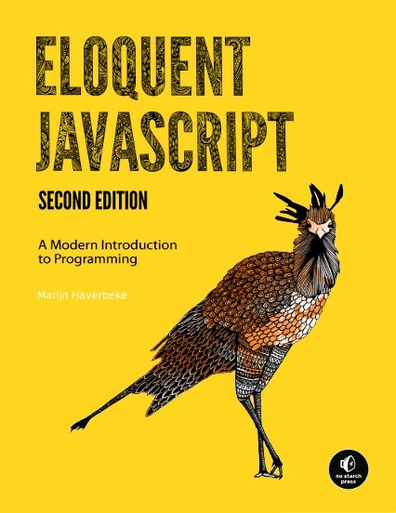
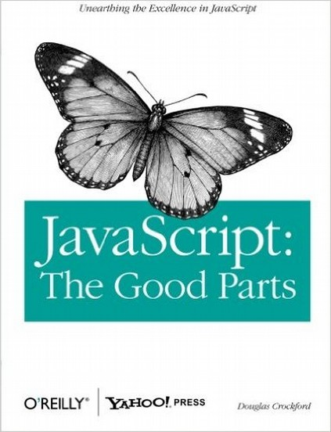
Books for Reference

Slide 5
Introduction
History
Syntax & Semantics
Objects
this keyword
Prototypes

Slide 6
Introduction
History
Syntax & Semantics
Objects
this keyword
Prototypes

Slide 7
History
Mosiac was a university project, a browser
Mozilla was created inspired by it
Marc Andreessen lead the team
Brendan Eich built the spec in 10 days
Codenamed Mocha
Shipped in beta release as LiveScript
Finally named JavaScript, a ploy some say

Slide 8
Why JavaScript?

Slide 9





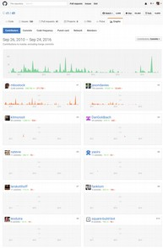
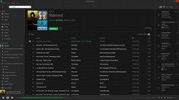
Why JavaScript?
Web Frontend
Server-side
Software
Desktop
Applications
Realtime Analytics
& Graphics

Slide 10
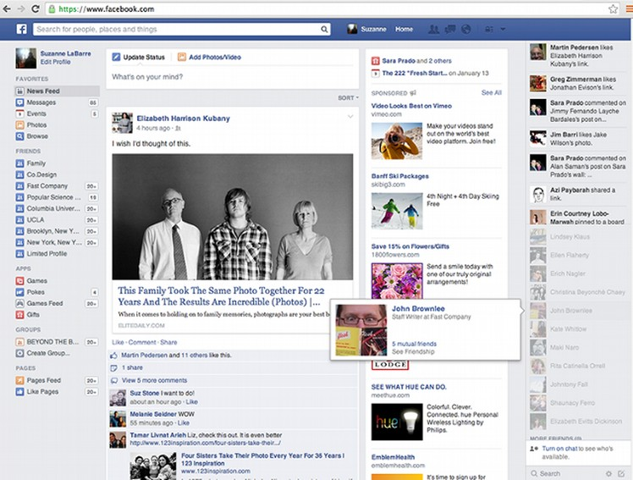


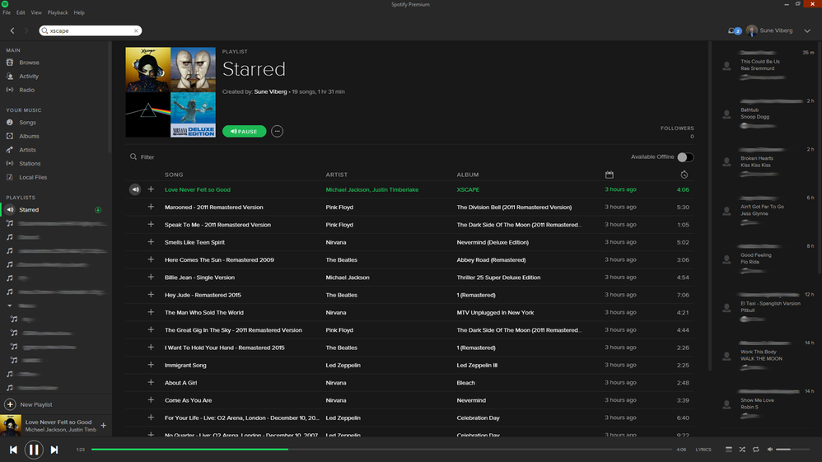
Why JavaScript?
Web Frontend
Server-side
Software
Desktop
Applications
Realtime Analytics
& Graphics

Slide 11
Why JavaScript?
Server-side
Software

Slide 12

Why JavaScript?
Desktop
Applications

Slide 13
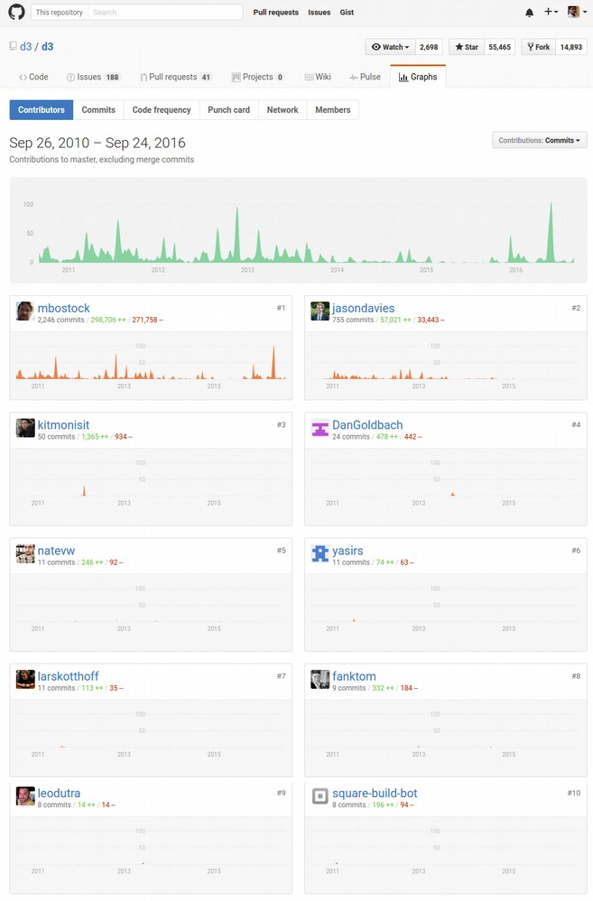

Why JavaScript?
Realtime Analytics
& Graphics

Slide 14
Spec Releases
Year | Versions
1996 | JS1.0 JS1.1
1997 | JS1.2 ES1
1998 | JS1.3 ES2
2000 | JS1.5 ES3
2005 | JS1.6
2006 | JS1.7
2008 | JS1.8 JS1.8.1 ES4
2009 | JS1.8.2 ES5
2010 | JS1.8.5
2011 | ES5.1
2015 | ES6
2016 | ES7
As Microsoft (JScript) & Adobe (ActionScript) were planning make their own browser script specs, there was a need to make a standardisation.
Hence, we had ECMAScript as a specification under ECMA.
It followed JS for a while.
Now JS follows ES spec.
That’s why we shall be learning about ES6/7 changes rather than as new versions of JavaScript.

Slide 15
Influences
C, Java, Scheme, ML

Slide 16
Influences
C, Java, Scheme, ML
Functional
Programming
Object Oriented
Programming
Prototypical
Inheritance

Slide 17
Influences
C, Java, Scheme, ML
Functional
Programming
Functions are first class entities.
Object Oriented
Programming
Prototypical
Inheritance

Slide 18
Influences
C, Java, Scheme, ML
Functional
Programming
Functions are first class entities.
Object Oriented
Programming
Abstraction, Encapsulation, Polymorphism, Inheritence
Prototypical
Inheritance

Slide 19
Influences
C, Java, Scheme, ML
Functional
Programming
Functions are first class entities.
Object Oriented
Programming
Abstraction, Encapsulation, Polymorphism, Inheritence
Prototypical
Inheritance

Slide 20
Influences
C, Java, Scheme, ML
Functional
Programming
Functions are first class entities.
Object Oriented
Programming
Abstraction, Encapsulation, Polymorphism, Inheritence
Prototypical
Inheritance
Prototypes are references to previous definitions

Slide 21
Recent Changes
Arrow Functions | (x, y) => x + y
Classes | class Student {}
Generators | Function* () { yield 0; yield 1; return 0; }
Object Literals | { [(alignInt) alignInt ? “right” : “left”]: 30 }
Modules | export { Student, makeStudent }; export default Student;
Promises | Promise.all([ getLunch, doHomework, goHome]).resolve/reject
Destructuring | (firstArg, ...restArgs) => return 0;
Let + Const | let a = 5; const b = 10;
Iterators
Proxies
More on: http://babeljs.io/docs/learn-es2015/

Slide 22
Introduction
History
Syntax & Semantics
Objects
this keyword
Prototypes

Slide 23
Premitive Data Types
null
undefined
  Boolean
Number
Object
String
Function

Slide 24
Premitive Data Types
“number” === typeof 3
“number” === typeof 3.4
“string” === typeof “Vamsi”
“object” === typeof { name: “Vamsi” }
“object” === typeof [3, 4, 5]
“boolean” === typeof true
“function” === typeof Math.sqrt
“undefined” === typeof asdfjkl
null

Slide 25
Operators
Operator | Operation Description
+ | Addition; Concatenation
- | Subraction
* | Multiplication
/ | Division
% | Modulus
++ -- | Increment, Decrement
|| && ! | Logical OR, Logical AND, Logical NOT
| & ^ | Bitwise OR, Bitwise AND, Bitwise XOR
> < <= >= | Conditional Operators
== === | Equals, Typesafe Equals
?: | Ternary Operator

Slide 26
Conditional Structures
if...else
switch
if (Math.random() > 0.5) {
console.log(“More than half.”);
} else {
console.log(“Less than or equal to half.”);
}
switch(‘a’) {
case ‘a’:
console.log(“a”);
break;
case ‘b’:
console.log(“b”);
break;
default:
console.log(“None”);
}

Slide 27
Iterative Structures
for
while
do...while
for (var i = 0; i < 10; i++) {
console.log(i);
}
var i = 0;
while (i < 10) {
console.log(i);
}
var i = 10;
do {
console.log(i);
} while (i < 10);

Slide 28
Functions
Definition
function myFunction(arg1, arg2) {
console.log(arg1, “and”, arg2, “passed”);
return 0;
}

Slide 29
Functions
Anonymous
function (arg1, arg2) {
console.log(arg1, “and”, arg2, “passed”);
return 0;
}(3, “hello”);

Slide 30
Functions
Another Method of Definition
var myfunction = function (arg1, arg2) {
console.log(arg1, “and”, arg2, “passed”);
return 0;
}

Slide 31
Functions
Nested Function
function (arg1, arg2) {
console.log(arg1, “and”, arg2, “passed”);
function conc() {
return arg1 + arg2;
}
console.log(“Concatenated:”, conc());
return 0;
}(3, “hello”);

Slide 32
Functions
Recursion
function series(n) {
if (n <= 0)
return;
else if (n < 2)
return 1;
else
return series(n-1) + series(n-2);
}
series(5);

Slide 33
Functions
Higher Order Functions
function series(n, fn) {
if (n <= 0)
return;
else if (n < 2)
return 1;
else
return fn(series(n-1), series(n-2));
}
series(5, function(a, b) { return a + b });

Slide 34
Functions
Currying
function setNum(n) {
return function setFunction(fn) {
return function series() {
if (n <= 0)
return;
else if (n < 2)
return 1;
else
return fn(series(n-1), series(n-2));
}
}
}
var addTwoNums = function(a, b) { return a + b }
var getFive = setNum(5);
var doAddGetFive = getFive(addTwoNums);
doAddGetFive();

Slide 35
Functions
Currying
const setNum = (n) =>
(fn) =>
() => {
if (n <= 0)
return;
else if (n < 2)
return 1;
else
return fn(series(n-1), series(n-2));
}
}
}
const addTwoNums = (a, b) => return a + b;
const getFive = setNum(5);
const doAddGetFive = getFive(addTwoNums);
doAddGetFive();

Slide 36
Introduction
History
Syntax & Semantics
Objects
this keyword
Prototypes

Slide 37
Objects
Definition
var student = {
name: “Vamsi”,
year: 4,
interests: [
“programming”,
“cycling”,
“photography”
]
}
student.name === “Vamsi”;
student[“name”] === “Vamsi”;

Slide 38
Objects
Can Include Functions
var student = {
name: “Vamsi”,
year: 4,
interests: [
“programming”,
“cycling”,
“photography”
]
code: function(problem) { return solution; },
peddle: function() { return distanceCovered; },
clickPhoto: function() { return picture; }
}
student.code();

Slide 39
Objects
Can Include Objects and Array of Objects
var student = {
name: “Vamsi”,
year: 4,
friends: [
{
name: “Ronak”,
year: 4
},
{
name: “Soumitro”,
year: 4
}
]
}
student.friend[0].name === “Ronak”;

Slide 40
JSON
JavaScript Object Notation
{
name: “Vamsi”,
year: 4,
friend_count: 2,
friends: [
{
name: “Ronak”,
year: 4
},
{
name: “Soumitro”,
year: 4
}
]
}

Slide 41
Introduction
History
Syntax & Semantics
Objects
this keyword
Prototypes

Slide 42
this
Context
var student = {
name: “Vamsi”,
friends: [
{ name: “Ronak” },
{ name: “Soumitro” }
]
}
Student.showFriends = function() {
this.friends.forEach(function(friend) {
console.log(friend.name);
});
}
student.showFriends();

Slide 43
Bind
var student = {
name: “Vamsi”,
friends: [
{ name: “Ronak” },
{ name: “Soumitro” }
]
}
showFriends = function() {
this.friends.forEach(function(friend) {
console.log(friend.name);
}
}
var studentFriends = showFriends().bind(student);
StudentFriends();

Slide 44
Introduction
History
Syntax & Semantics
Objects
this keyword
Prototypes

Slide 45
Prototype
Property of objects
Allows making ‘new’ instances of objects

Slide 46
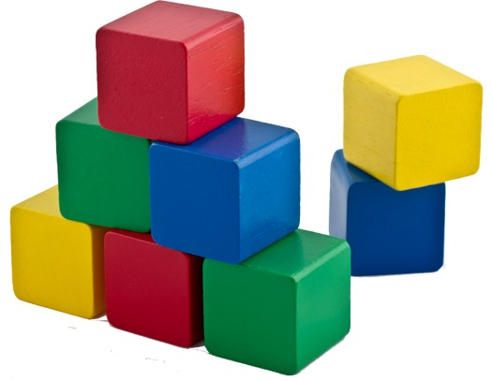
Prototype
Property of objects
Allows making ‘new’ instances of objects

Slide 47
Prototype
Property of objects
Allows making ‘new’ instances of objects
block

Slide 48
Prototype
Property of objects
Allows making ‘new’ instances of objects
red
block
yellow
blue

Slide 49
Prototype
var block = { shape: “cube” };
var redBlock = { color: “red” };
Object.setPrototype(redBlock, block);
Object.getPrototype(block);

Slide 50
Prototype
var Block = function() {};
Block.prototype.shape = “cube”;
var redBlock = new Block();
redBlock.color = “red”;
Object.getPrototype(redBlock);
RedBlock.shape === “cube”;

Slide 51
Questions?

