Slide 1
Web Scraping Gas Prices
With Python
‘Cause I got work to do!
Travis Vanos

Slide 2
What you will need:
- Copy “D:\Web_Crawler” to local or network drive
Replace “C:\Python27” with “D:\Python27”
Start Notepad++ or favorite editor
In Chrome: open www.ontariogasprices.com and open developer tools (“F12”)

Slide 3
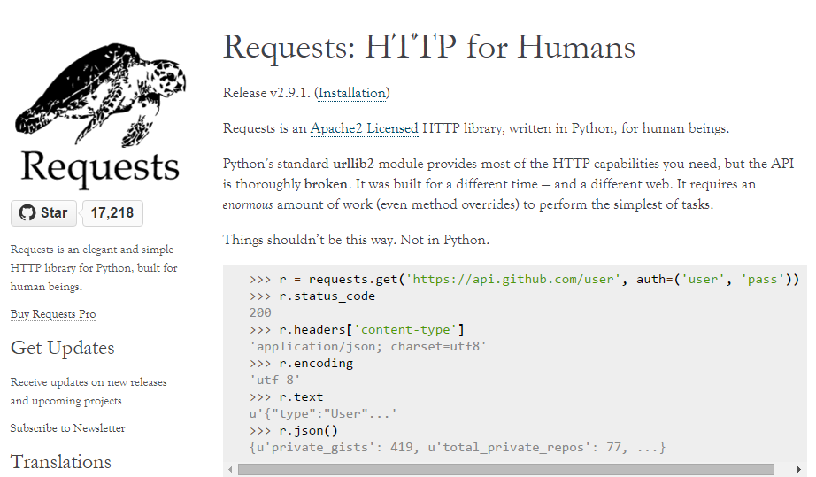
Python HTTP Requests

Slide 4
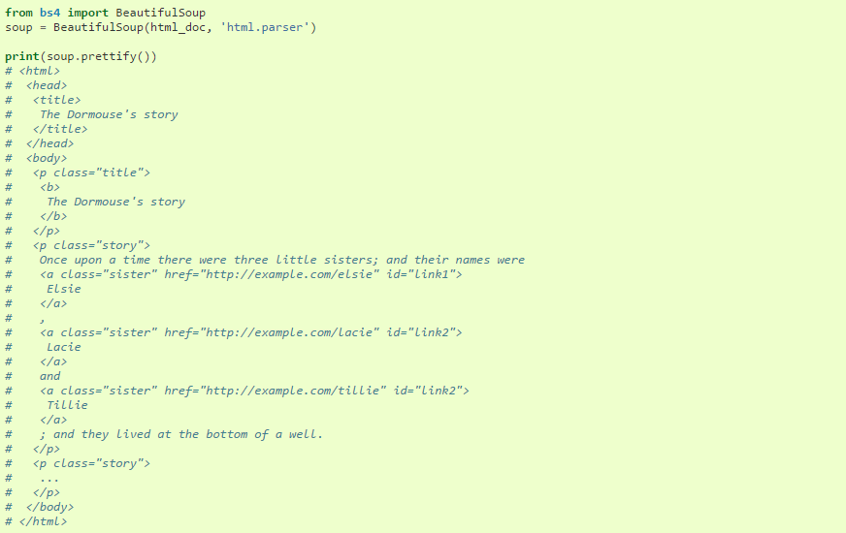
Beautiful Soup (v4.4)
Beautiful Soup is a Python library for pulling data out of HTML and XML files.
Beautiful soup can use a built-in parser or added tools such as (lxml, libhtml5)

Slide 5
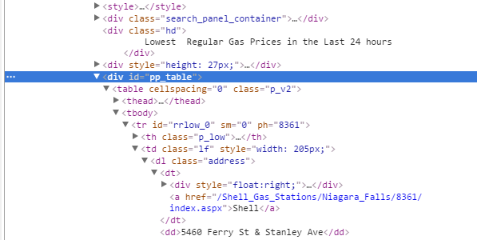
Review on HTML

Slide 6
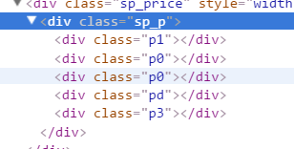
Ontariogasprices.com
And why it may feel like you’re crawling through the mud (haha! )
Inconvenient folder structure (station type before location = harder for us)
Decimal is a character “d” rather than a period or a float number
Gas prices stored in DIV ID … ONE DIGIT AT A TIME! (Nonsense)
Non standard DIV class naming convention (Makes our code longer and messier)
- 2 choices “sp_p” or “sp_p sp_ml” (May mean something to someone)

Slide 7
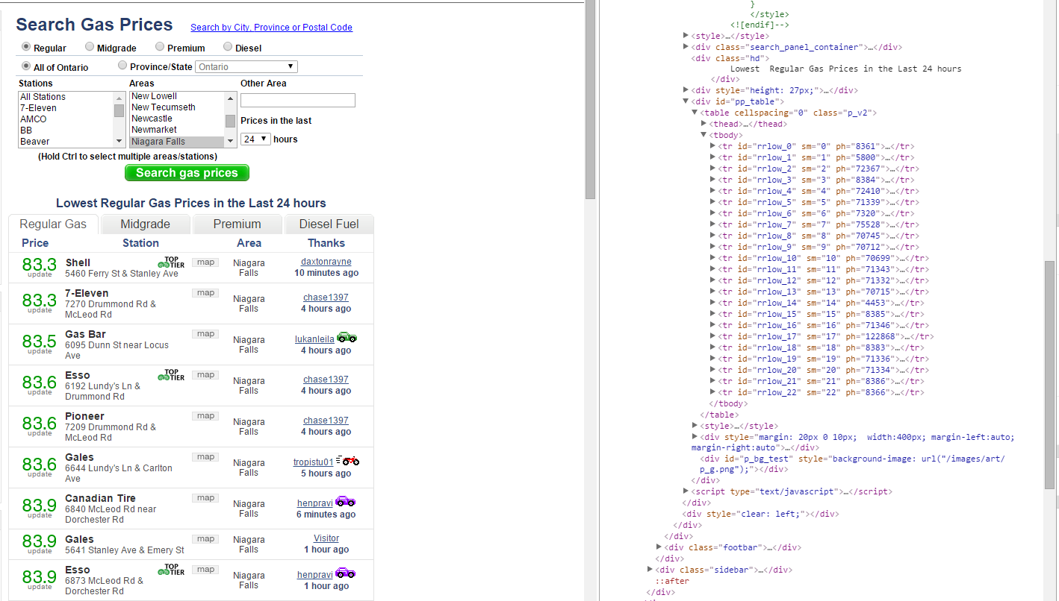
Gas Price List

Slide 8
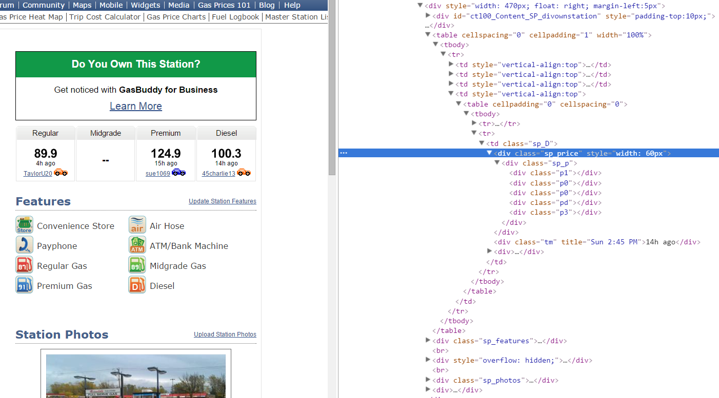
Typical Station Page

Slide 9
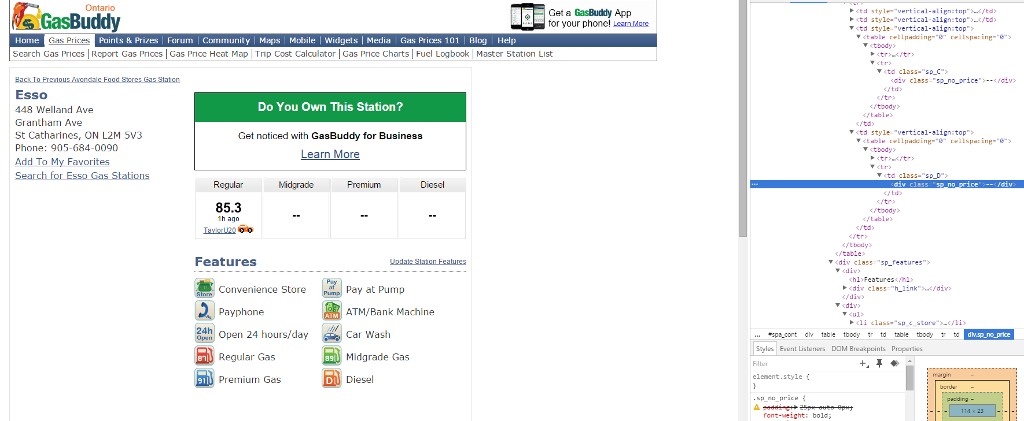

Slide 10
DEMO

