Slide 1
Project on
Audio Assistant Based Image Captioning System Using RLSTM and CNN
19311A1975-T V AKHILA
19311A1976-T.SAI

Slide 2
ABSTRACT
As we know, visually impaired or partially sighted people face a lot of problems reading or identifying any local scenarios. To vanquish this situation, we developed an audio-based image captioner that will identify the objects in an image and form a meaningful sentence that gives the output in the aural form.
Image processing is a widely used method for developing many new applications. It is also open source, so developers can use it easily. We used NLP (Natural Language Processing) to understand the description of an image and convert the text to speech.
A combination of R-LSTM and CNN is used, which is nothing but a reference based long-short term memory which matches different text data and takes it as reference and gives the output.
Some of the other applications of image captioning are social media platforms like Instagram, etc., virtual assistants, and video editing software.

Slide 3
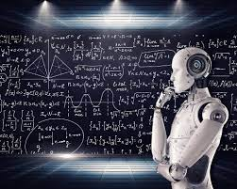
EXISTING SYSTEM
CNN-RNN framework based image captioning technique has two drawbacks in training phase.
1.First drawback is each caption gets equal importance without their individual importance .
2. second drawback is during caption generation objects may not be correctly recognized.

Slide 4
PROPOSED SYSTEM
In this we have also added Reference based long short term memory (R-LSTM) that main aim is by implementing reference information to give more descriptive caption for a query image.
According to the relation between image and words during the training phase, different weights are assigned. In addition to maximizing the agreement-score among the captions produced through the captioning methods and the reference data from the adjoining images of the intentional images that can limit the issue of not recognizing a correct image.
For encoding textual data a special RNN is used called Long Short Term Memory (LSTM) and for encoding visual data a deep Convolutional neural network is used.
for decoding image features conditioned on feature vector of background words, structure content neural language is utilized that allows to generate a sentence word after word.

Slide 5
HARDWARE REQUIREMENTS SOFTWARE REQUIREMENTS
Processor : Intel I3 or above
RAM : 4GB and Higher
Hard Disk : 100GB minimum
Programming Language : Python,LSTM ,NLTK
IDE : Google Colab

Slide 6
ARCHITECTURAL DESIGN

Slide 7
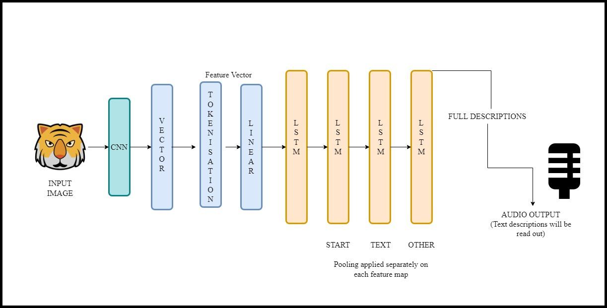

Slide 8
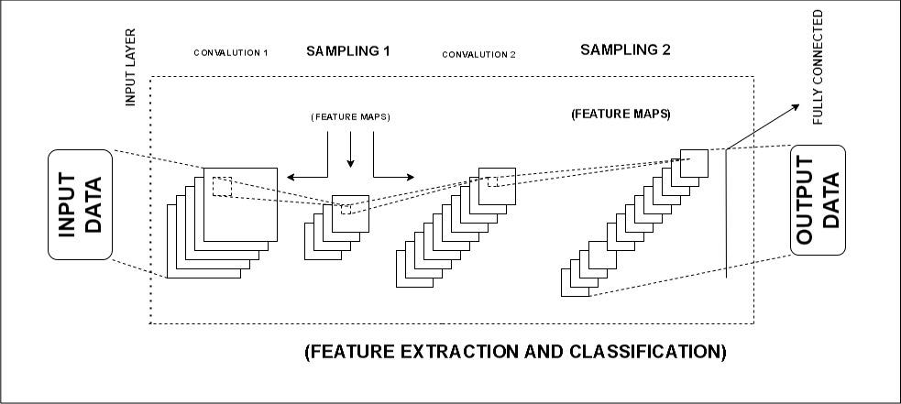

Slide 9
USE CASE DIAGRAM:

Slide 10
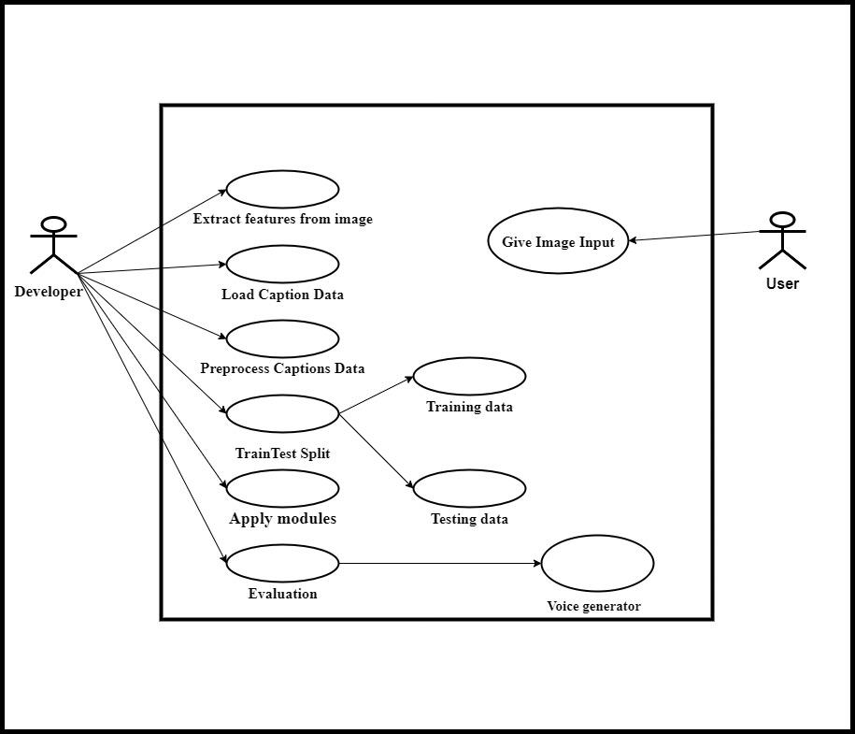

Slide 11
CLASS DIAGRAM:

Slide 12
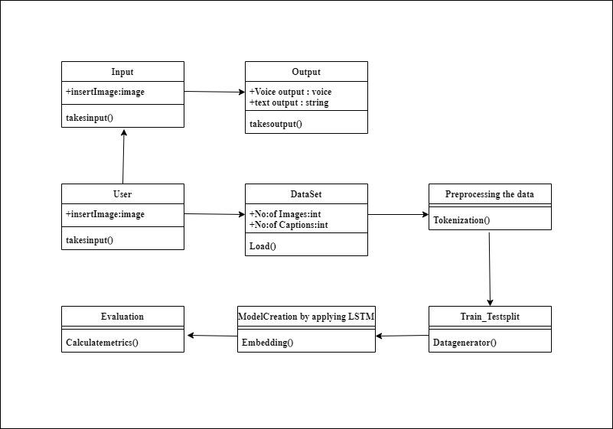

Slide 13
ACTIVITY DIAGRAM:

Slide 14
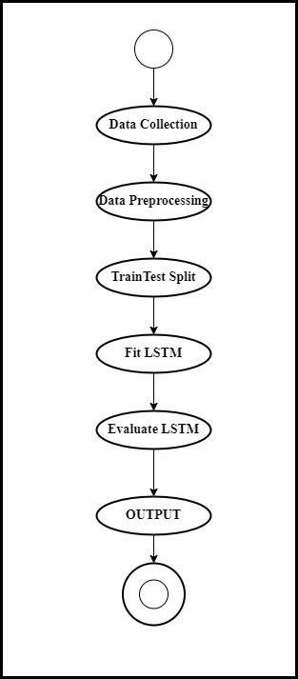

Slide 15
SEQUENCE DIAGRAM:

Slide 16
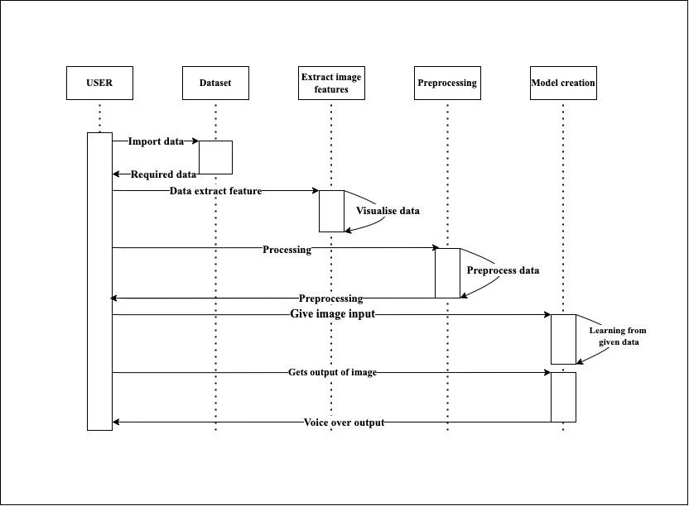

Slide 17
OBJECT DIAGRAM:

Slide 18
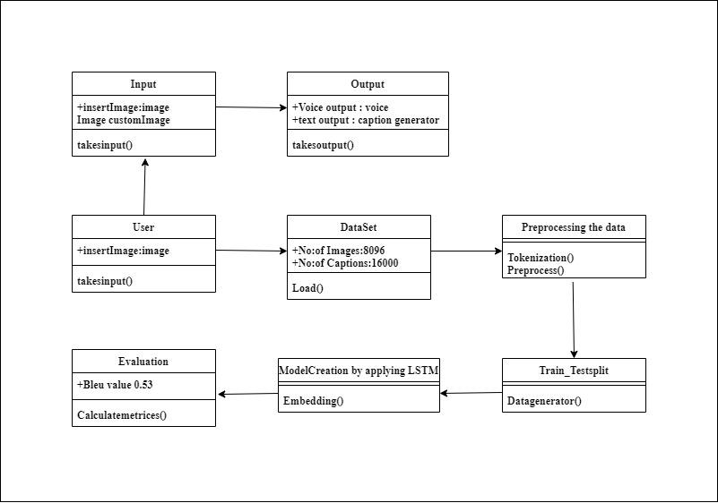

Slide 19
IMPLEMENTATION:

Slide 20
IMPLEMENTATION :
Step 1: import all the required libraries like VGG16, preprocess_inputInput, Dense, LSTM, Embedding etc.
Step2-importing the dataset FLICKR
Step 3: Load The Caption Data
Step 4-Preprocessing the data
Step 5-Train Test Split
Step5-Model Creation
Step 6:Generate Captions for the Image
Step7: Display Set of Captions
Step 8:Generate Caption using RLSTM
Step 9- Caption with voice Generation

Slide 21
Source Code:

Slide 22
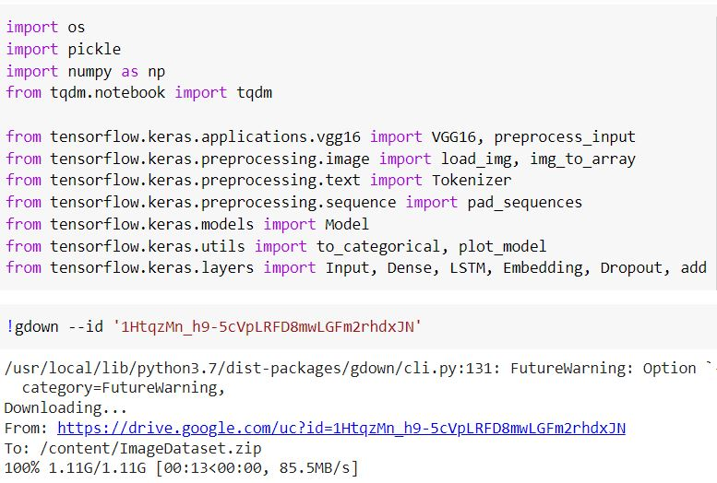

Slide 23
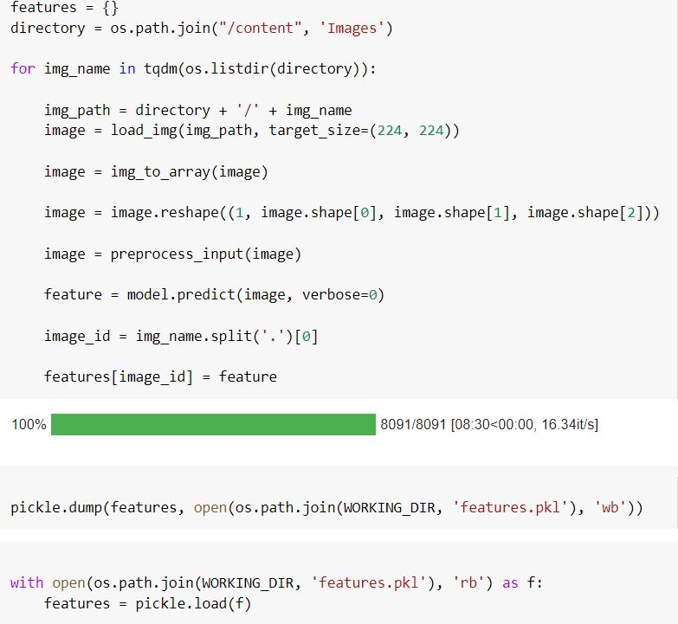

Slide 24
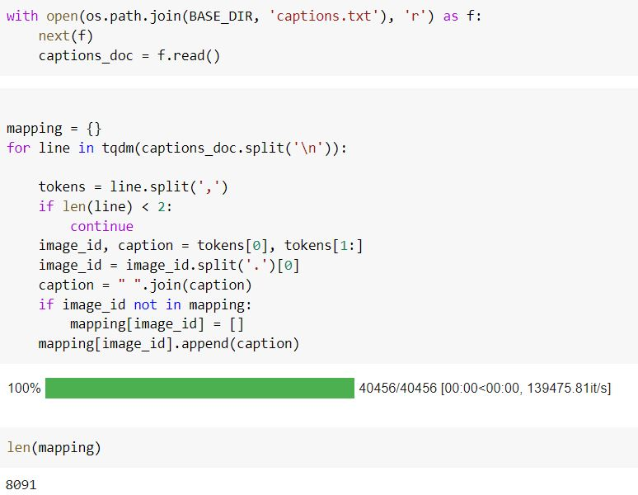

Slide 25
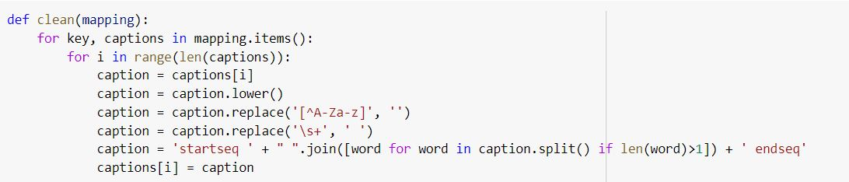

Slide 26
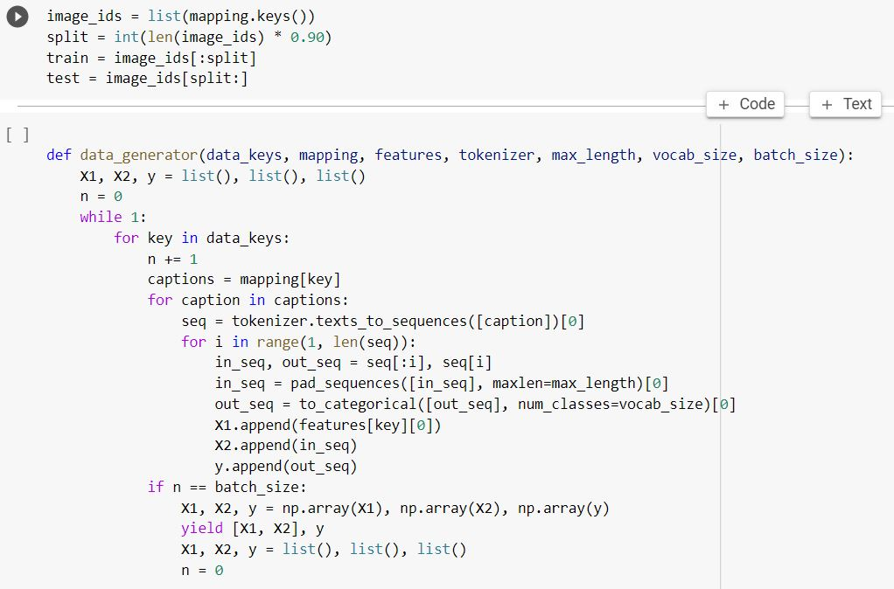

Slide 27
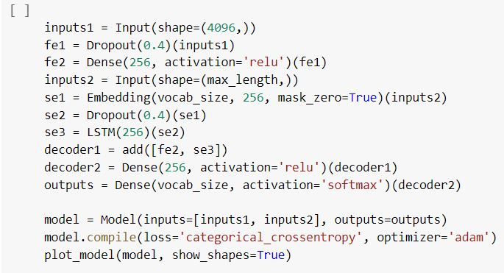

Slide 28
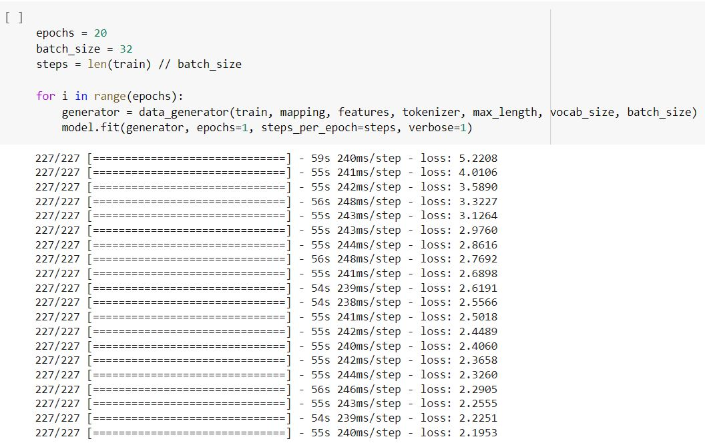

Slide 29
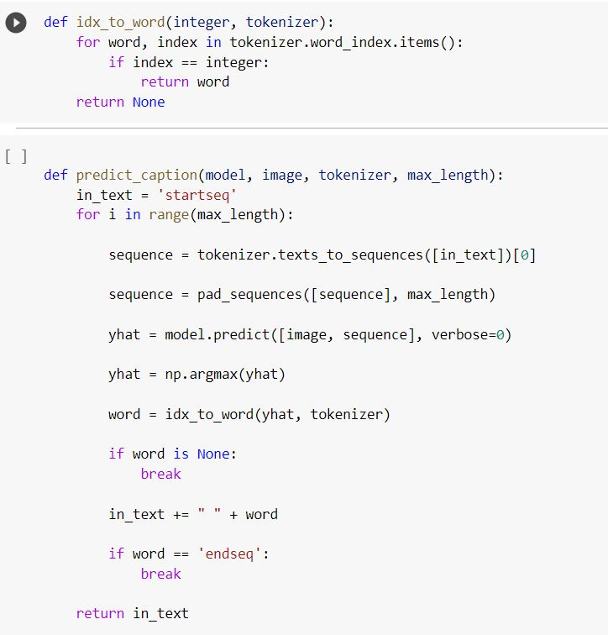

Slide 30
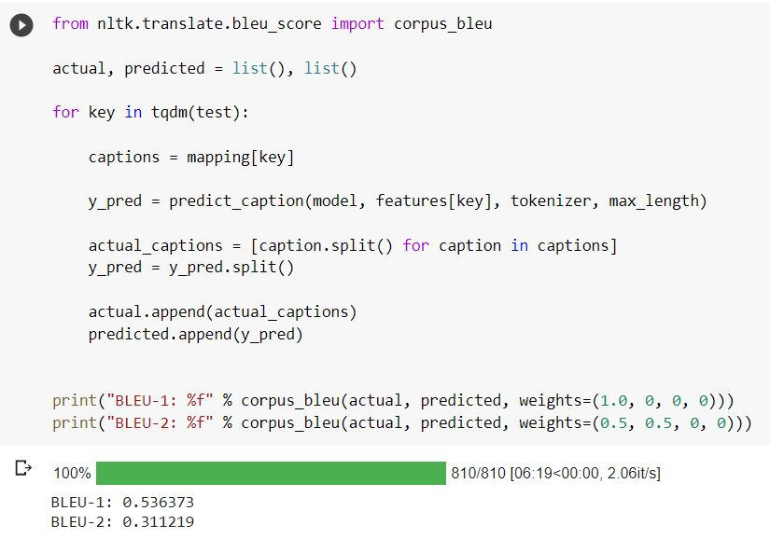

Slide 31
Output screens:

Slide 32
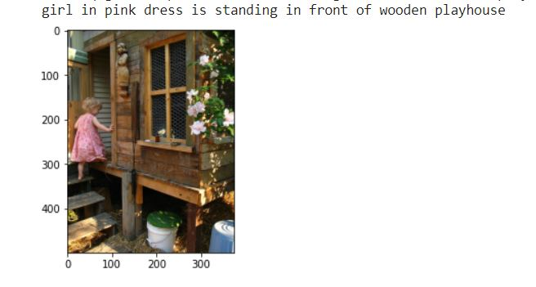


Slide 33
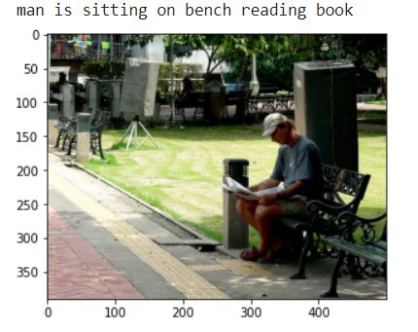

Slide 34
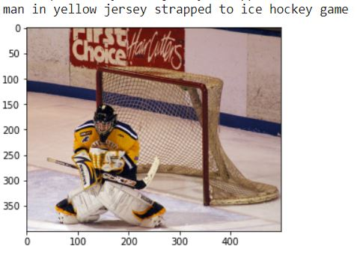

Slide 35
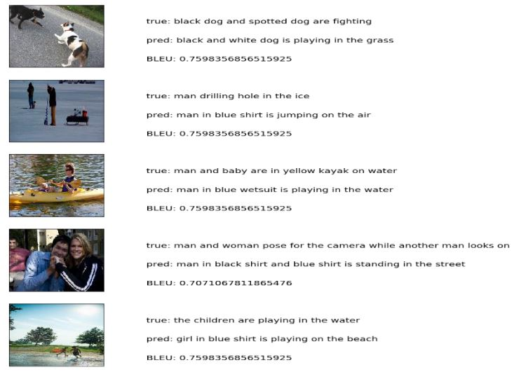

Slide 36
CONCLUSION
we have successfully developed an audio-based assistant for image caption generation. This project will undoubtedly benefit the blind because it will provide audio output. accuracy can be increased by training with large datasets and video caption generators can be developed. Modifications can be made in the identification of the images to recognize them more clearly. Learning from the user feedback will also be added. This model represents the exact representation and works with most of the object pictures.

Slide 37
Future Scope
Our novel technology holds a lot of practical applications for future use, especially in the domain of assistive technology for blind individuals. Given that the base model is equipped with limited images and captions, our project aims to expand our image and caption acquisition by five times. For instance, we can build on our current software of Flicker 8k by moving to newer modes (i.e. Flicker 60k) that offer quicker transfer speeds and more efficient image acquisition performance. Overall, the simple principle of image-to-text transfer can be used to enhance the field of assistive technology as we work to automate one’s most basic sense: vision.By keeping all these factors , In the coming days there exists a visual capturing spectacles for the blind people where it detects all the objects that are placed or moving In Front of them . During this process the camera that is fixed to the spectacles detect the live image and sends the message to the person via voice to describe about the live image.

