Slide 1
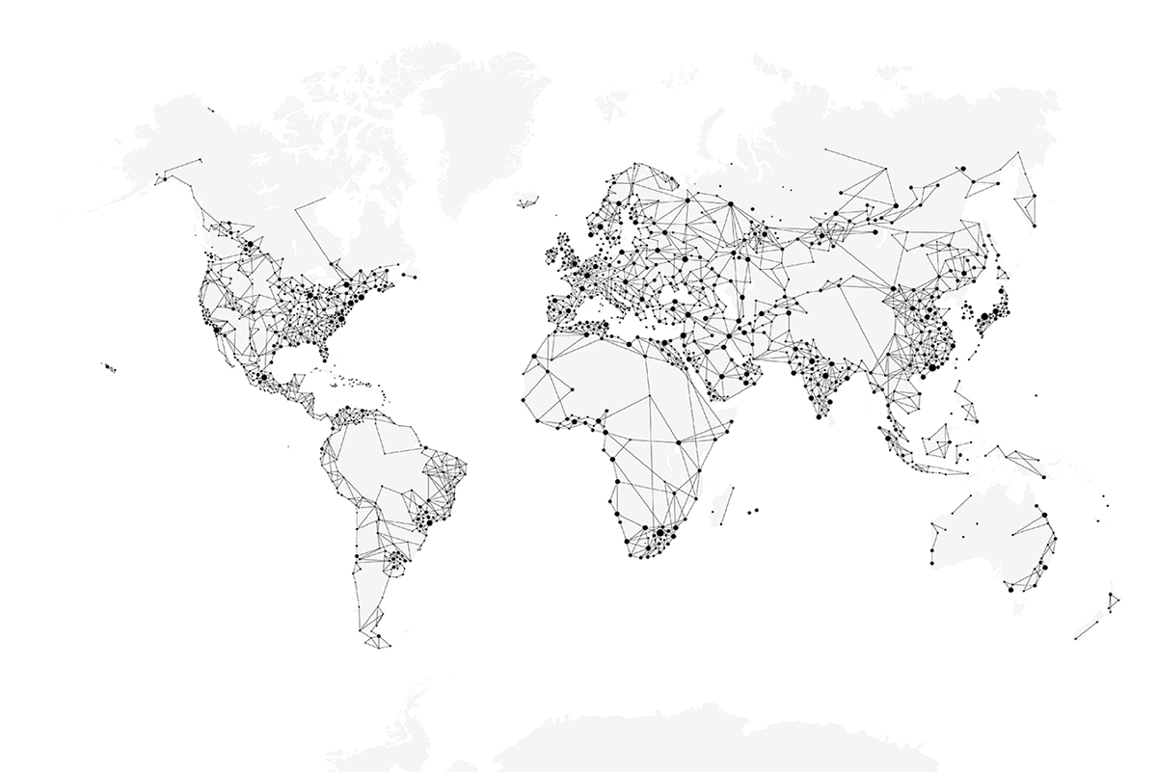

____________( Heading)
________________( Business/Division)
____________ 2025 ( Date)
Classification: Internal

Slide 2
Production Planning
A systematic approach to organizing resources, machines & materials — ensuring the right parts are produced at the right time, in the right quantity.
KEY ELEMENTS OF PRODUCTION PLANNING
📦 Demand (Indent)
⚙️ Capacity
🗃️ Inventory
How much needs to be made daily / monthly
How many hours machines can run
How many parts are already in stock
📅 Scheduling
🔧 Resources
📋 Rules
Which part to make first, on which machine
Machines, tools, colors & terminals needed
Safety stock limits & machine restrictions
BENEFITS OF GOOD PLANNING
✅ Smooth Operations
✅ Machines Fully Used
✅ Less Waste
✅ On-Time Delivery
✅ Lower Costs
Classification: Internal

Slide 3
Production Planning — Common Challenges
6 Critical Pain Points Impacting Production Efficiency
🔴
Machine Breakdowns
🔵
Labour Issues
Equipment failure disrupts schedules & forces replanning.
Shortage of skilled operators or unexpected absenteeism affects capacity.
🟠
Material Shortages
🟣
Data Accuracy
Raw materials or terminals may not arrive on time, blocking production.
Wrong or missing information in planning leads to poor decisions.
🟡
High Changeover Times
⚪
Coordination Gaps
Switching machines between different parts/colors consumes valuable hours.
Miscommunication between planning, procurement & shop floor teams.
⚡ These challenges lead to production delays, cost overruns & missed deliveries — demanding a smarter scheduling solution
Classification: Internal

Slide 4
Where We Are and Where We Want to Be
❌ CURRENT STATE
⚠️ GAP / CHALLENGE
✅ FUTURE STATE
👥 Manual Planning
⏱ Time-Consuming
🤖 Fully Automated
Done by 2–3 people; slow & time-consuming
Manual work takes hours daily
Digital scheduling with real-time data
→
→
📉 Inventory Issues
⚖️ Imbalanced Stock
📦 3-Day Safety Stock
Parts overproduced or face shortages
Some excess, some shortage
Consistent buffer maintained always
⚙️ Machine Tracking
🔍 No Utilisation Data
📊 Optimised Planning
No visibility on utilisation or downtime
Machines left idle or on PDT
Data-driven, efficient allocation
🎯 Digital Production Scheduling bridges this gap — transforming manual, reactive planning into automated, proactive execution
Classification: Internal

Slide 5
Digital Production Scheduling
Smart · Automated · Real-Time
🤖 A smart, automated system that creates production plans using real-time data from demand (indents), inventory & machine capacity
🔧 WHAT PROBLEMS IT SOLVES
🚀 WHY IT SHOULD BE USED
✖ Removes manual planning
✔ Faster & accurate plans
Slow, error-prone processes eliminated
No human delays or errors in scheduling
✖ Balances demand vs hours
✔ Clear production visibility
Machine hours matched to actual demand
Know what to make, when and how much
✖ Reduces over/under stock
✔ Better machine utilisation
Safety stock maintained automatically
Fewer idle hours, higher throughput
✖ Tracks utilisation
✔ Lower costs
Full visibility on machine uptime
Smoother shop floor operations
✖ Cuts changeover waste
✔ Easy to adapt
Parts grouped to minimise setups
Adjusts when demand or machines change
Classification: Internal

Slide 6
Where to Implement?
🏭 Implementation Area: MOULDING SECTION — Injection Moulding Division, Uno Minda Rika Pvt. Ltd.
Why the Moulding Section Was Selected
👥
Manual Planning:
Planning done by 2–3 people — slow & time-consuming
📦
Inventory Issues:
Some parts overproduced; others face shortages — causing imbalance
⚙️
Machine Utilisation Gaps:
No proper tracking; machines remain idle or on downtime undetected
🎯
High Impact Area:
Moulding is a critical stage — improvements here directly affect overall efficiency
🤖
Best Fit for Automation:
Clear demand signals, measurable machine hours & visible inventory — ideal for digital scheduling
✅ This section has the biggest gaps AND the clearest data — making it the perfect starting point for digital scheduling
Classification: Internal

Slide 7
Important Guidelines
Ensure every slide has a page number written on bottom right side. Exclude writing page number on cover slide.
While counting total number of slides of the presentation include cover slide and thank you slide. Count first slide, which is also the cover slide, as slide number 1.
Total number of slides= Cover Slide + Thank you Slide + All inner slides
The thank you slide has clickable links to our official social media handles in the form of icons. These links open to their respective handles. Please ensure the links are clickable at all times.
Editable items in cover slide are Presentation title, month & year. Email ID, address (if applicable) in the thank you slide.
DO NOT TAMPER with the design of the PPT.
‹#›/19
Classification: Internal

Slide 8
Constraints Implemented in Digital Production Scheduling
Maintain Safety Stock
Full Capacity Utilization
Fixed Machine Allocation
Plan According To Category
Minimum Changeover
Terminal Availability
Classification: Internal

Slide 9
Constraint 1 — Maintain Safety Stock
🎯 Maintain a minimum 3-day safety stock for all parts — ensuring uninterrupted production flow against downtime, demand fluctuations & supply disruptions
TARGET STOCK: 3 Days Safety Stock + 2 Days Rolling Stock = 5 Days Total Buffer
1–2 Days CRITICAL
2–3 Days SAFETY STOCK
4 Days ROLLING STOCK
5 Days TARGET LEVEL
← 0 Stock
Safety Zone →
Rolling Zone →
← Target
PRODUCTION SCENARIOS BASED ON STOCK LEVEL
Case 0 | Stock < 1 Day
S–1 | Stock 1–3 Days
S–2 | Stock > 3 Days
🚨 Urgent Production
⚠️ Balance Shortage
✅ Maintain Flow
Stop everything — produce immediately
Prioritise short parts while keeping stable parts running
Keep production flowing; optimise machine efficiency
Classification: Internal

Slide 10
Constraint 2 — Plan According to Category
🏷️ Schedule production based on part type — balancing fast-moving & slow-moving items by classifying into Runners, Repeaters & Strangers
CATEGORIES
🏃 RUNNER
🔁 REPEATER
🔮 STRANGER
Fast-moving parts High demand Produced frequently
Moderate demand Produced regularly but not daily
Slow-moving parts Low demand Produced occasionally
→ PRIORITISE FREQUENTLY
→ PLAN AT INTERVALS
→ PLAN STRATEGICALLY
High Indent Frequent Production
Regular Planning Avoid Shortages
Occasional Demand Slow Moving

Slide 11
Constraint 3 — Full Capacity Utilization
⏱ 2 Shifts × 12h | 1h Break Each = 11h per Shift = 22 Available Hours per Day
Ensure all machine hours are fully utilised — maximising productivity and minimising idle time by balancing workloads across all machines.
DAILY CAPACITY BREAKDOWN
Shift 1 11h
Shift 1 • 11h Active
Shift 2 11h
⏸
Shift 2 • 11h Active
⏸
SCHEDULING FLOW
1 Total Available Hours = 22
2 Subtract Downtime & Changeover
3 Allocate Parts to Machines
4 Balance Workload Across Machines
✓ Full Capacity Utilisation Achieved!

Slide 12
Constraint 4 — Fixed Machine Allocation
🔒 Machines assigned to certain parts always run ONLY those parts and are excluded from planning & reallocation. Keeping them dedicated saves time, reduces changeover costs & keeps production steady.
⏱ Saves Time
💰 Reduces Costs
📈 Steady Output
🎯 Full Capacity
No replanning needed for fixed machines
No changeover expense for dedicated parts
Consistent production flow maintained
Parts needing 100% machine capacity handled
DECISION LOGIC
🔍 Check Each Machine
Is the Machine Fixed?
⛔ Skip It! (Do Not Reallocate)
YES
NO
✅ Plan Parts on It (Include in Schedule)

Slide 13
Constraint 5 — Minimum Changeover
⚡ Daily Changeover Limit = 25 | Group same-color parts together to minimise machine reconfiguration time & cost
Intelligently sequences parts to minimise setups — ensuring machines spend more hours PRODUCING rather than stopping for reconfiguration.
IMPACT OF MINIMISING CHANGEOVERS
🕐 Less Downtime
💰 Lower Cost
🎨 Color Grouping
📊 Better Utilisation
Machines run longer without stops
Fewer setup resources & labour needed
Same-color parts batched together
More hours producing, less setting up
CHANGEOVER DECISION FLOW
Daily Limit = 25 Changeovers Set
Within Limit?
📅 Shift to Next Day
NO →
YES ↓
🎨 Group Same Color Parts
✅ Allocate Parts to Machines

Slide 14
Constraint 6 — Terminal Availability
🔌 Parts are scheduled ONLY when ALL required terminals are available — preventing interruptions, bottlenecks & scheduling conflicts. If even ONE terminal is unavailable (downtime/overload/maintenance), the part is held until all are active.
Each part depends on specific terminals
System checks availability before confirming plan
ONE missing terminal = part is NOT scheduled
Prevents errors, bottlenecks & delays
TERMINAL AVAILABILITY CHECK LOGIC
🔌 Terminals Required For a Part
All Terminals Available?
✅ Plan This Part (Schedule Confirmed)
YES →
NO ↓
⛔ Skip to Other Parts (Re-check Later)
↺ Hold until all terminals are active

Slide 16
WHAT THIS PRESENTATION COVERS
10 constraints — each explained with the problem it solves, the mechanism, and the flowchart
C1
Inventory Health
C6
Minimum Tools
5-Day target with safety floor & ceiling
1→2→3 tool escalation logic
C2
Priority Scoring
C7
Serial Tool-Changer
Urgency-first assignment, displacement pass
Structural no-overlap guarantee
C3
22-Hour Rule
C8
Minimum Run Block
Two-shift planning with hard ceiling
4-hour effective production floor
C4
Specialised Machines
C9
No Machine Idle
Part-count based machine ranking
90% utilisation enforcer — uncapped extension
C5
Same-Part Continuation
C10
Colour Grouping
Changeover minimisation & queue stagger
10-min purge penalty & colour-aware ranking
‹#›/19
Classification: Internal
Smart APS V9 | Uno Minda Rika Private Limited | Injection Moulding Division

Slide 17
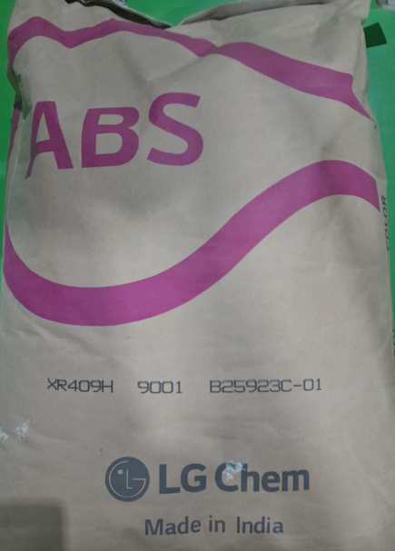
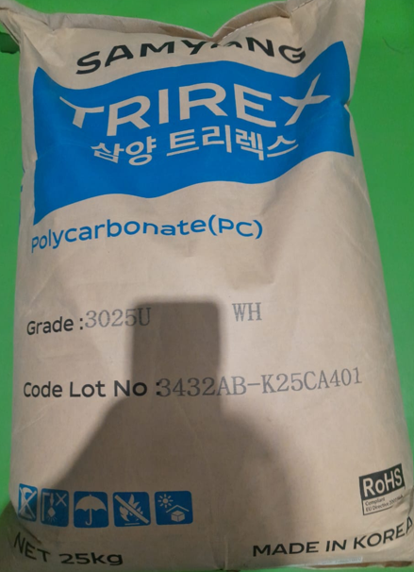
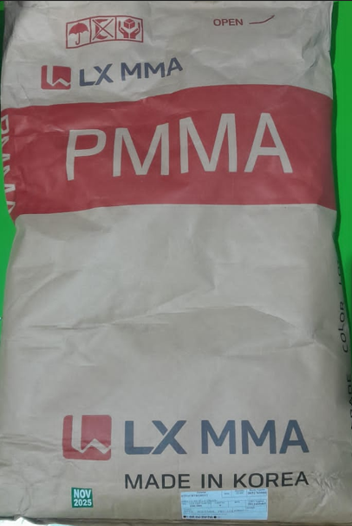
14SW210301-00004X1 KNOB PWS CP
RTPABSBKG0027Y
ABS XR-409H (BLACK) OF LG
RTPPOCWHG0012Y
PC-TRIREX 3025U(WHITE) OF SAMYANG
RTPACRTRG0012Y
PMMA I.G. 840 OF L.G. (TRANS)
‹#›/19
Classification: Internal

Slide 18
Font Specification
Heading….. (32, Calibri, Black, Bold)
Sub Heading…. (28, Calibri, Black)
Contents…. (minimum 18 - 24, Calibri, Black) :
‹#›/19
Classification: Internal

Slide 19





Thank You
Corporate Office
Address: Village Nawada Fatehpur,
P.O. Sikanderpur Badda, Manesar,
Gurgaon – 122004, India.
Website: www.unominda.com
Email ID: xxxx@unominda.com
Follow us on social media. Links below
‹#›/19
Classification: Internal

