Slide 1

The happiness Retirement Conundrum
Where do I go to live my best life?

Slide 2

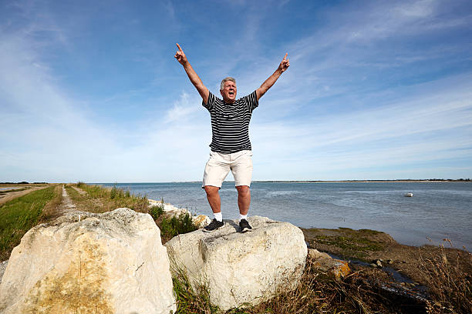


Where Will You Go?
What are the average happiness scores across the years and in what countries? Happiest, middle and least?
What are the main factors that determine the highest levels of happiness?
Are people happier in the pre or post Covid years? Why? Why not?
Which countries will be the best places to live in the next decade and why?
What are the Top 5 places forecasted to retire in 2027?
How can we track weather for the top 5 places to retire? Can we create a weather app and track weather?
Photos Credit to iStock

Slide 3
Background
Datasets analyzed
Kaggle 2015 – 2019 https://www.kaggle.com/datasets/unsdsn/world-happiness?resource=download
World Happiness Report 2022: https://worldhappiness.report/ed/2022/#appendices-and-data, Data for Figure 2.1.
World Happiness Report Survey
Cantrell ladder based on 6 happiness factors
Team took a deeper dive into individual factors:
Healthy Life Expectancy
Social Support / Family
Freedom
Generosity
Government Trust
GDP (Gross Domestic Product)

Slide 4
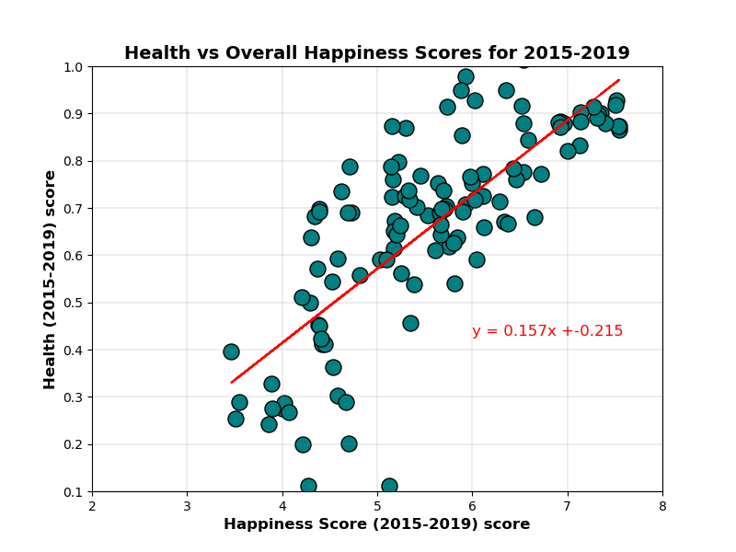
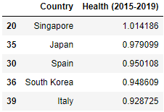
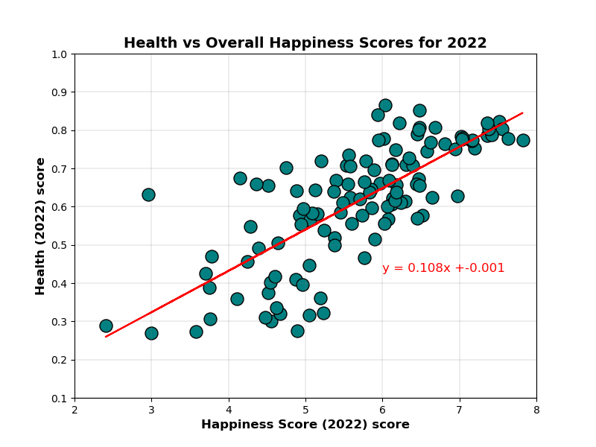
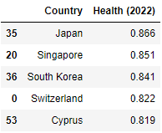
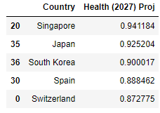
Healthy Life Expectancy
The r-value is: 0.587 and the pvalue is: 0.0
Number of Years? Or more?
Redefining Quality of Life
Moderate uphill (positive) relationship
Technology and Government Policy
The r-value is: 0.564 and the pvalue is: 0.0

Slide 5
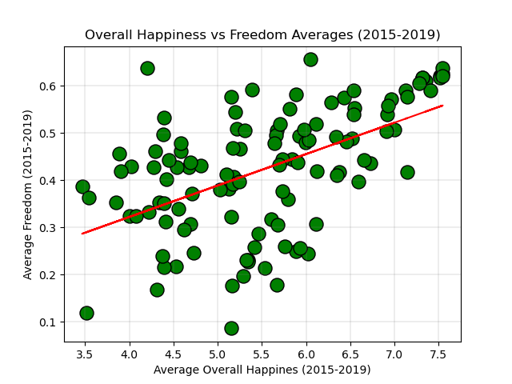
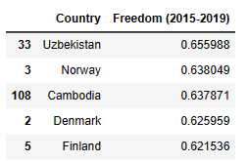
Freedom
Top chart represents the Average Overall Happiness to Freedom factor scores for years 2015-2019.
According to the World Happiness Report, the chart represents well the shift in Freedom for a rise with eastern european countries and steady trends for northern countries.
Looking at the individual years, 2015 through 2019, Freedom is not the highest factor determining happiness. Freedom moves from last place of the six factors to third from last place in 2019. (according to World Happiness Report website).

Slide 6
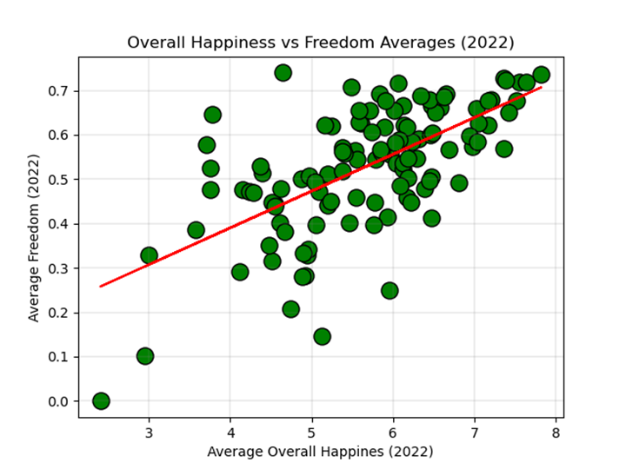
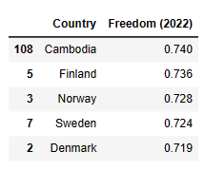
Freedom
Bottom chart represents the Average Overall Happiness to Freedom factor scores for 2022.
A little more than half of the countries involved in the study became more concerned with Freedom. It became more of a factor due to Post-Covid times.
Cambodia ranks first of the 5 countries listed for highest Average Overall Happiness to Freedom score. According to the World Happiness Report, southeastern asian countries had a significant spike in Freedom importance , so it re-enforces the fact that Cambodia ranks with highest average.

Slide 7
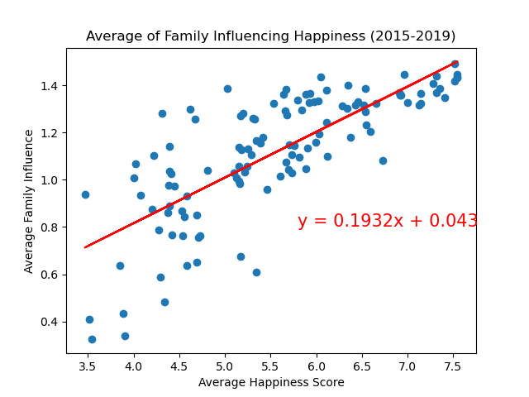
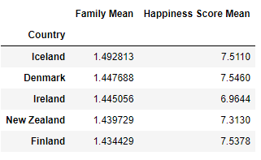
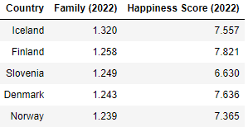
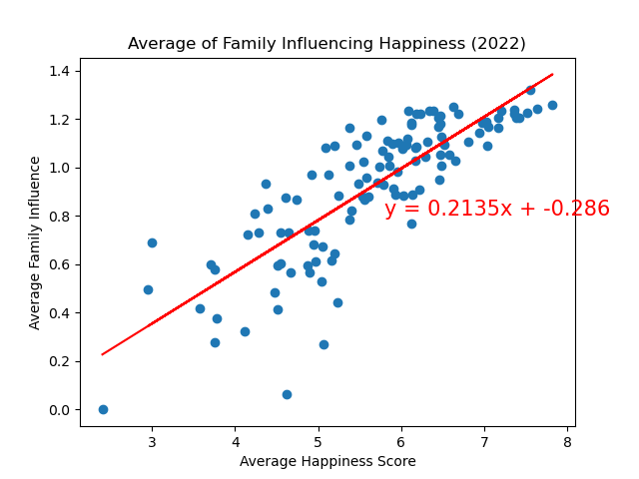
Social Support / Family
The r-value is: 0.5852636004828339
The r-value is: 0.6725286030848764
This factor scored higher amongst all factors except GDP for all years.
Iceland remains #1 pre and post Pandemic under this factor
Stronger correlation in 2022 than 2015-19 that this factor influences the Happy Score.
Iceland, Denmark and Finland remained in the top 5 for scoring highest in this factor

Slide 8
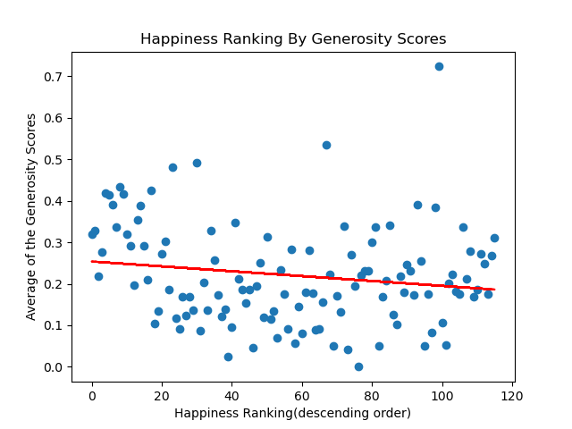
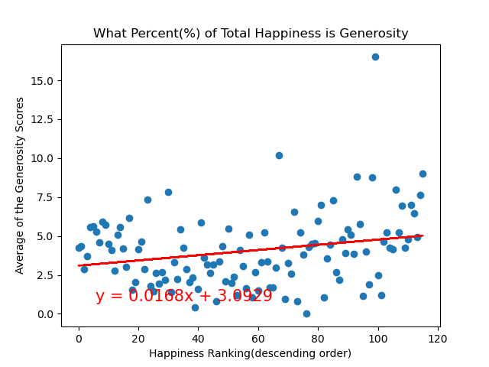
Generosity
Generosity tended to be the lowest scoring factor for each country.
The Countries at both ends (the happiest and unhappiest) tended to have higher generosity scores than those in the middle

Slide 9
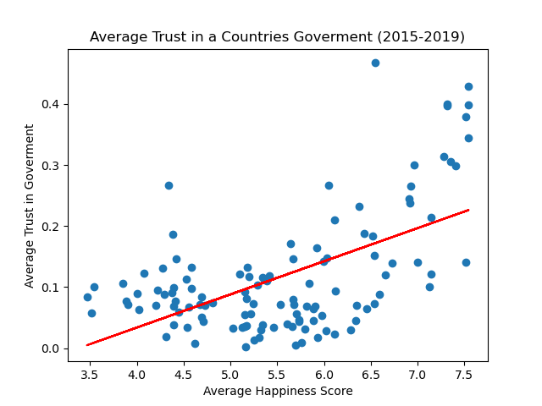
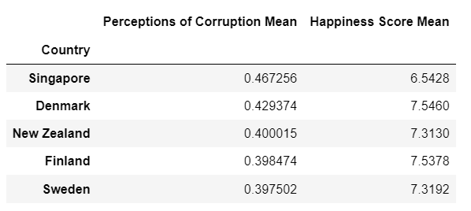
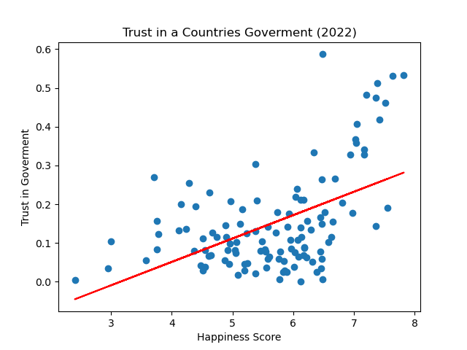
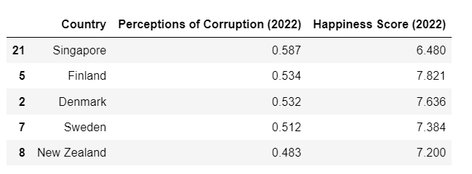
Trust in Government
The r-value is: 0.3211669952184197 (2015-2019)
The r-value is: 0.25373272657445173 (2022)

Slide 10
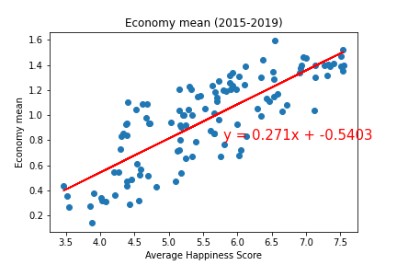
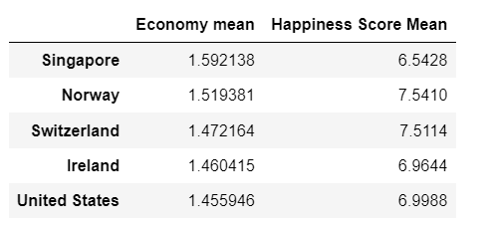
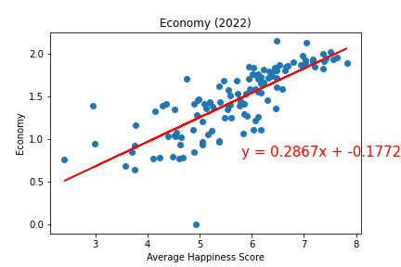
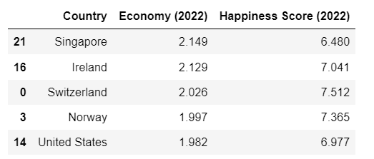
GDP (Gross Domestic Product)
The r-value is: 0.6542597754829528
The r-value is: 0.614400820625597

Slide 11
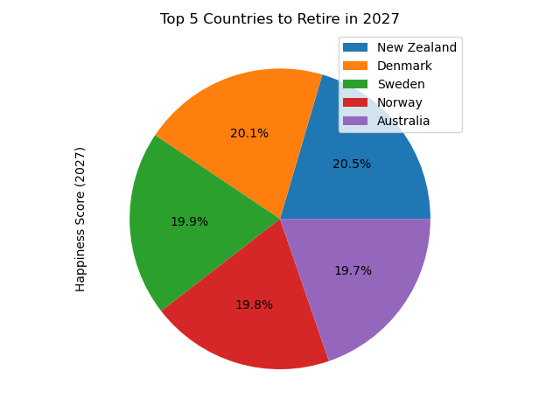
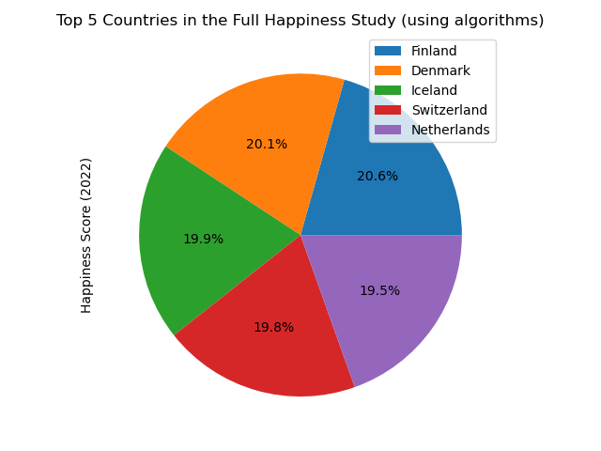
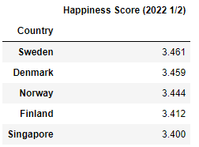
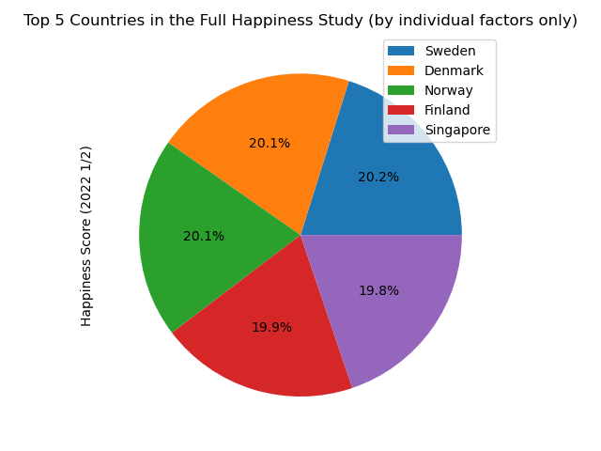
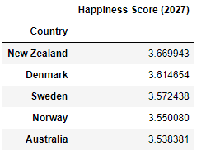
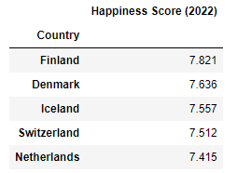
Top 5 Places for Retirement

Slide 12
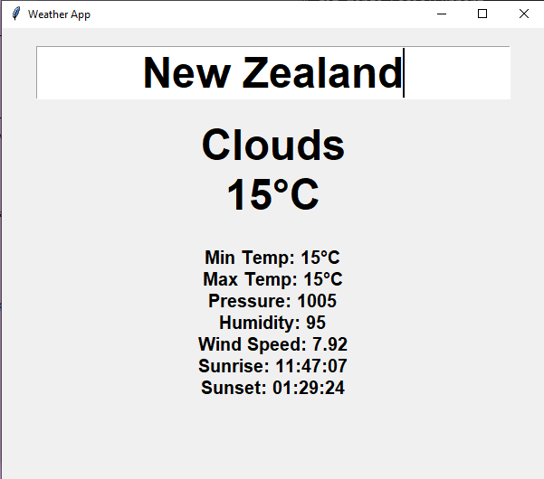
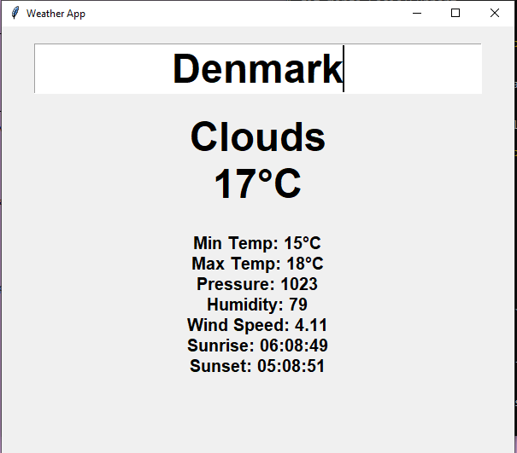
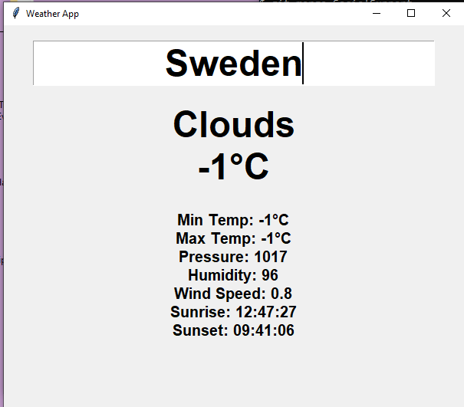
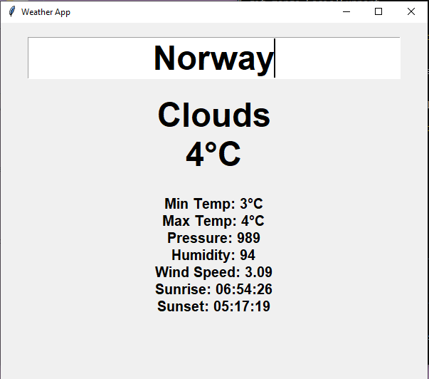
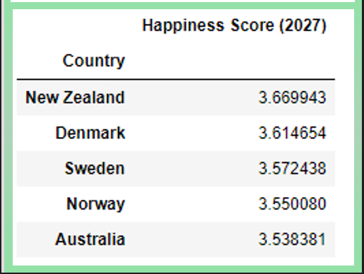
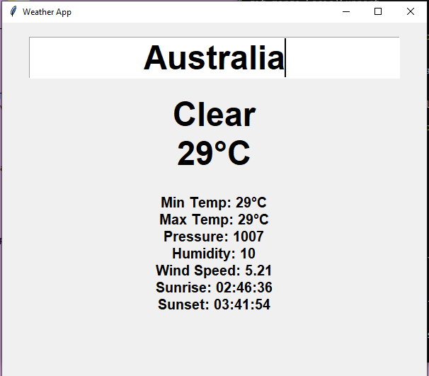

Weather as a Factor For 2027 Retirement
New Zealand
Temp was checked on 2-15-23 @ 1013 (15 $°C)$
Denmark
Temp was checked on 2-15-23 @ 1017 (17 °C)
Sweden
Temp was checked on 2-15-23 @ 1014 (-1 °C)
Norway
Temp was checked on 2-15-23 @ 1015 (4 °C)
Australia
Temp was checked on 2-15-23 @ 1016 (29 °C)

Slide 13
Q U E ST I O N S?
Where will you go to live your best life…

