Slide 1

The happiness Retirement Conundrum
Where do I go to live my best life?

Slide 2
Background
Datasets analyzed
Kaggle 2015 – 2019 https://www.kaggle.com/datasets/unsdsn/world-happiness?resource=download
World Happiness Report 2022: https://worldhappiness.report/ed/2022/#appendices-and-data, Data for Figure 2.1.
World Happiness Report Survey
Cantrell ladder based on 6 happiness factors
Team took a deeper dive into individual factors:
Healthy Life Expectancy
Social Support / Family
Freedom
Generosity
Government Trust
GDP (Gross Domestic Product)

Slide 3
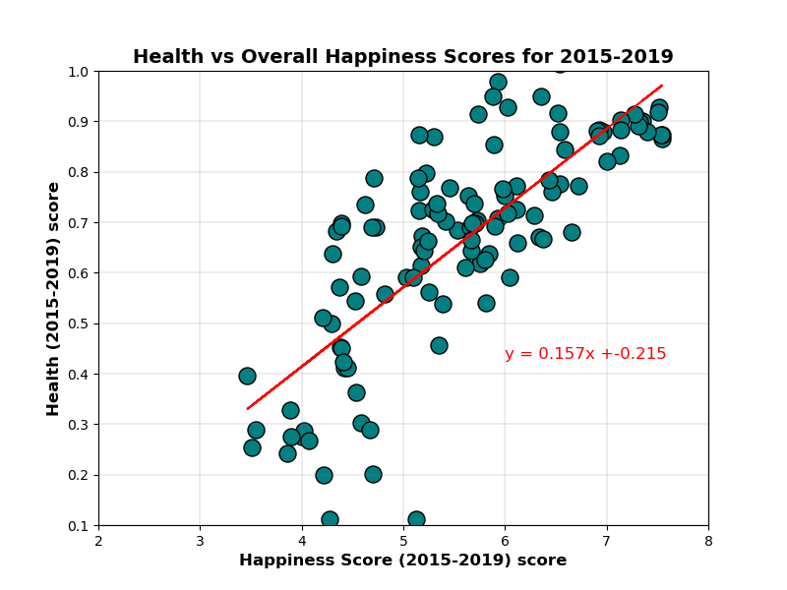
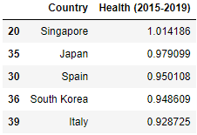
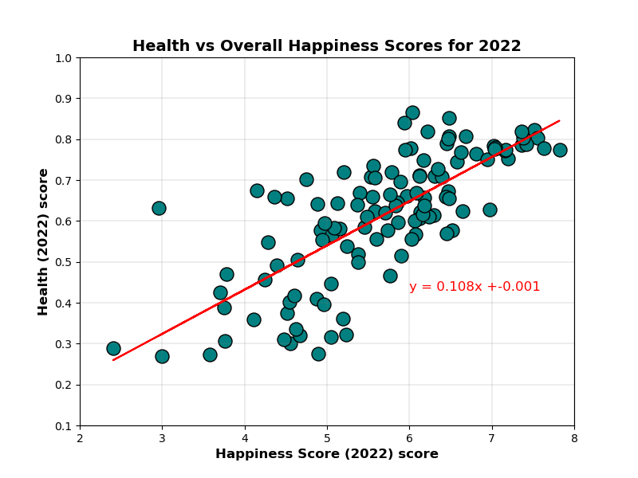
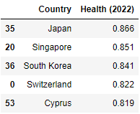
Healthy Life Expectancy
The r-value is: 0.587 and the pvalue is: 0.0
The r-value is: 0.564 and the pvalue is: 0.0

Slide 4
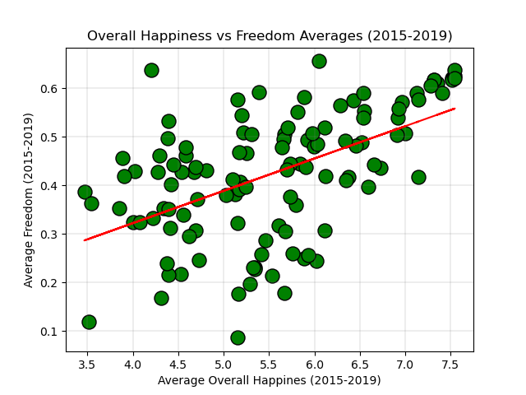
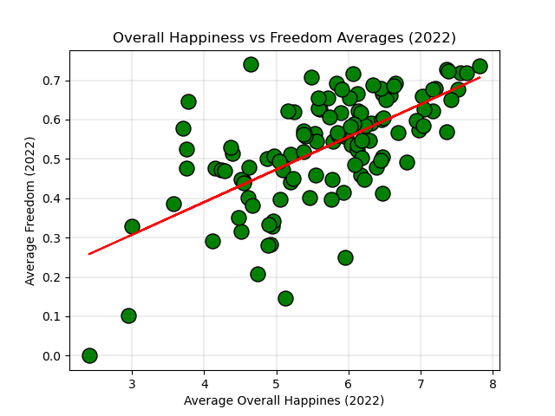
Freedom

Slide 5
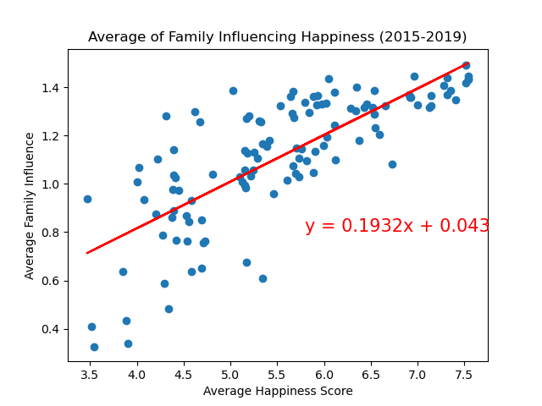
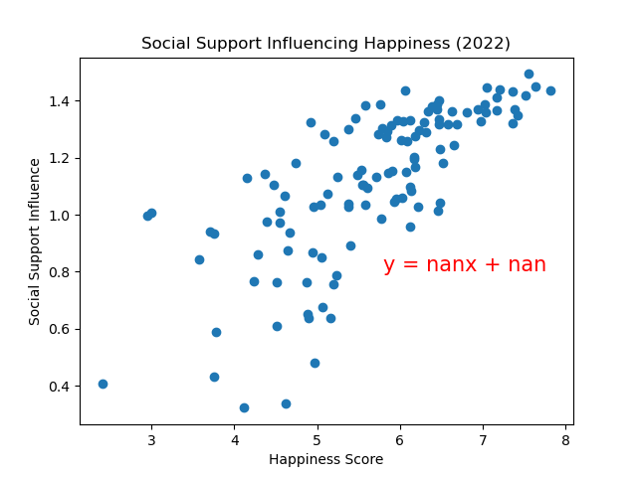
Social Support

Slide 6
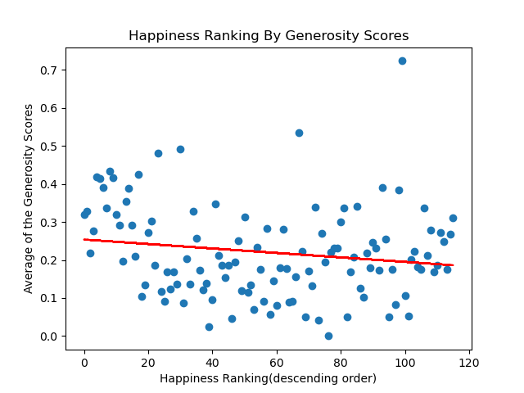
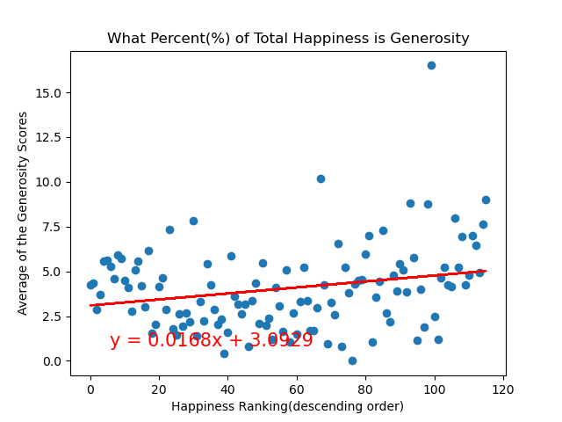
Generosity

Slide 7
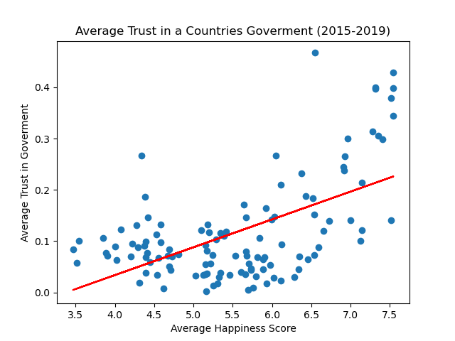
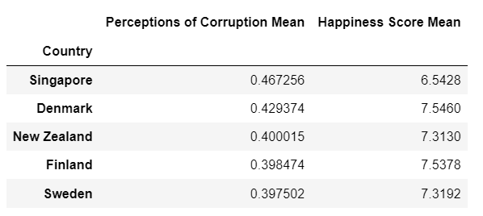
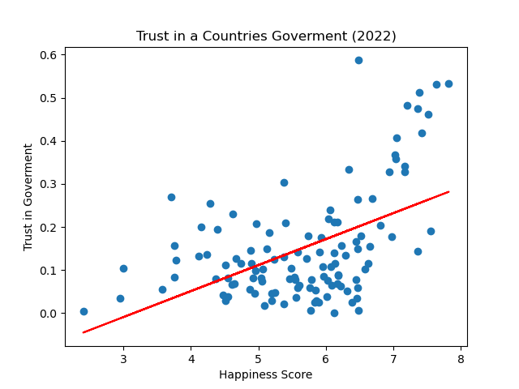
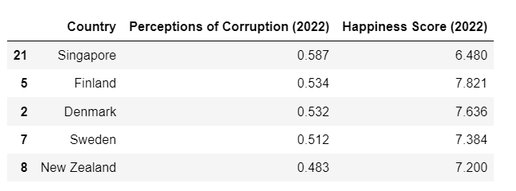
Trust in Government
The r-value is: 0.3211669952184197 (2015-2019)
The r-value is: 0.25373272657445173 (2022)

Slide 8
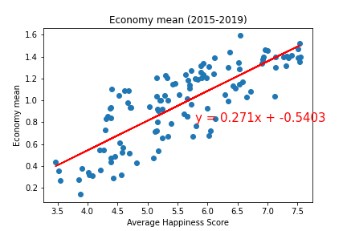
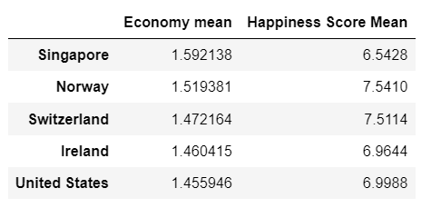
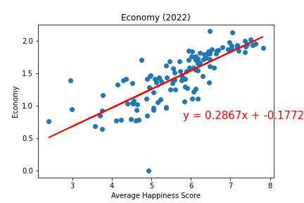
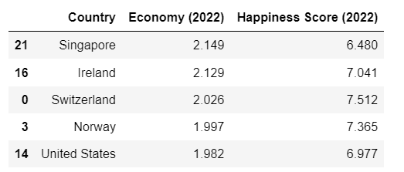
GDP (Gross Domestic Product)
The r-value is: 0.6542597754829528
The r-value is: 0.614400820625597

Slide 9
Top 5 places to retire today

Slide 10
Q U E ST I O N S?
Where will you go to live your best life…

